Slide 1
FlowNet: A Deep Learning Framework for Clustering and Selection of Streamlines and Stream Surfaces
Jun Han¹, Jun Tao², and Chaoli Wang¹
1 University of Notre Dame, 2 Sun Yat-sen University

Slide 2
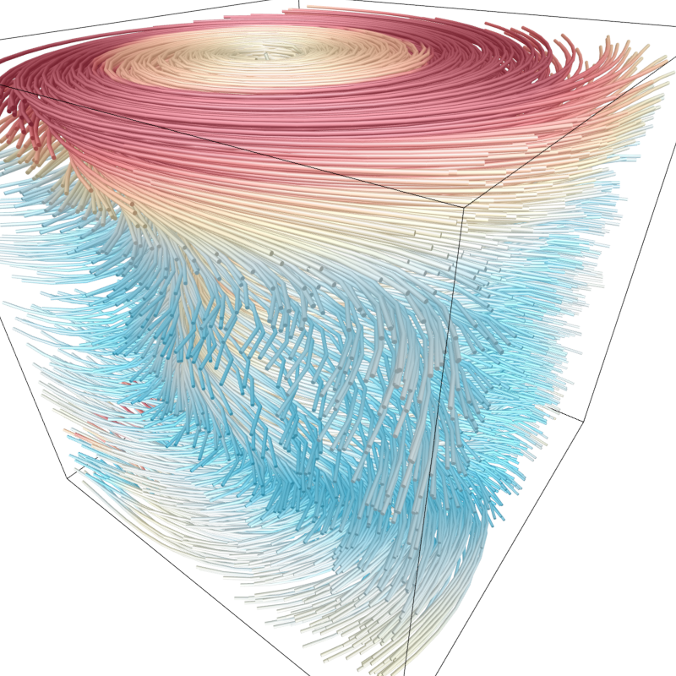
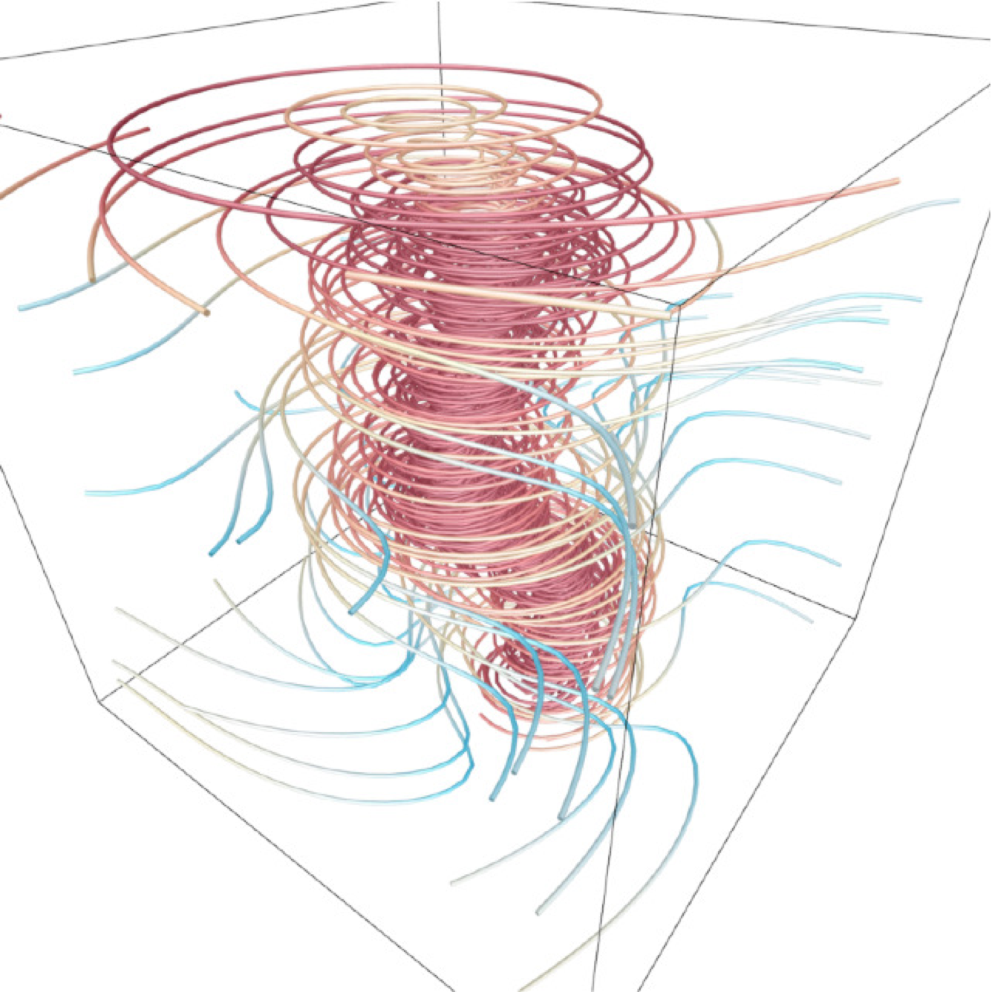
Streamline selection
1

Slide 3
Autoencoder
https://iq.opengenus.org/autoencoder/
2

Slide 4
FlowNet: Architecture
3

Slide 5
FlowNet: Binary cross-entropy loss
$$ℒ=−\frac{1}{N}\overset{N}{\underset{i=1}{∑}}[p_{n}log\overset{̂}{p_{n}}+(1−p_{n})log(1−\overset{̂}{p_{n}})],$$
$$p_{n}$$
: target probability (1 or 0) of a voxel being filled
: predicted probability obtained through FlowNet
: number of voxels
$${\overset{̂}{p}}_{n}$$
$$N$$
4

Slide 6
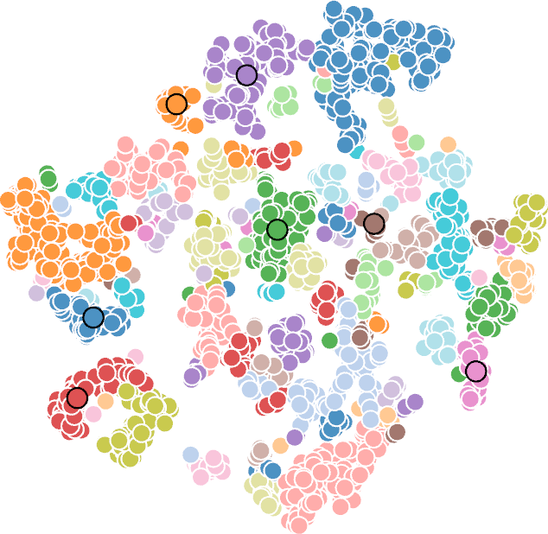
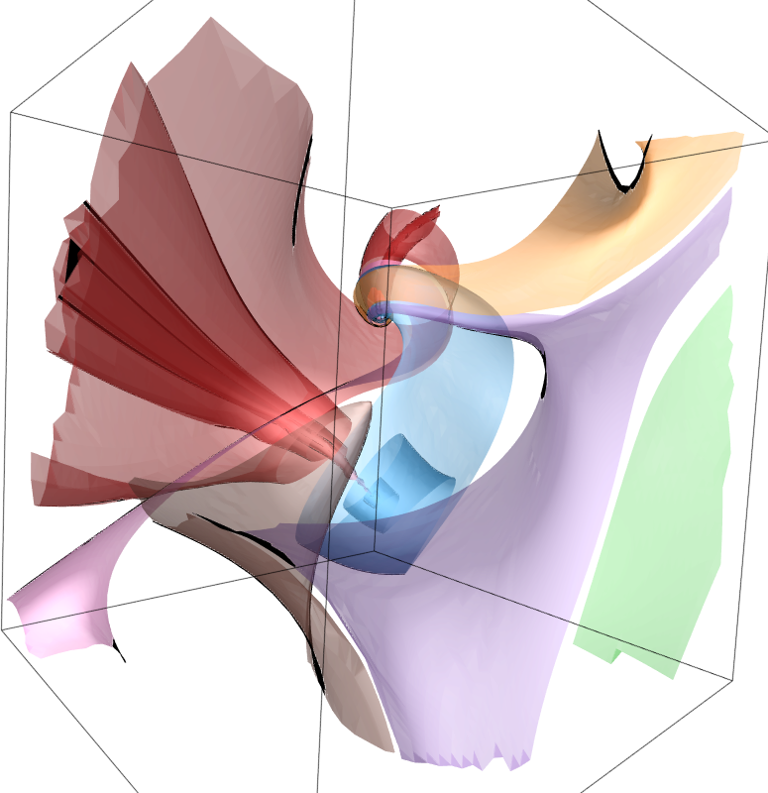
FlowNet: Inference
t-SNE
DBSCAN
Ester et al. A Density-Based Algorithm for Discovering Clusters in Large Spatial Databases with Noise. KDD, 1996.
L. J. P. van der Maaten and G. E. Hinton. Visualizing High-Dimensional Data Using t-SNE. JMLR, 2008.
5

Slide 7
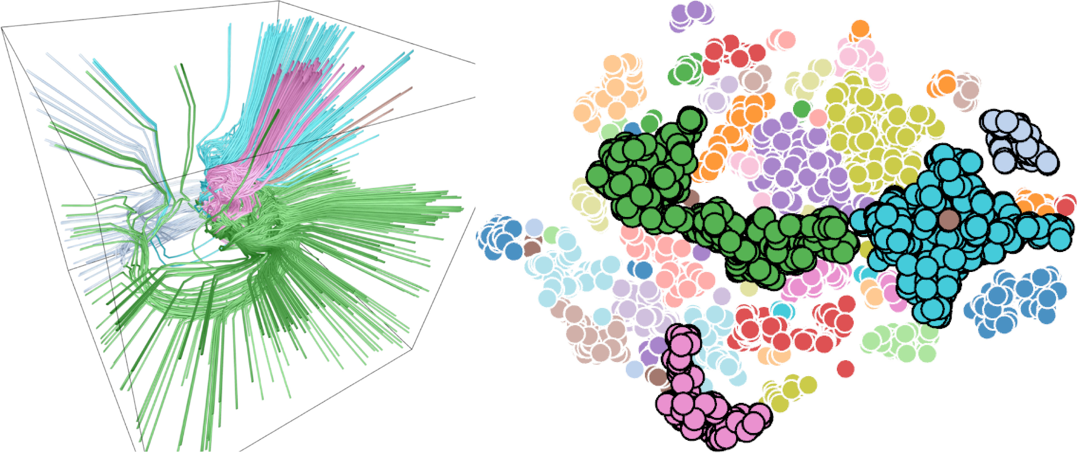
FlowNet: Interface (supernova)
choosing multiple clusters
6

Slide 8
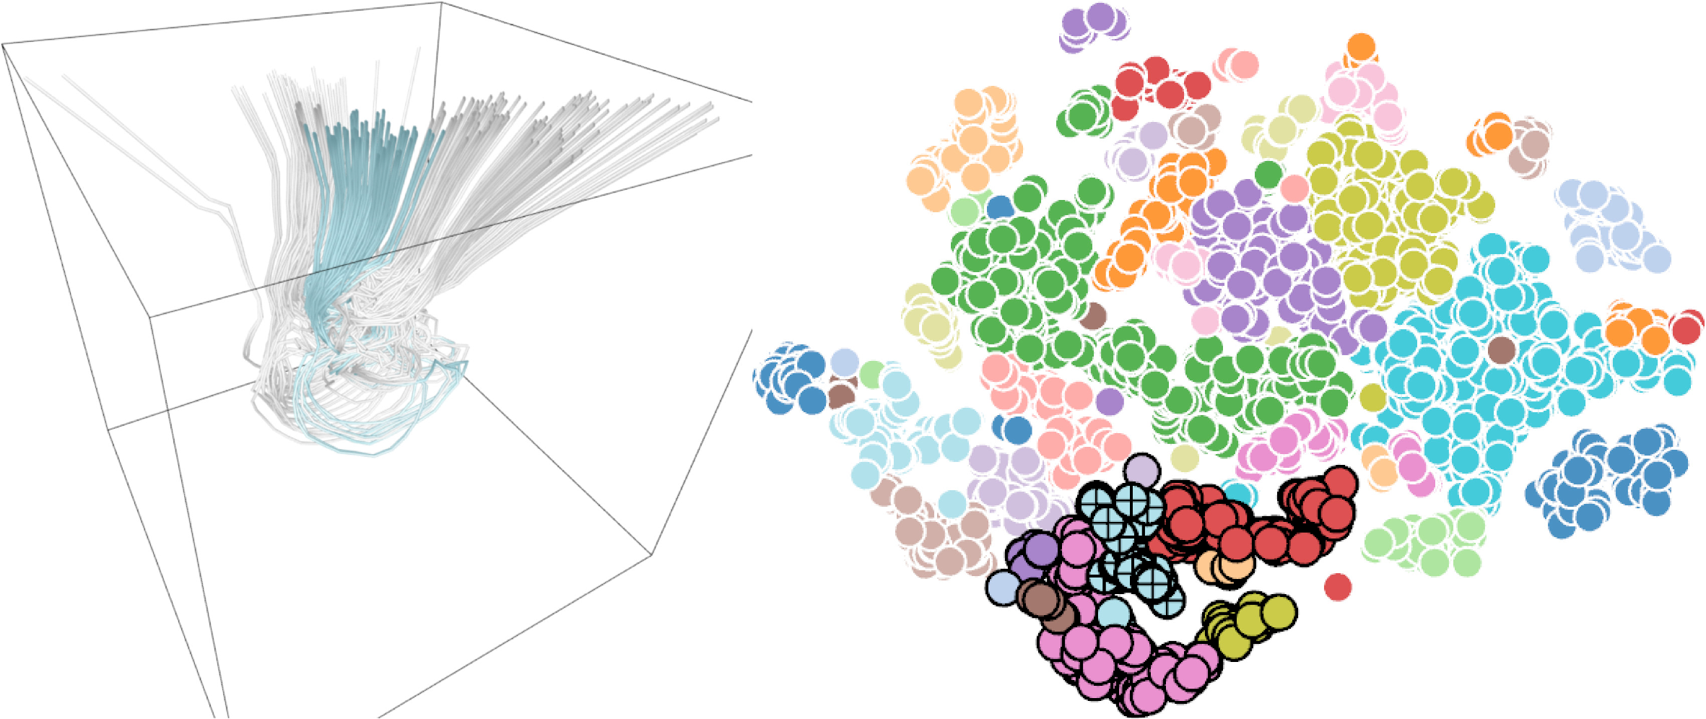
FlowNet: Interface (supernova)
looping clusters
7

Slide 9
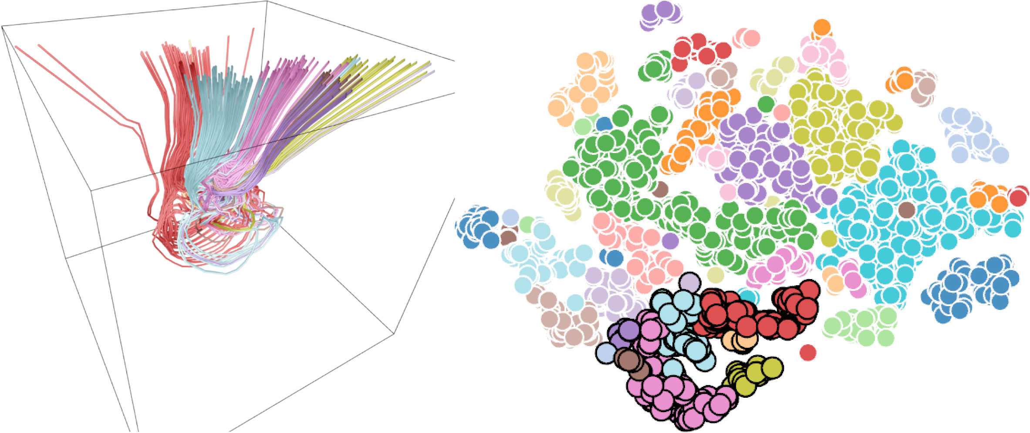
FlowNet: Interface (supernova)
expanding one cluster to its neighboring clusters
8

Slide 10
9

Slide 11
FlowNet: Validation
Distance measure
Mean of the closest point distance
Hausdorff distance
Euclidean distance
Loss function
Mean squared error
Dice loss
Binary cross-entropy
10

Slide 12
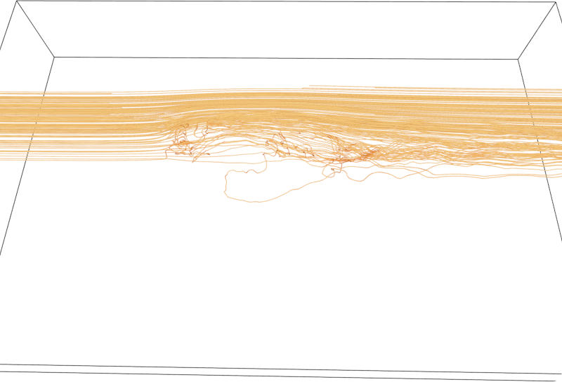
Distance measure (car flow)
Mean of the closet point distance (MCP)
11

Slide 13
Distance measure (car flow)
Hausdorff distance
12

Slide 14
Distance measure (car flow)
Euclidean distance
13

Slide 15
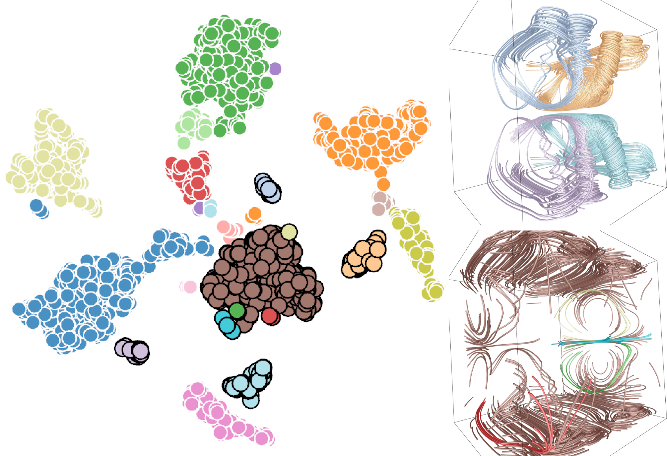
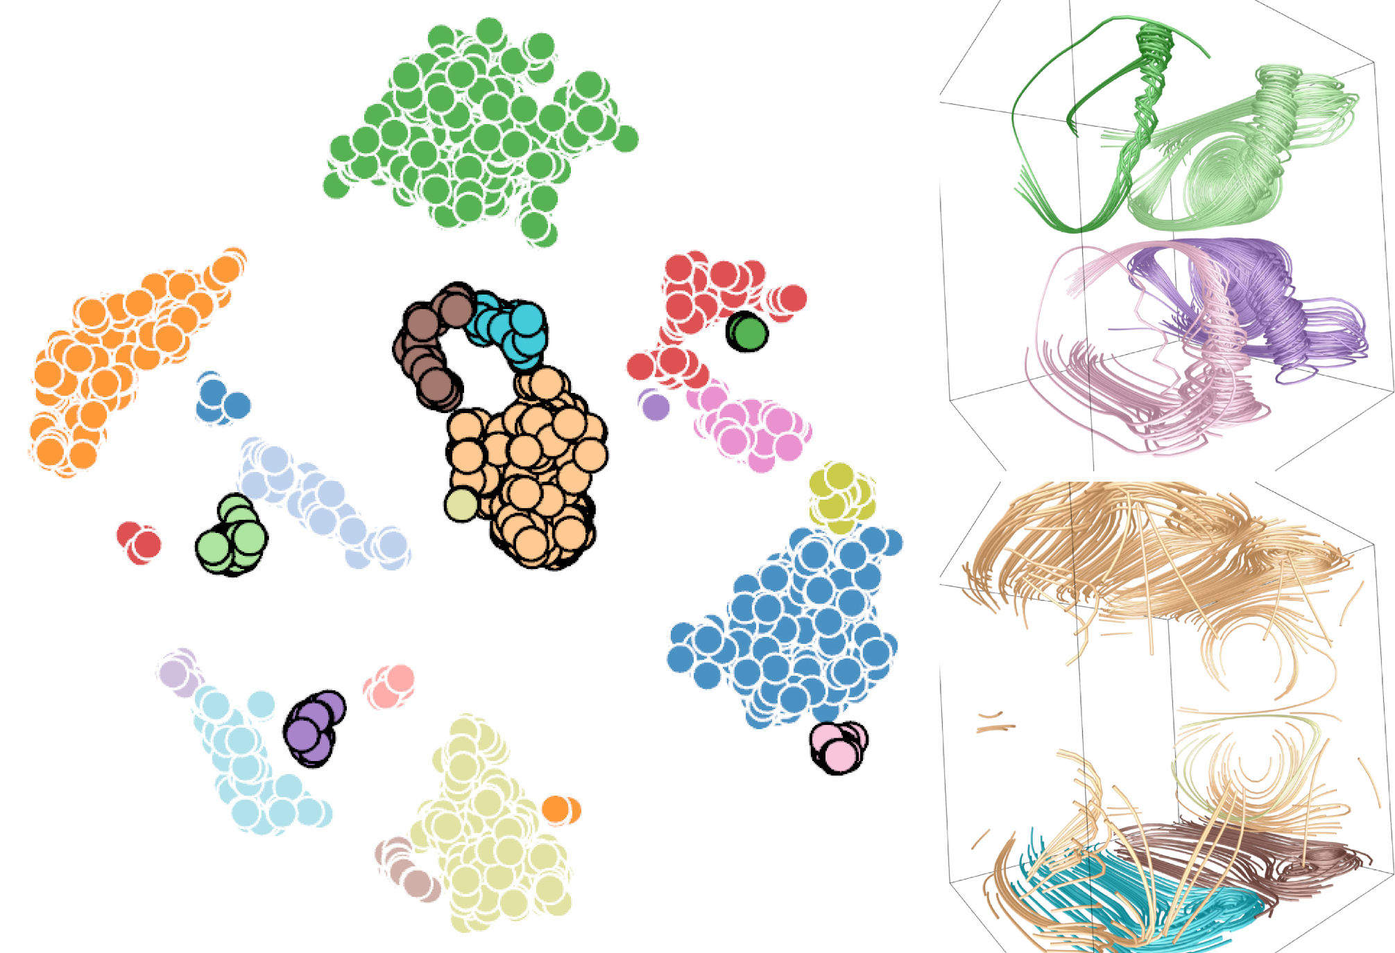
Loss function (two swirls)
binary cross-entropy
Dice
14

Slide 16
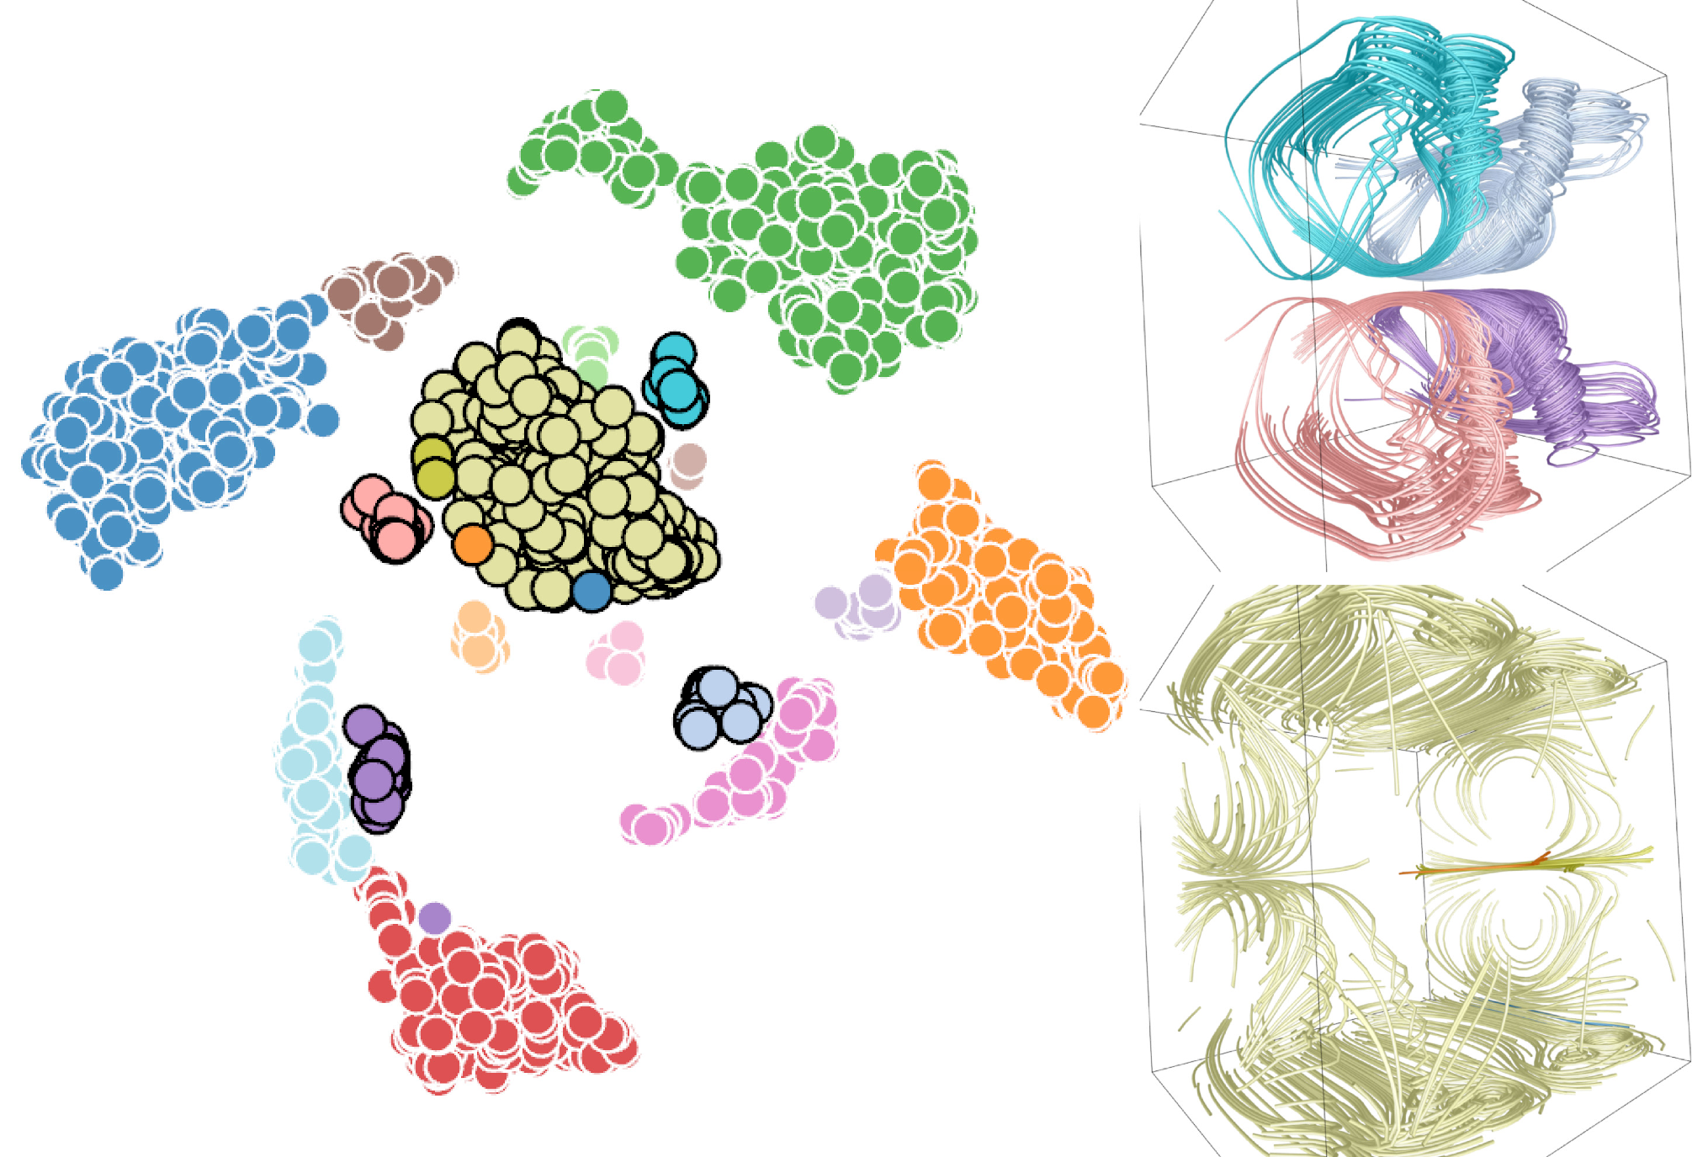
Loss function (two swirls)
binary cross-entropy
mean squared error
15

Slide 17
Results
Reconstructed objects
F1 score
Streamline selection
Peak signal-to-noise ratio (PSNR)
Average angle difference (AAD)
Cross-dataset training
Surface selection
Automatic selection
Manual selection
16

Slide 18
Evaluation of reconstructed objects
Data set | Training F1 score for streamlines | Testing F1 score for streamlines | Training F1 score for stream surfaces | Testing F1 score for stream surfaces
Bénard flow | 0.87 | 0.80 | 0.84 | 0.79
square cylinder | 0.84 | 0.72 | 0.91 | 0.86
tornado | 0.91 | 0.76 | 0.88 | 0.78
two swirls | 0.88 | 0.75 | 0.91 | 0.81
17

Slide 19
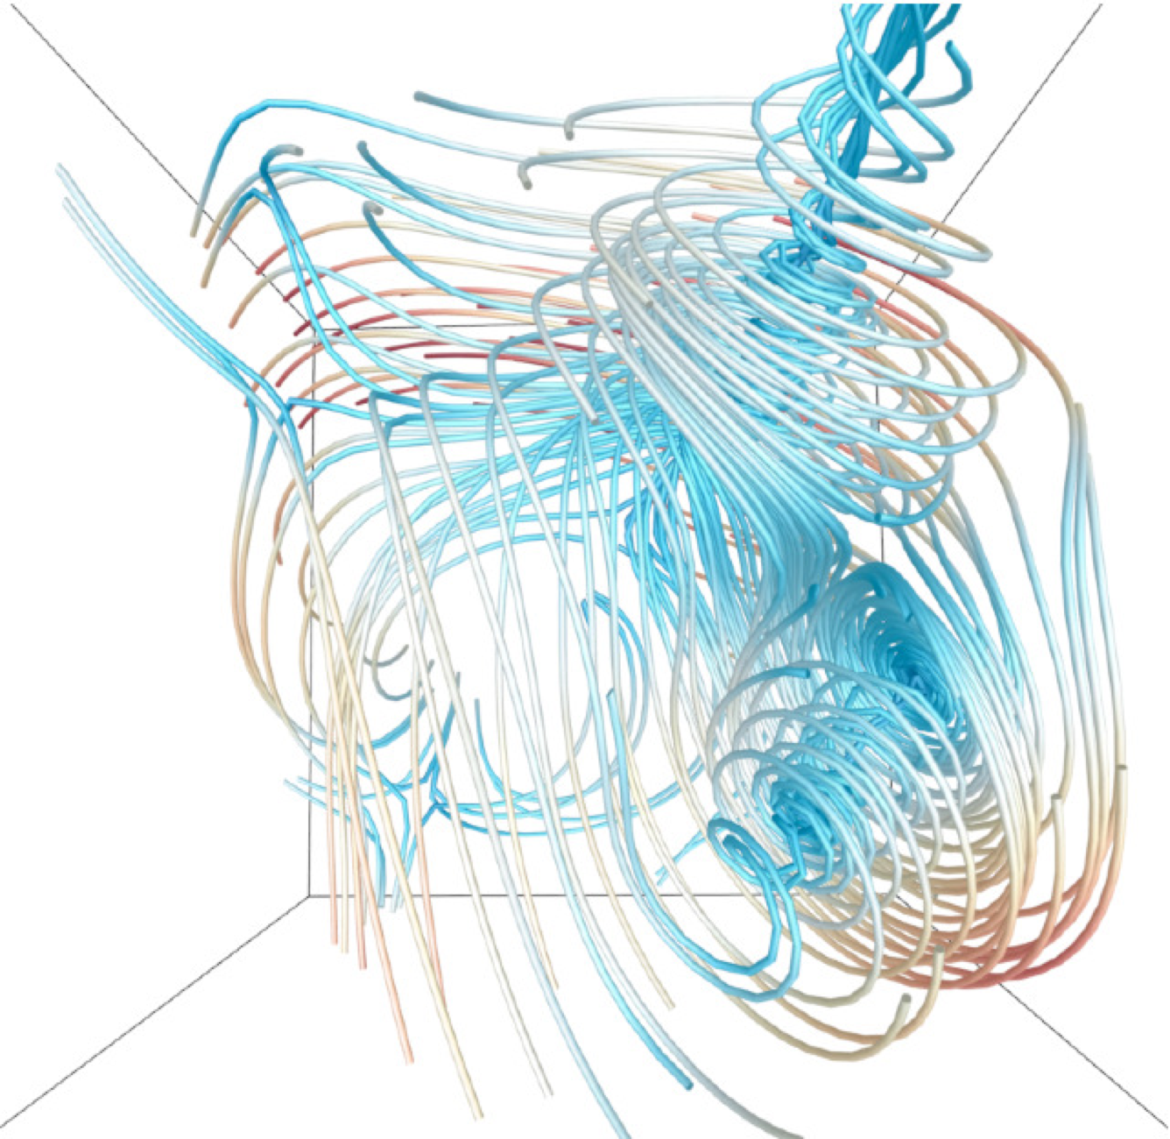
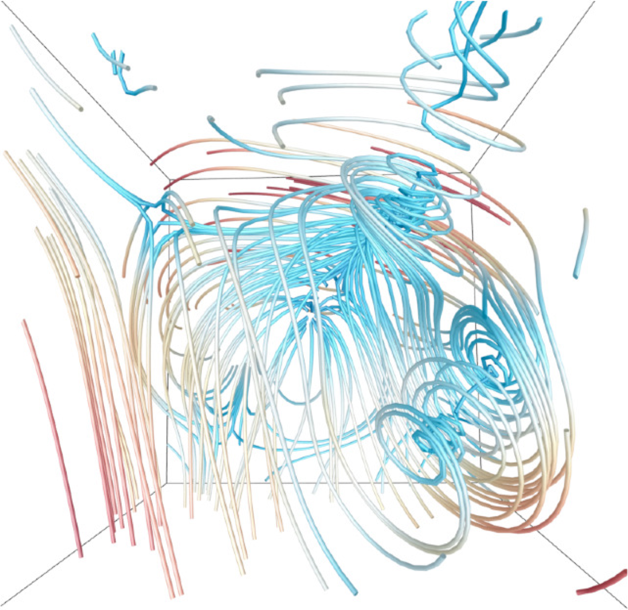
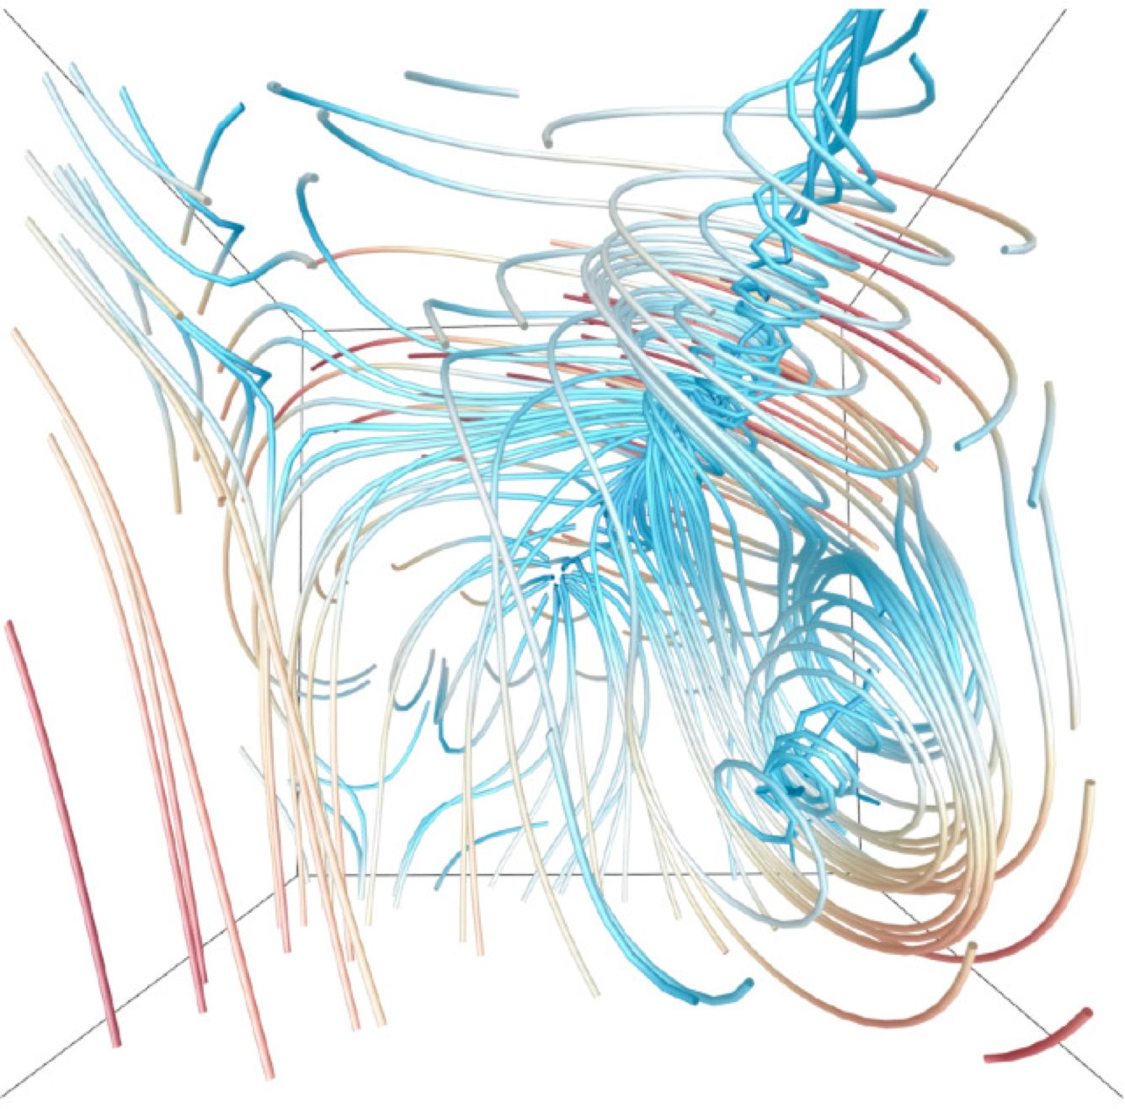
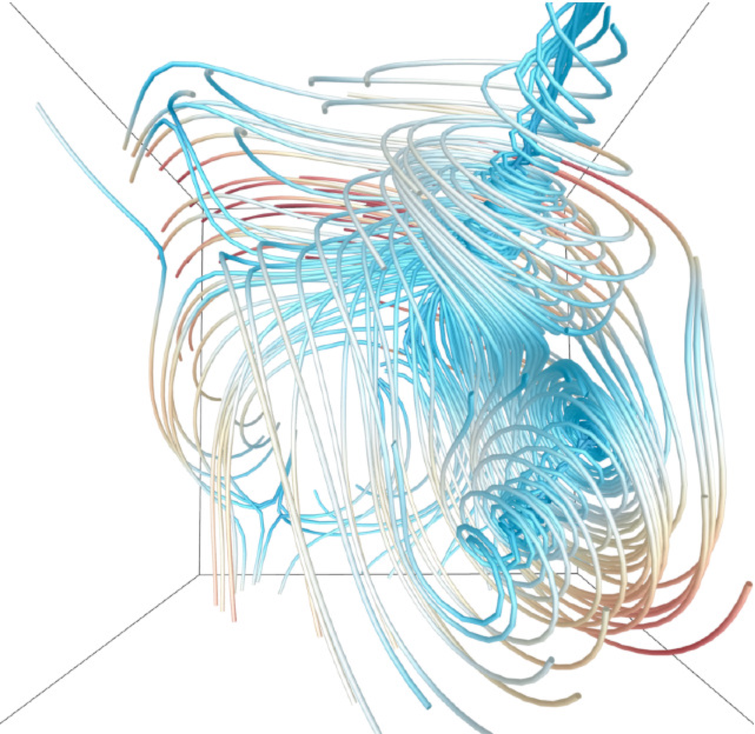
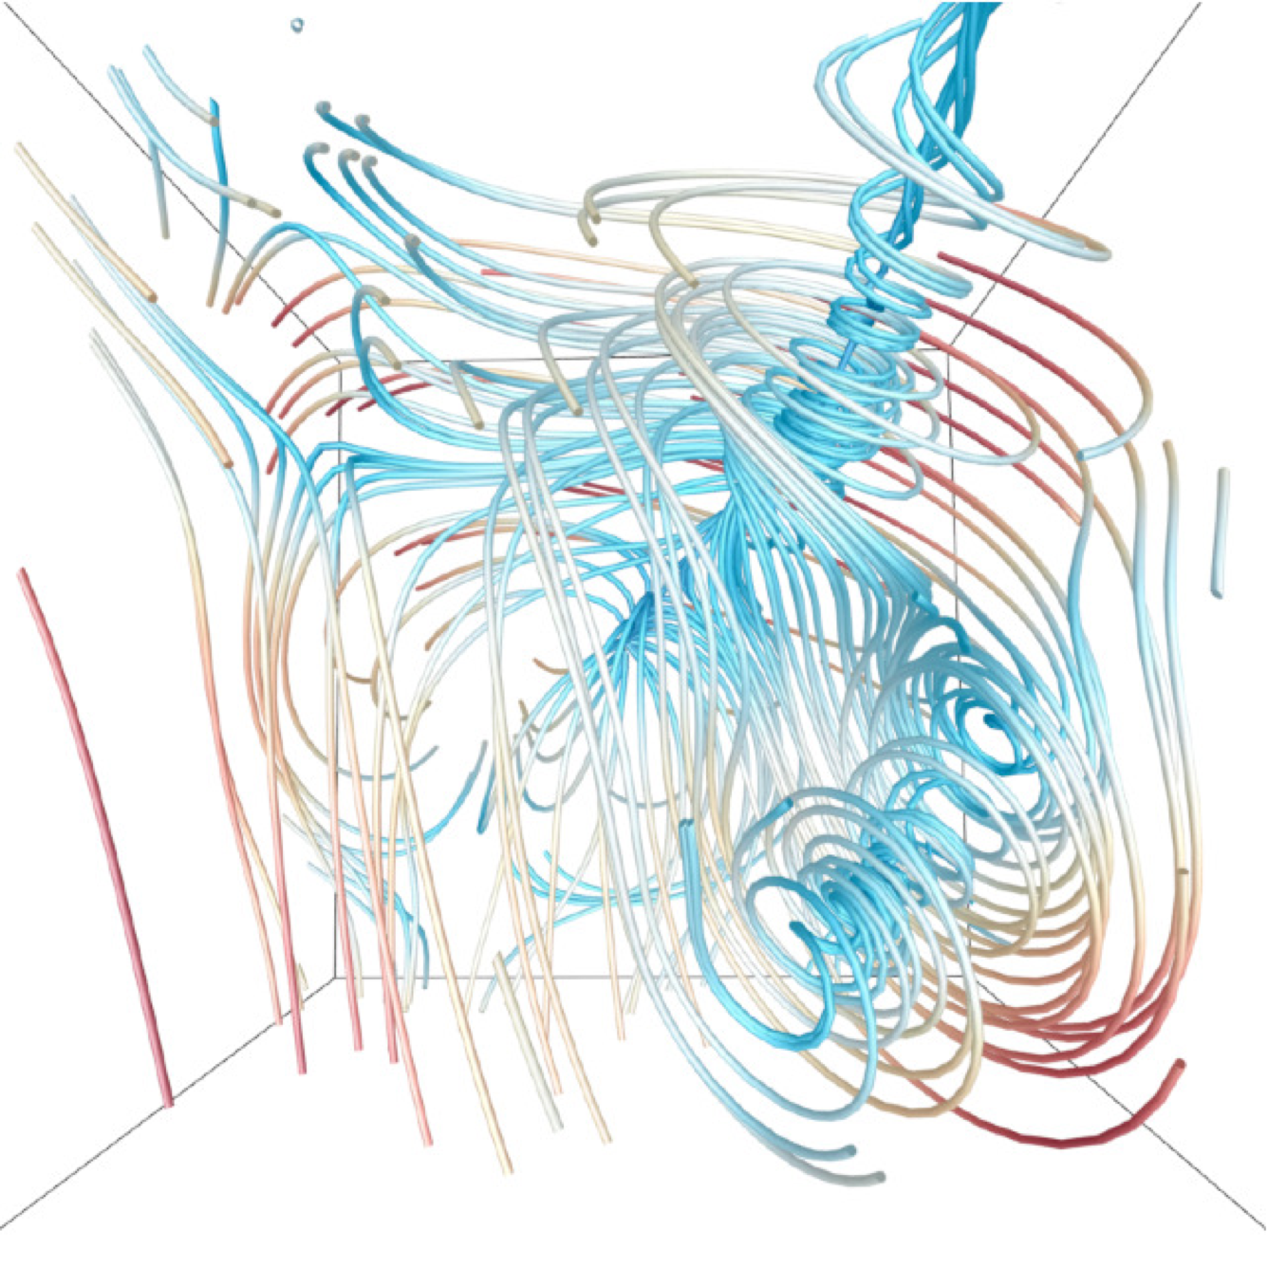
Streamline selection (five critical points)
p(s)
REP
ours
I(s;v)
Xu et al.
Tao et al. A Unified Approach to Streamline Selection and Viewpoint Selection for 3D Flow Visualization. IEEE TVCG, 2013.
Xu et al. An Information-Theoretic Framework for Flow Visualization. IEEE TVCG, 2010.
18

Slide 20
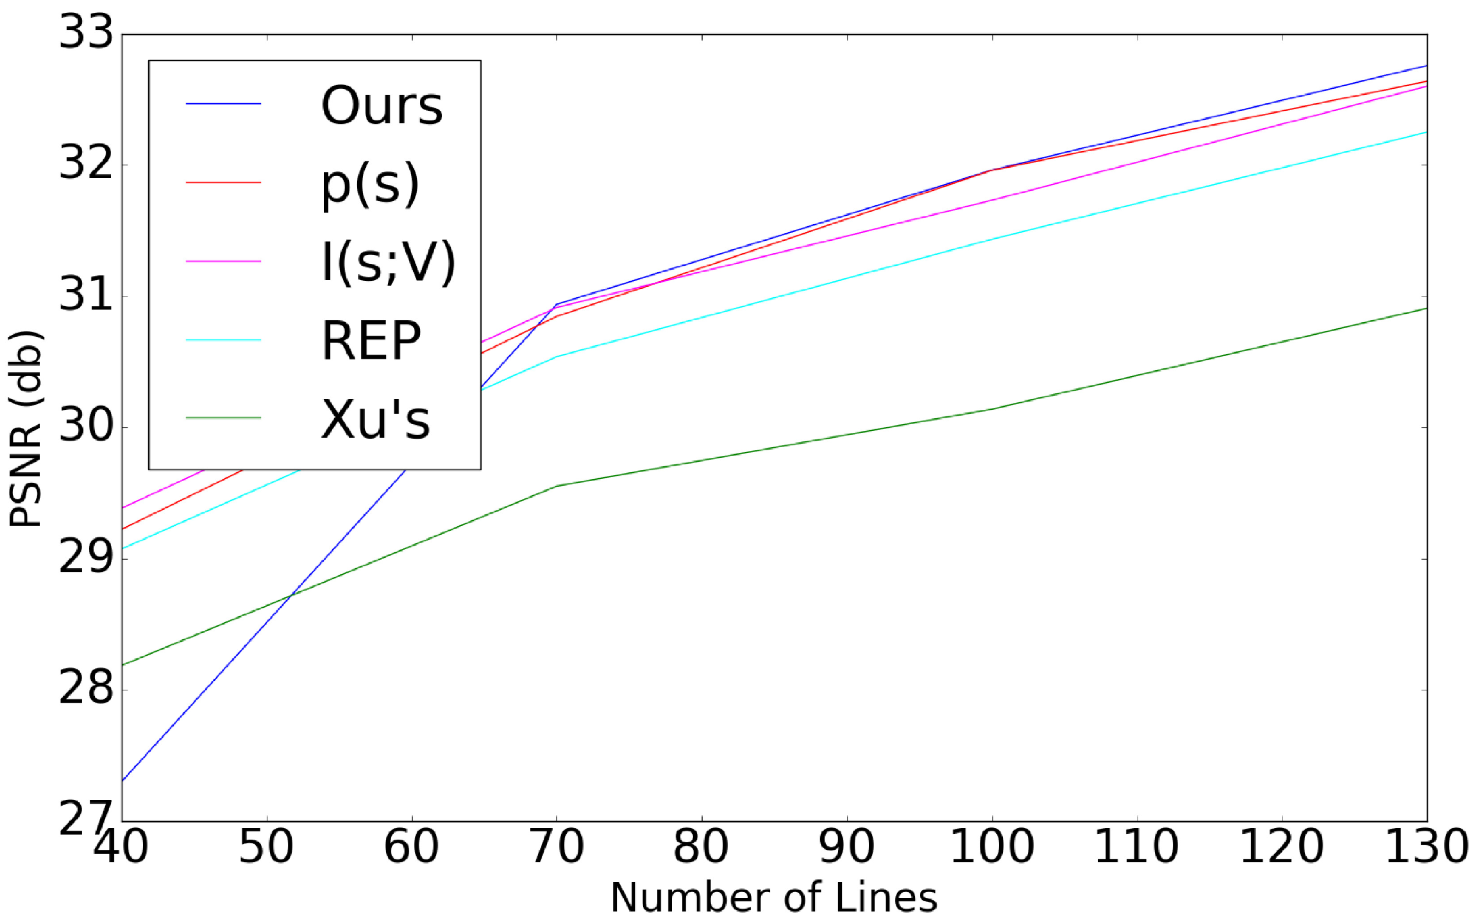
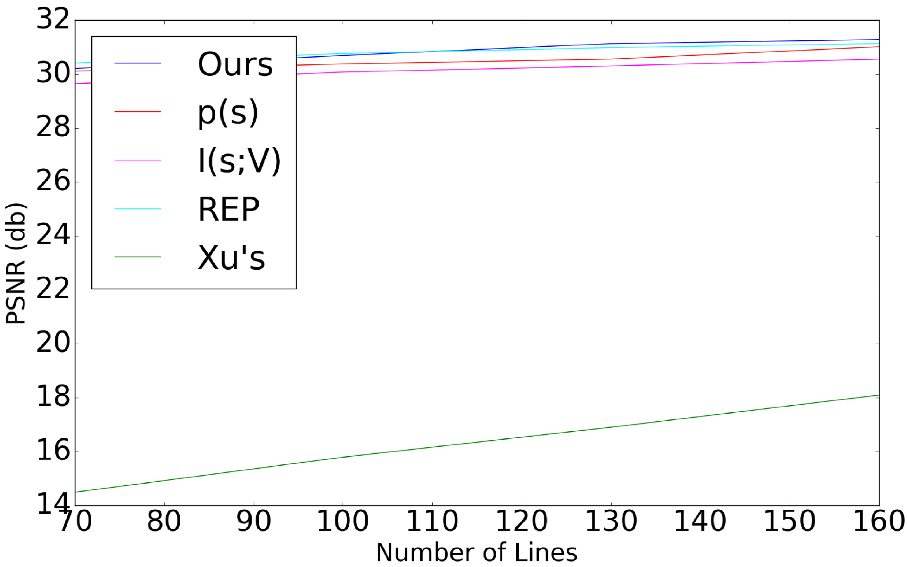
Streamline selection
crayfish
solar plume
19

Slide 21
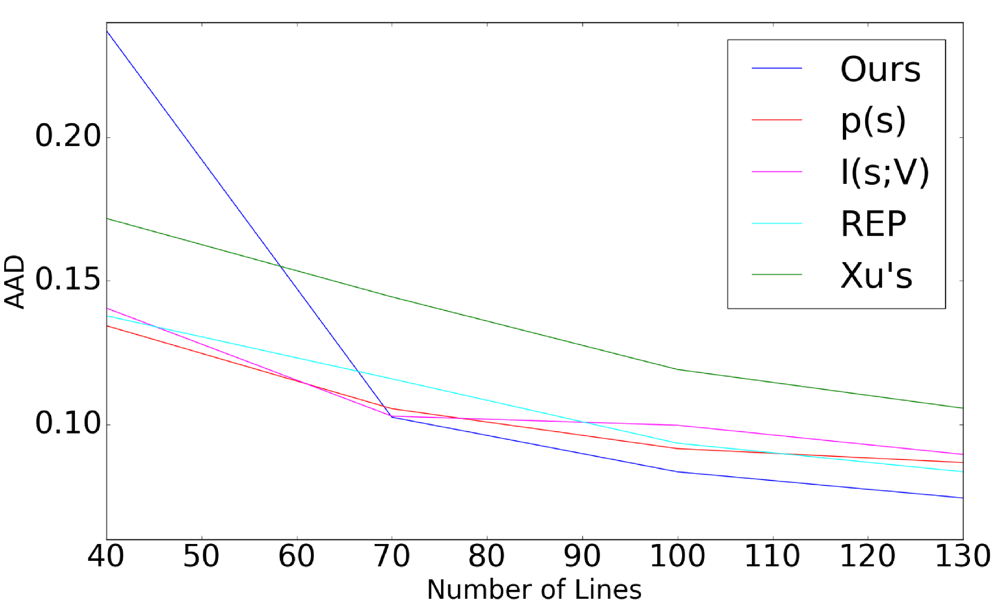
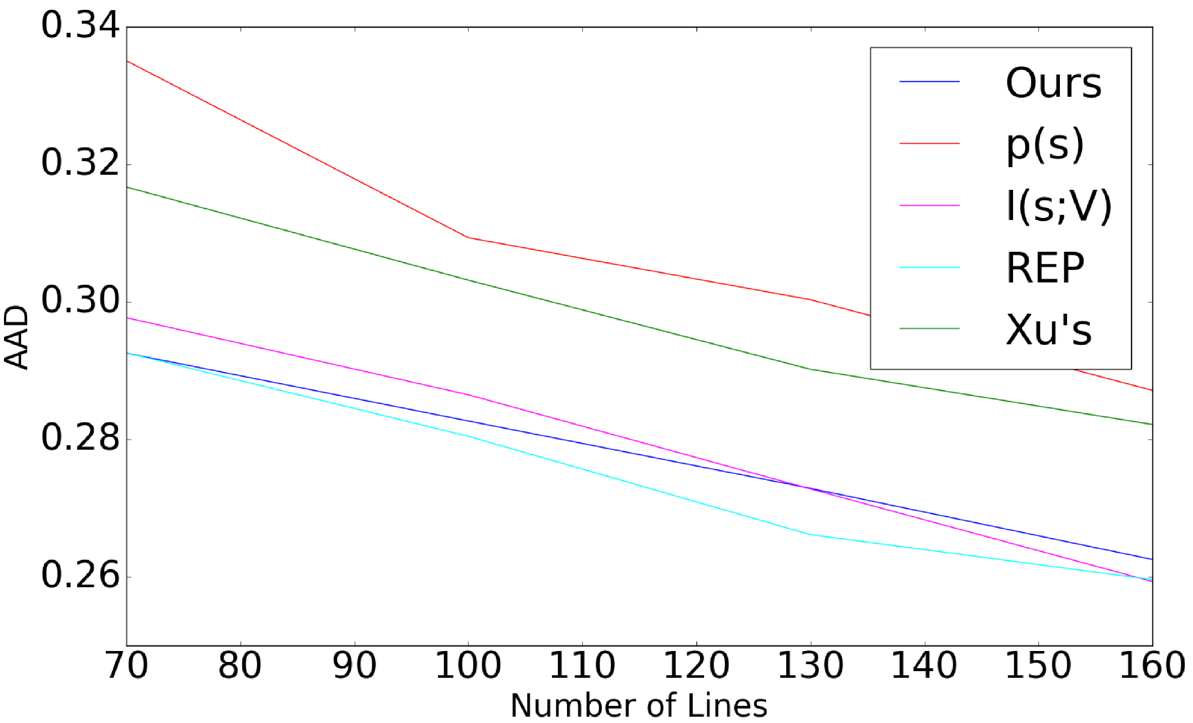
Streamline selection
crayfish
solar plume
20

Slide 22
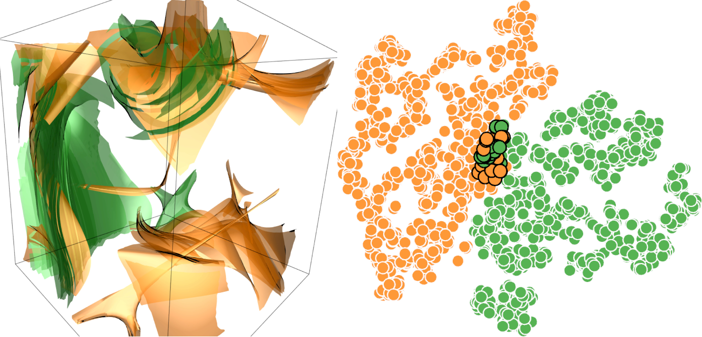
Cross-dataset training (ABC and five critical points)
21

Slide 23
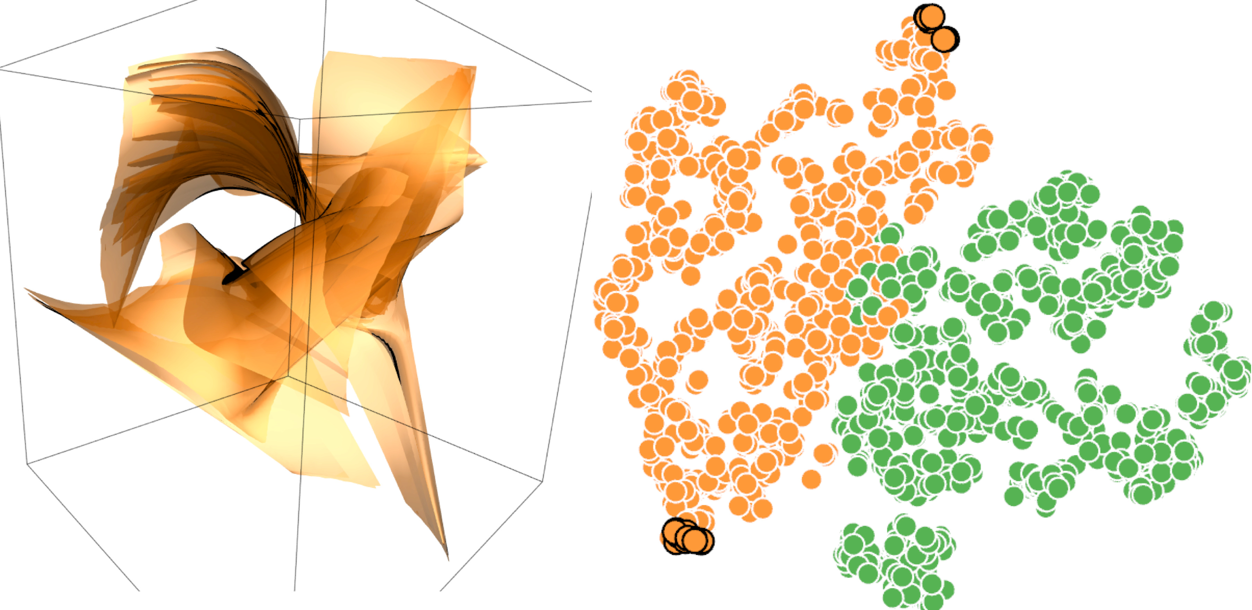
Cross-dataset training (ABC and five critical points)
22

Slide 24
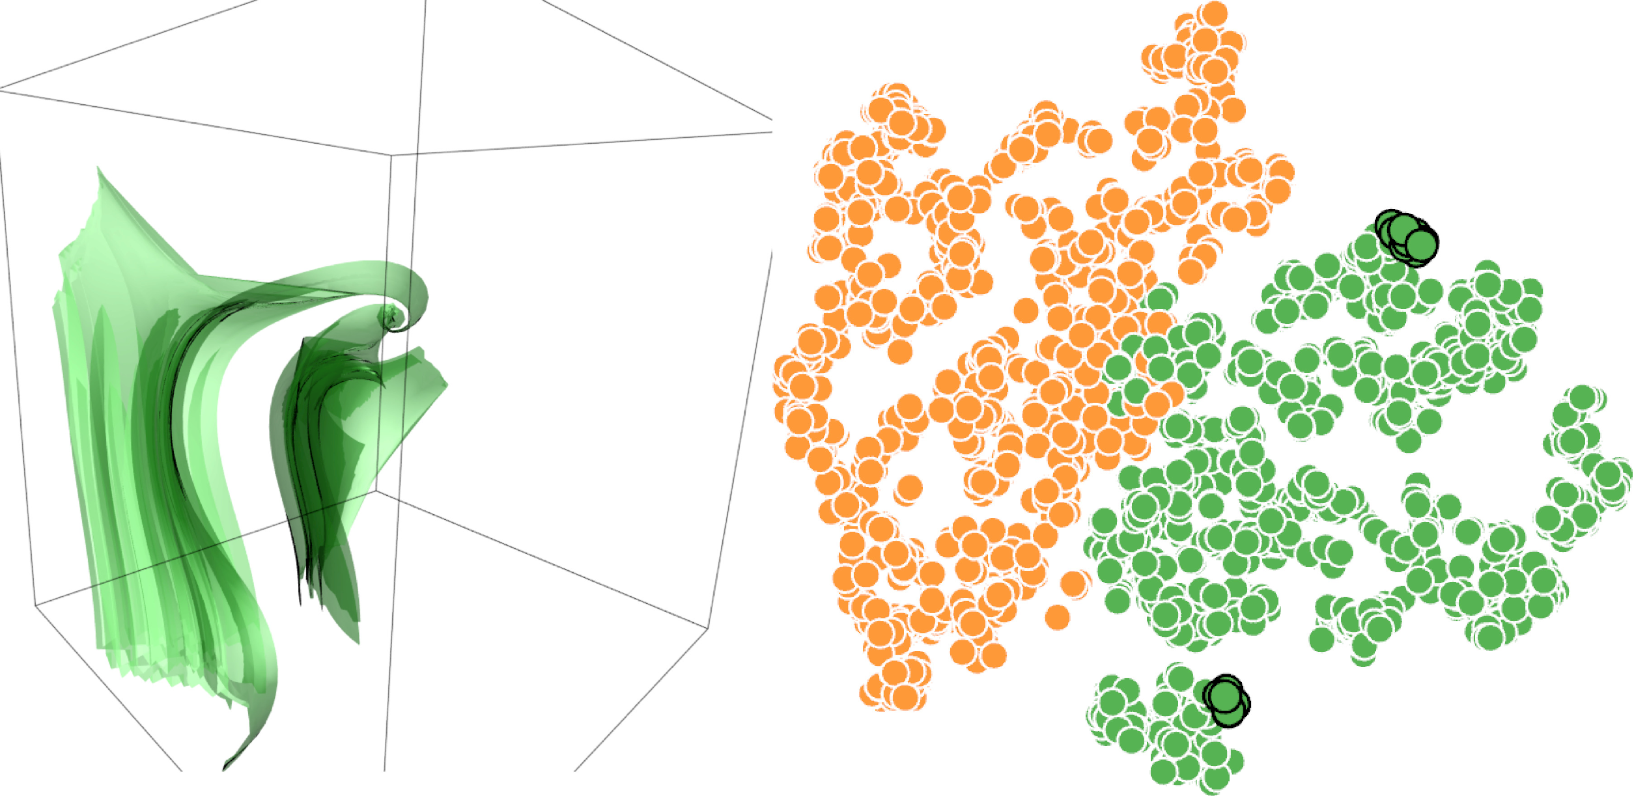
Cross-dataset training (ABC and five critical points)
23

Slide 25
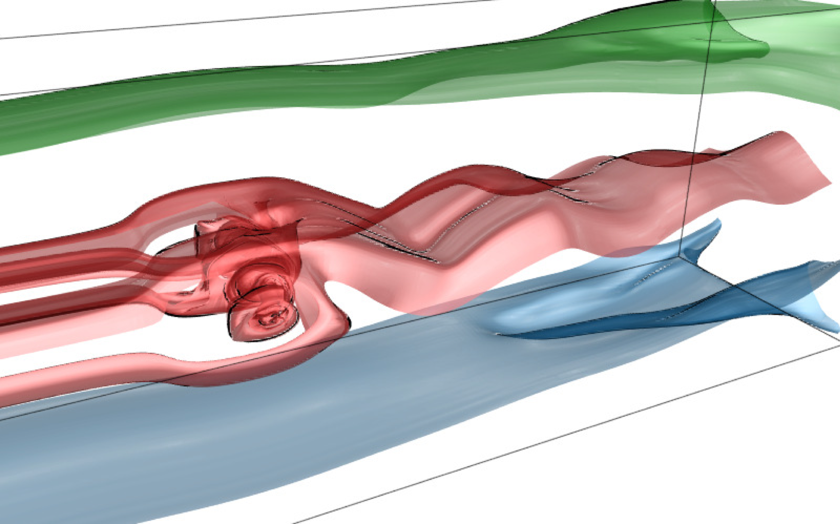
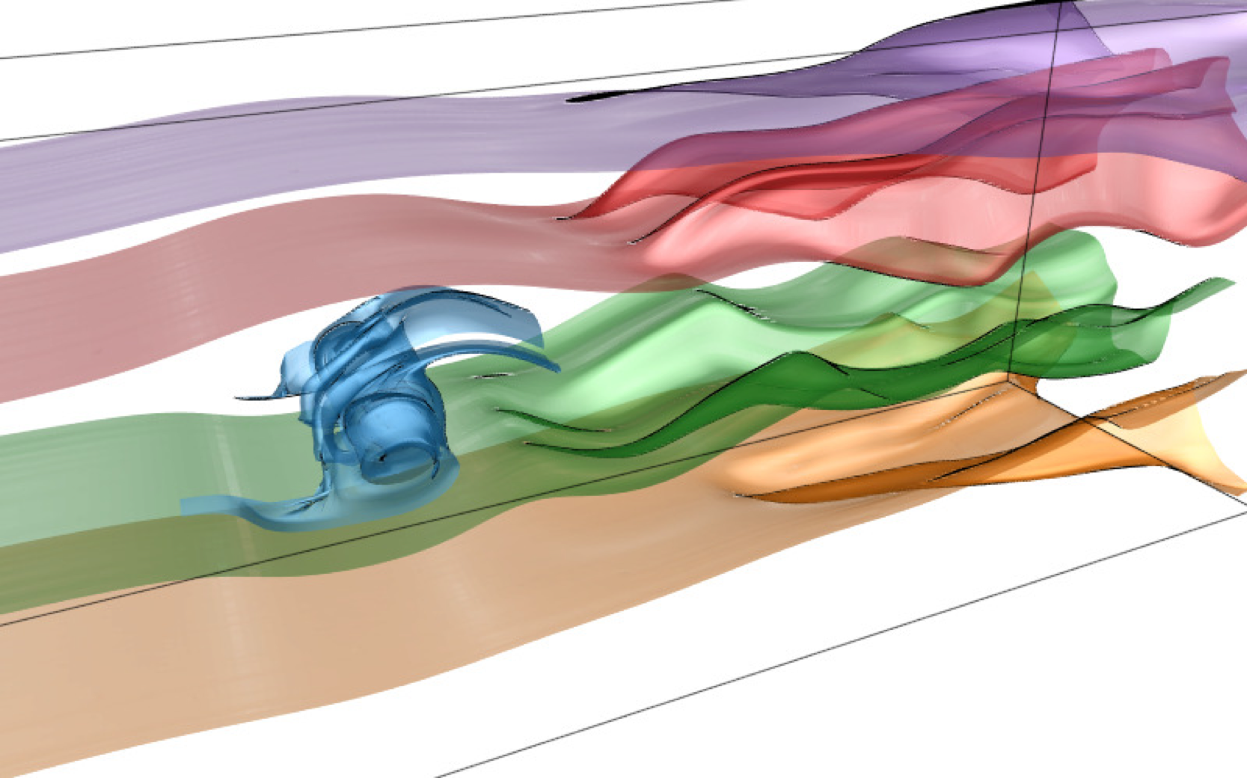
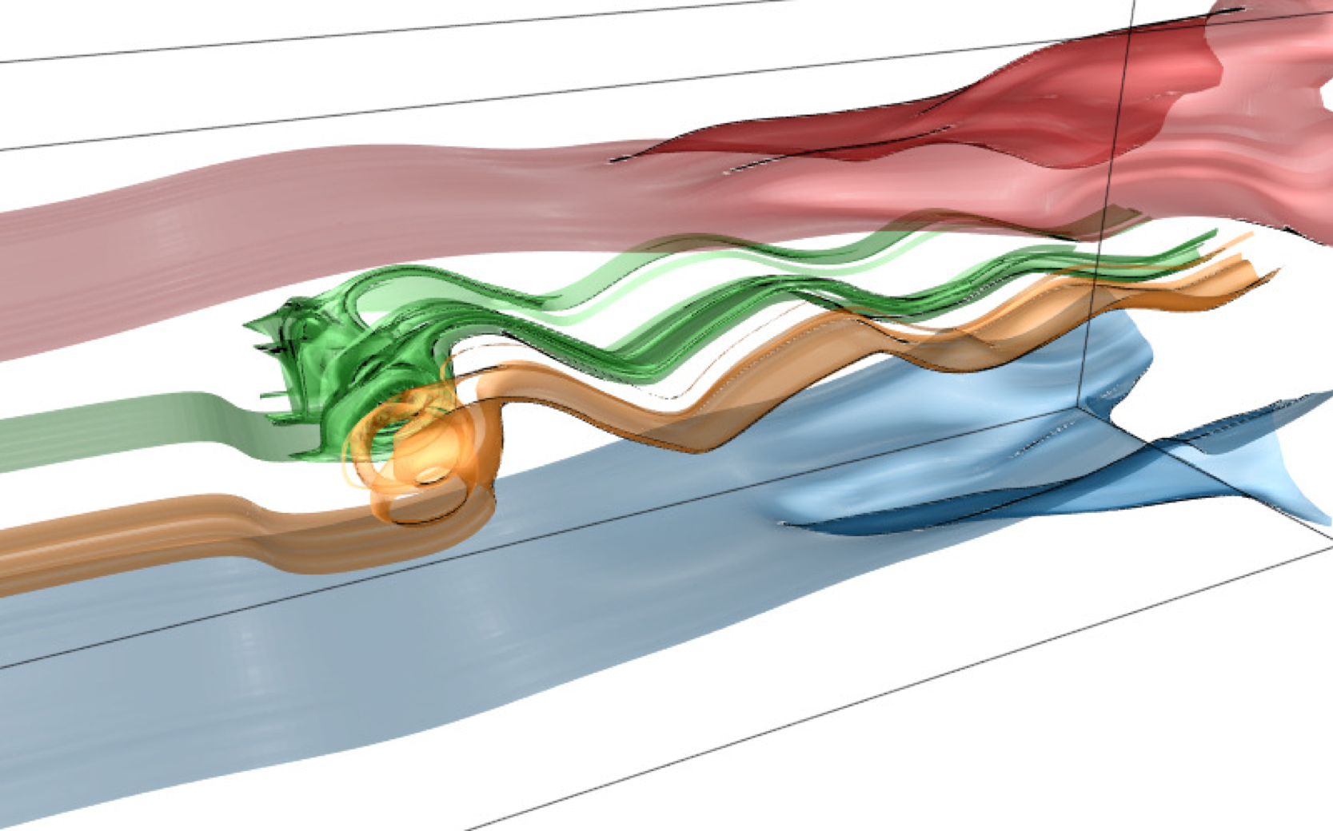
Stream surface selection (square cylinder)
ours
Edmuds et al.
Schulze et al.
Edmunds et al. Automatic Stream Surface Seeding: A Feature Centered Approach. CGF, 2012.
Schulze et al. Sets of Globally Optimal Stream Surfaces for Flow Visualization. CGF, 2014.
24

Slide 26
Stream surface selection (computer room)
automatic selection
(60 surfaces)
manual selection
(15 surfaces)
25

Slide 27
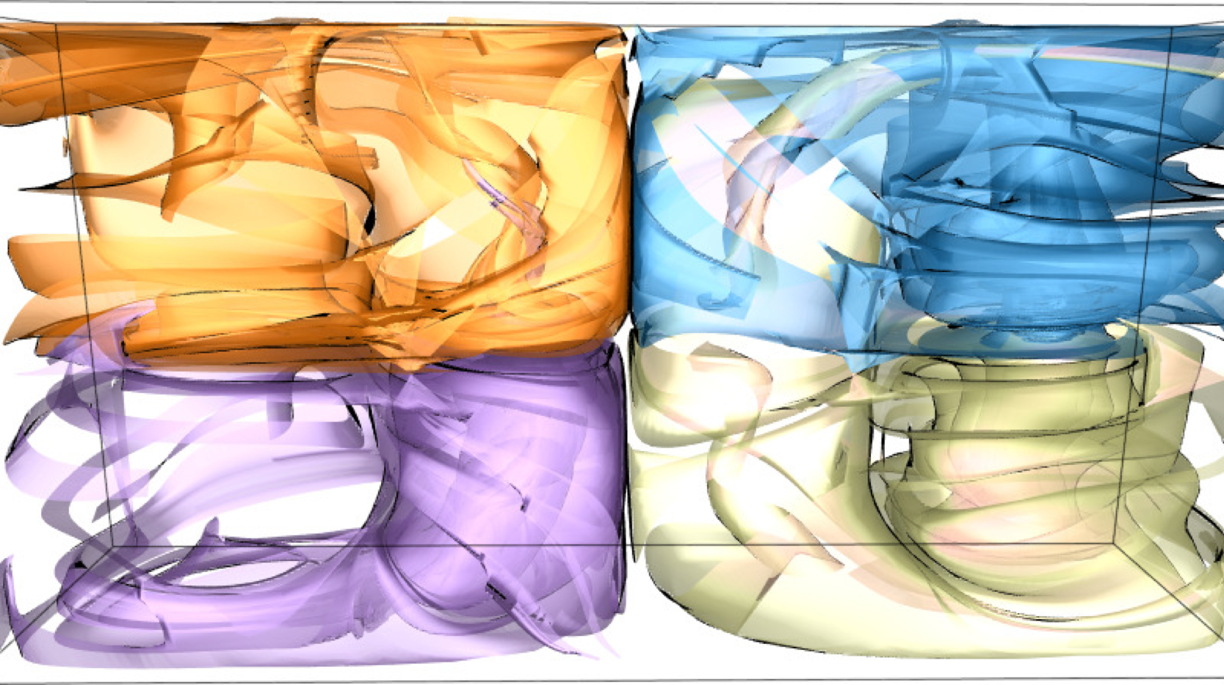
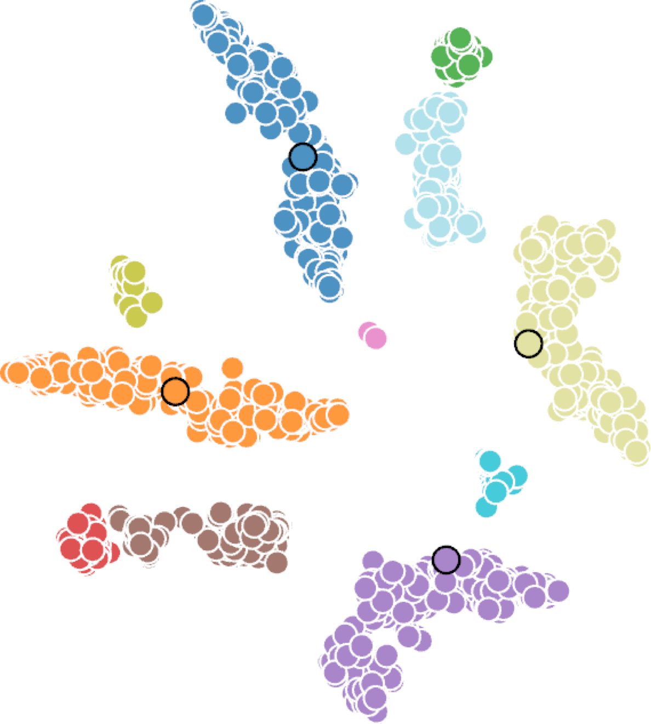
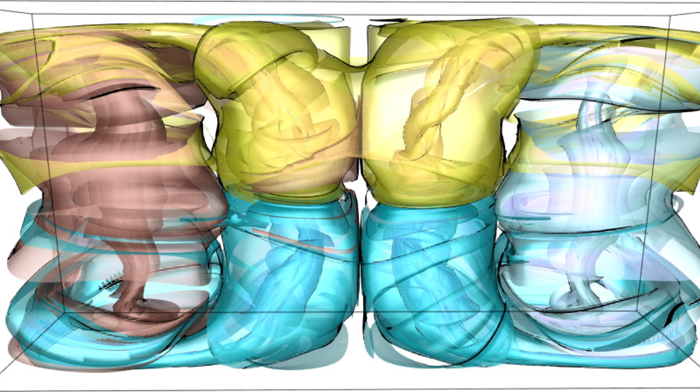
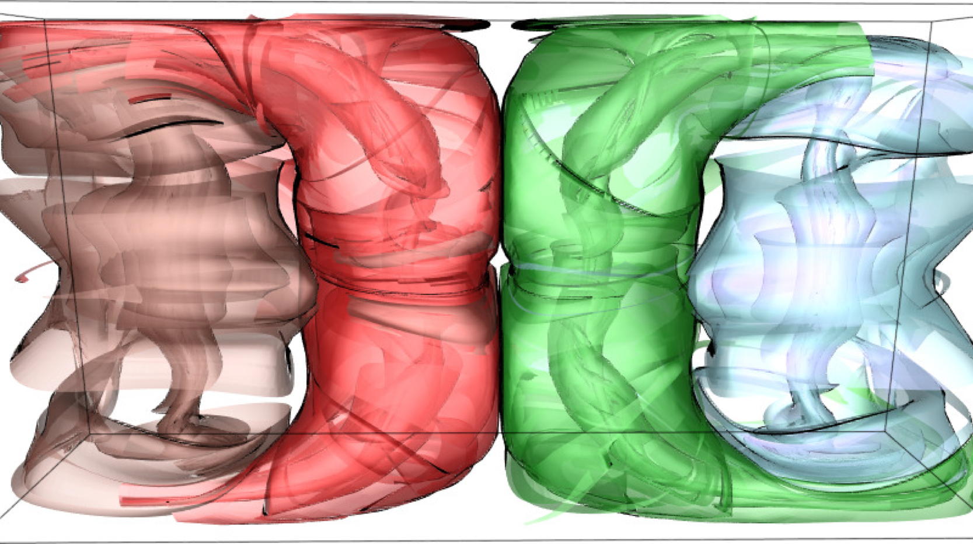
Stream surface selection (Bénard flow)
26

Slide 28
27

Slide 29
Conclusion
A single framework that works for both streamlines and stream surfaces
Select representative streamlines and stream surfaces for effective flow visualization
28

Slide 30
Acknowledgements
NSF grants IIS-1456763, IIS-1455886, and CNS- 1629914
NVIDIA GPU Grant Program
29

Slide 31
Thank you!
Questions?
30

Slide 32
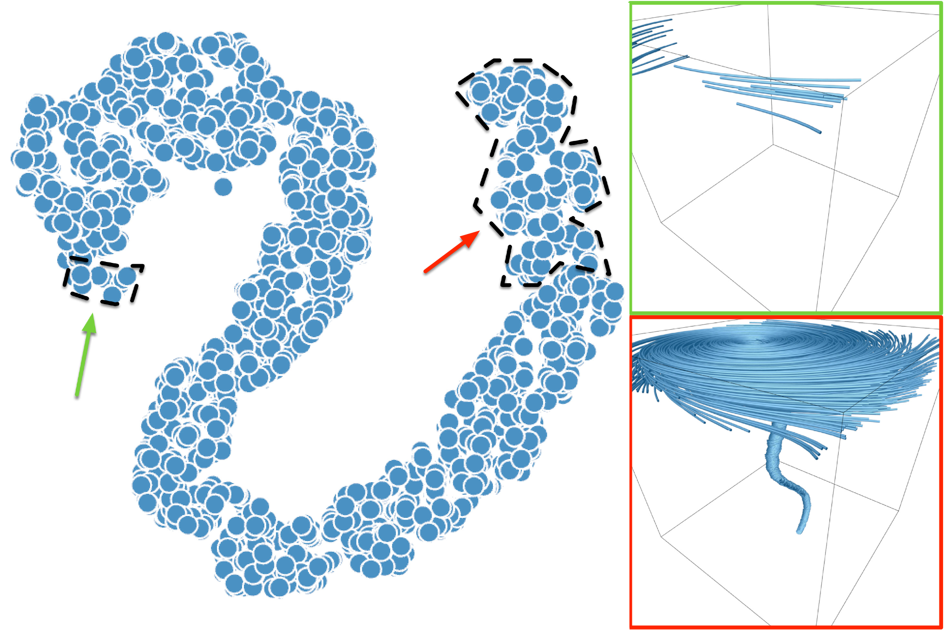
Underfitting and overfitting (tornado)
training set only
31

Slide 33
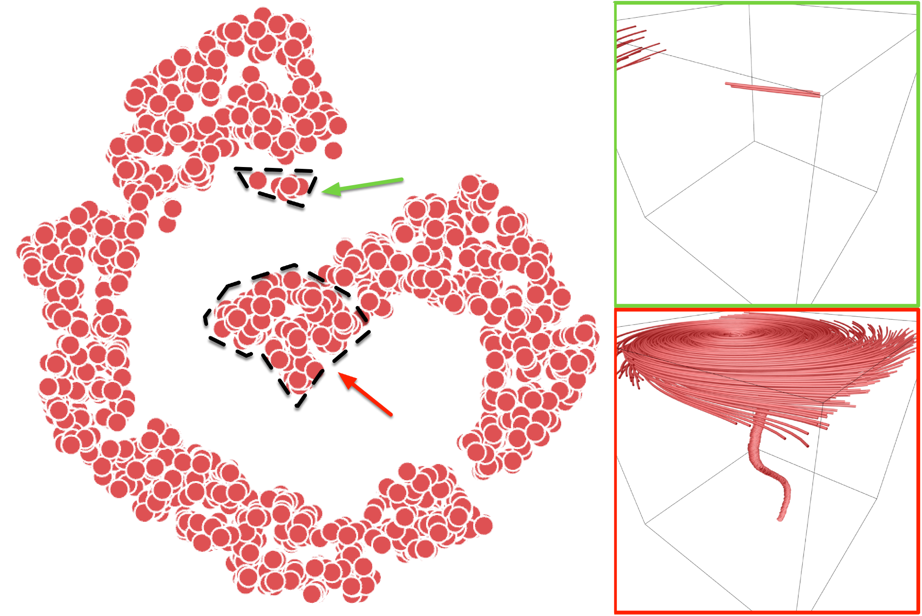
Underfitting and overfitting (tornado)
test set only
32

Slide 34
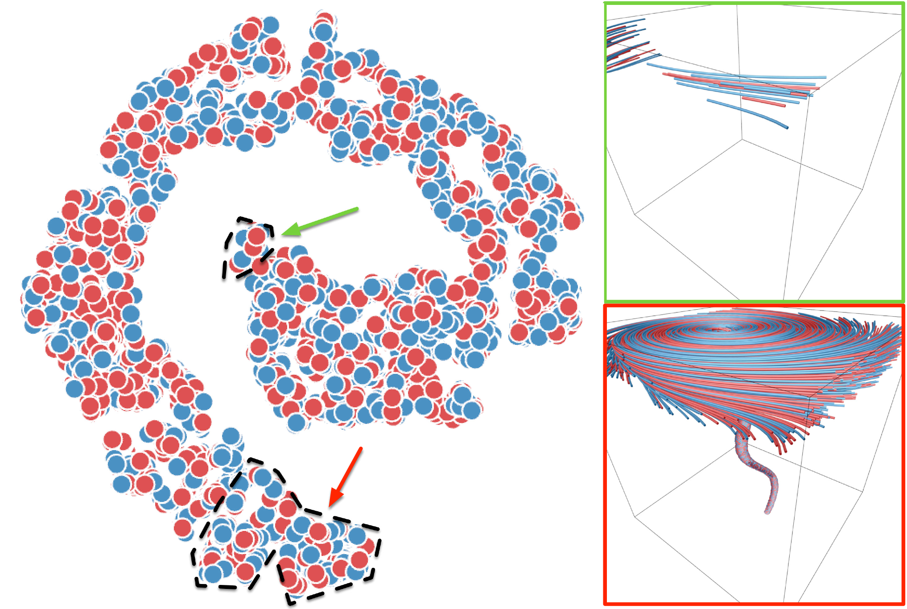
Underfitting and overfitting (tornado)
training set
+
test set
33

Slide 35
Stream surface selection
tornado
two swirls
34

Slide 36
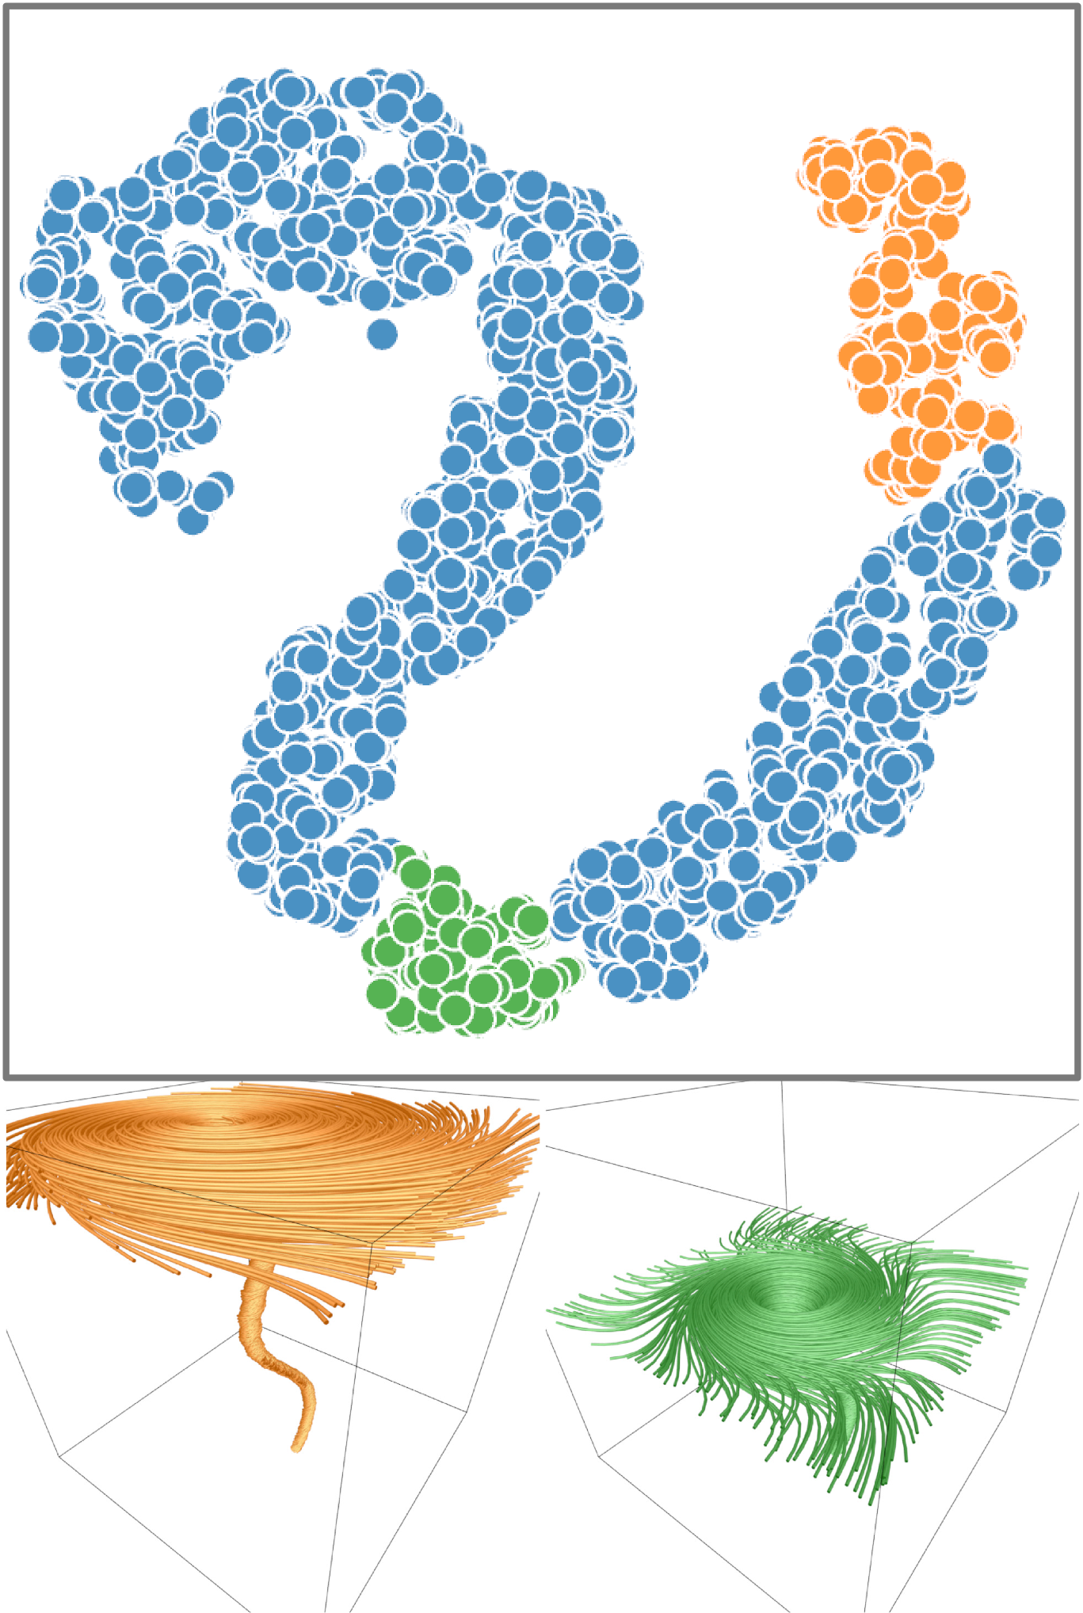
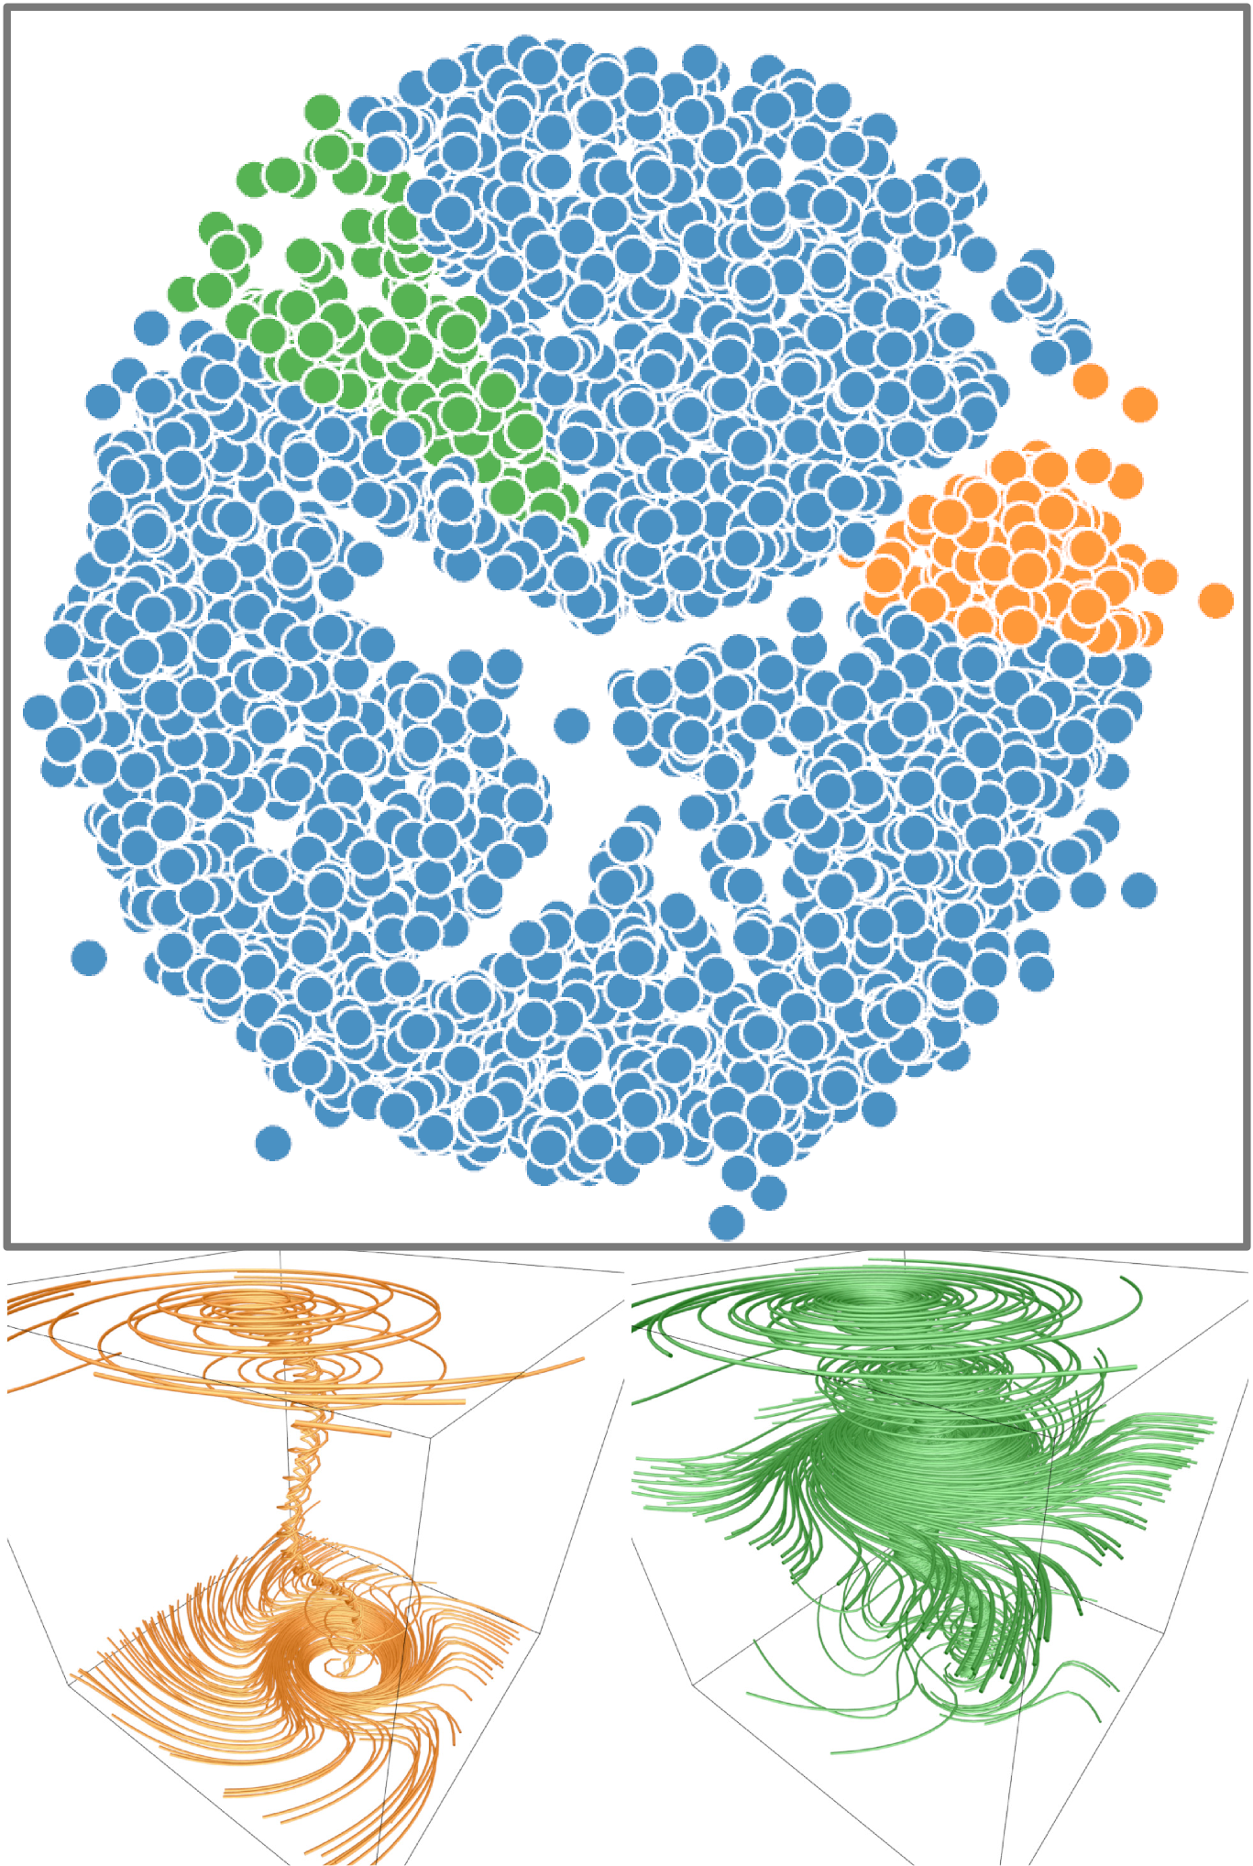
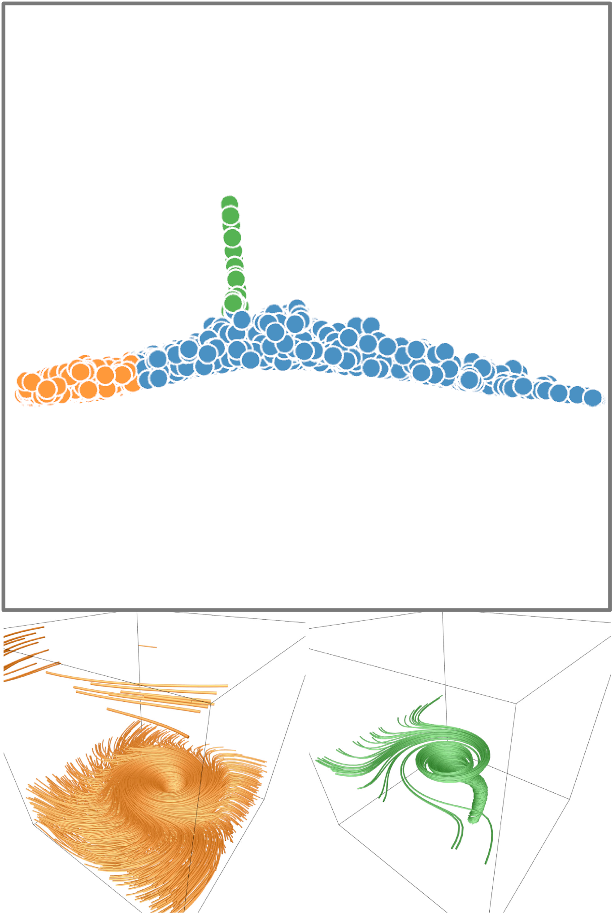
Comparison of dimensionality reduction methods
t-SNE
MDS
Isomap
35

Slide 37
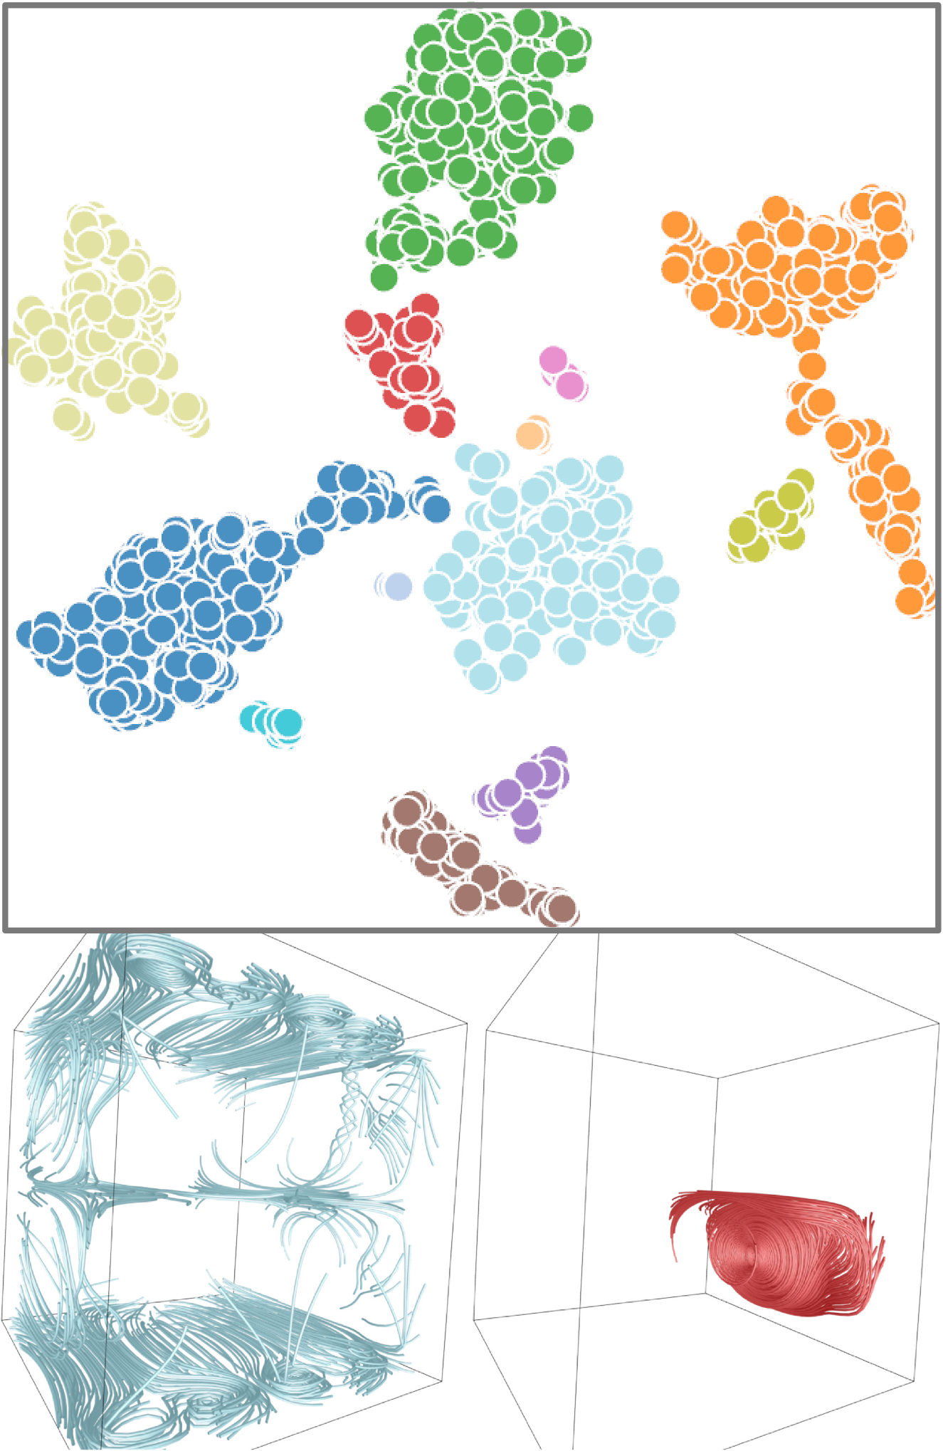
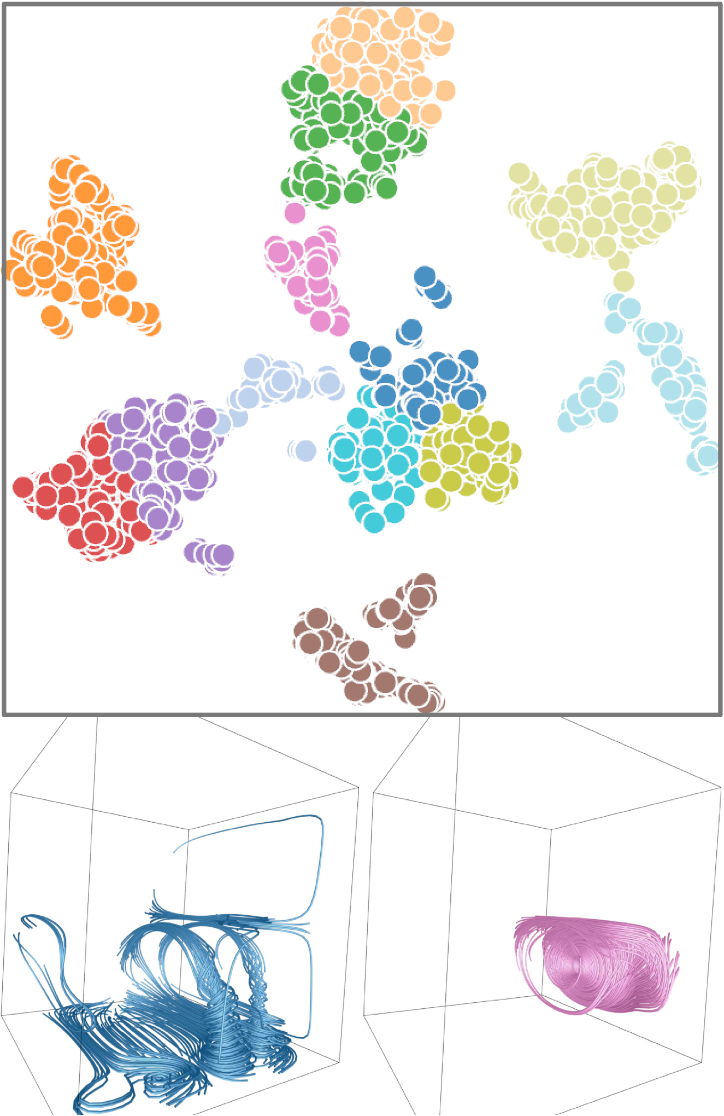
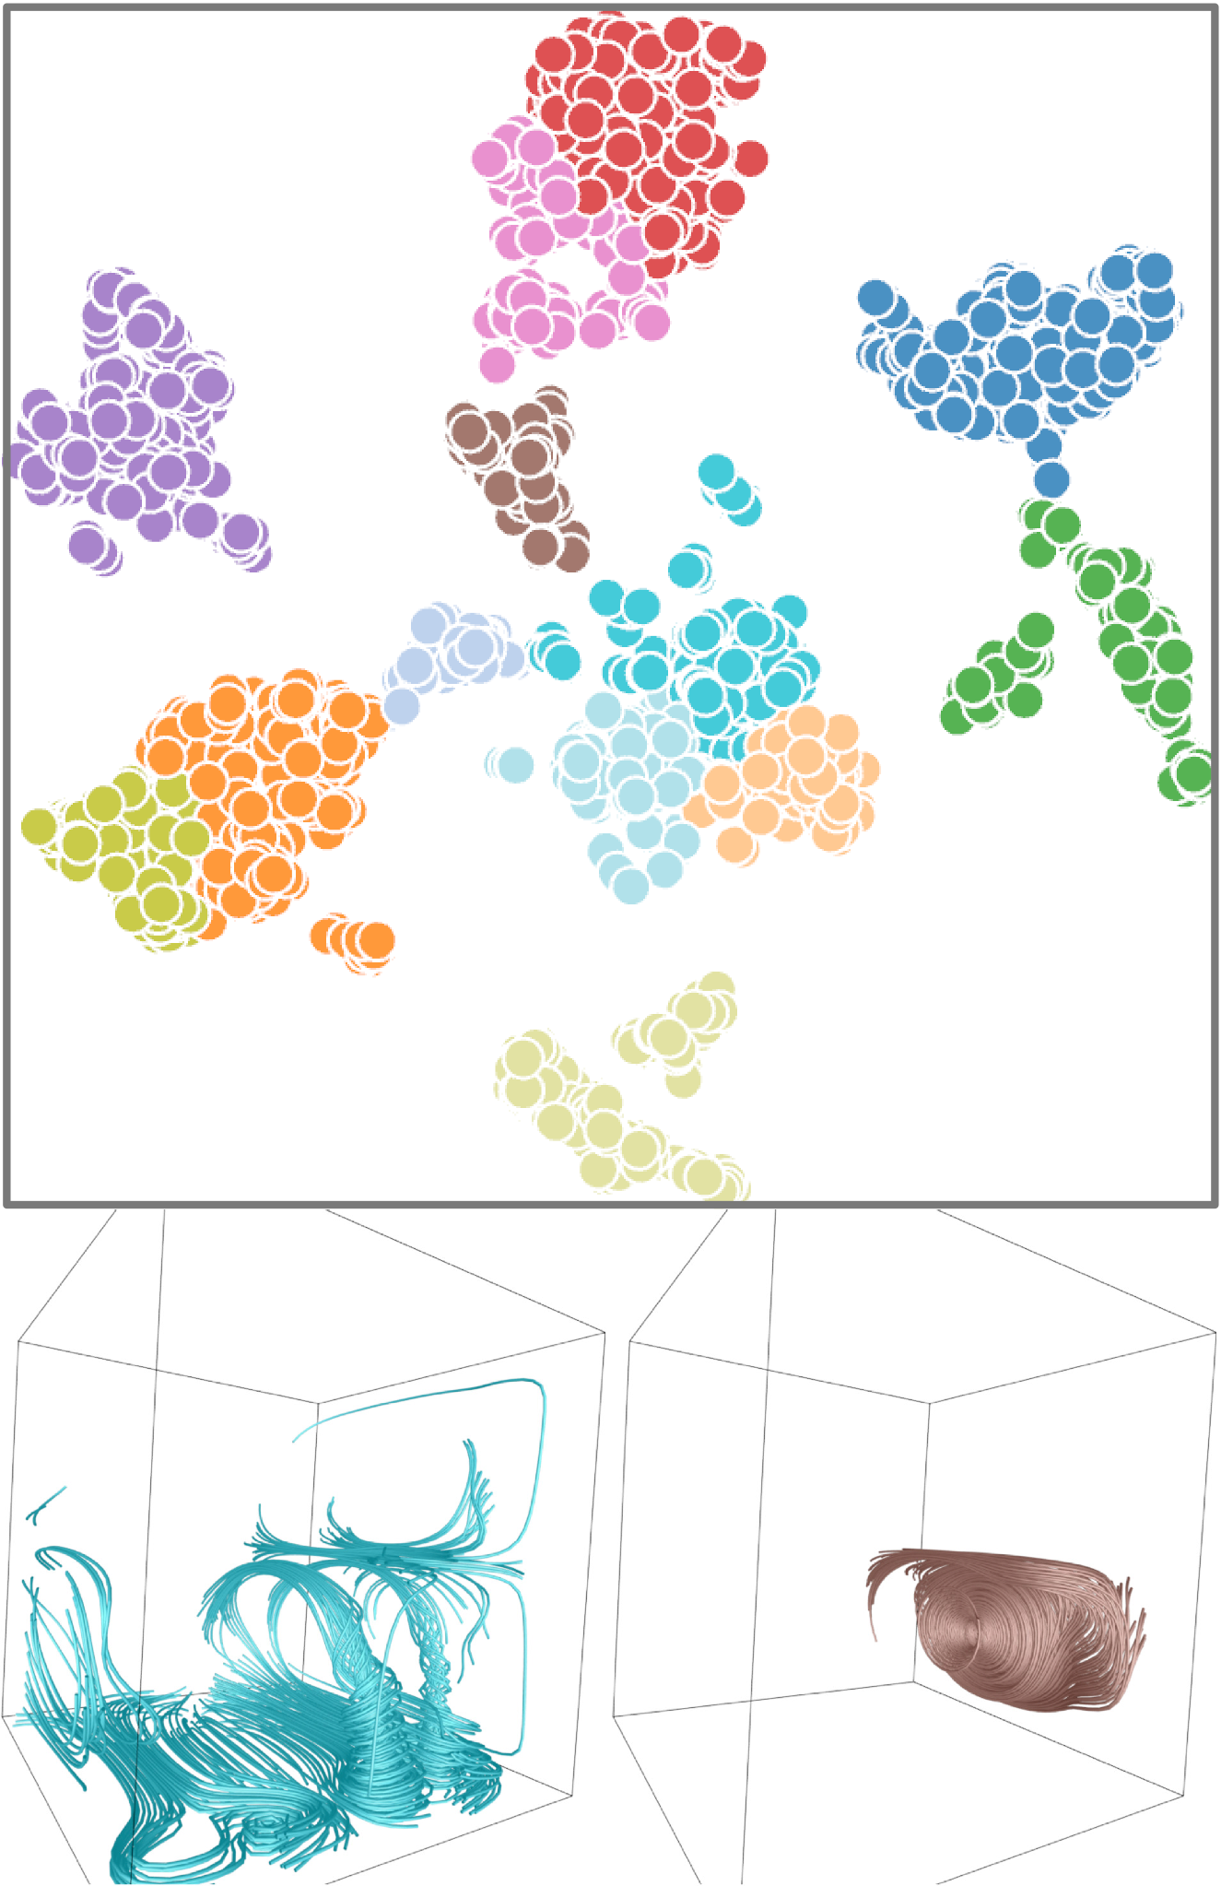
Comparison of clustering algorithms
DBSCAN
k-means
agglomerative
36

Slide 38
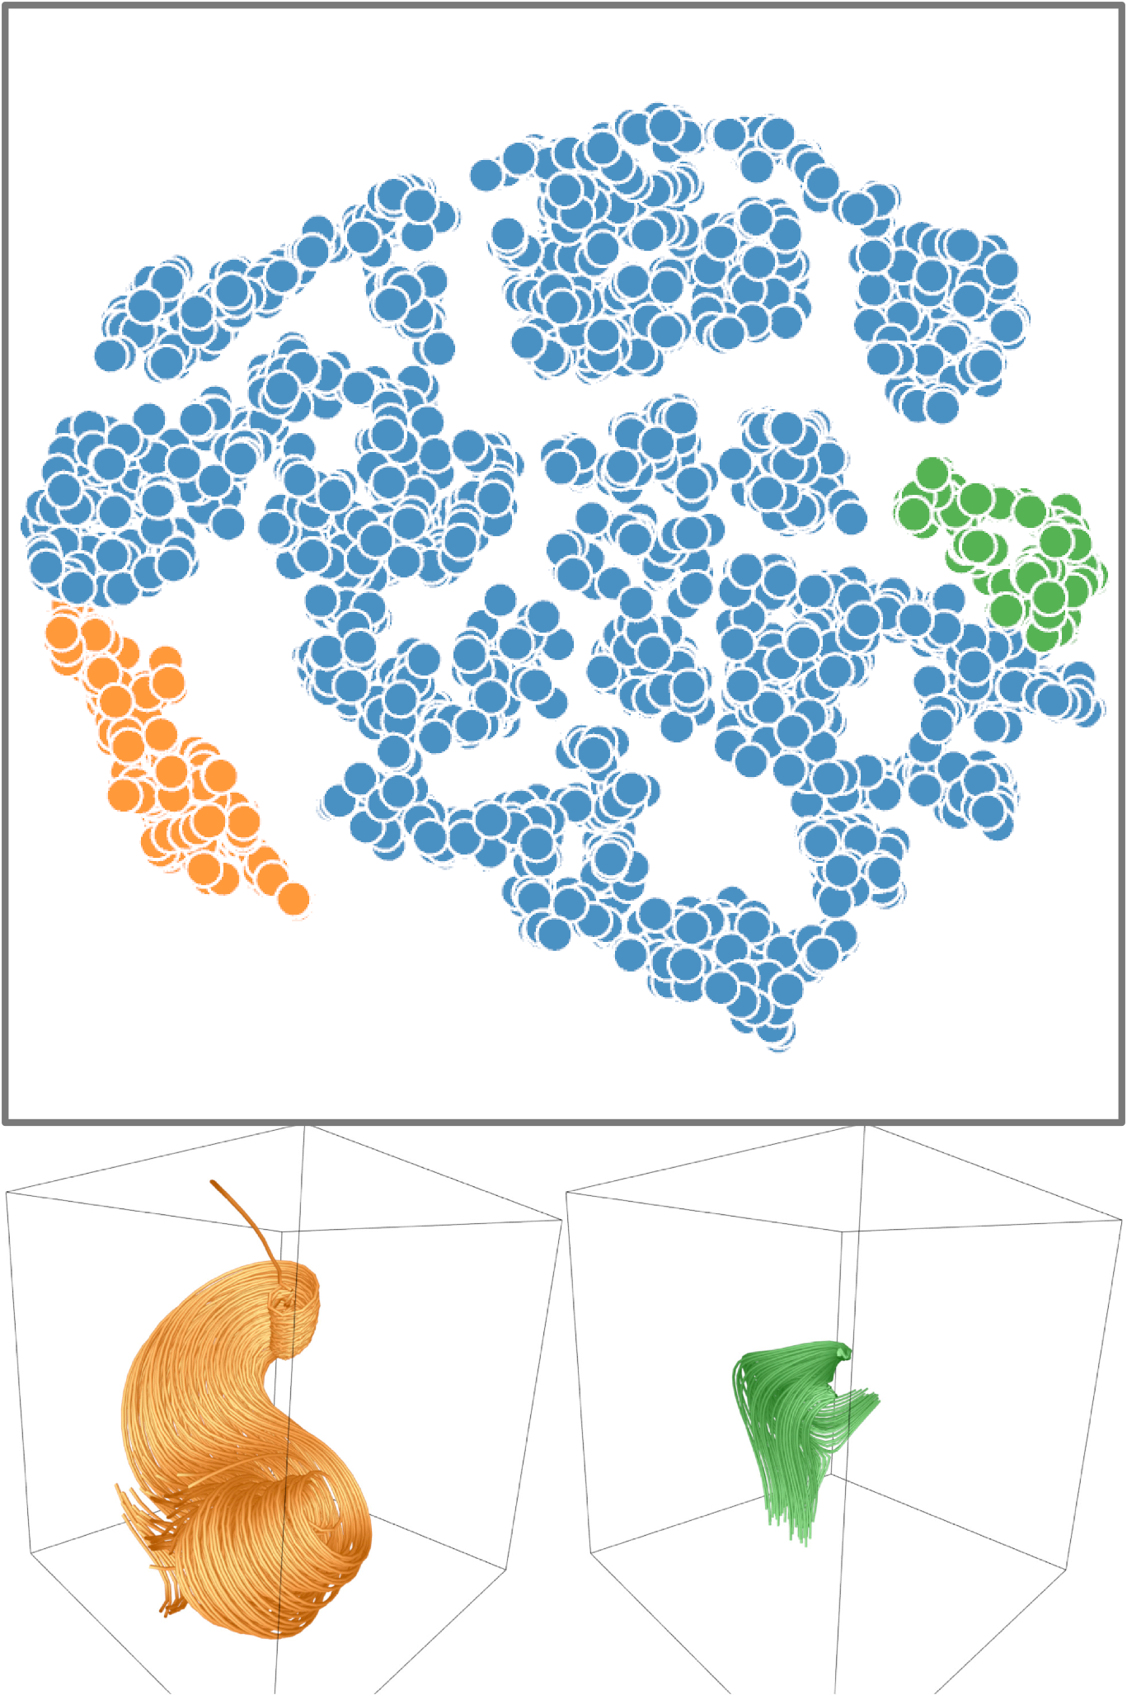
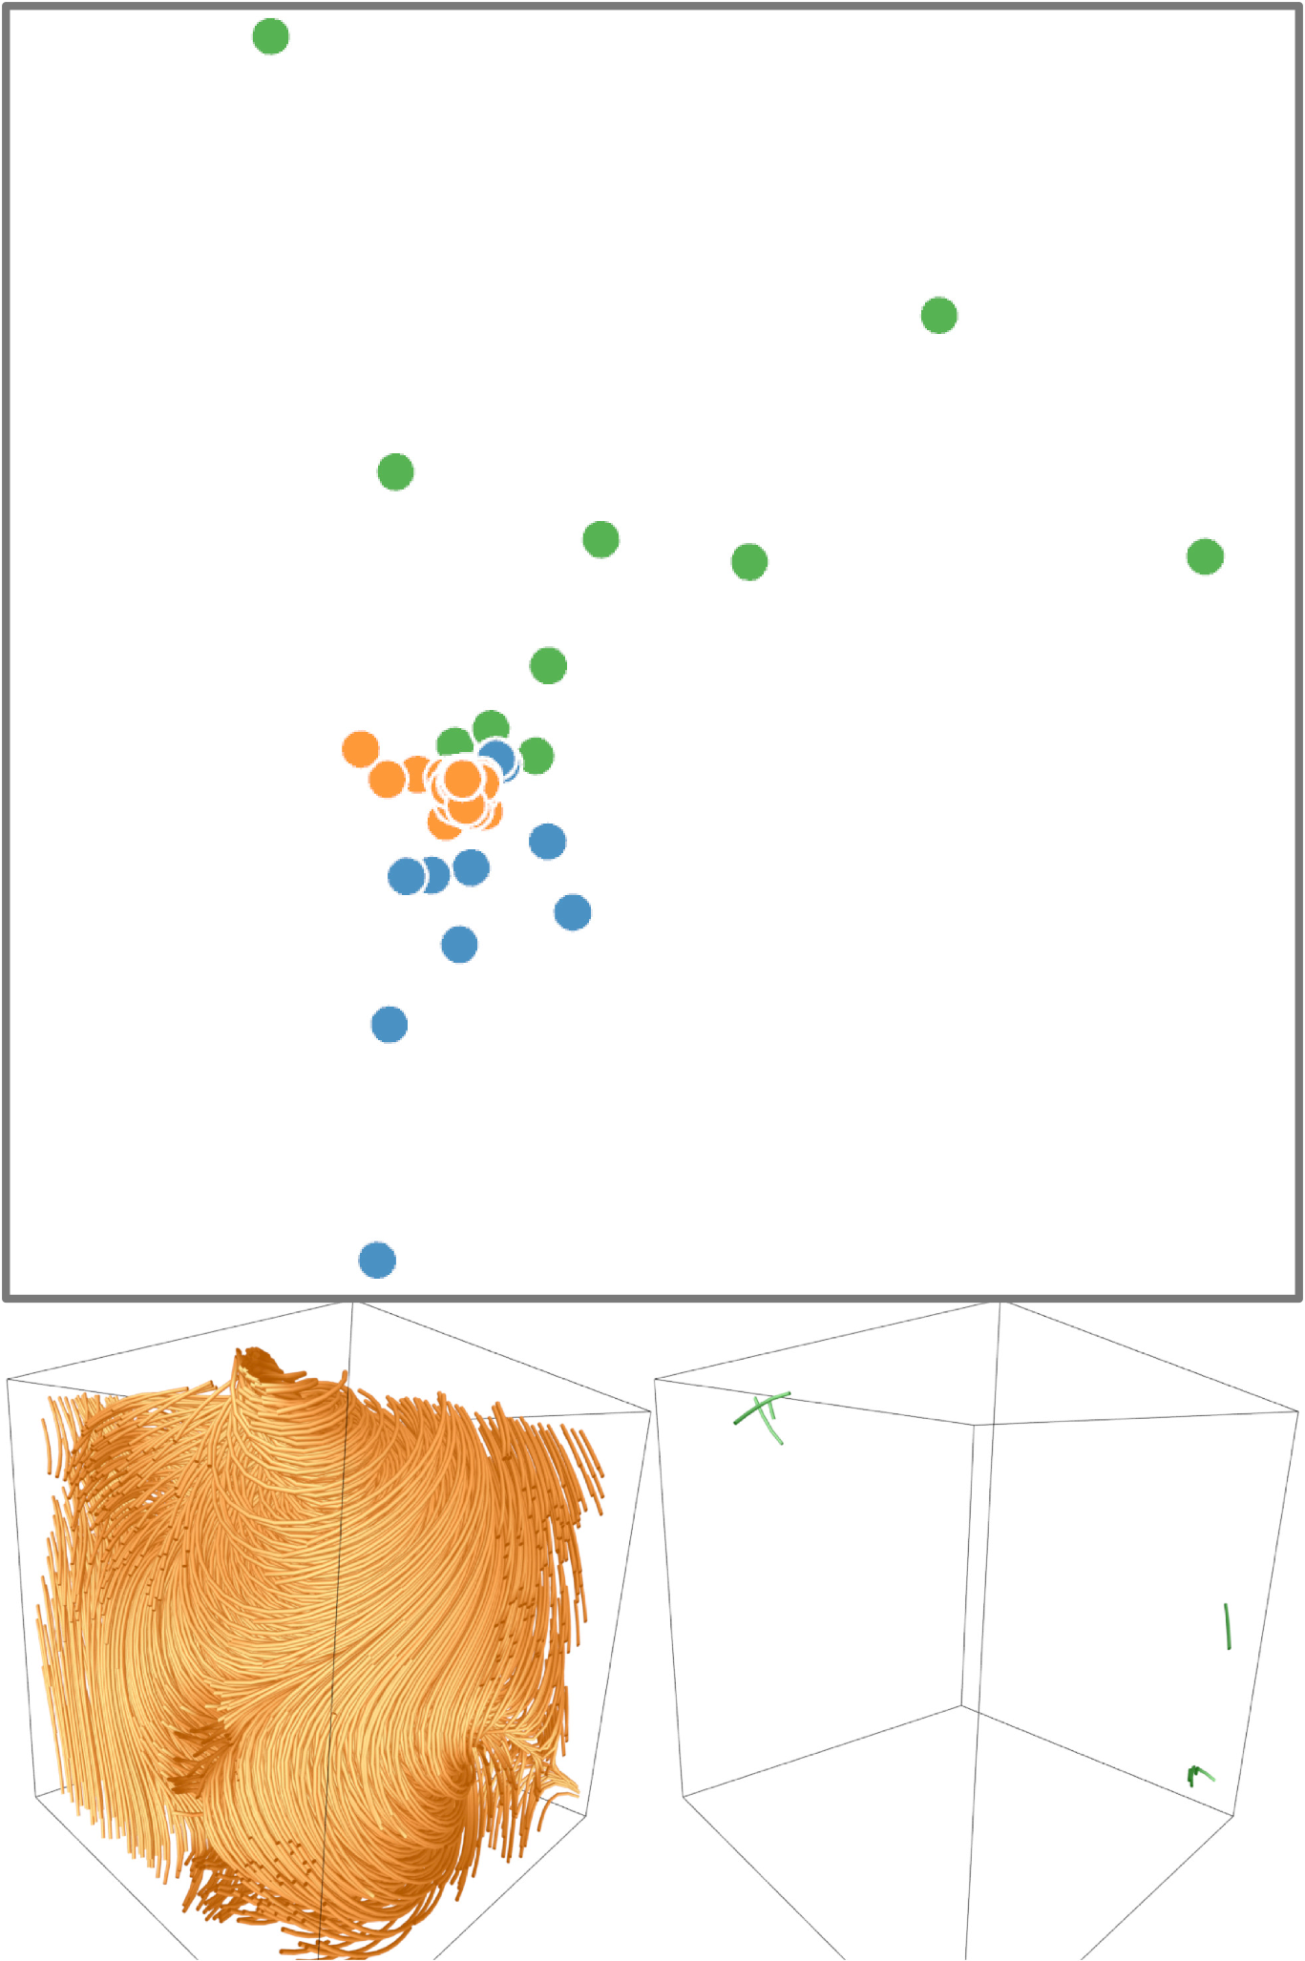
t-SNE projection of features and binary volumes
binary
volumes
features
38

