Slide 1
A Deformation Framework for Focus+Context Flow Visualization
Jun Tao, Michigan Technological University
Chaoli Wang, University of Notre Dame
Ching-Kuang Shene, Michigan Technological University
Seung Hyun Kim, The Ohio State University

Slide 2
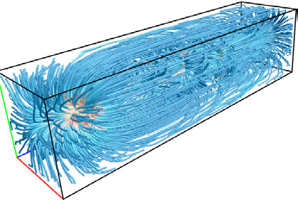
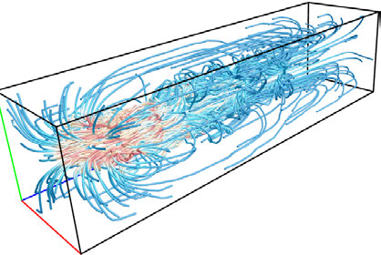
Motivation (1/3)
Focus on integration-based flow visualization (streamlines, pathlines)
Address the occlusion and clutter problem for complex 3D flow fields
Varying line densities (selection or filtering)
[Xu et al. 2010, Marchesin et al. 2010, Lee et al. 2011, Yu et al. 2012, Tao et al. 2013]

Slide 3
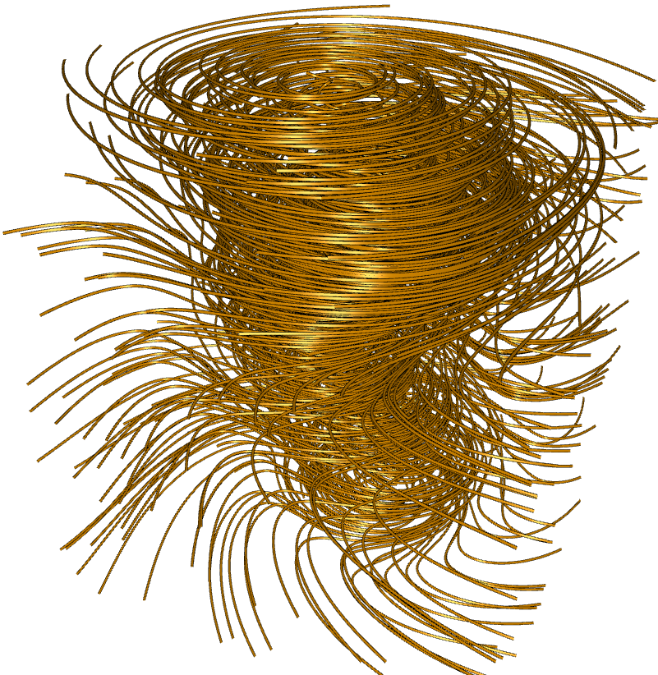
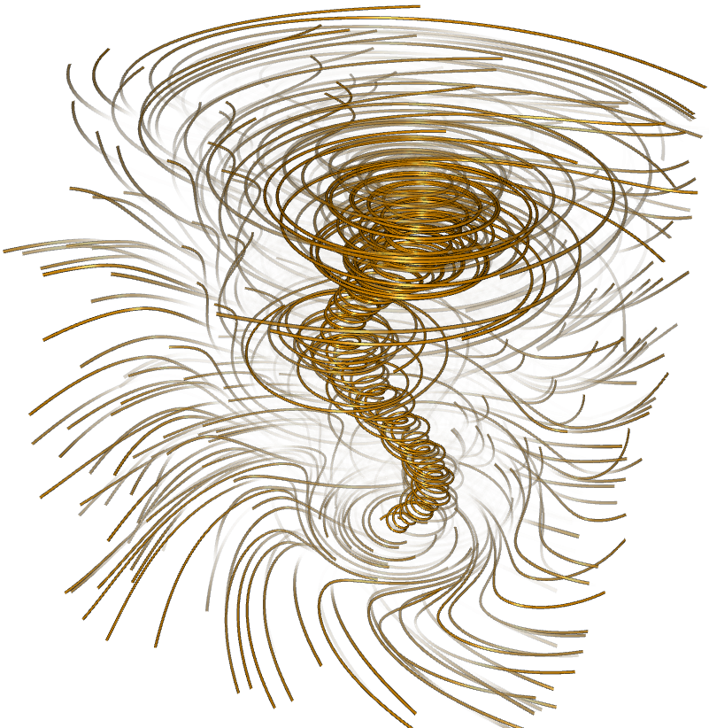
Motivation (2/3)
Address the occlusion and clutter problem for complex 3D flow fields
Varying line opacities (opacity optimization)
[Günther et al. 2013, Günther et al. 2014]

Slide 4
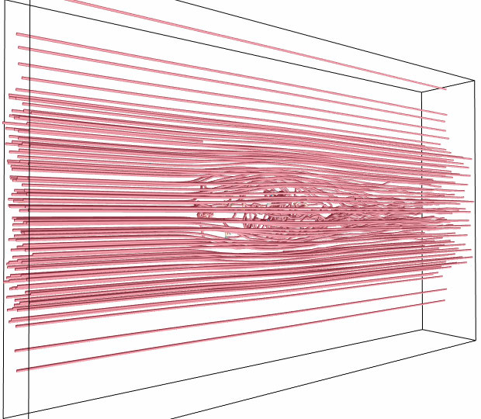
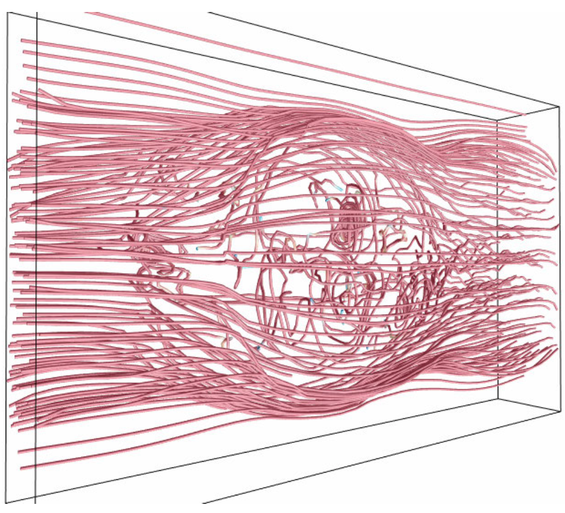
Motivation (3/3)
Address the occlusion and clutter problem for complex 3D flow fields
Varying line positions (streamline deformation)

Slide 5
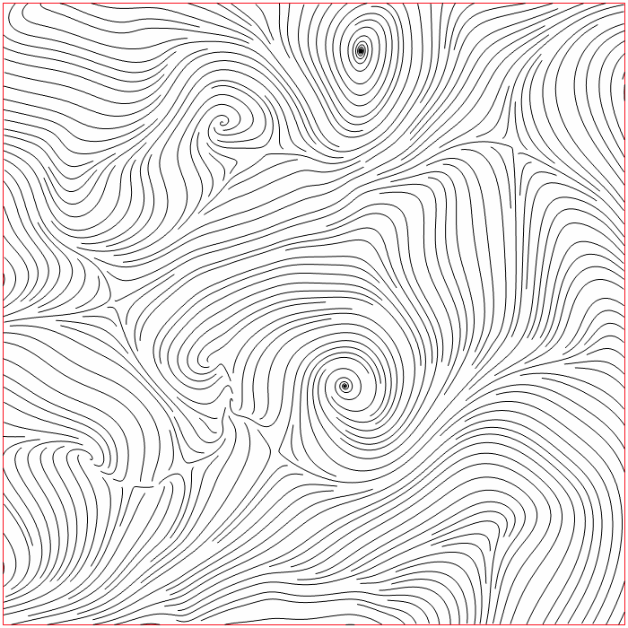
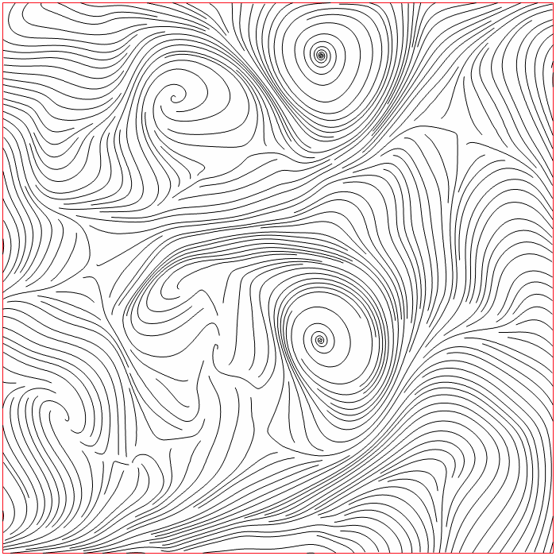
2D example

Slide 6
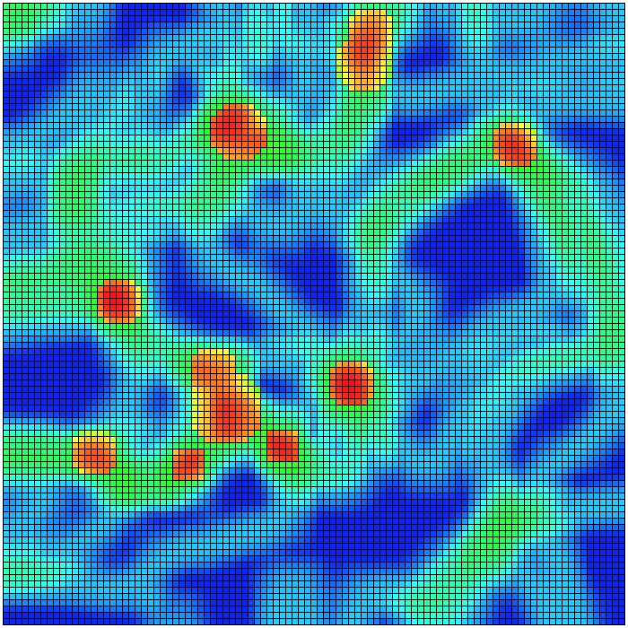
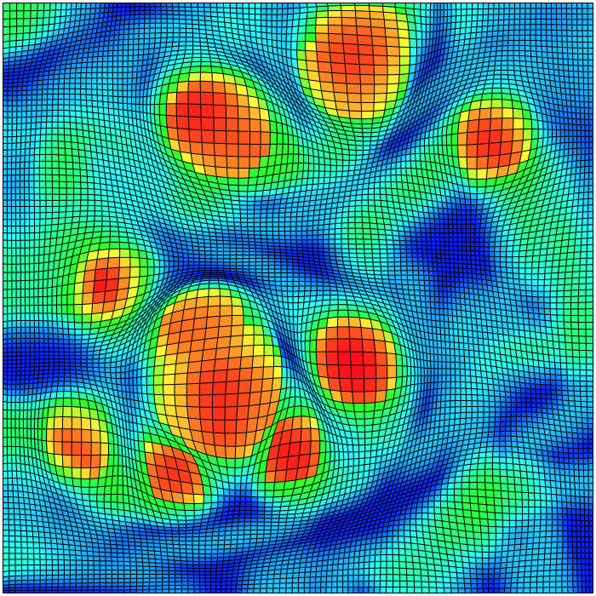
Underlying grid

Slide 7
Outline of our approach
Partition the volume into blocks
Derive block importance
Formulate block expansion and smoothing terms
Search for a deformed grid to minimize the object energy function
Use deformed grid to guide streamline repositioning

Slide 8
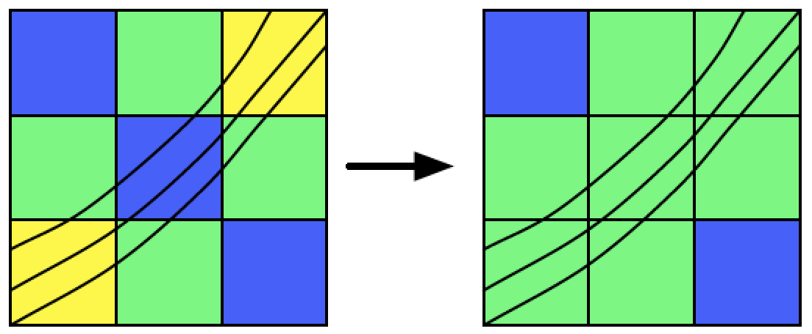
Automatic block evaluation
Flow entropy (vector direction and magnitude)
Two solutions
Line-based (consider streamlines passing each block)
Voxel-based (consider a local window center at each voxel)
Flow-aware adjustment
Smooth importance values of neighboring blocks sharing a large number of streamlines
Notes:
We solve this problem by considering the importance value as some energy term: when the flow moves from an important block to a less important one, it will also carry the energy along with it. In other words, neighboring blocks sharing more streamlines in common should have more similar importance values.

Slide 9
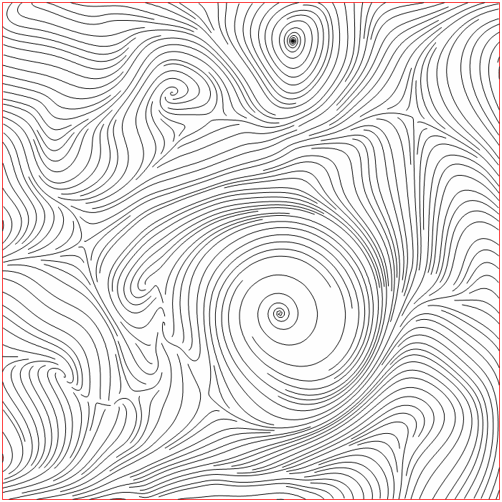
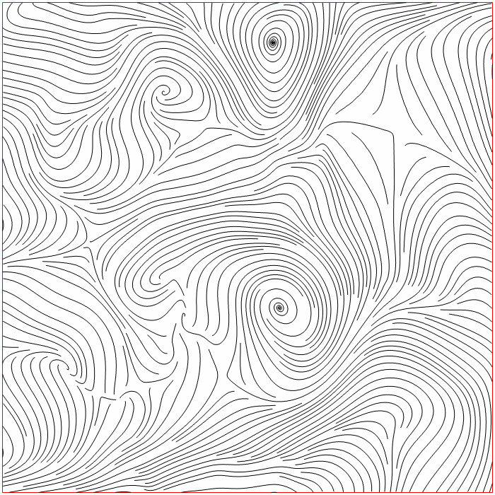
Manual importance specification

Slide 10
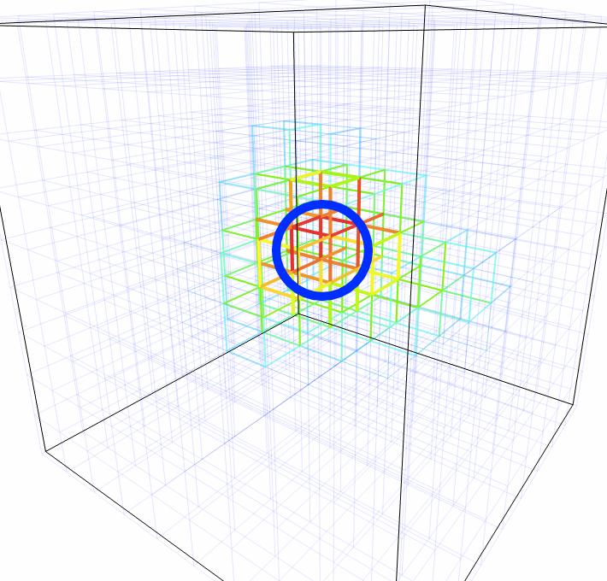
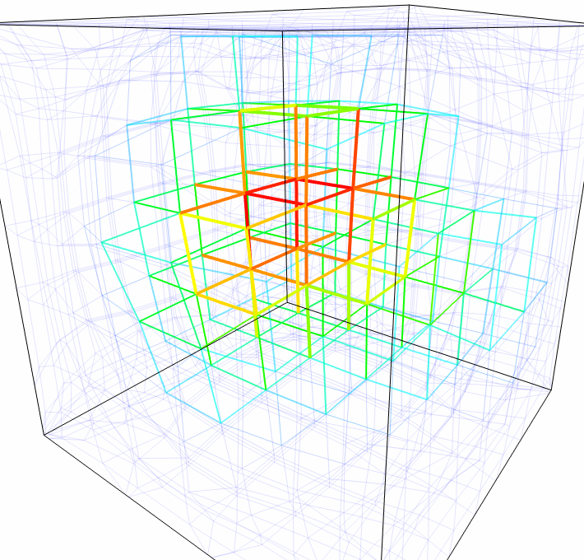
Spherical block focus
Suitable for magnifying small features

Slide 11
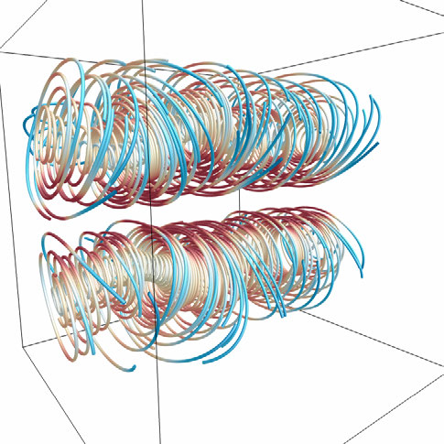
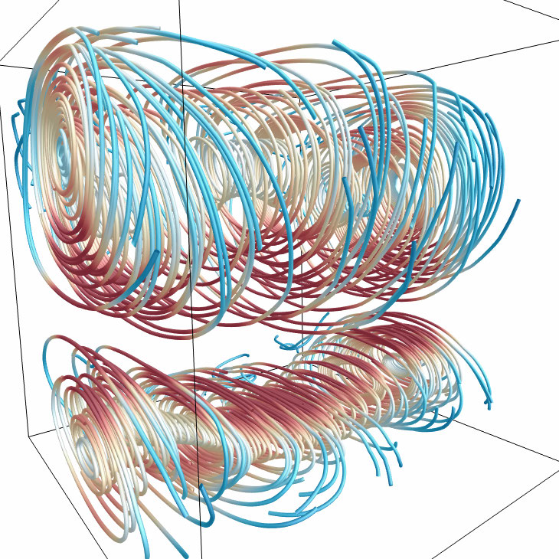
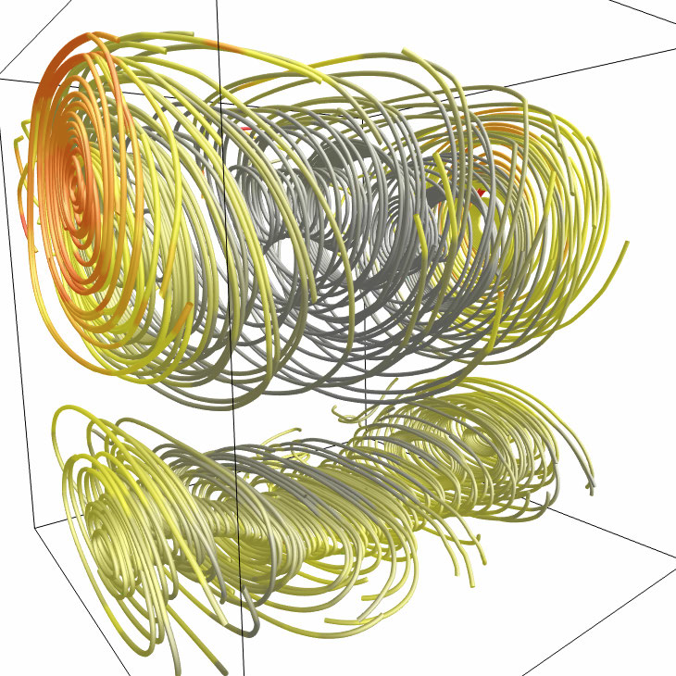
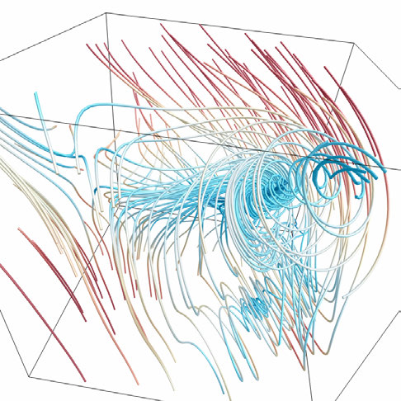
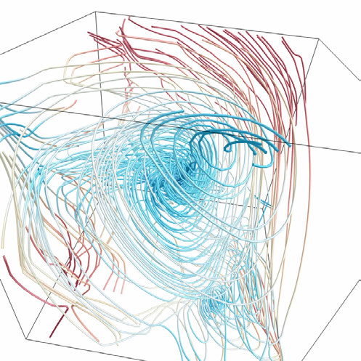
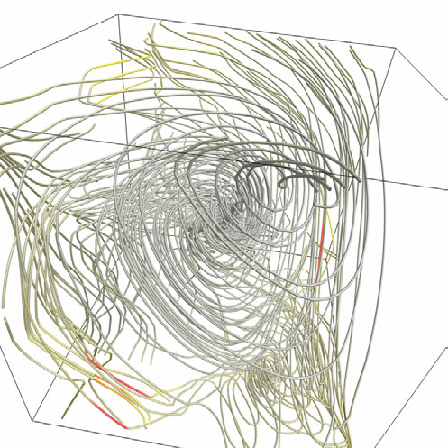
original
spherical block focus
error mapping

Slide 12
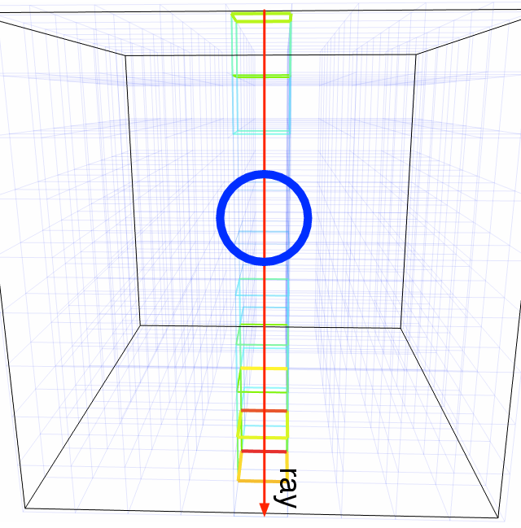
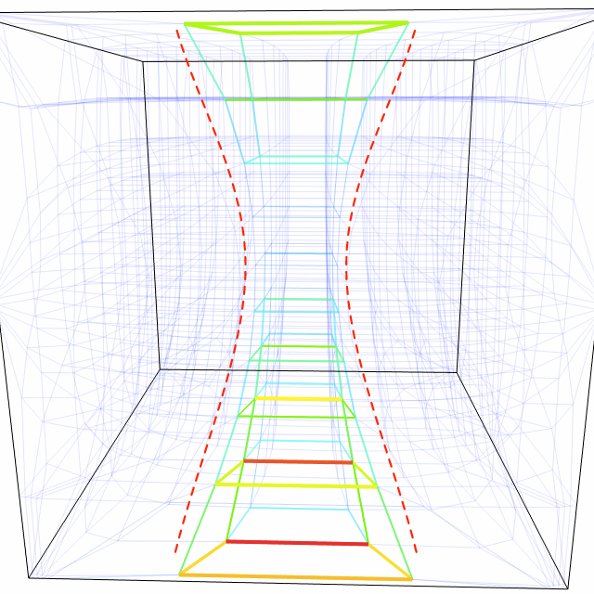
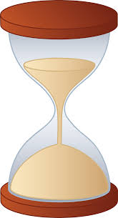
Hourglass block focus
Spherical block focus not effective for features hidden by surrounding streamlines
sparse
dense
sparse

Slide 13
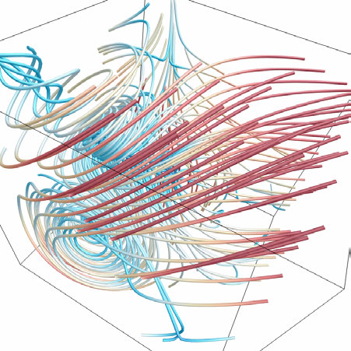
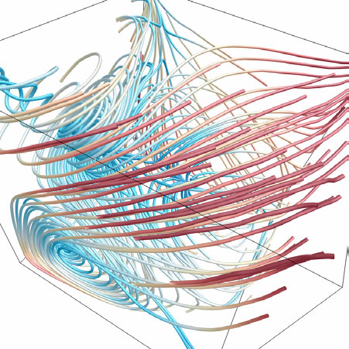
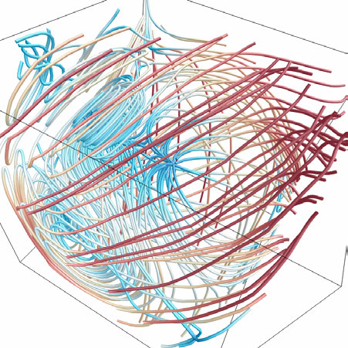
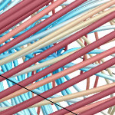
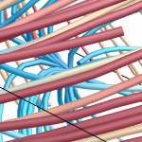
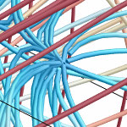
original
spherical block focus
hourglass block focus

Slide 14
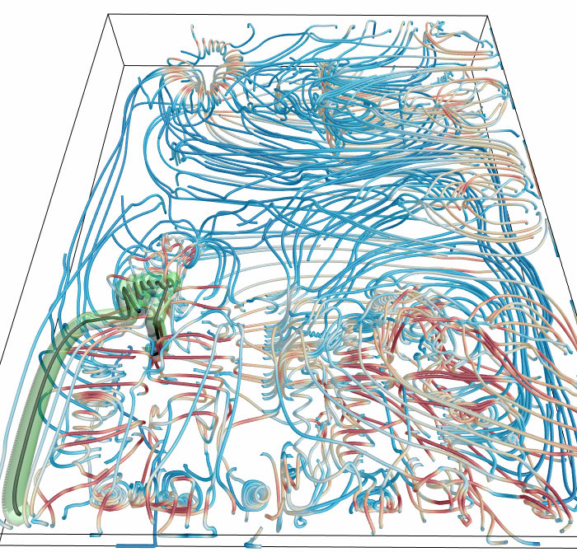
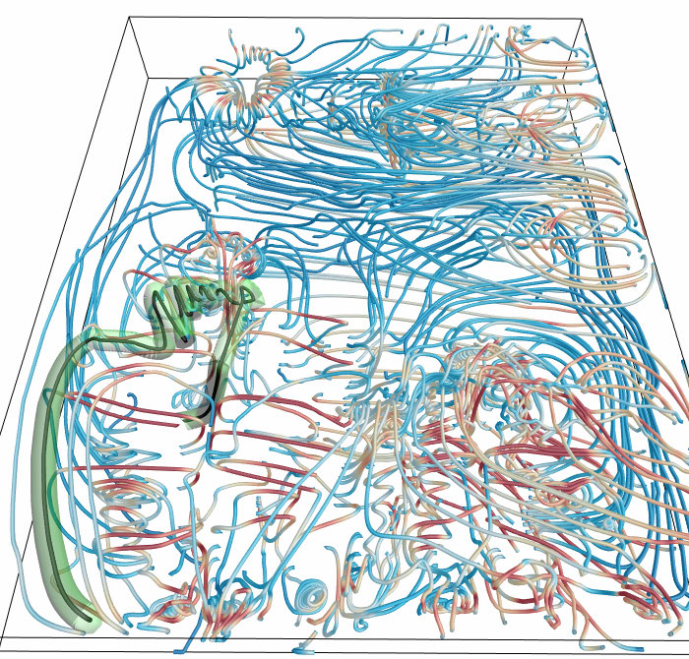
Streamline focus and animation (1/2)
User selects a streamline of interest
Perform focus+context visualization on the entire streamline
Animate through the streamline from end to end

Slide 15
Streamline focus and animation (2/2)

Slide 16
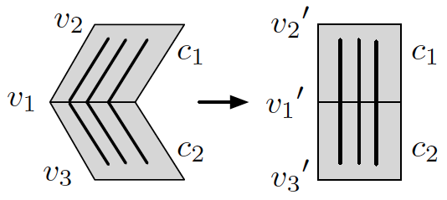
Grid space deformation
Individual block expansion
Allow each block to resize independently
Include translation, rotation and scaling
Neighboring block smoothing
Preserve the continuity of neighboring blocks
Flow-aware smoothing
Preserve the shape of streamlines
Notes:
We illustrate an example of severe streamline distortion, where straight streamlines are deformed into polylines due to the different orientations of the two neighboring blocks c1 and c2. To reduce this kind of distortion, we drag v1 shared by c1 and c2 back to the center of the two adjacent vertices v′2 and v′3.

Slide 17
Constraints and energy optimization
Constraints
Edge flipping constraints
Volume boundary constraints
Optimize the energy function
Construct a linear system and solve it in a lease-squares sense
Utilize the concurrent number cruncher (CNC) GPU sparse solver for speed performance
Notes:
Edge flipping can only be found for edges that belong to less important blocks. However, such a happening is still not desirable, since it might lead to the change of relative positions of blocks that are incident to the flipped edge. We detect edge flipping by computing the angle formed by the deformed edge and the original one. If the angle is larger than 90 degree, we consider the edge as flipped.

Slide 18
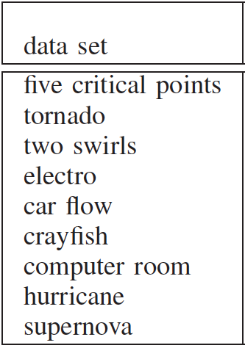
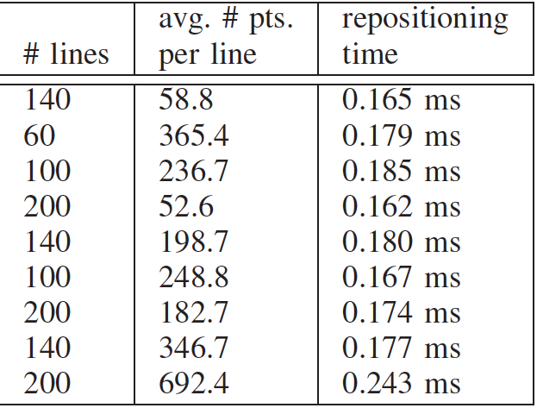
3.2GHz CPU, 24GB memory, nVIDIA GeForce GTX 580 with 1.5GB graphics memory

Slide 19
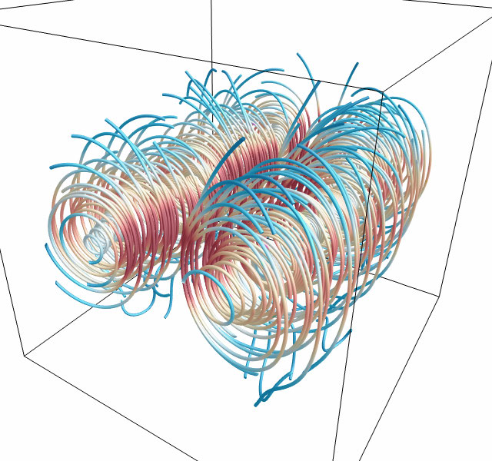
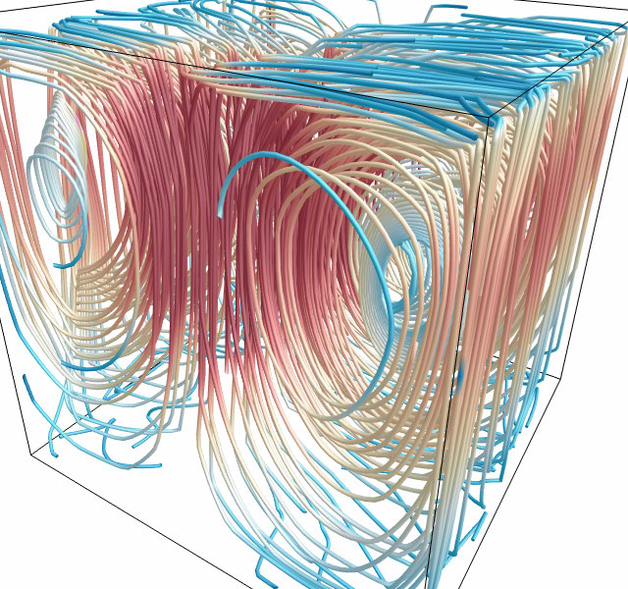
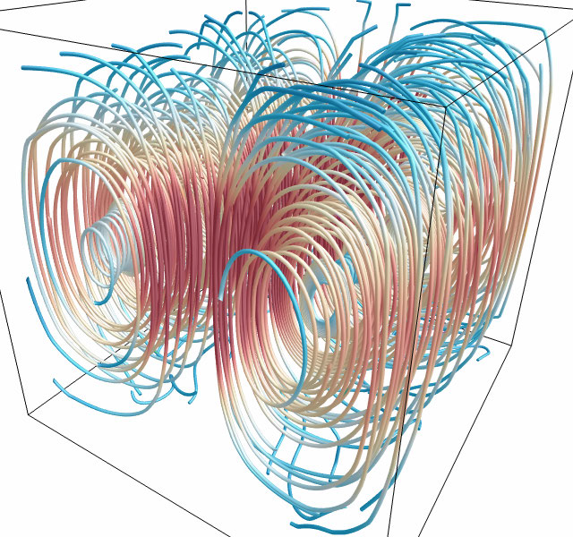
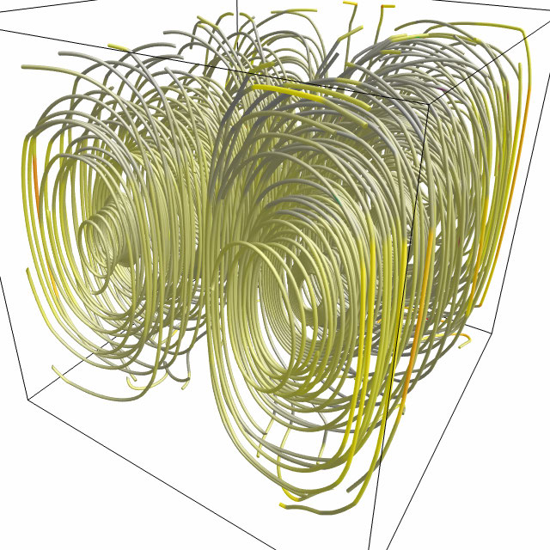
+ individual block expansion
original
+ block smoothing
+ flow-aware adjustment
+ flow-aware smoothing
error mapping

Slide 20
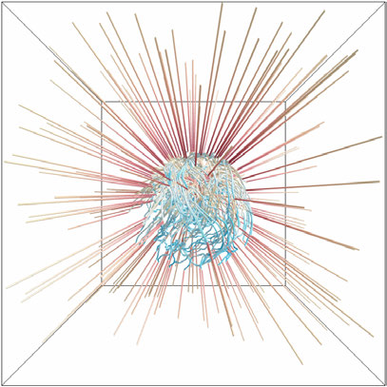
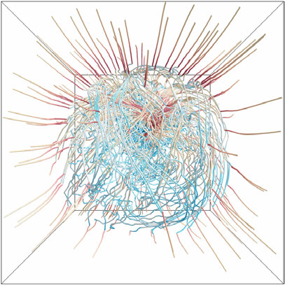
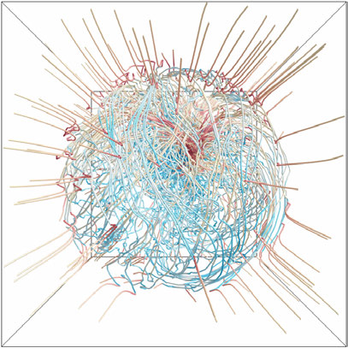
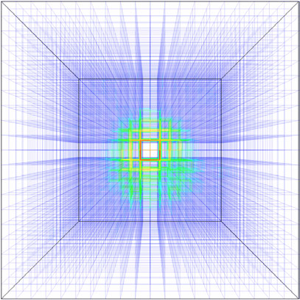
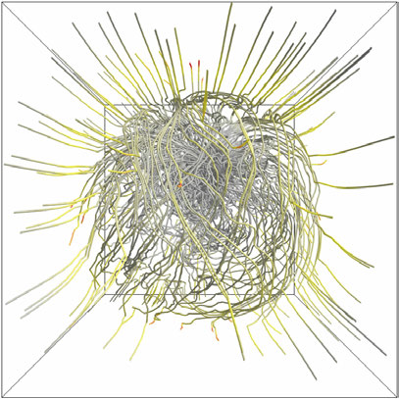
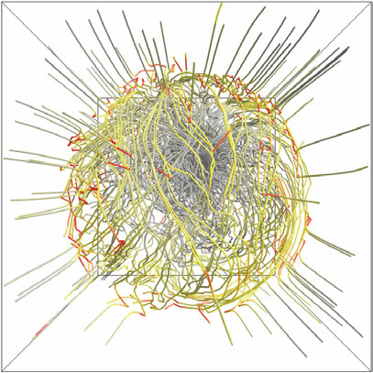
original
s_{f} = 5.0, 20 × 20 × 20
s_{f} = 10.0, 20 × 20 × 20

Slide 21
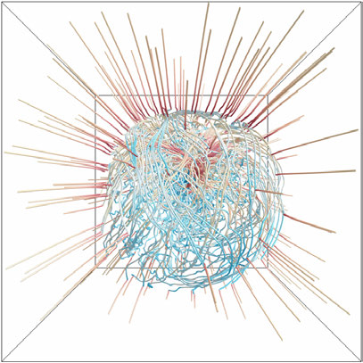
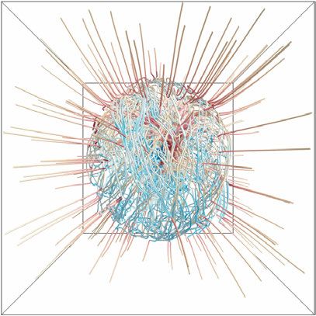
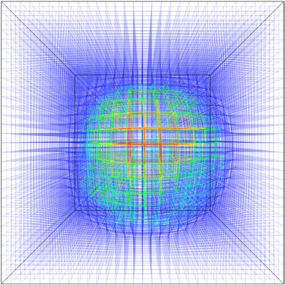
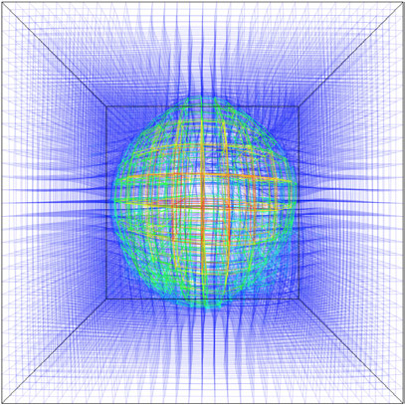
original
s_{f} = 5.0, 30 × 30 × 30
s_{f} = 10.0, 30 × 30 × 30

Slide 25
Evaluation and limitations
Evaluation
Comparison with fisheye view
Empirical expert evaluation
User study
Limitations
Block-based vs. streamline-based distortion measures
Scalar-based vs. shape-based distortion values
Parameter setting
Extremely dense streamlines

Slide 26
Summary and acknowledgements
Summary
Reduce occlusion and clutter via streamline repositioning
Achieve focus+context visualization
Flexible deformation for practical use
U.S. National Science Foundation
IIS-1017935, DUE-1105047, IIS-1319363, and IIS-1455886

