Slide 1
Coherent Time-Varying Graph Drawing with Multifocus+Context Interaction
Kun-Chuan Feng, National Cheng Kung University
Chaoli Wang, Michigan Technological University
Han-Wei Shen, The Ohio State University
Tong-Yee Lee, National Cheng Kung University

Slide 2
Motivation
Dynamic or time-varying graph drawing
Spatiotemporal coherence
Focus+context (F+C) visualization
Stable F+C viewing
Aesthetic quality
Dynamic stability
Computational efficiency

Slide 3
Related work
Layout algorithms for static graphs
Force-directed layout [Eades 1984]
Kamada-Kawai layout [1989]
Fruchterman-Reingold layout [1991]
Linlog [Noack 2004]
Stress majorization [Gansner et al. 2005]
Proximity stress [Gansner & Hu 2010]
High-dimensional embedding [Harel & Koren 2002]

Slide 4
Related work
Layout algorithms for dynamic graphs
Mental map preservation [Misue et al. 1995]
Empirical analysis of mental map [Purchase et al. 2006, 2008]
Bayesian approach [Brandes & Wagner 1997]
Super graph [Diehl et al. 2001]
Dynamic clustered graphs [Frishman & Tal 2004]
Orthogonal and hierarchical graphs [Görg et al. 2005]
Online dynamic acyclic graphs [North 1996]
GPU-based online dynamic graphs [Frishman & Tal 2007]

Slide 5
Related work
F+C techniques for graph drawing
Fisheye views [Furnas 1986]
Graphical fisheye [Sarkar & Brown 1992]
Topological fisheye [Gansner et al. 2004]
“Stretching the rubber sheet” [Sarkar et al. 1993]
Our contributions
Transform the graph layout problem to a constrained optimization problem for mesh deformation
Distort a triangulated, meshed version of the graph in the geometry space
Achieve multiple F+C visualization for dynamic graph drawing

Slide 6
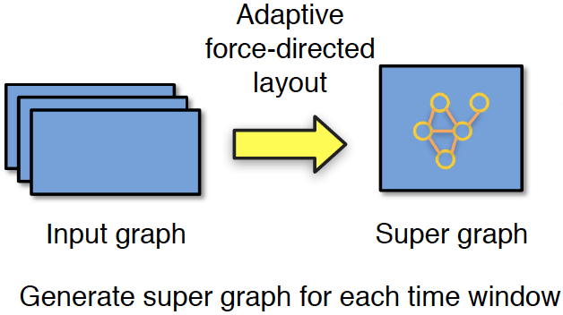
Our approach – initial layout generation using super graph

Slide 7
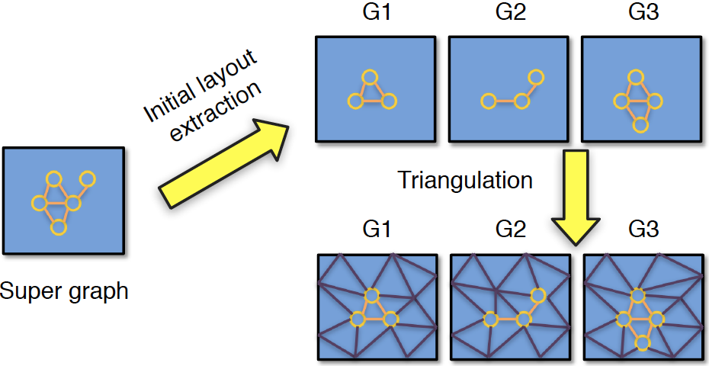
Our approach – initial layout extraction and triangulation

Slide 8
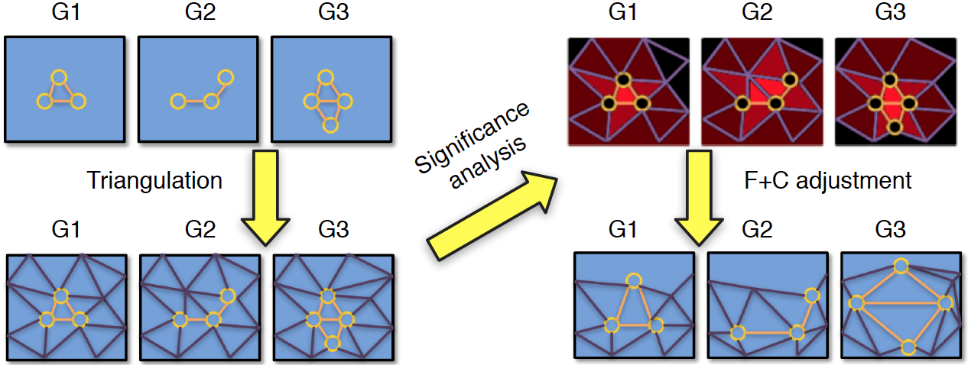
Our approach – significance analysis and F+C adjustment

Slide 9
Significance analysis (node / face / edge)
Node importance
Centrality
Authority
Blend with its values at previous time steps
v_{i,t}
e_{ij,t}
v_{j,t}

Slide 10
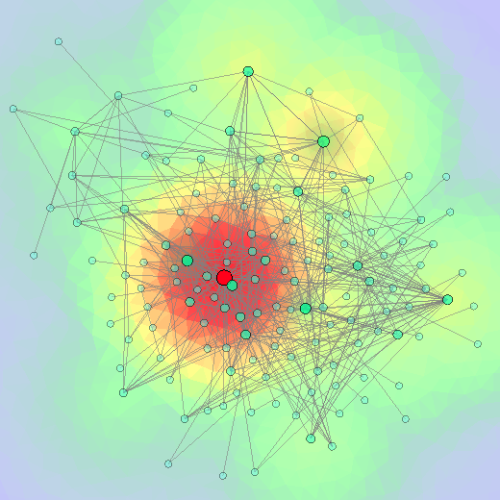
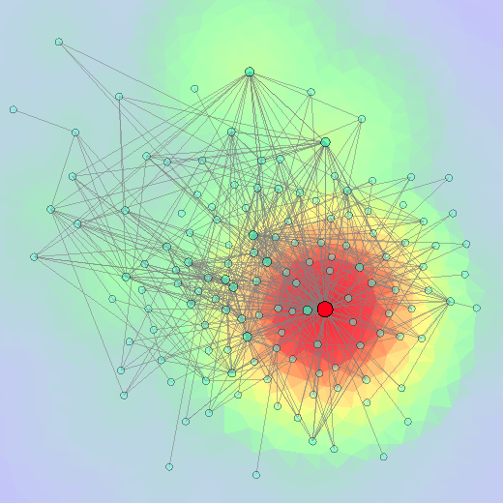
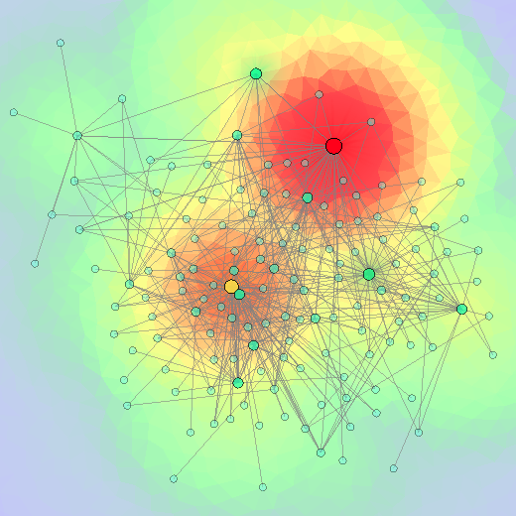
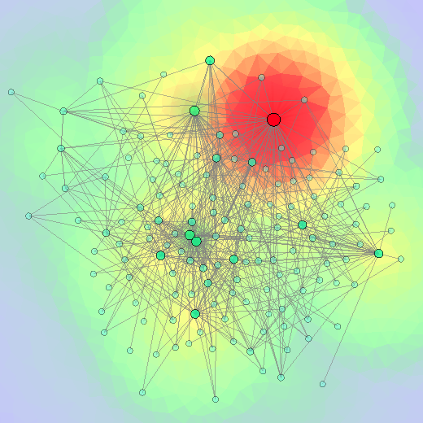
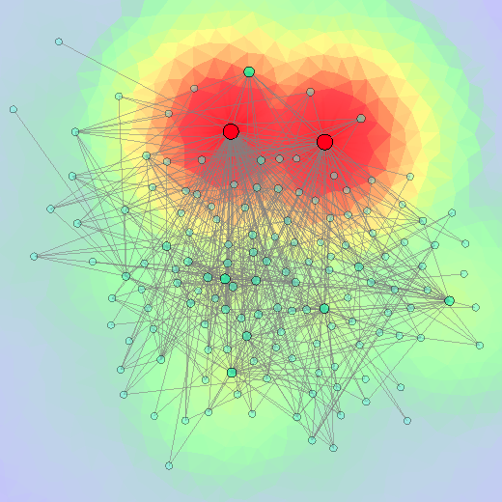
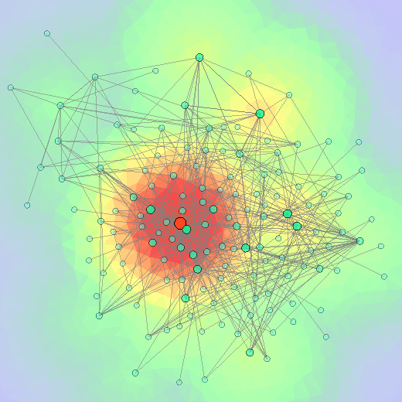
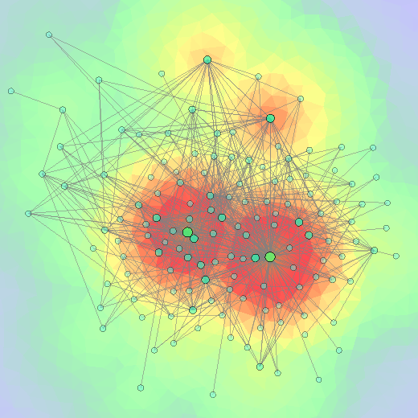
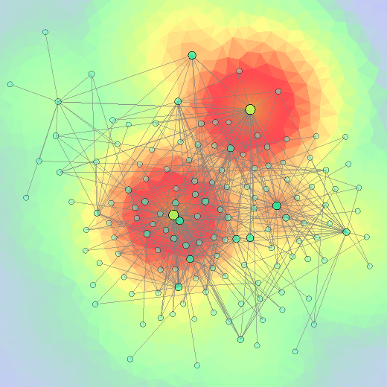
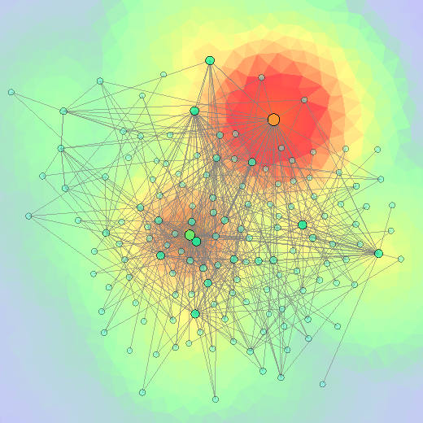
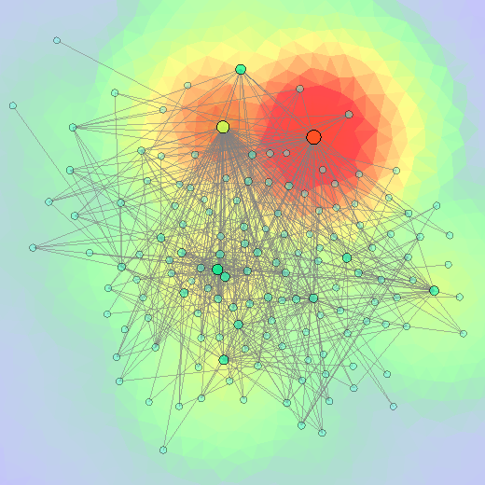
Comparison
Without blending node importance
Blending node importance

Slide 11
Significance analysis (node / face / edge)
Face importance: only consider the face importance for a contributing node if
the node’s importance is nonzero and
the distance from the node to the center of mass of the face is less than

Slide 12
Significance analysis (node / face / edge)
Edge importance: the average of the importance of its incident faces

Slide 13
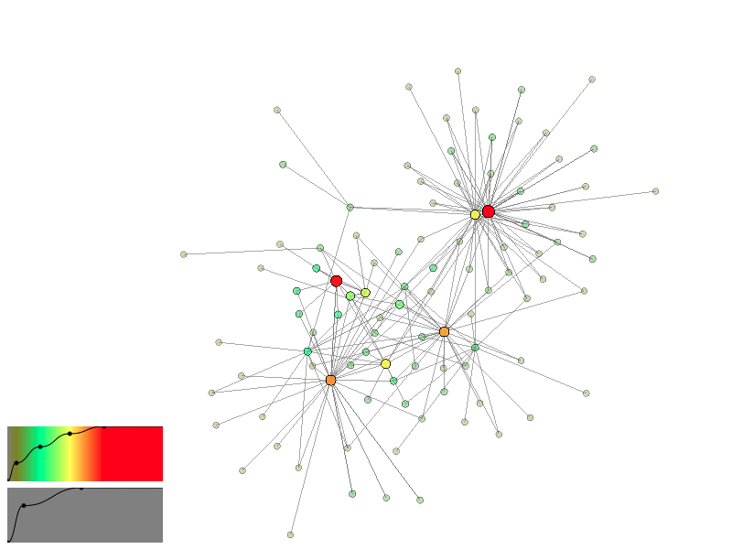
Initial graph layout

Slide 14
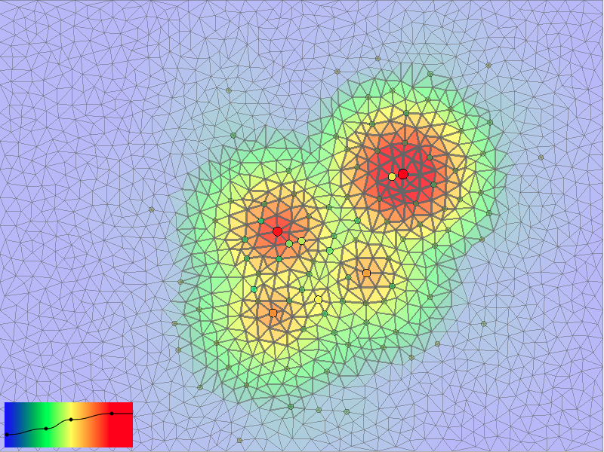
Constrained conforming Delaunary triangulation (CCDT) mesh [Shewchuk 1996]

Slide 15
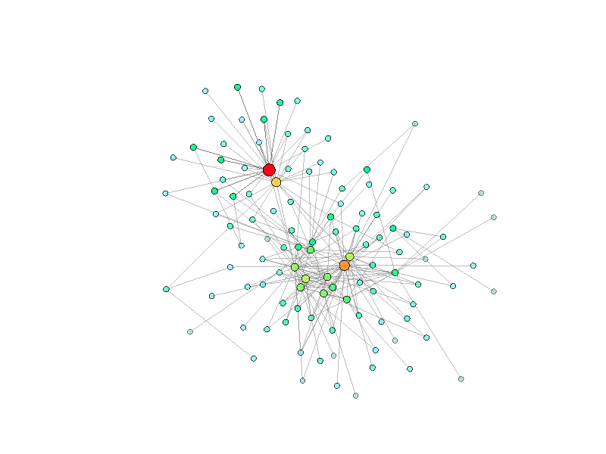
Benefits of using triangle mesh
Initial graph

Slide 16
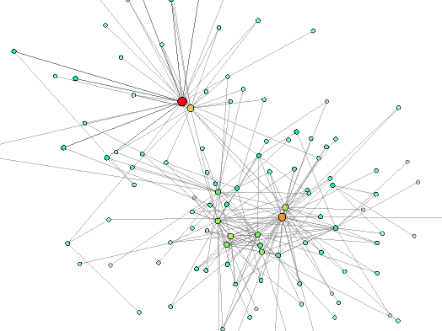
Benefits of using triangle mesh
F+C adjustment
using original edges

Slide 17
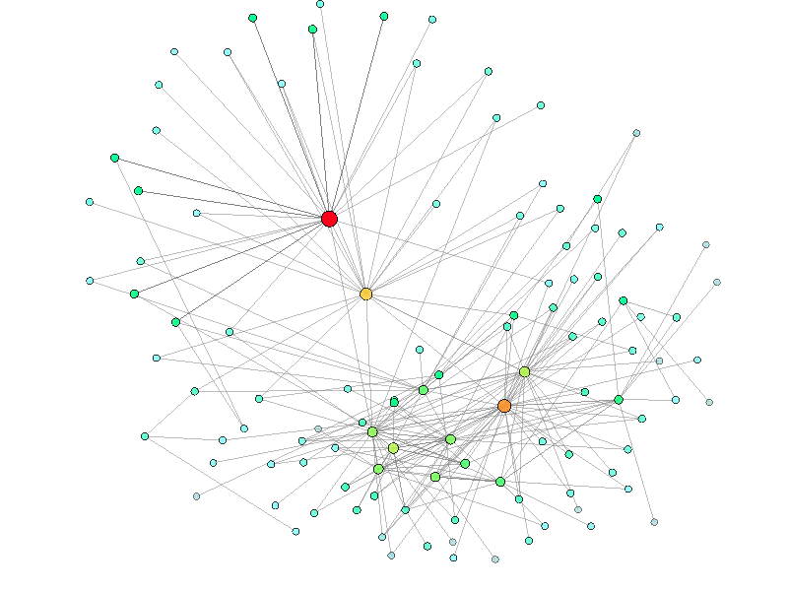
Benefits of using triangle mesh
F+C adjustment using
triangle mesh edges

Slide 18
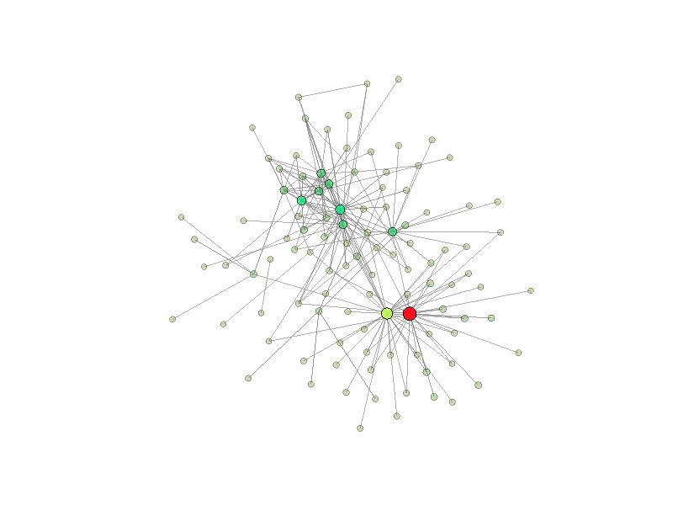
Benefits of using triangle mesh
Initial graph

Slide 19
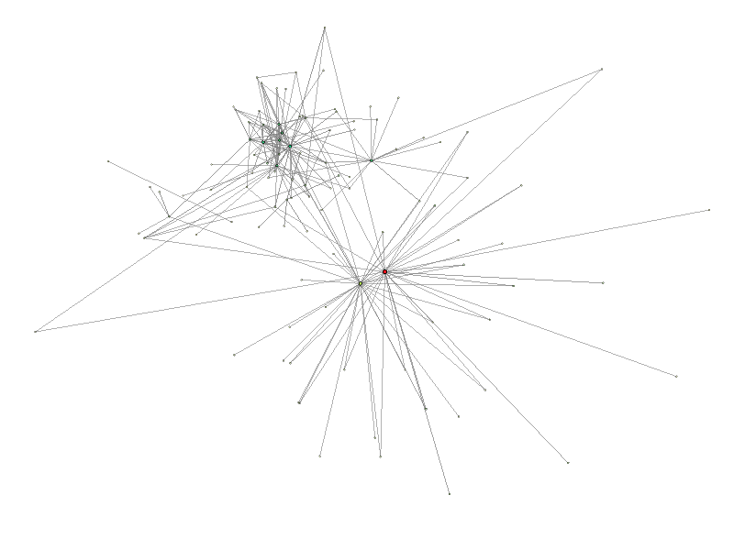
Benefits of using triangle mesh
F+C adjustment
using original edges

Slide 20
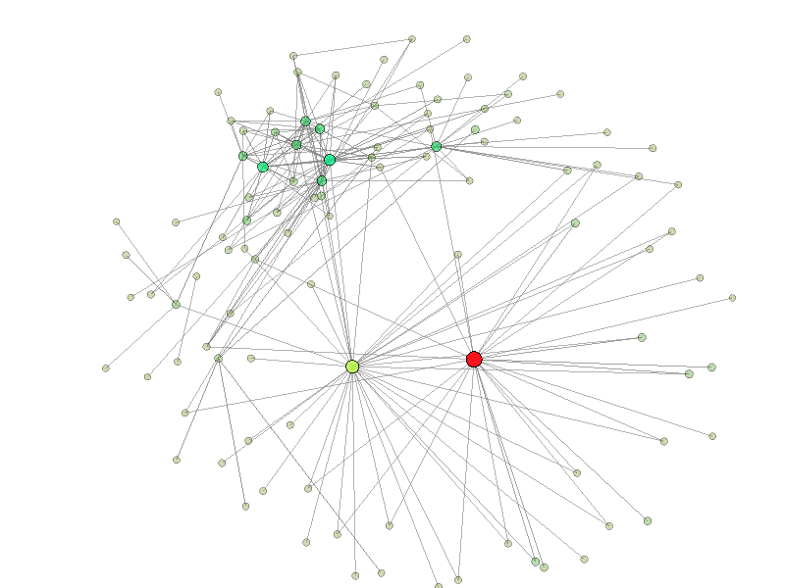
Benefits of using triangle mesh
F+C adjustment using
triangle mesh edges

Slide 21
Optimized F+C visualization
Aesthetic balance adjustment (the size of each face should match its importance)
Deformed version
Optimal length
Unit vector

Slide 22
Optimized F+C visualization
Weighted edge expansion (focus+context, important edges should expand more)
Deformed version
Unit vector
Scaling factor
Optimal length
Expected scaling factor
User-specified scaling factor

Slide 23
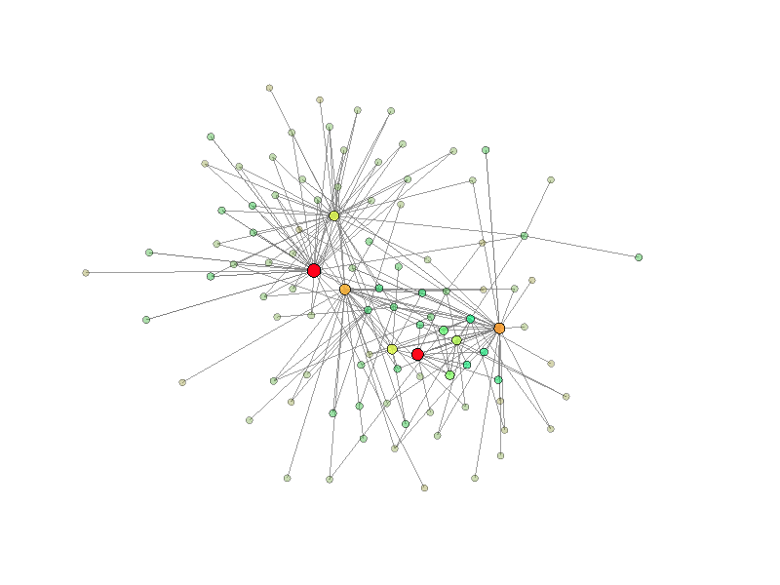
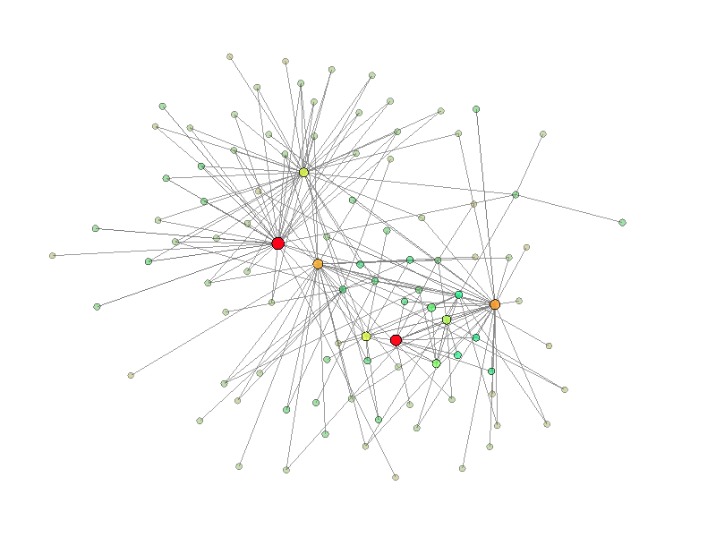
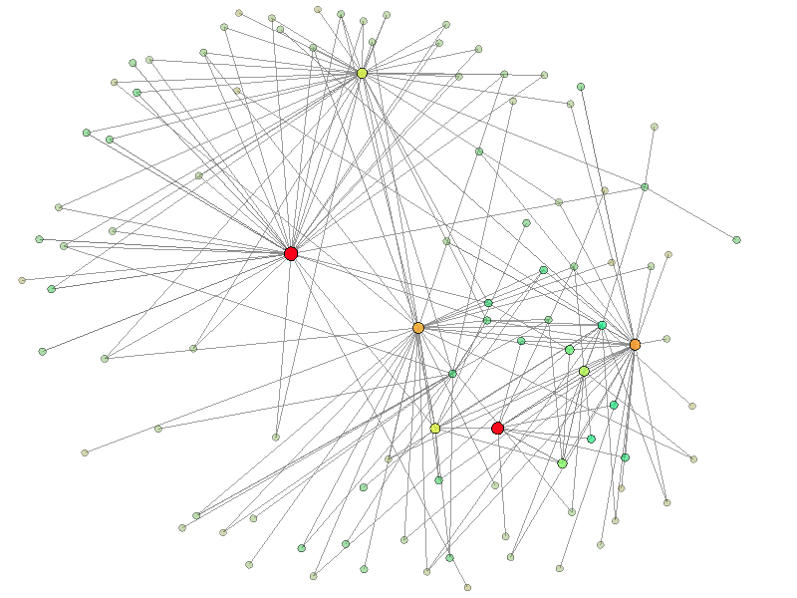
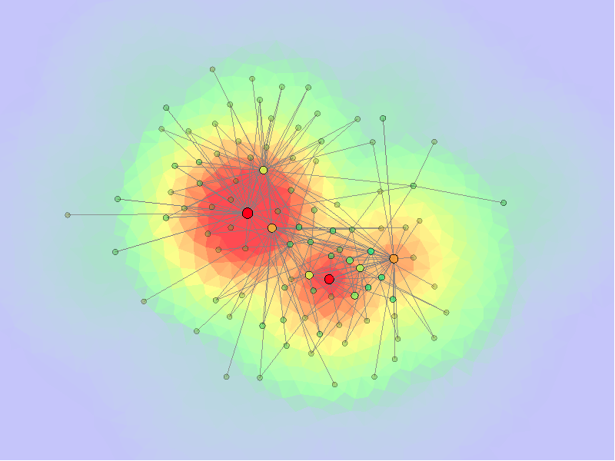
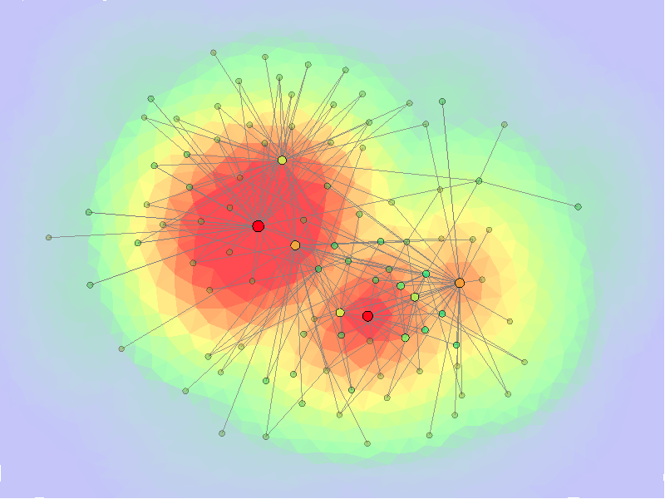
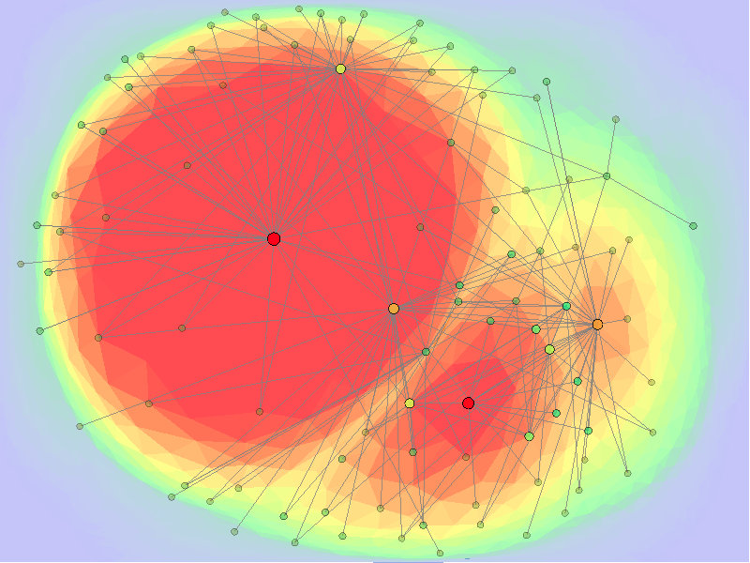
Comparison
Original
+ aesthetic balance adjustment
+ weighted edge expansion

Slide 24
Optimized F+C visualization
Temporal coherence preservation (important nodes should not move much accumulatively over time)
New node position
Node position

Slide 26
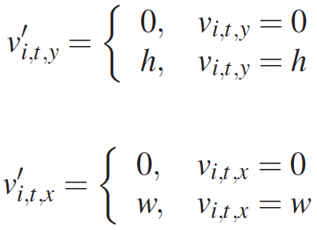
Optimized F+C visualization
Boundary constraints
Overlapping constraints

Slide 27
Optimized F+C visualization
Objective energy function
Solve in the least-squares sense using a linear system solver
Aesthetic balance adjustment
Weighted edge expansion
Temporal coherence preservation

Slide 28
Data sets
Enron email
38 months, 151 employees
DBLP coauthorship
One influential author and her coauthors as well as her coauthors’ coauthors
31 years, 873 authors
Astronomy tag
Daily and weekly at the year of 1998

Slide 29
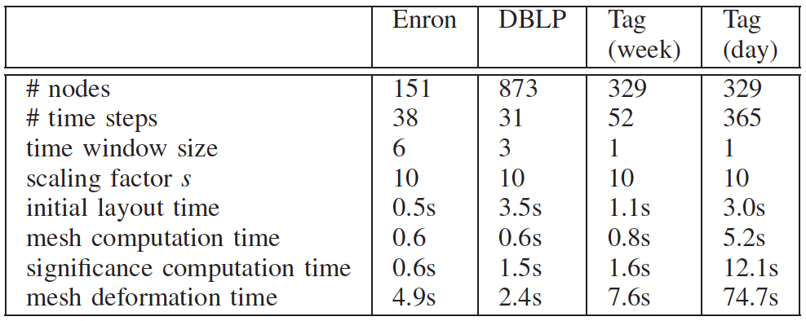
Timing performance
Intel 2.67GHz CPU, 8GB memory, nVidia GTX 295 graphics card

Slide 30
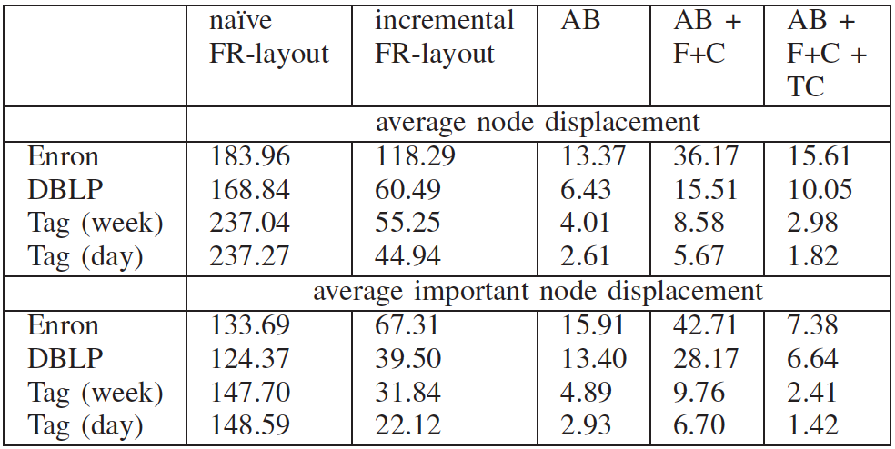
Average node displacement

Slide 32
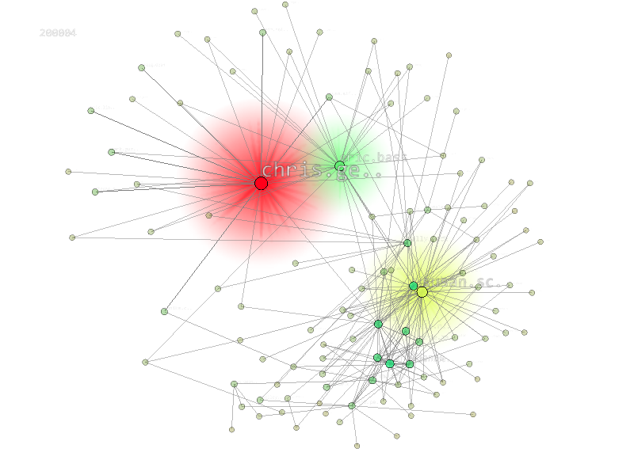
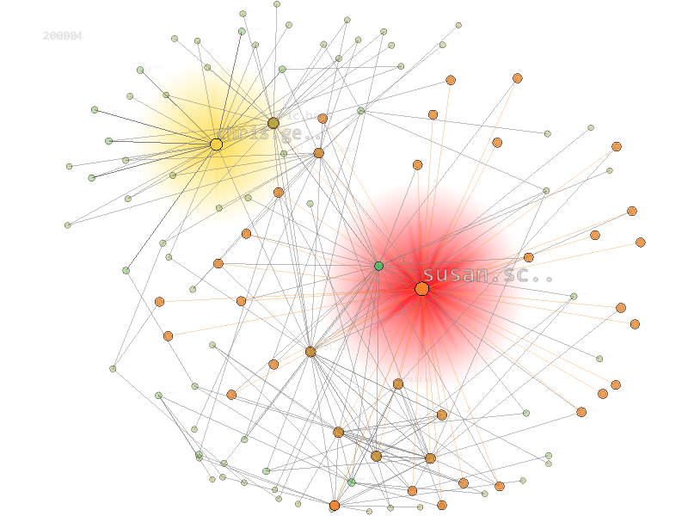
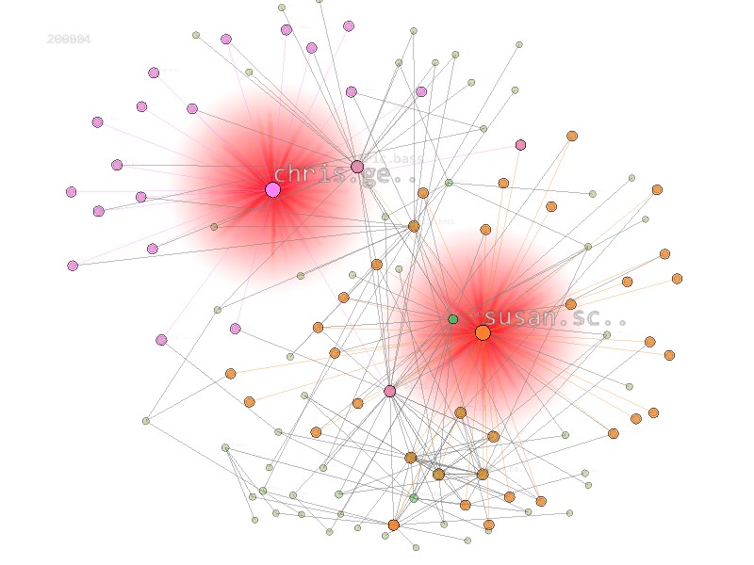
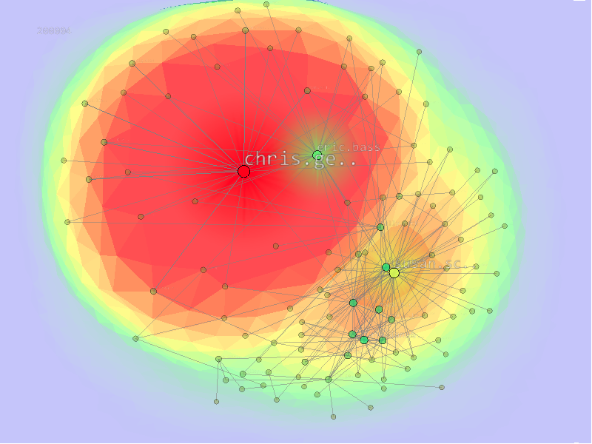
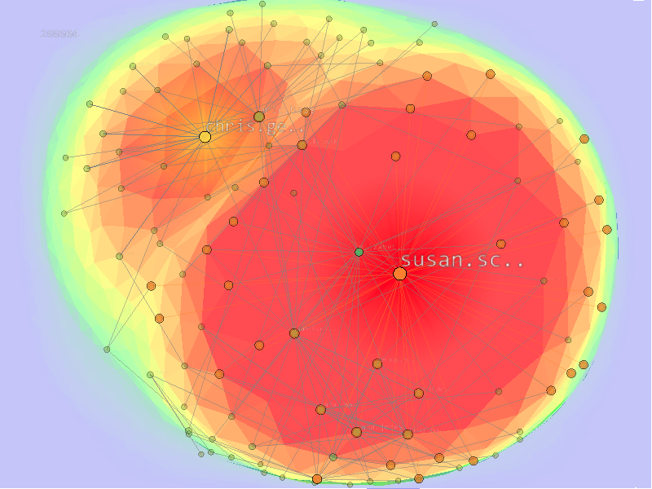
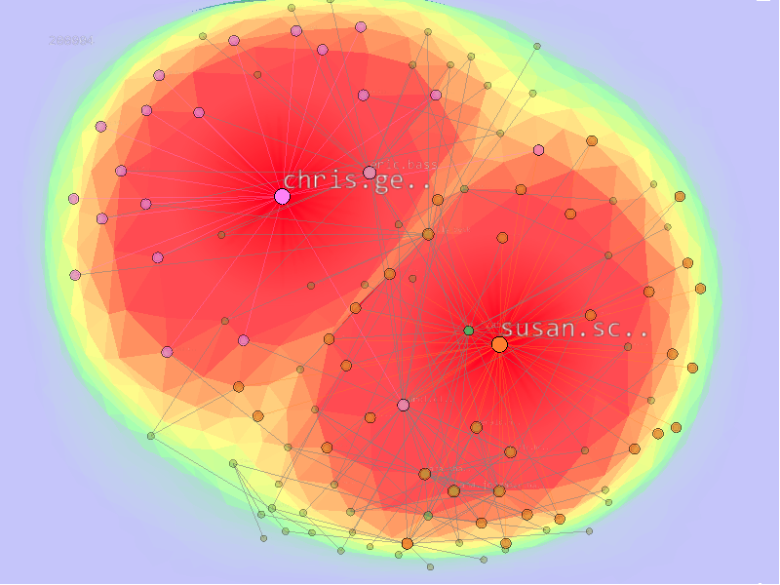
Multifocus+context
Initial
Single focus
Two foci

Slide 33
Summary
Coherent F+C visualization for time-varying graphs
Maintain spatiotemporal coherence using super graph
Keep high aesthetic quality using energy terms
Incur low computation cost
Achieve stable F+C viewing
Allow multifocus+context interaction
Deliver smooth transition between local time windows

Slide 34
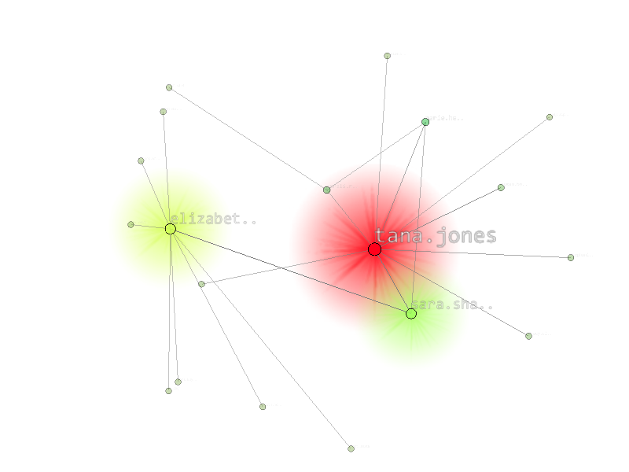
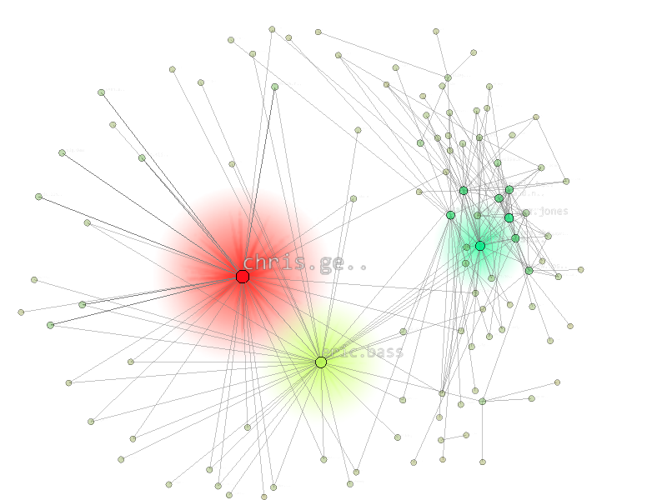
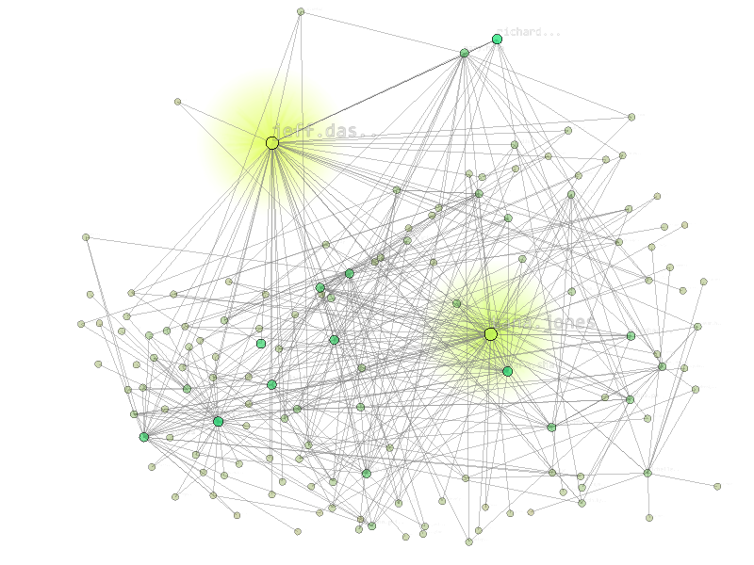
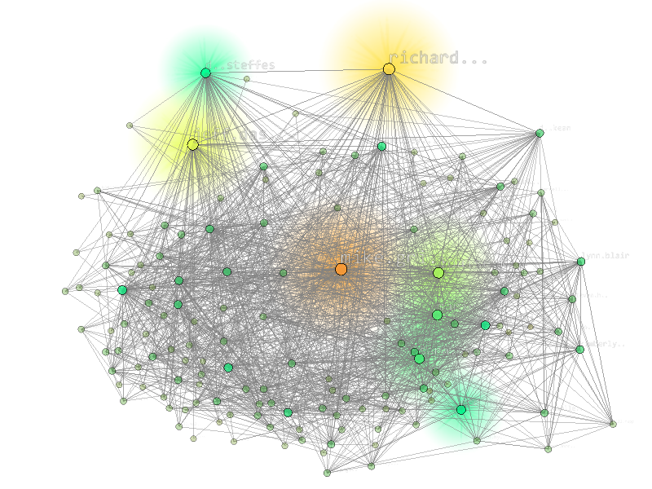
Thank you
National Science Council, Taiwan
NSC-99-2221-E-006-066-MY3
NSC-100-2628-E-006-031-MY3
NSC-100-2221-E-006-188-MY3
U.S. National Science Foundation
IIS-1017935
chaoliw@mtu.edu

