Slide 1
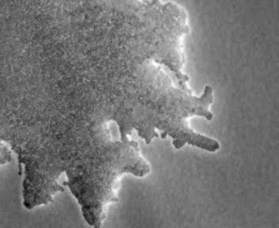
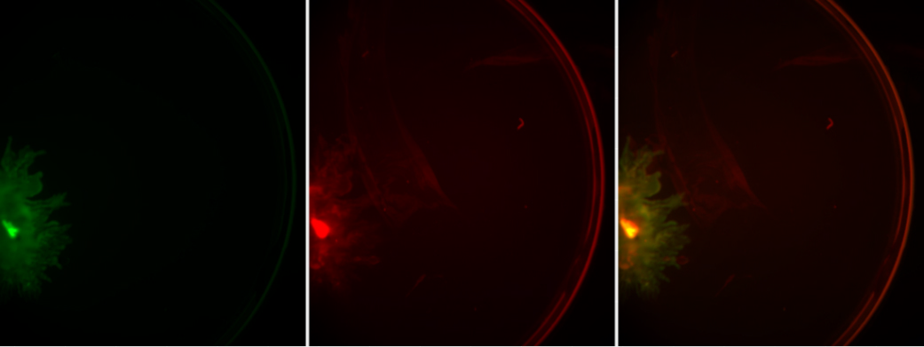
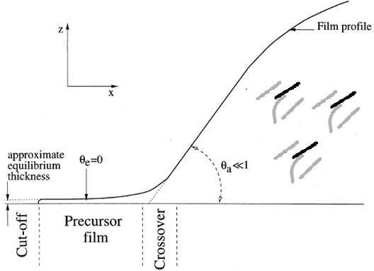
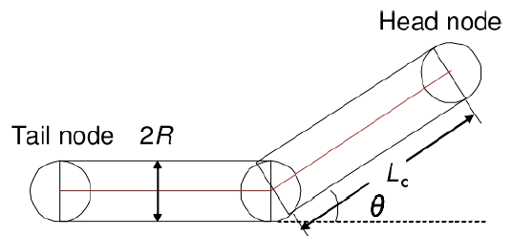
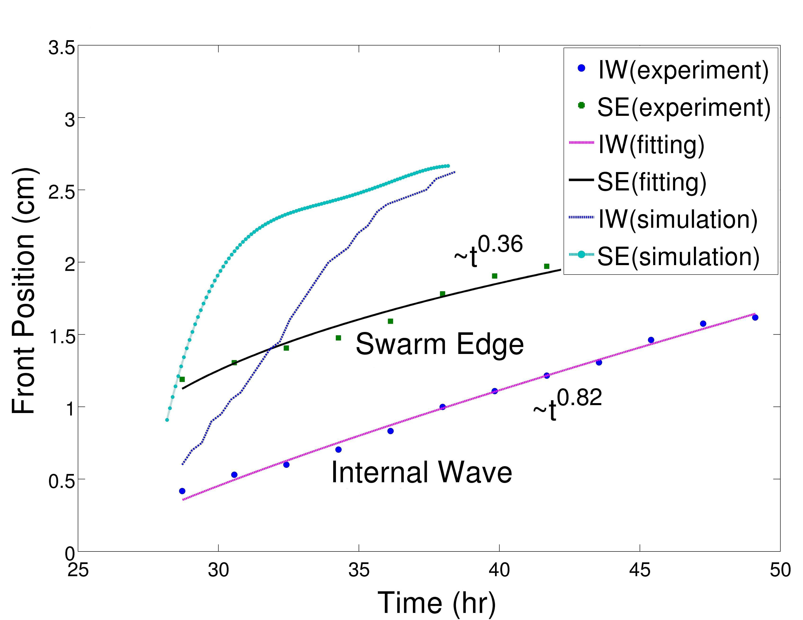
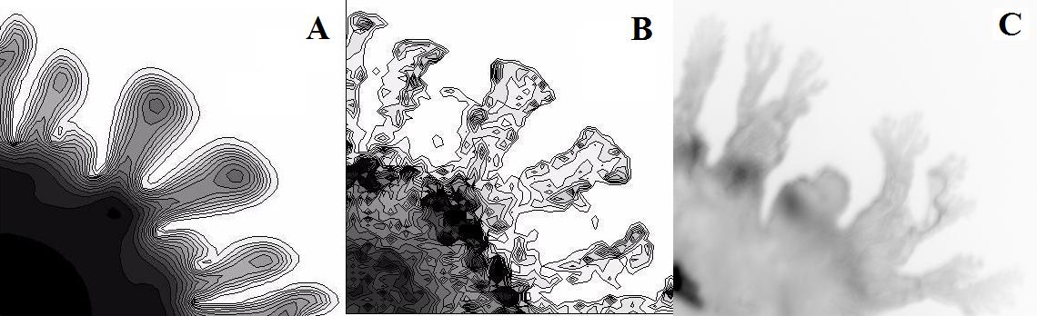
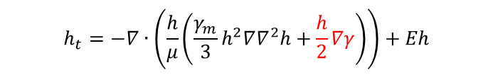
Zhiliang Xu, ACMS Department
Multi-scaling of Pseudomonas aeruginosa swarming
$$h_{t}=−∇∙\left(\frac{h}{μ}\left(\frac{γ_{m}}{3}h^{2}∇∇^{2}h+\frac{h}{2}∇γ\right)\right)+Eh$$
Individual cell will be represented by 3 nodes connected by 2 elastic segments.
Y. Wu, Y. Jiang, D. Kaiser, M. Alber, PLoS Comput Biol 3:e253 (2007).
Results of simulations shows development of primary and secondary tendrils similar to the ones obtained in experiment on soft agar. H. Du, Z.-L. Xu, M. Anyan, O. Kim, W.M. Leevy, J.D. Shrout and M. Alber, “High Density Waves of the Bacterium Pseudomonas aeruginosa in Propagating Swarms Result in Efficient Colonization of Surfaces”, Biophysical J., (103)1-9, 2012.

Slide 2
Multi-scaling of blood clot formation
Zhiliang Xu, ACMS Department
Simulation of the clot and blood flow. (a) Clot with indicated different cell types; (b) Vorticity distribution around the thrombus at 24 sec.
Xu, et al, 2009. Study of Blood Flow Impact on Growth of Thrombi Using a Multiscale Model, Soft Matter 5:769-779 (2009).
Xu, et al, 2008. A multiscale model of thrombus development. Journal of The Royal Society Interface 5:705-722 (2008).
Z.-L. Xu, J. Lioi, J. Mu, M.M. Kamocka, X. Liu, D.Z. Chen, E.D. Rosen, and M.S. Alber, “A Multiscale Model of Venous Thrombus Formation with Surface-Mediated Control of Blood Coagulation Cascade”, Biophysical Journal, 98(9):1723-1732, 2010.

Slide 3
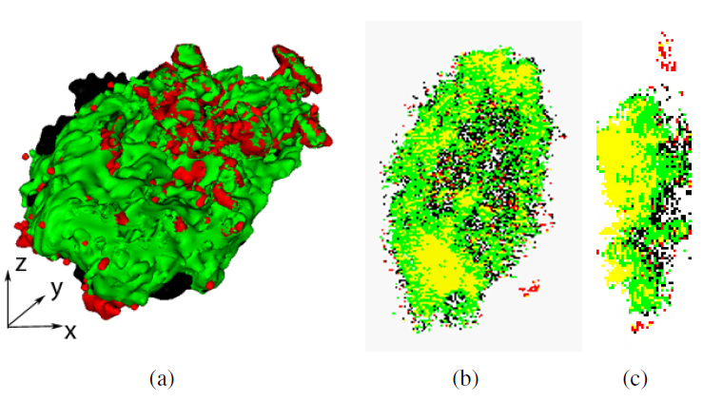
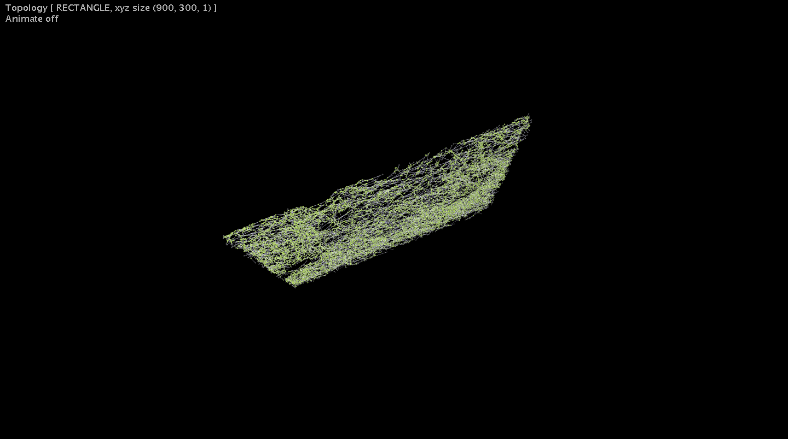
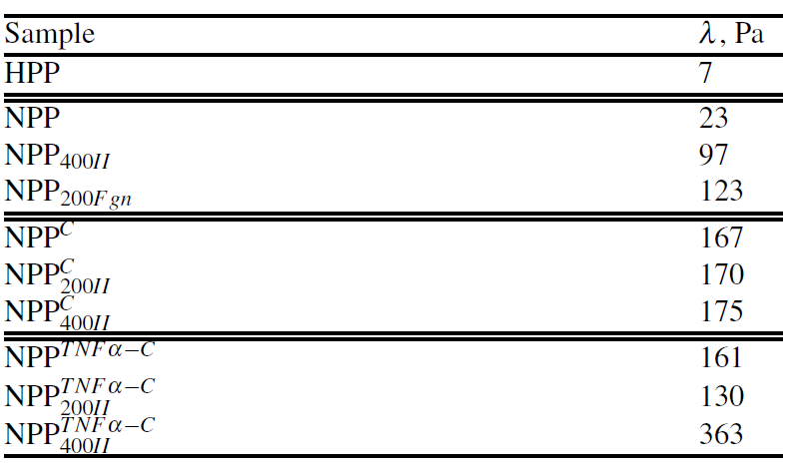
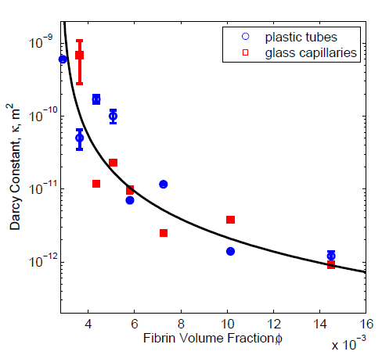
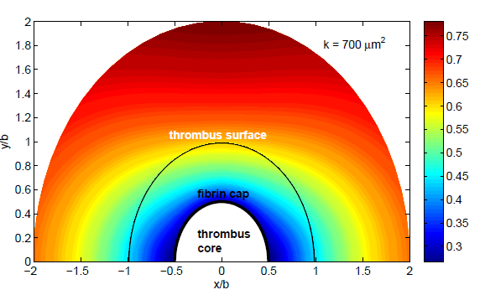
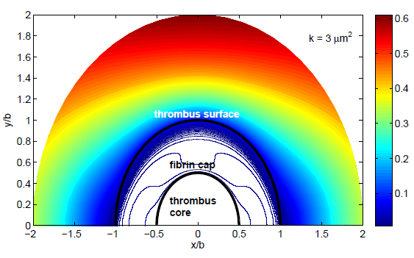
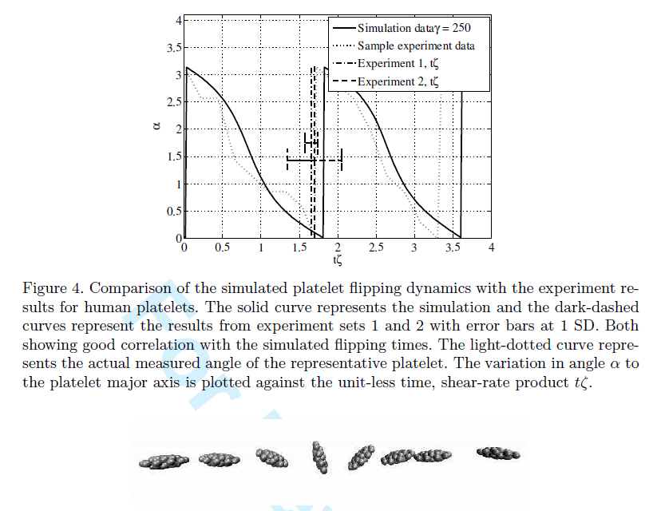
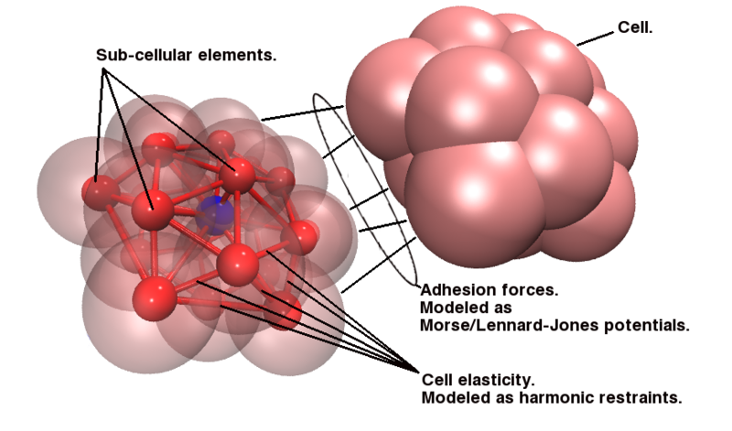
Zhiliang Xu, ACMS Department

