Slide 1
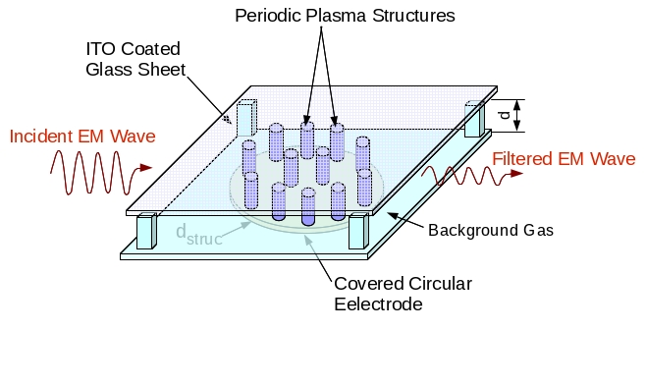
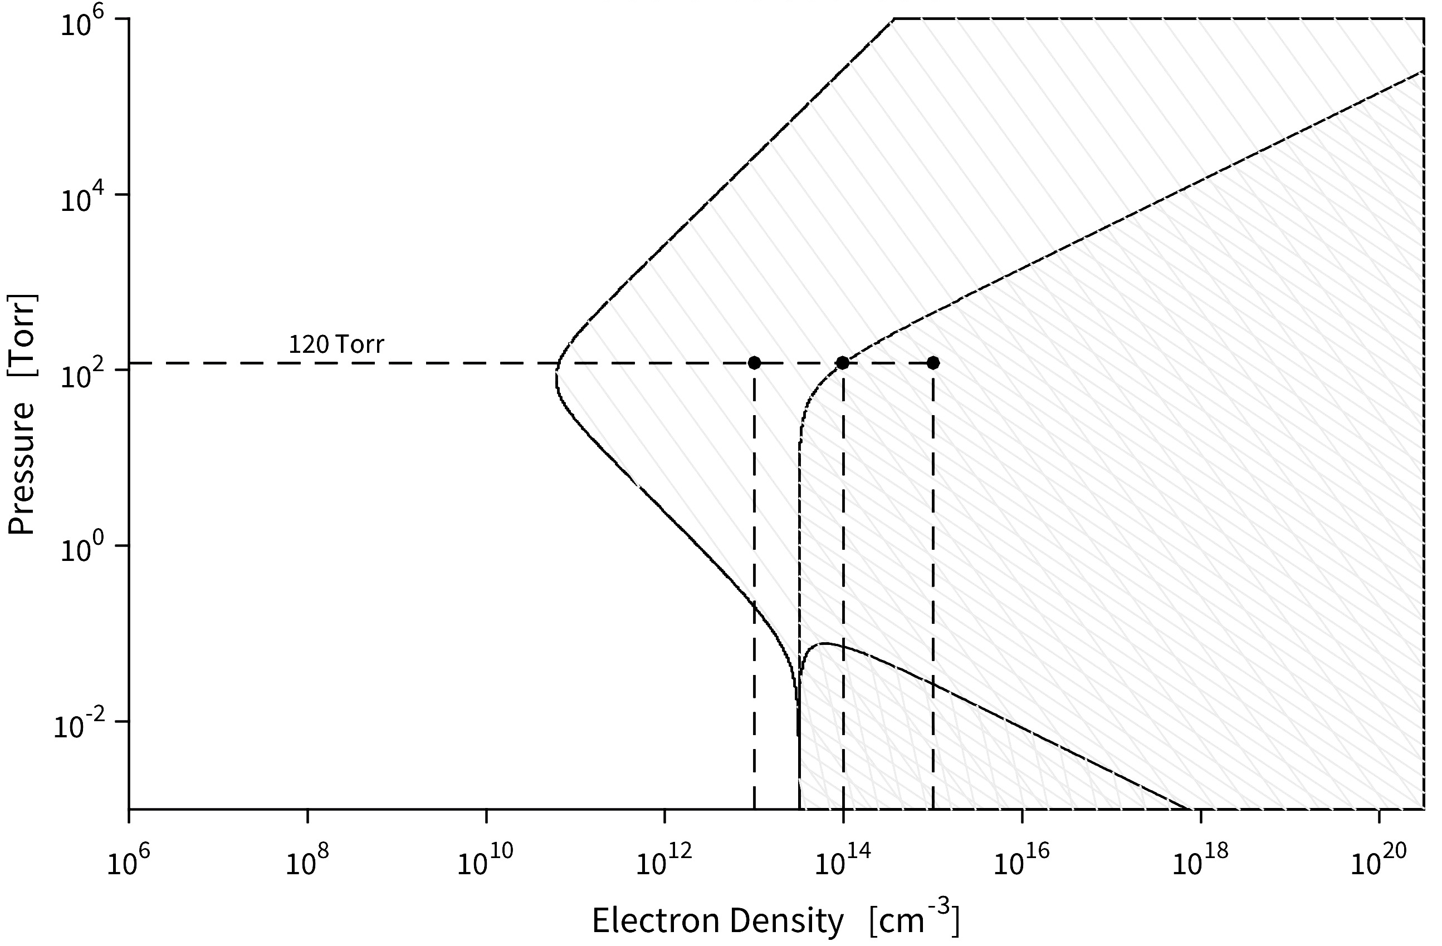
Research Objectives
Experimentally generate spatially periodic plasma structure gratings
  Exploit charge instability between electrodes separated by a dielectric layer
Demonstrate dynamic control of spacing of plasma structures
  Depends on gas pressure (P_{s}), gap distance (d), and AC voltage (V_{AC})
Incorporate experimentally derived plasma gratings into EM wave simulation to determine transmission characteristics
  Probing frequency: 20 - 80GHz
  Electron density: 10¹⁹ – 10²¹ m⁻³
  P_{s}=115 - 142 Torr
Transmission
Absorption
125 Torr
Re{ε_{p}}< 0

Slide 2
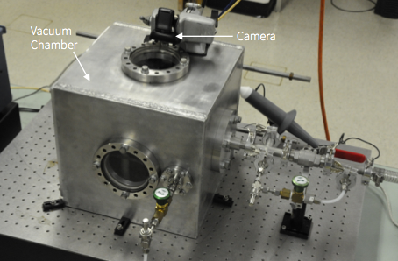
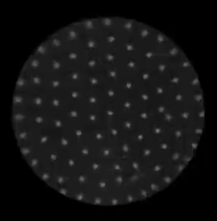
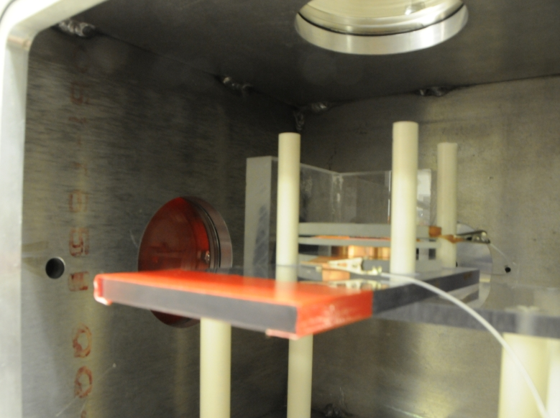
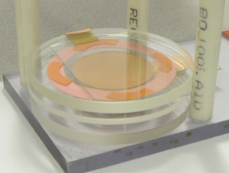
Experimental Setup

Slide 3
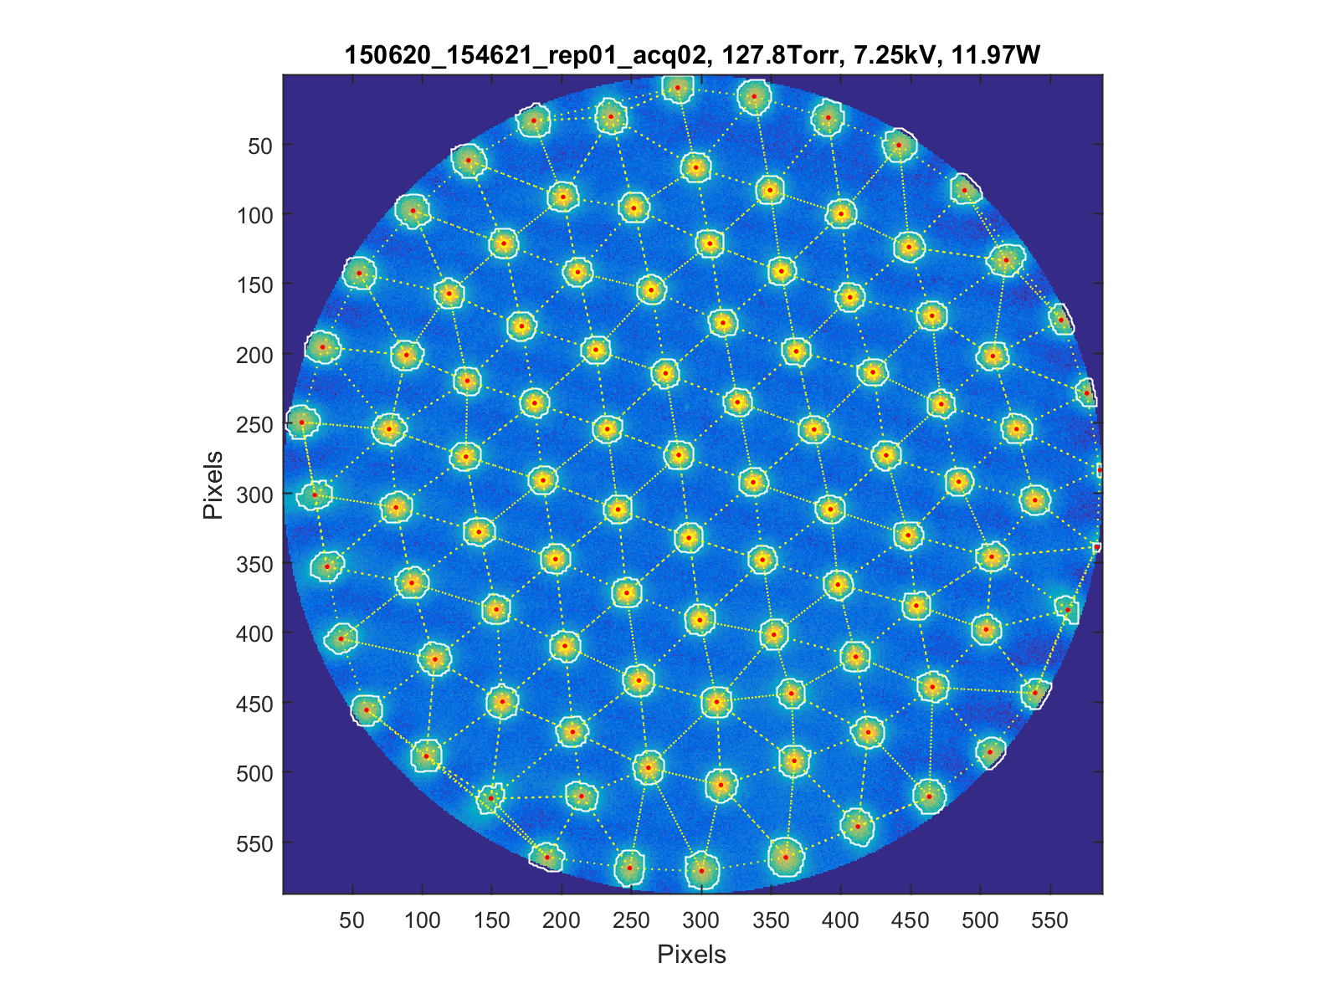
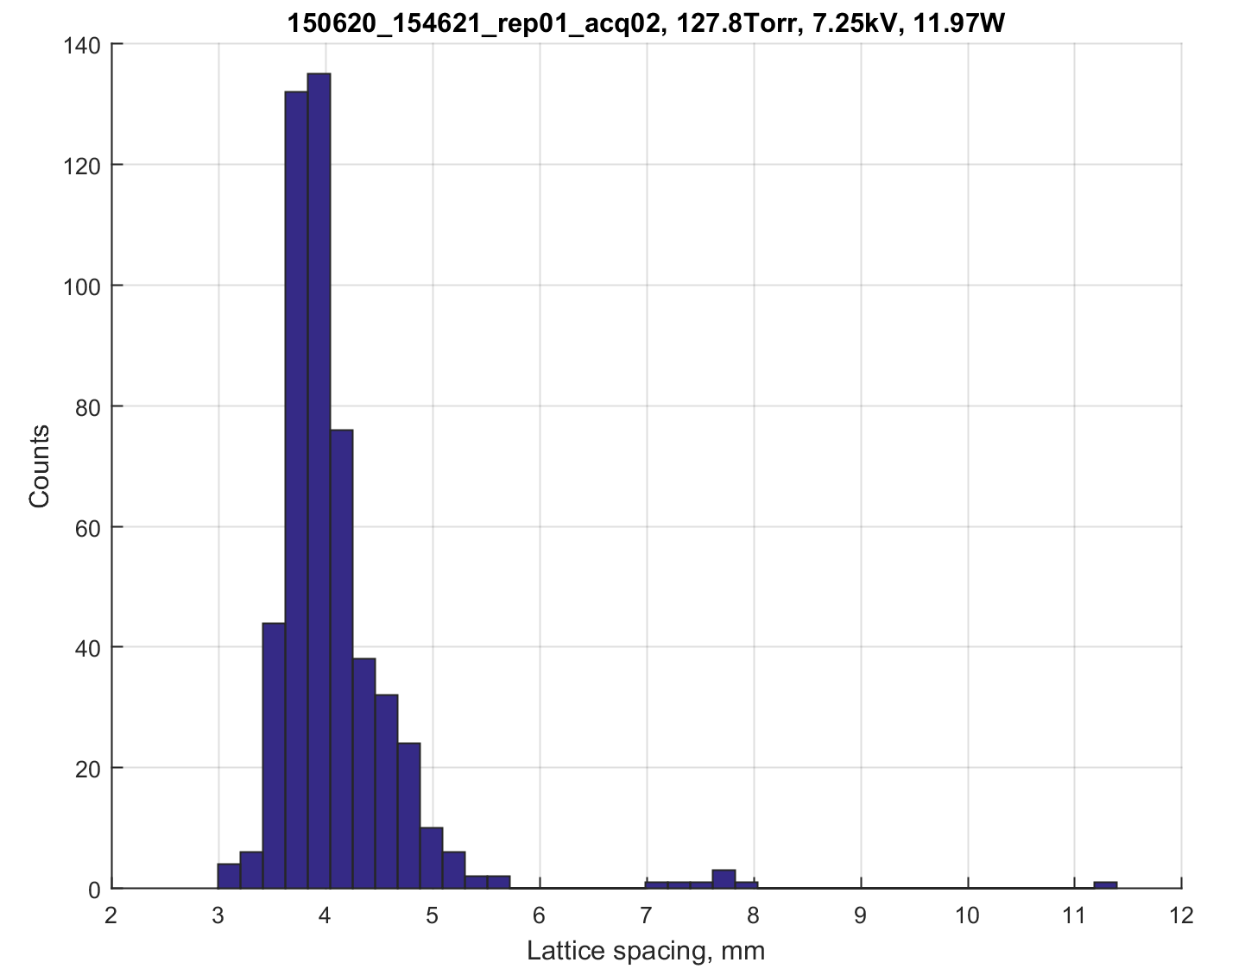
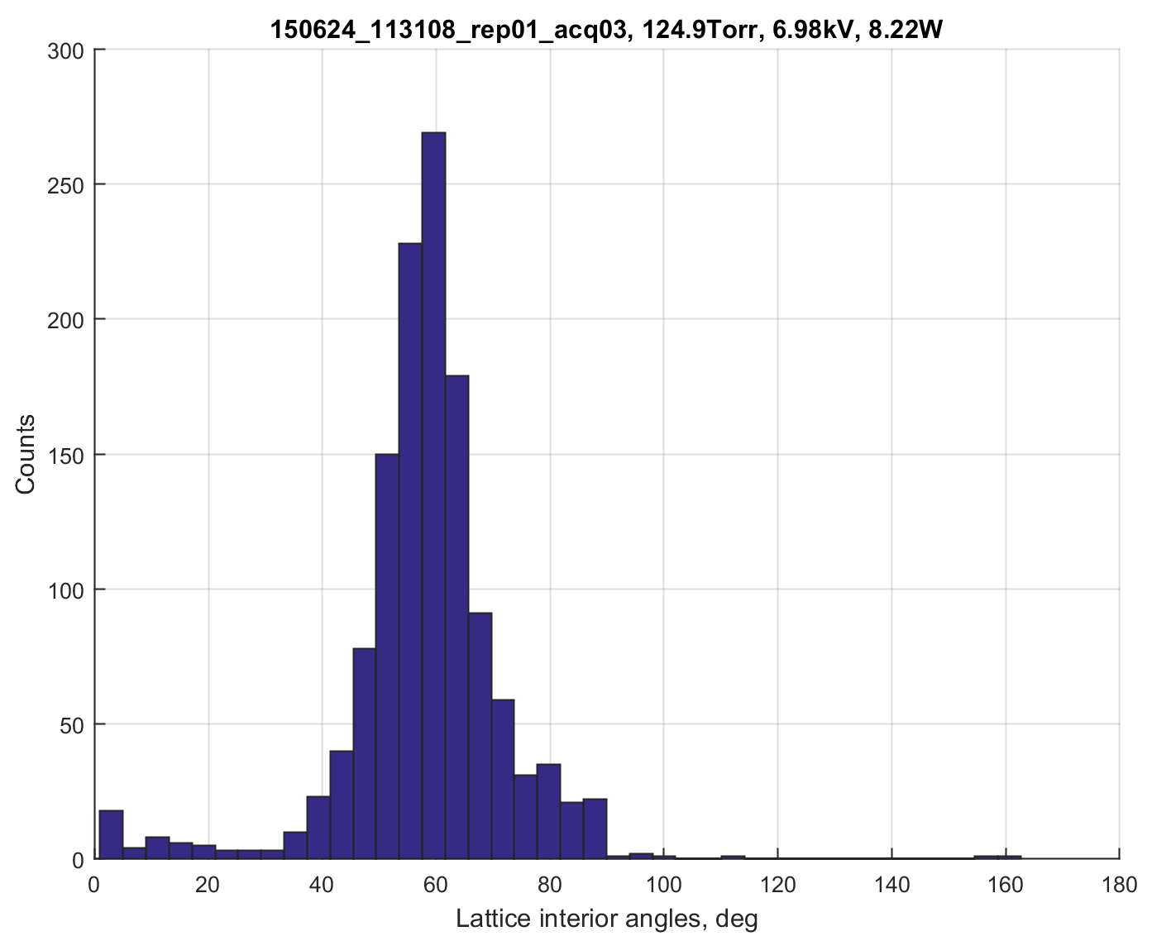
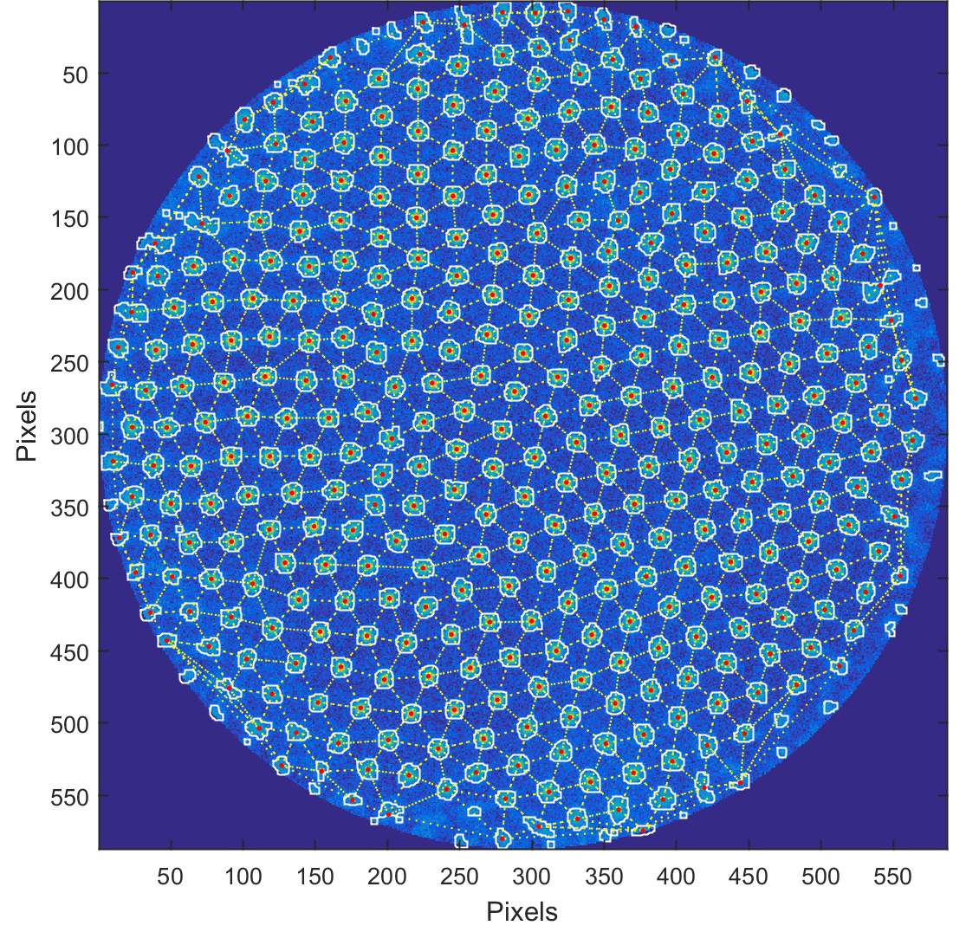
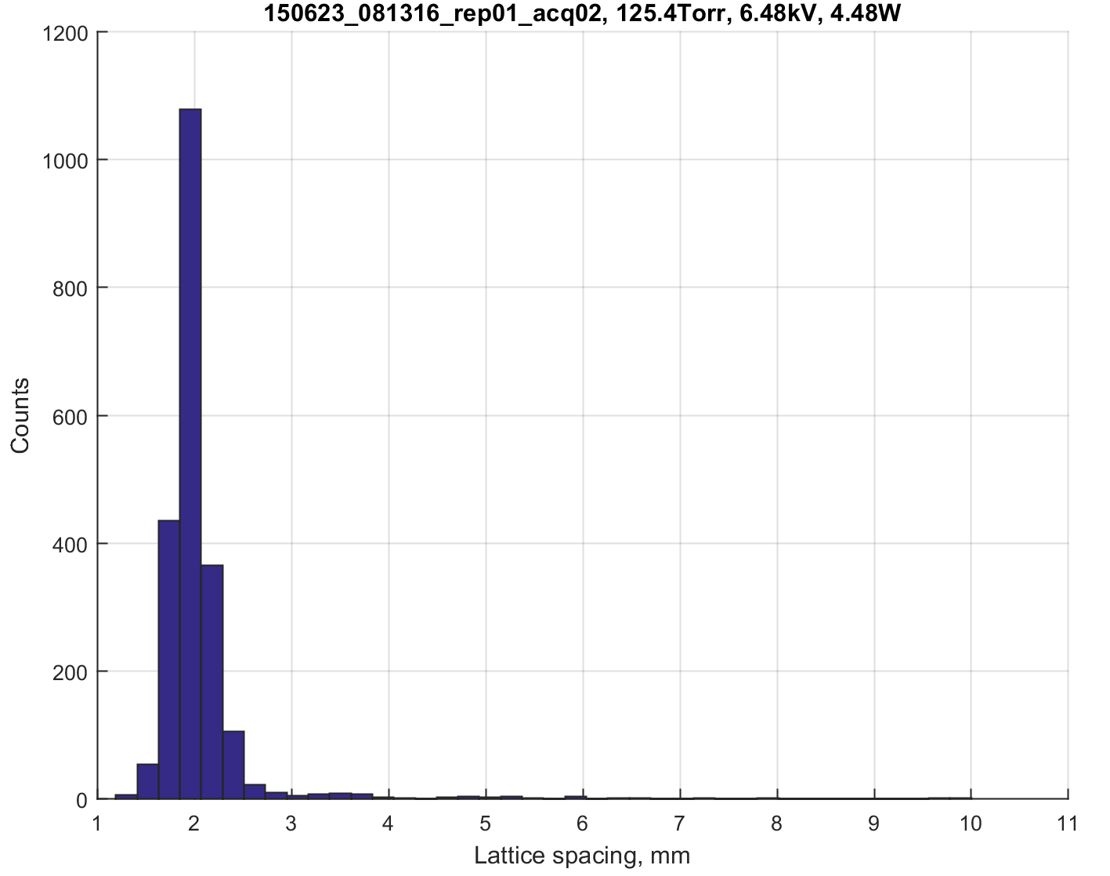

Lattice Analysis: Node Locations, Radii and Spacing
4 mm.
Lattice Spacing
Lattice Interior Angles
2 mm.

Slide 4
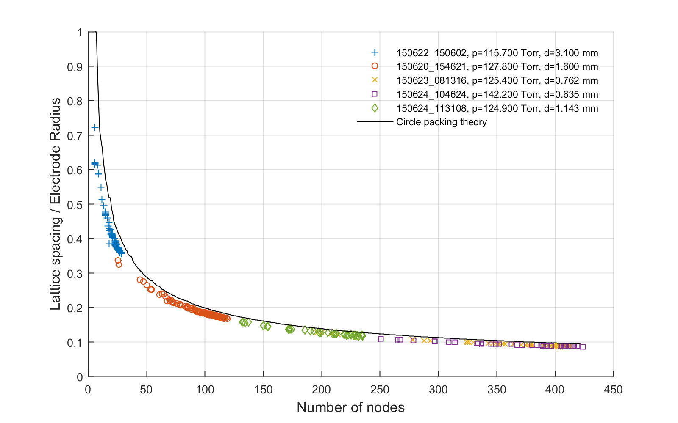
Predictive Plasma Structure Control
Follows Circle Packing Theory

Slide 5
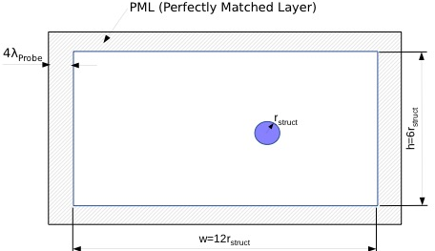
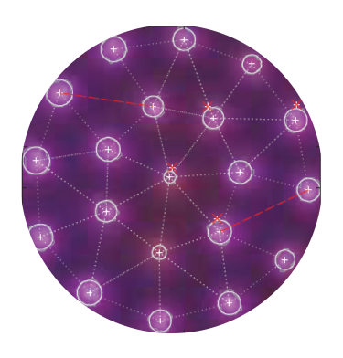
EM Wave Simulation
Utilized MIT open-source (Meep) software that solves Maxwell’s equations at each time step to realize the electromagnetic field at discrete spatial locations.
Dispersive materials are defined in Meep using a Lorentz-Drude model, which we adapted to allow for plasma permittivity.
PML (Perfectly Matched Layer)
r_{struct}
4λ_{Probe}
Computational Domain
h=6r_{struct}
w=12r_{struct}

Slide 6
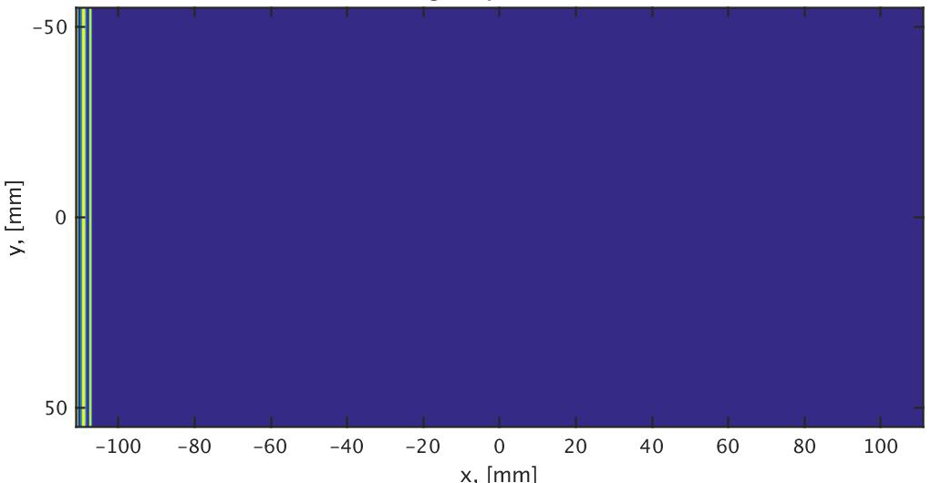

Meep Simulations: p_{air}=125 Torr, n_{e}=1.3e²⁰m^{-3,} f_{probing}=70GHz
λ_{plasma}= 8mm.
λ_{plasma}= 2mm.

Slide 7
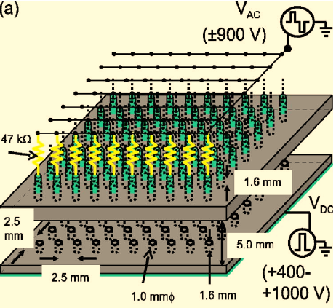
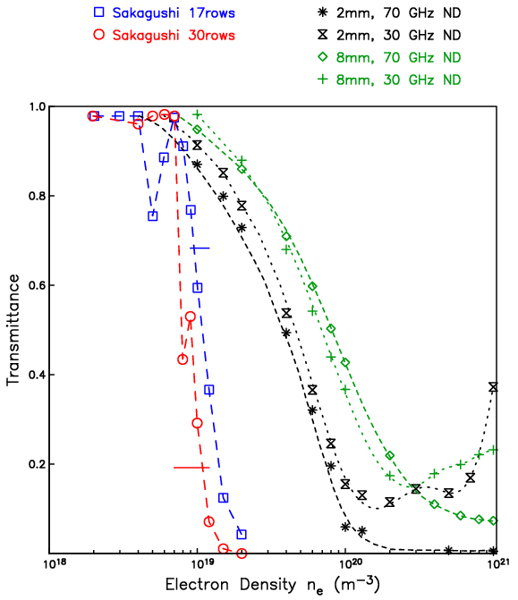
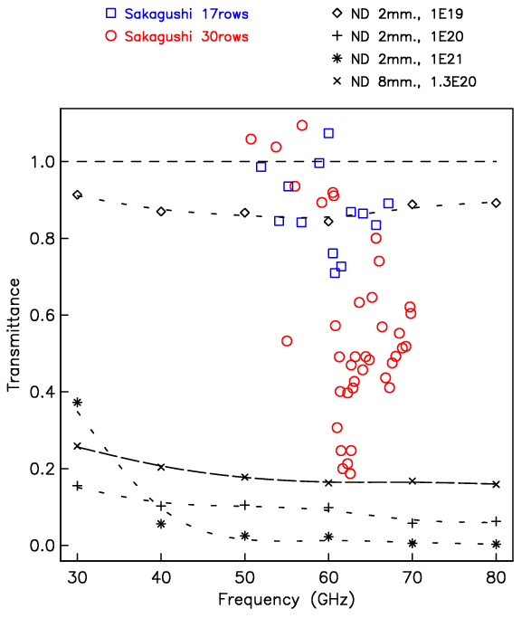
Effect of Electron Density and Probing Frequency
Effect of Electron Density
Effect of Probing Frequency

