Slide 1


Institute for Flow Physics and Control
Thomas Corke
Director, Institute for Flow Physics and Control
University of Notre Dame
College of Engineering
Notre Dame, IN
tcorke@nd.edu
University of Notre Dame

Slide 2
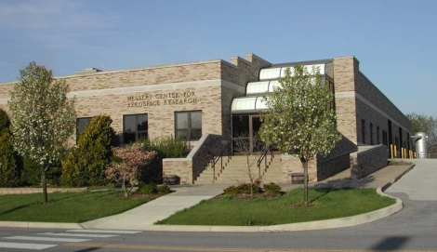
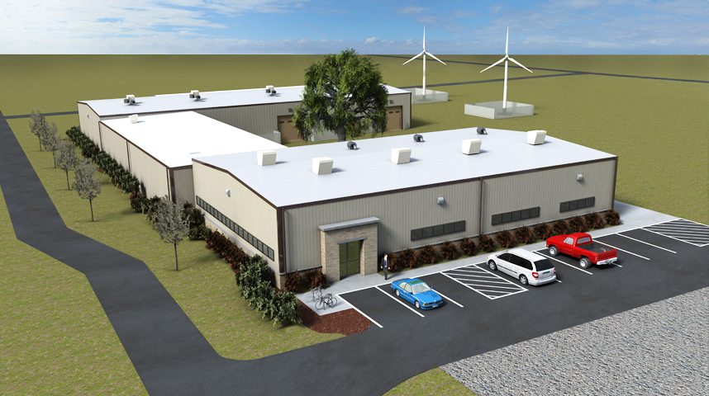
Institute for Flow Physics and Control
SIGNATURE RESEARCH AREAS
Aero-acoustics
Aero-optics
Fluid-structure Interactions
Gas-turbine Propulsion
Wind Energy
Multi-phase Flows
Plasma Dynamics
Sensors and Flow Control Actuators
Hypersonic Aerodynamics
Hessert Laboratory
PARTICIPANTS
20 T&R Faculty
8 R Faculty
12 Technical Staff
75 Ph.D. Students (85% U.S. citizens)
11 U.S. Govt. Agencies
25 Companies
White Field Laboratory

Slide 3
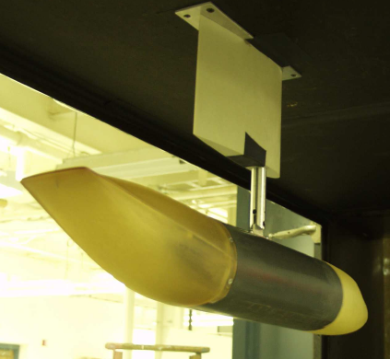
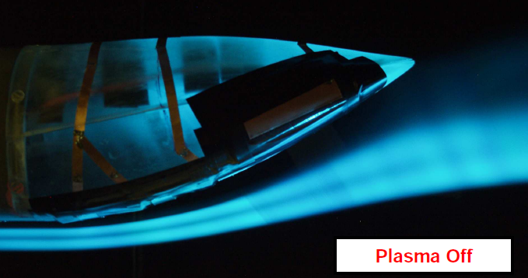
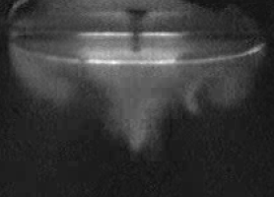
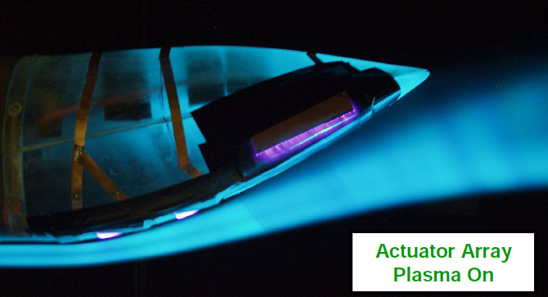
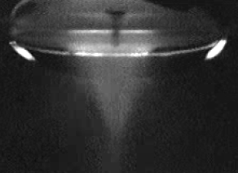
Low-Speed Wind Tunnels
Initial investigations utilizing flow visualization and other flow diagnostic tools (hot-wire, LDV, PIV, etc)

Slide 4
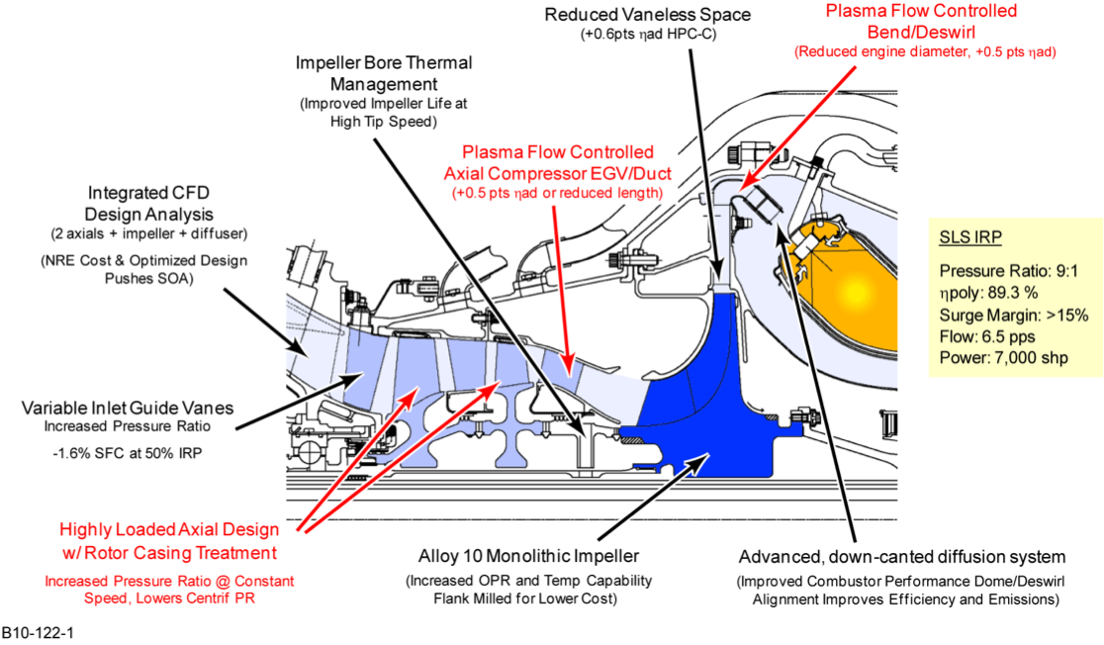
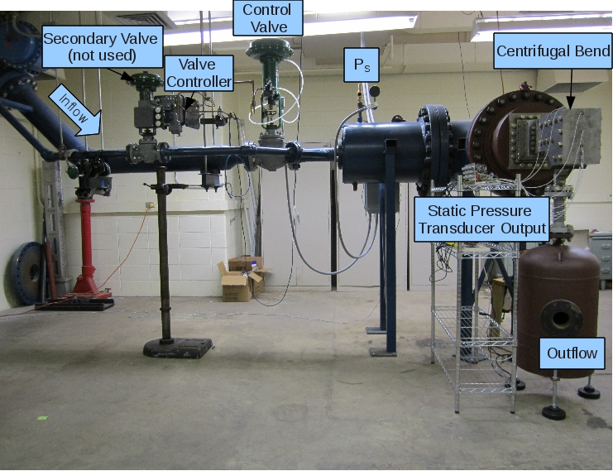
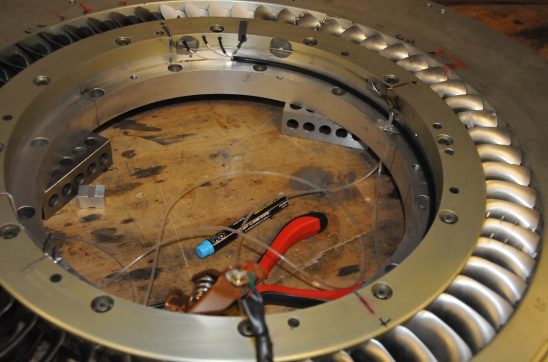
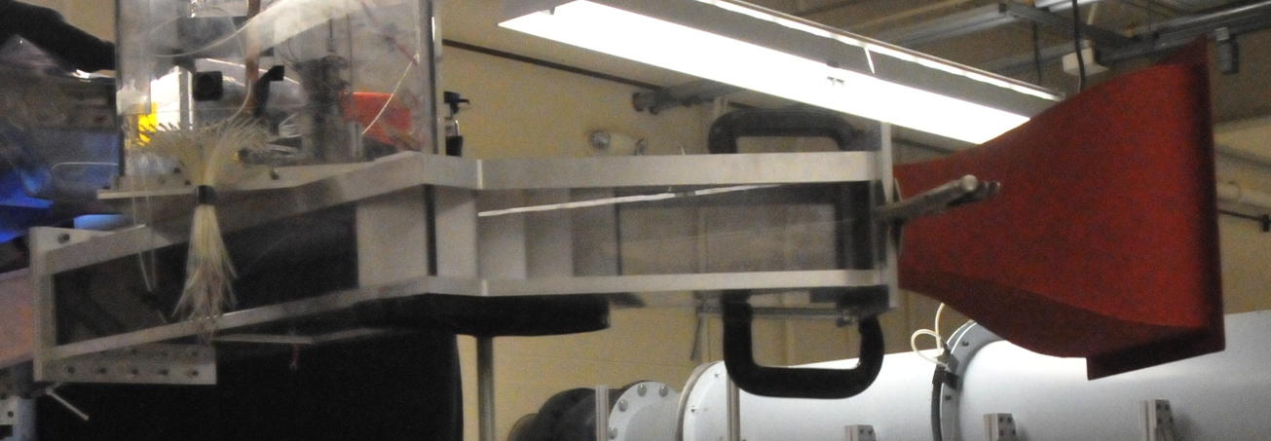
Component Facilities
Army/Honeywell/UND VAATE Program
40Bar Blow-down Facility
In-draft Tri-Sonic Facility

Slide 5
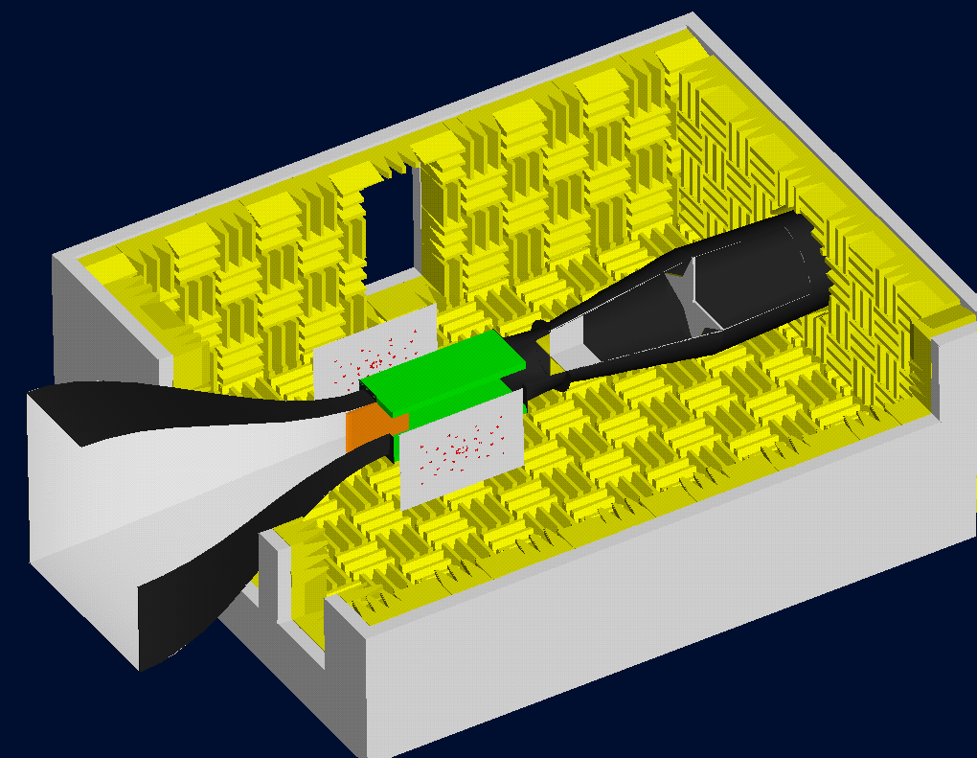
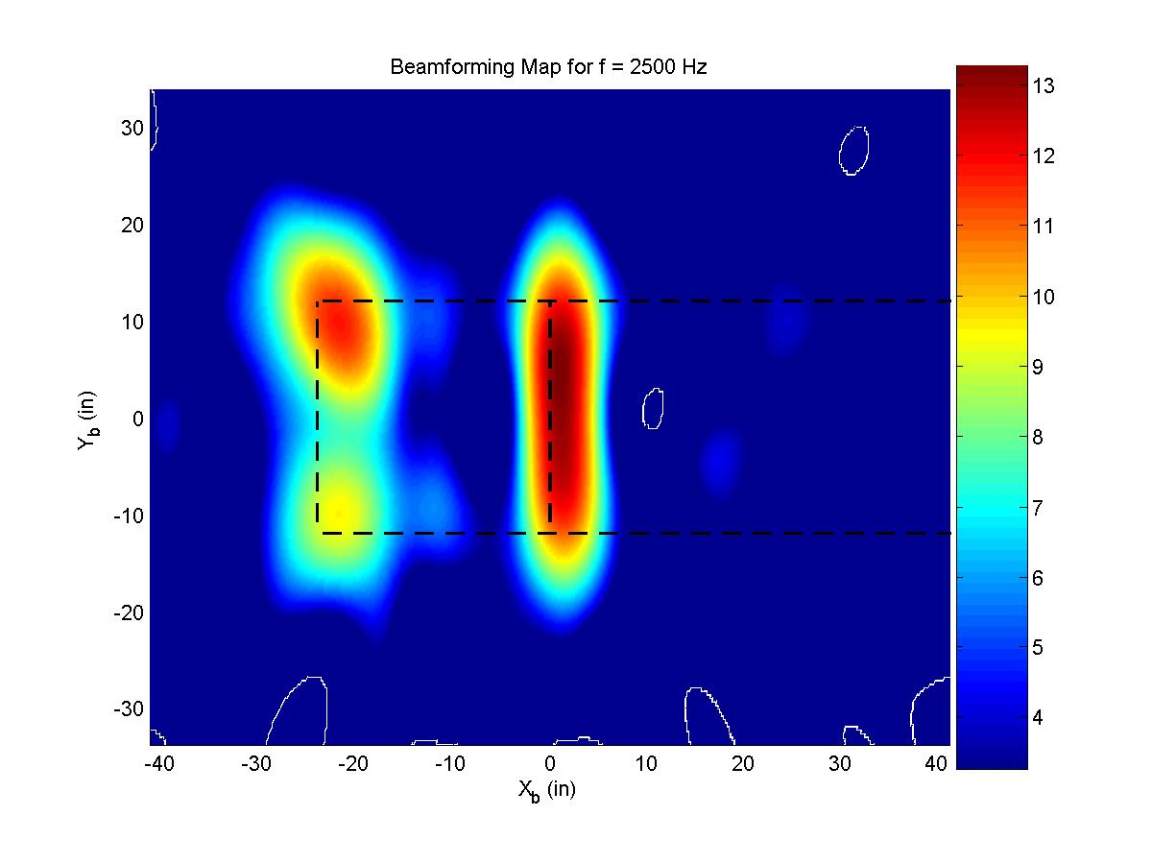
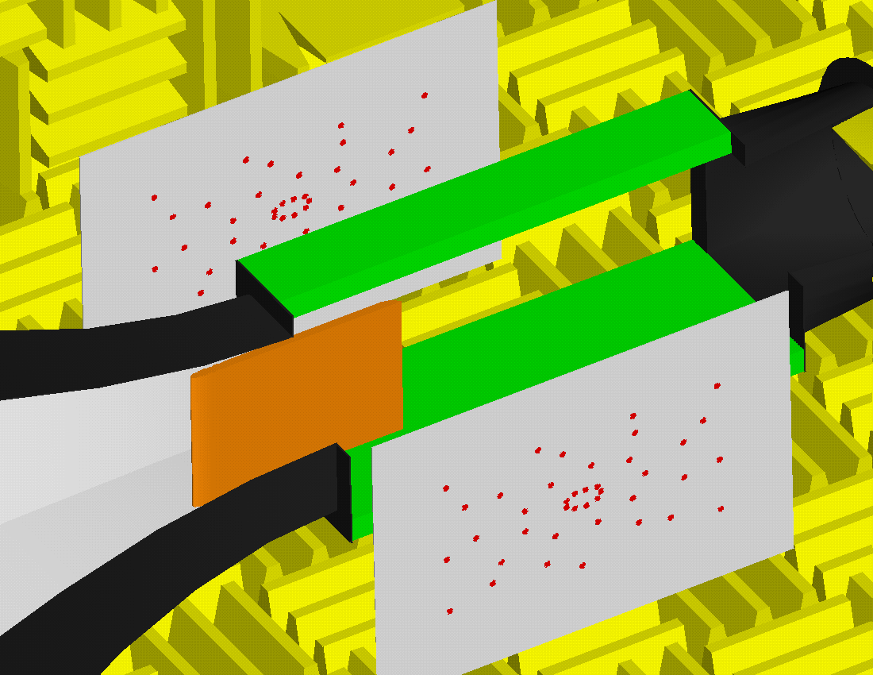
Anechoic Wind Tunnel
Sample Beam Forming
Sound Pressure Level (dB)

Slide 6
Experimental Facilities Vision
Actual Applications
Government and Industry
Testing Facilities
Power
FlowPAC Target Capability
Envelope of
Highest Relevance
Typical
University
Technology Readiness

Slide 7
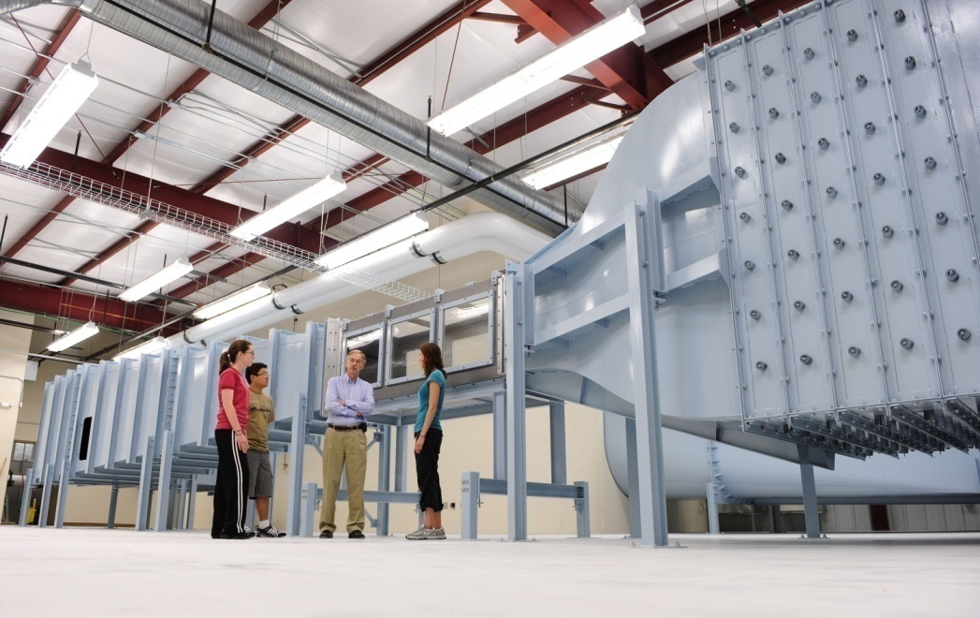
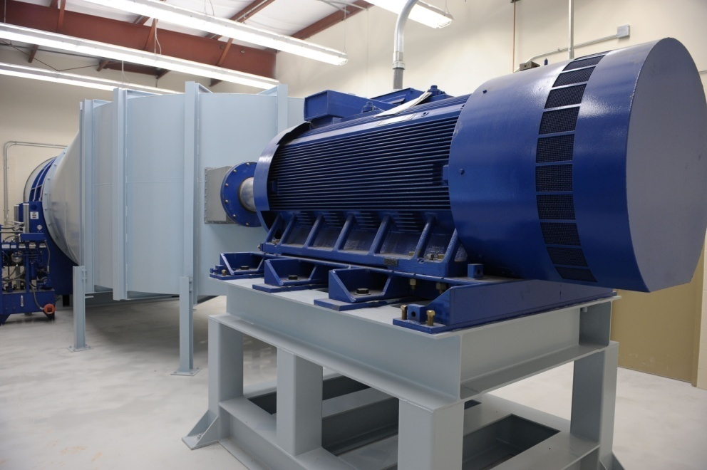
Mach 0.6 Wind Tunnel
3’x3’x9’ test sections
Large optical access
Low turbulence
Temperature controlled
1750 H.P. motor
Variable R.P.M. AC
8’ diam., 2-stage fan
1000 ton-hr ice-storage chilled water cooling

Slide 8
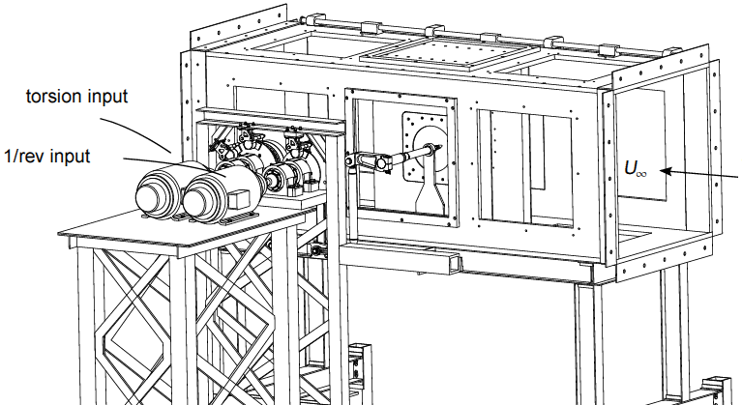
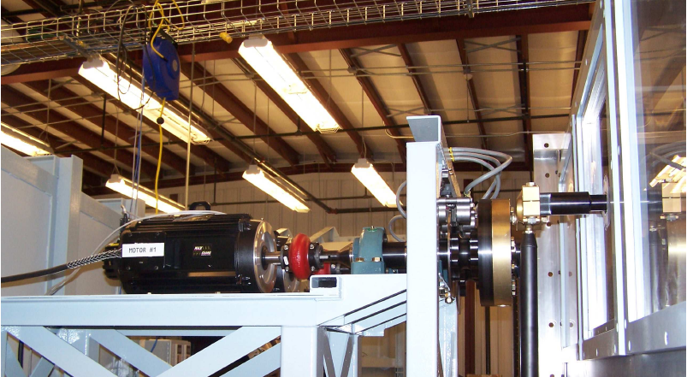
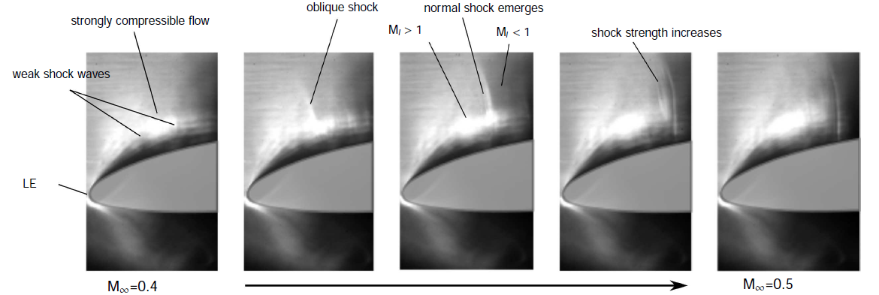
Helicopter Dynamic Stall Facility
Focused Schlieren Images

Slide 9
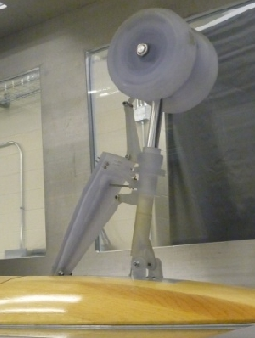
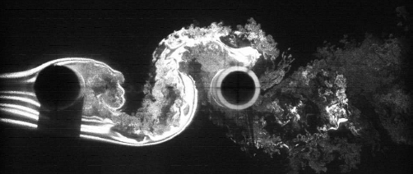
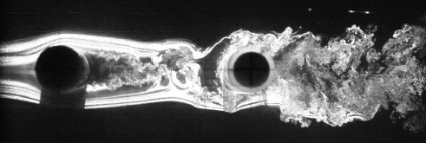
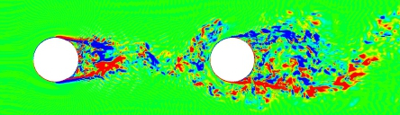
Airframe Noise
Gulfstream 550 Nose LG

Slide 10
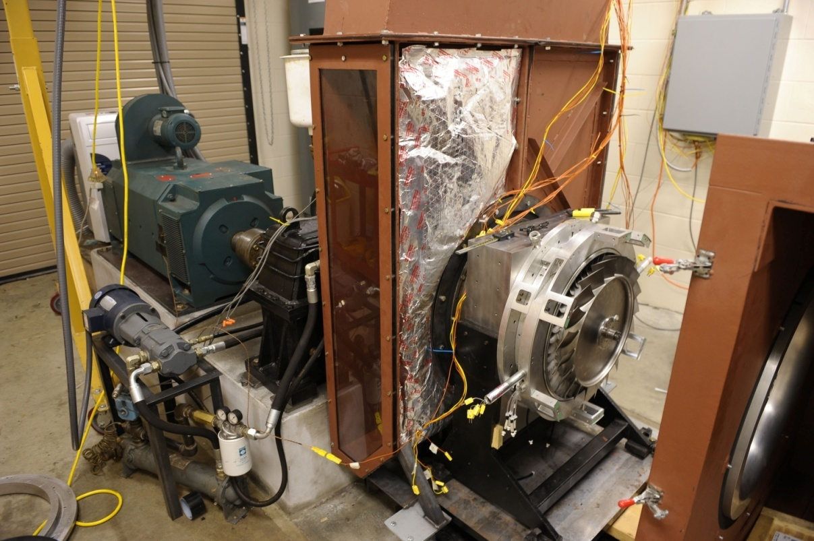
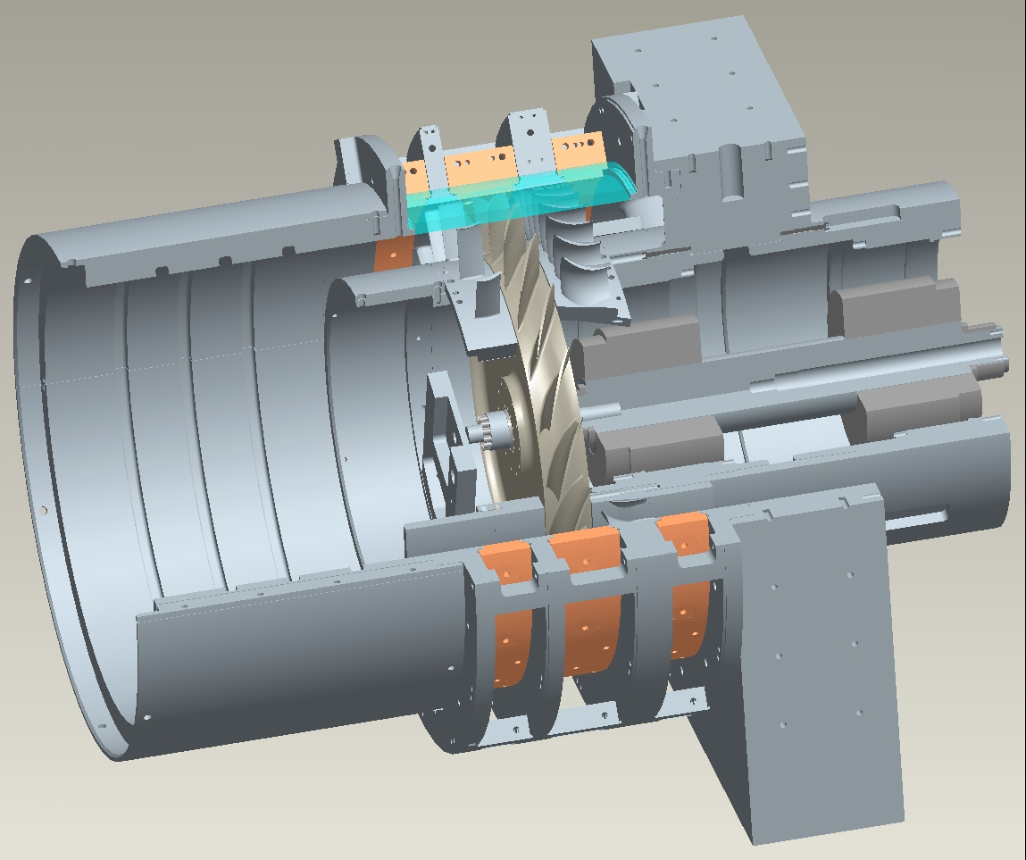
Transonic Compressor Facility
400 H.P.
15,000 R.P.M.
Design tip-Mach: 1.2
Magnetic levitation rotor bearings
Rotor optical access

Slide 11
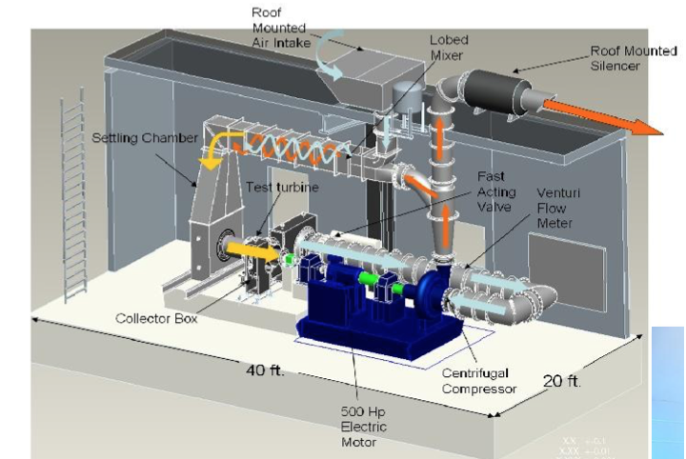
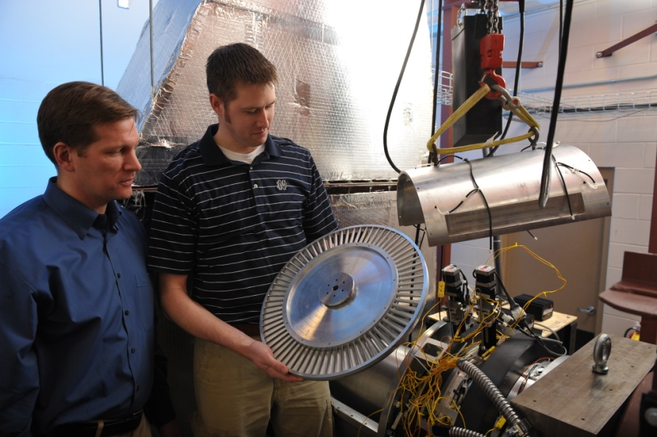
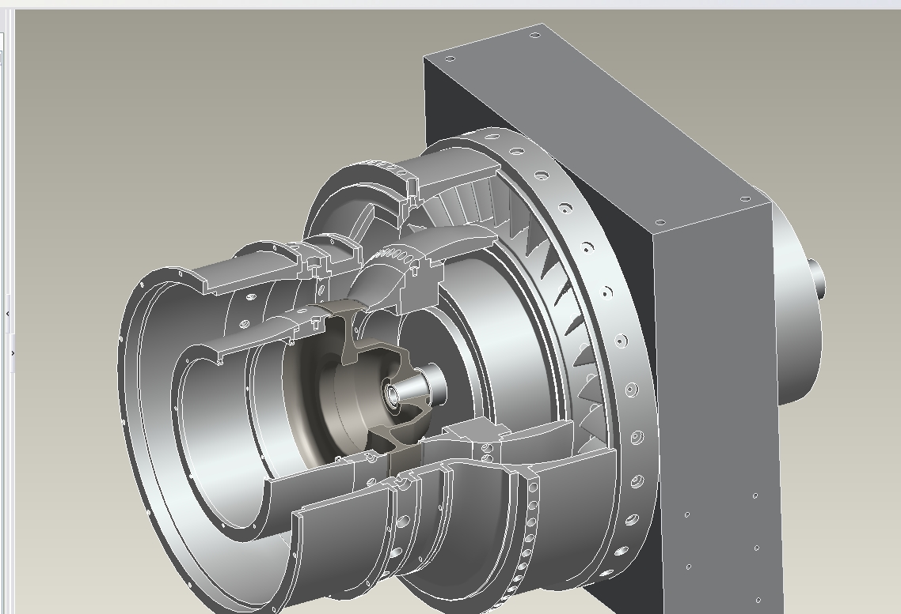
Transonic Turbine Facility: LPT & HPT Modules
800 H.P. compressor
500 H.P. motor
Design 300 H.P. turbine
Magnetic levitation rotor bearings
Highly-loading rotor design
HPT
LPT

Slide 12
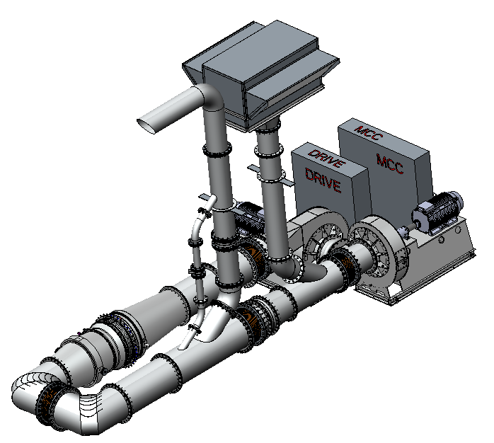
Hot Annular Nozzle Cascade (HANC)
700°F primary flow
Transonic nozzle Mach numbers
Full secondary cooling systems
46 inch diameter
Controlled inlet turbulence characteristics.
Highly detailed aero/thermal measurements

Slide 13
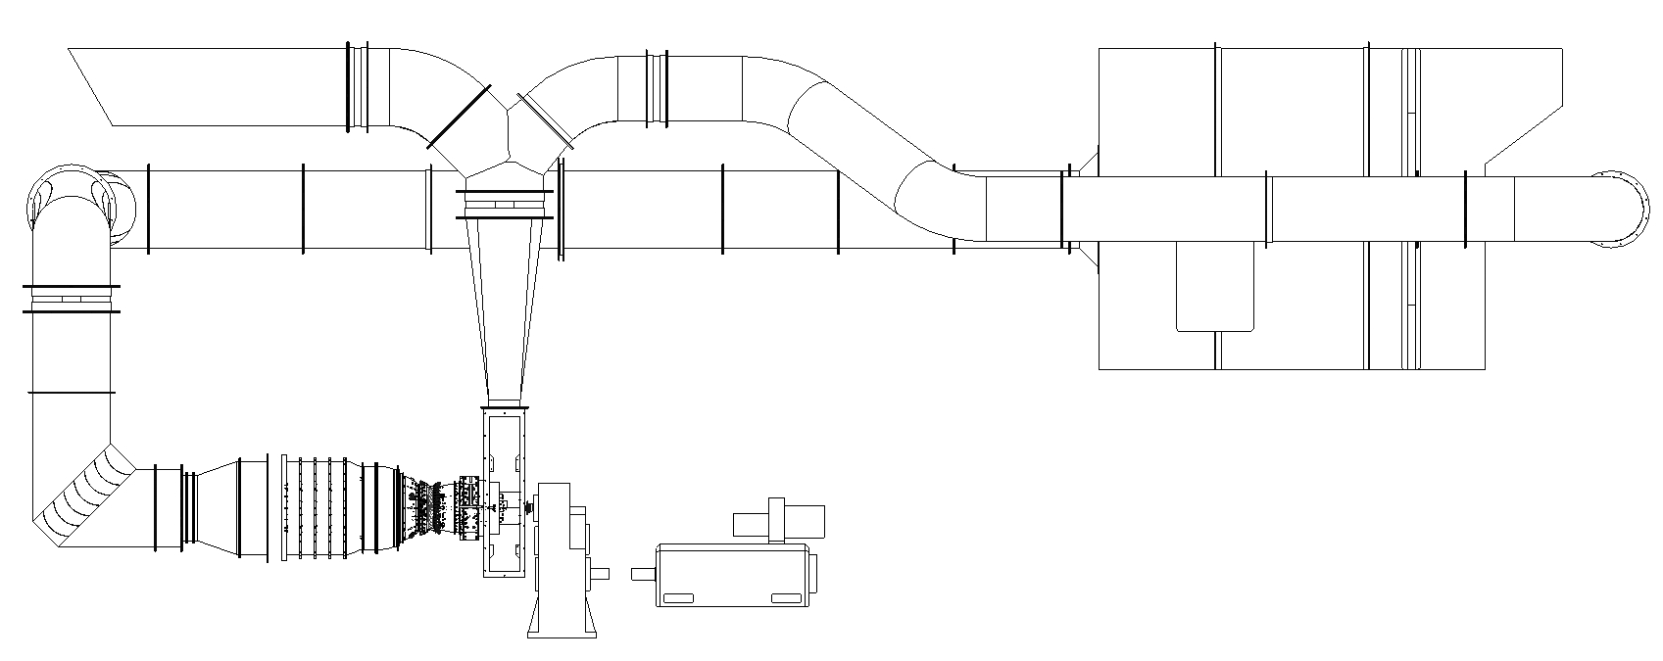
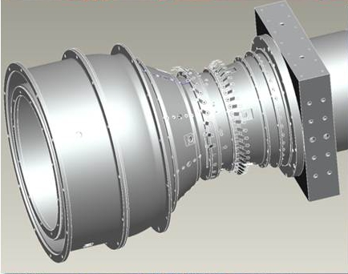
Front Stage Core Compressor (FSCC)
800 H.P.
Variable IGV
Transonic tip Mach number
Magnetic levitation rotor bearings

Slide 14
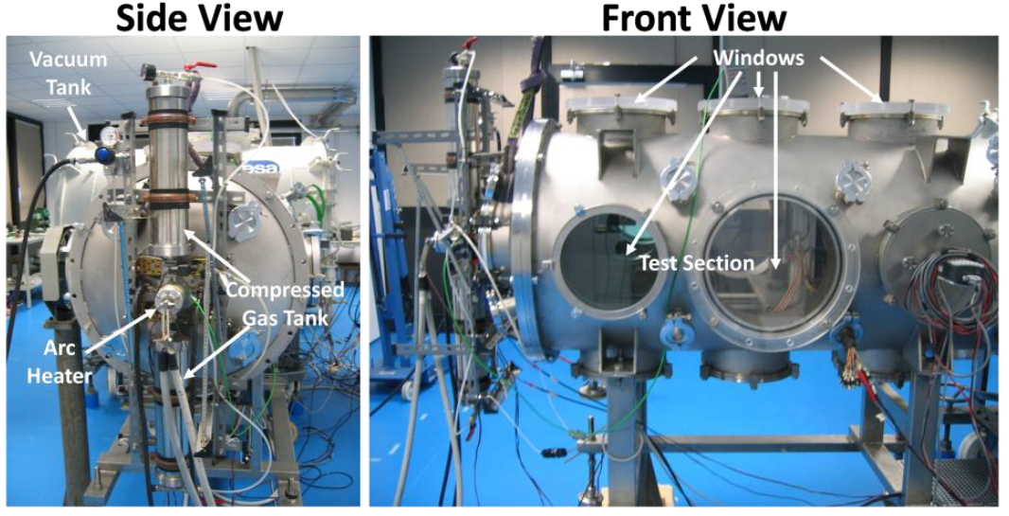
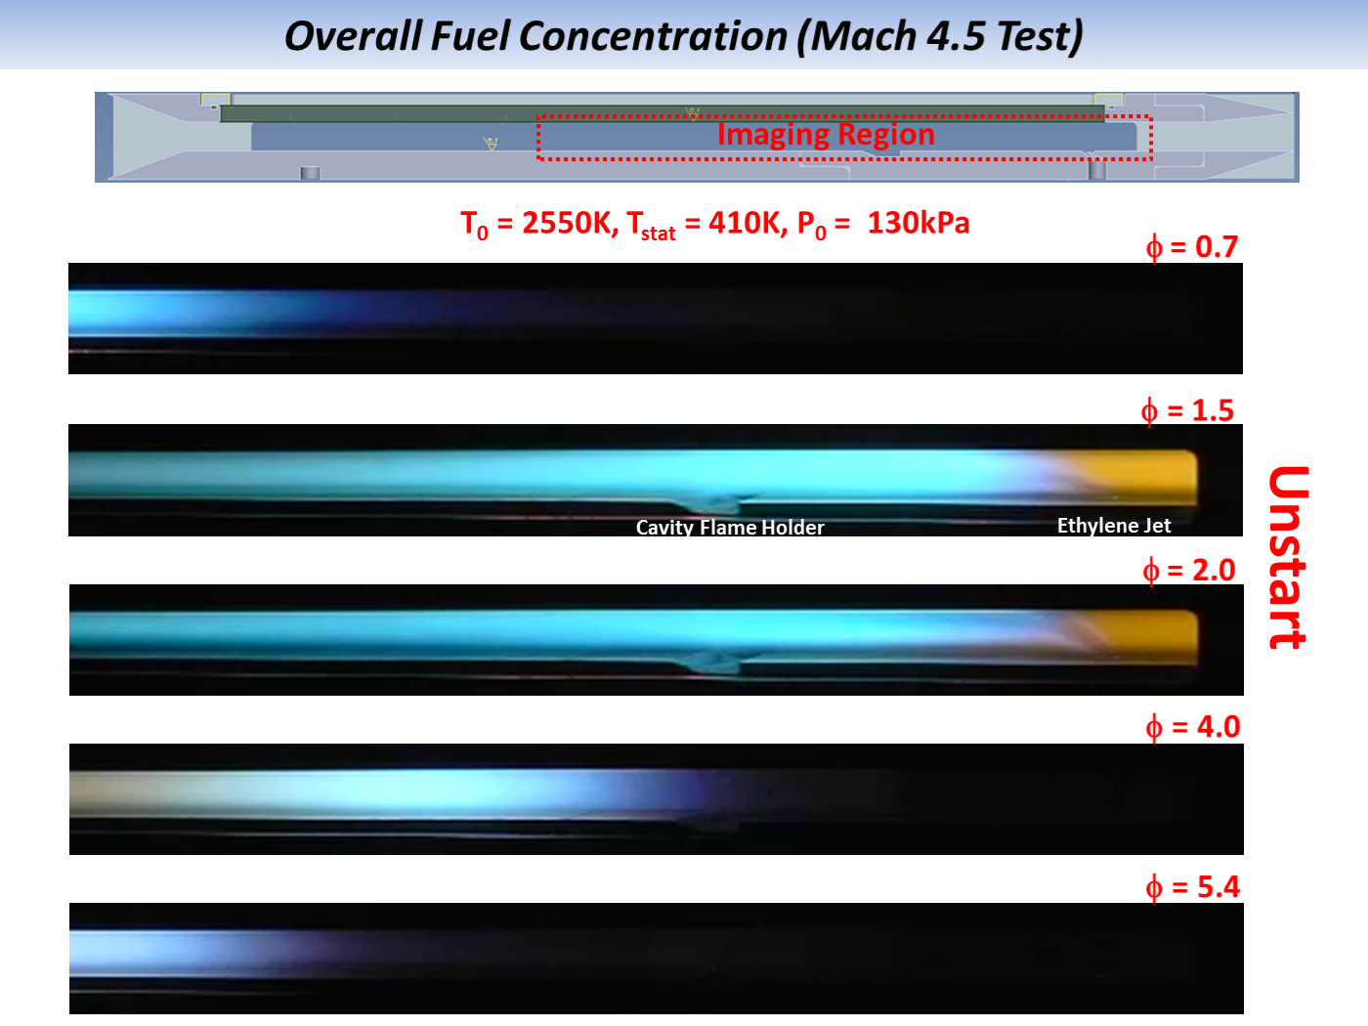
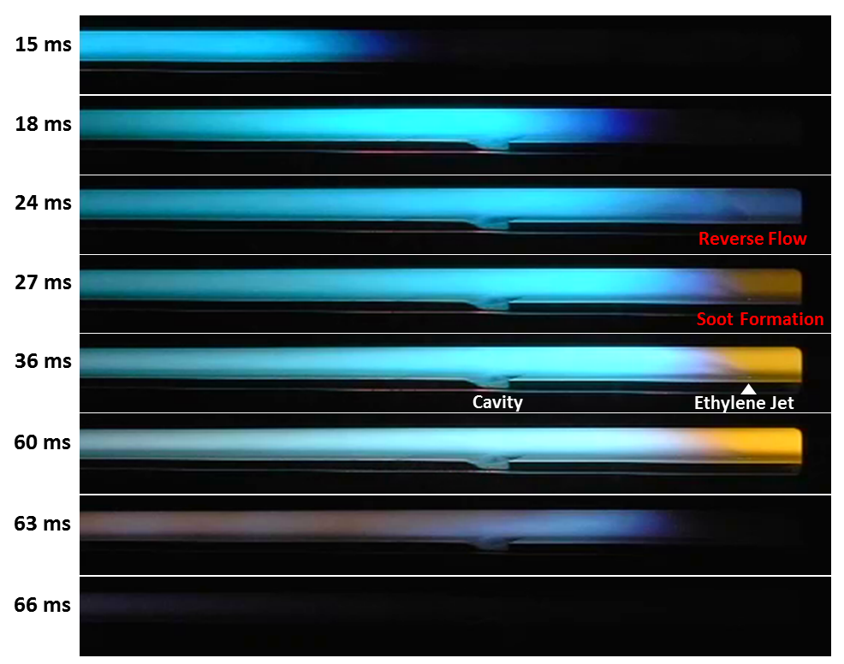
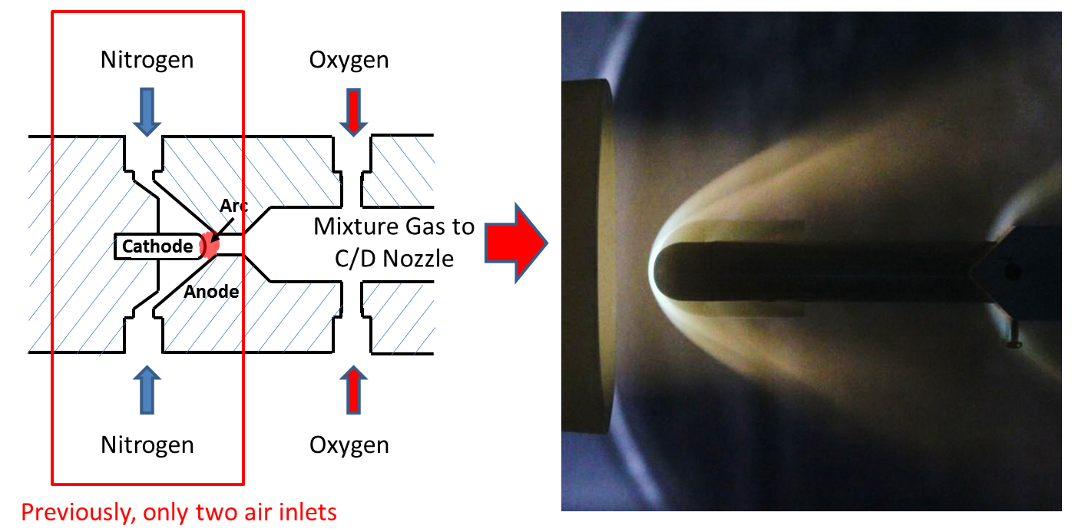
Arc Heated Hypersonic Wind Tunnel
10m³ Internal Volume
500kW Maximum Power
Mach Nos. 3, 4.5, 6 & 9
Max. T₀ = 4200K
Run Time ~ 1s
Freestream Flow
Time Resolved Unstart Flame Dynamics
Minimizing test gas contamination: pure nitrogen arc-heating to prevent plasma induced chemical reactions in air, e.g., NOx production in plasma

Slide 15
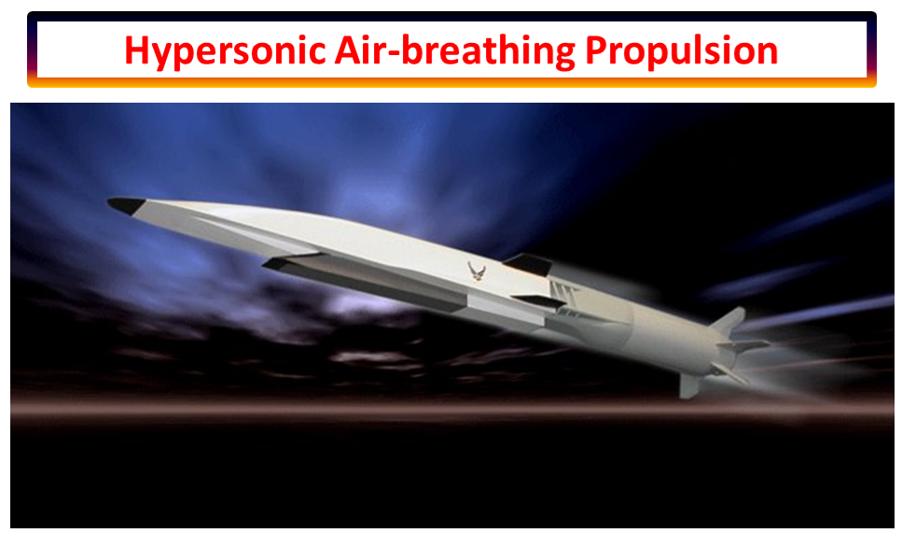
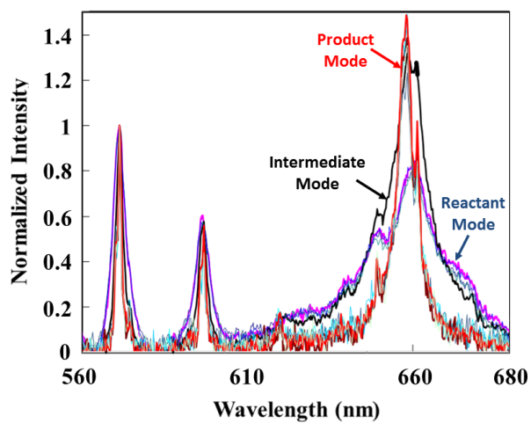
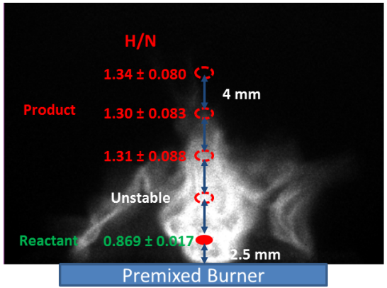
Notre Dame - AFRL/AFOSR Collaboration⁺
Non-intrusive Flow Property Measurements for Supersonic/Hypersonic Flows
(2012/2013 Air Force Summer Faculty Fellowship Program)
Experimental Investigation of Turbulent Flames in Hypersonic Flows
(AFOSR Grant, FA9550-12-1-0161)
Wright Patterson Air Force Base
(Dr. Campbell D. Carter)
Air Force Office of Scientific Research
(Dr. Chiping Li & Dr. Campbell D. Carter)
Instantaneous Plasma
Emission Spectra near Flame Zone
Locations of Plasma Probe in a Reacting Flow
*Do & Carter (2013)
X-51A, Waverider
Turbulent combustion enables hypersonic flights: turbulence property quantification & investigation of flame dynamics in supersonic/hypersonic flows.
Optically resolved unsteady ethylene flame dynamics at Mach 4.5, 6 and 9 scramjet flight conditions.
A short-gated (35 ns measurement time) laser diagnostics method for fuel concentration/gas density measurement in high-speed unsteady reacting flows is proposed and tested.
The new method will be used in RC-19 supersonic wind tunnel at Wright-Patterson Air Force Base to measure fuel concentration/temperature field in a scramjet combustor
*H. Do and C. D. Carter (2013) Combustion and Flame 160: 601–609
⁺Hyungrok Do, PI

Slide 16
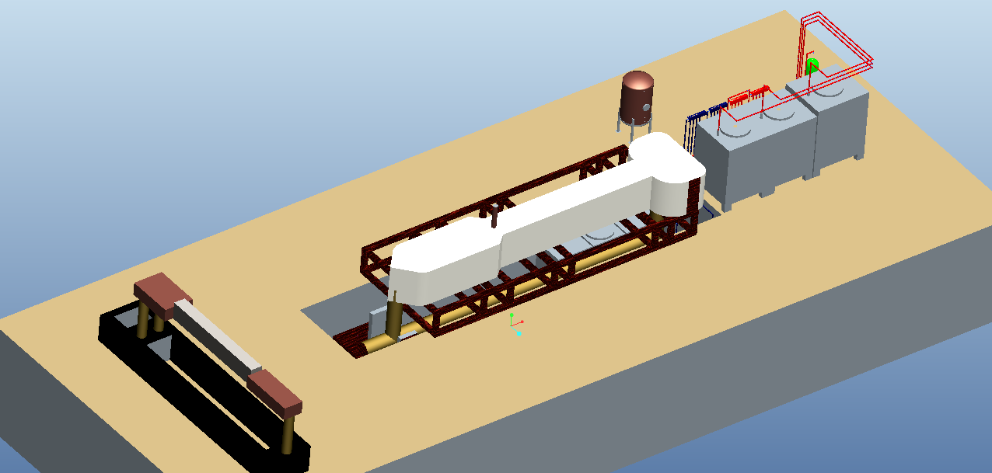
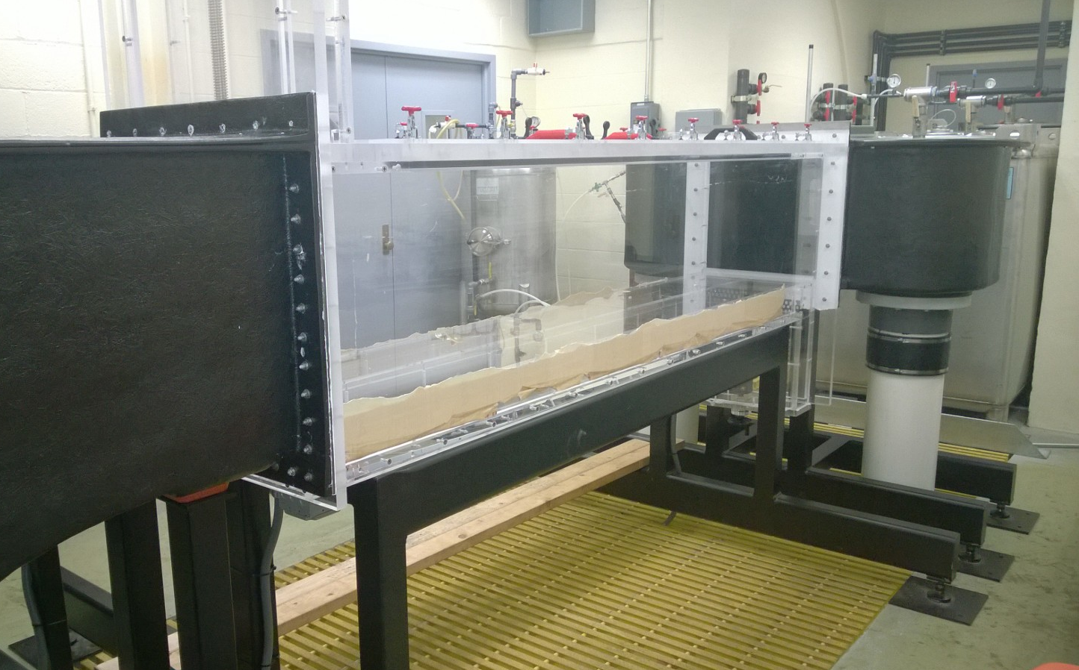
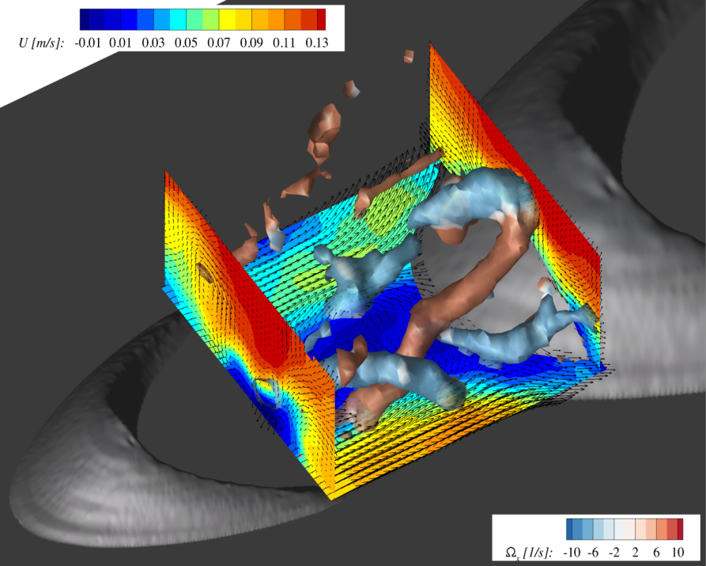
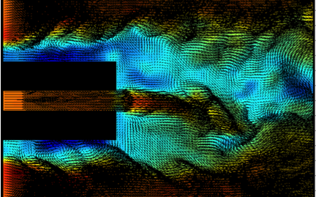
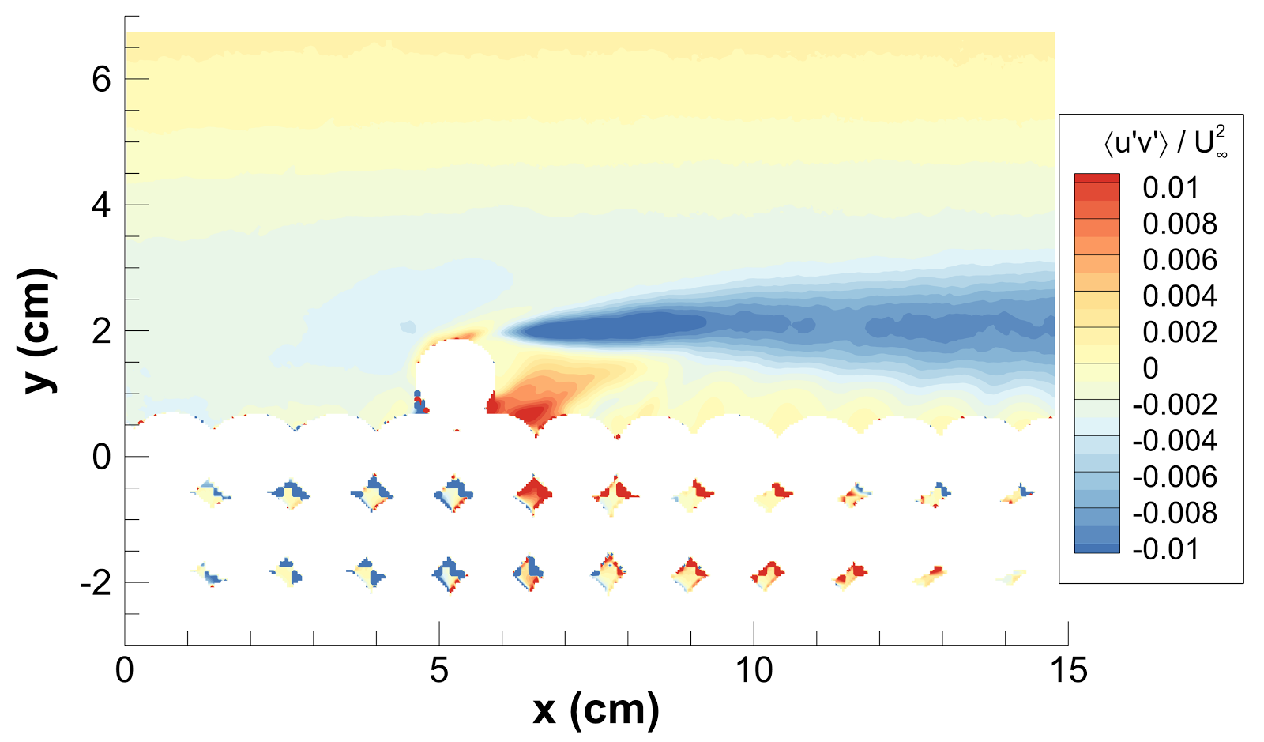
Refractive-Index-Matched (RIM) Flow Facilities*
Laboratory overview
Large-scale RIM
2 Closed-loop flow tunnels
NaI processing system
Piping system
Storage
N₂
Processor
NaI Storage units
Large-scale RIM
Temperature controlled
Pressure resistant (N₂)
Corrosion resistant
Scratch resistant
Sediment recirculation (ϕ = 2 mm)
Small-scale RIM
Total volume: 4200 liters
Velocity up to ~ 2 ms⁻¹
Cross section: 0.45 m x 0.45 m
Length: 2.5 m
Complex 3D topography
Bluff Bodies
Permeable boundaries
Applications
*AFOSR MURI, Ken Christensen PI

Slide 17
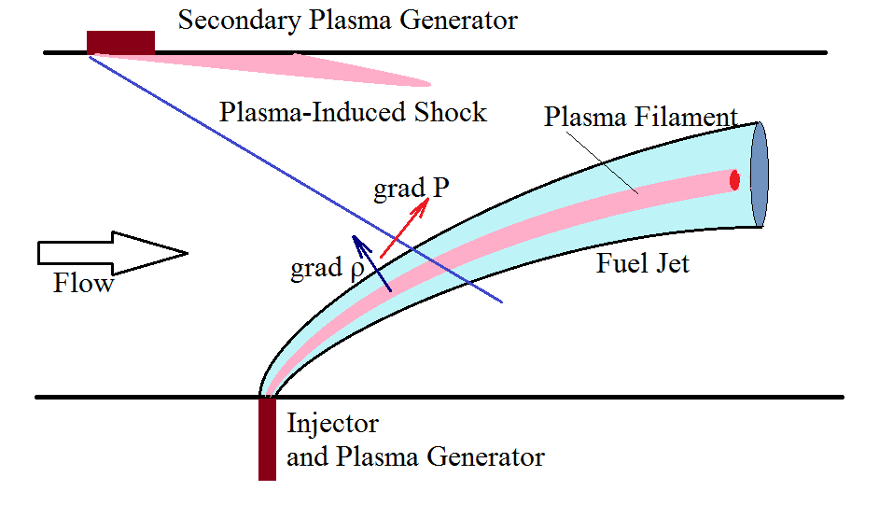
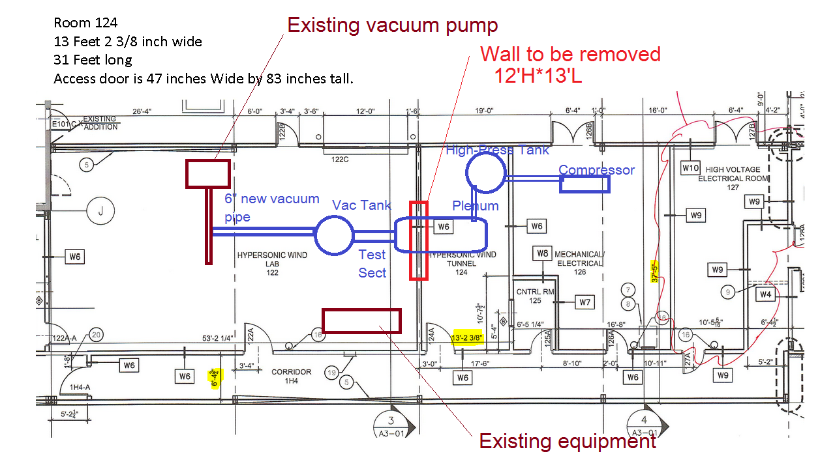
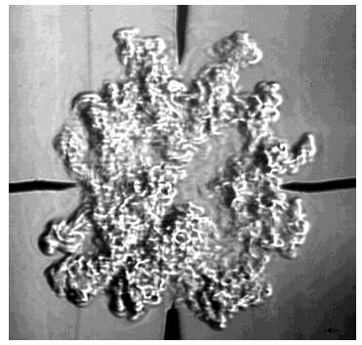
Supersonic Mixing Facility
Mixing Enhancement and Flame Stabilization in High-Speed Combustion Systems by Transient Plasma*
*Proposal by Sergey Leonov.
In review, Chiping Li (AFOSR)

Slide 18
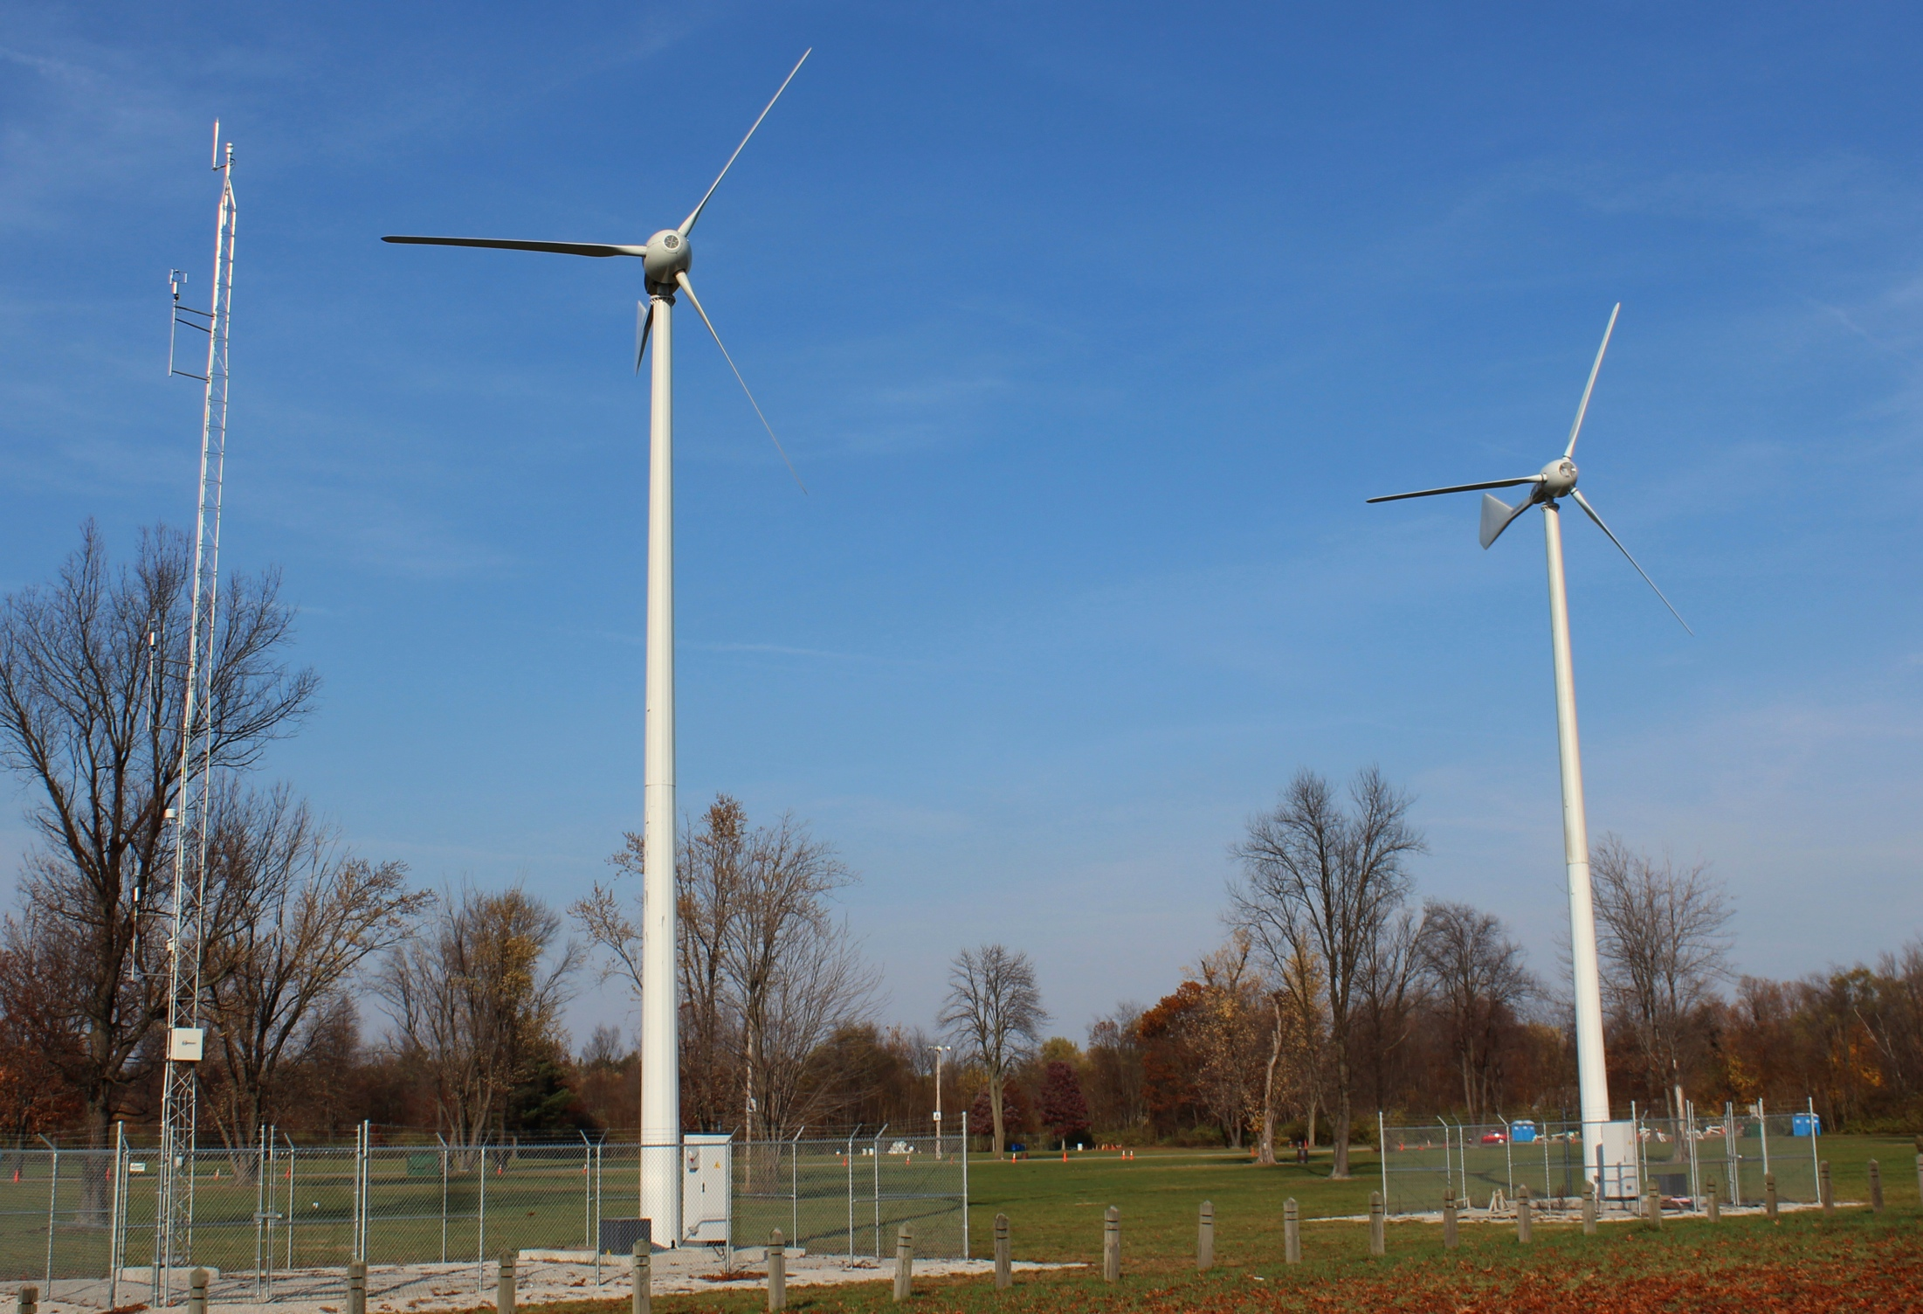
Wind Energy Laboratory (eWiND)
25kW Turbines:
30’ Diameter
59’ Hub Height
Pitch Controlled
Meteorological Tower:
3-component, fast response ultrasonic anemometers
Temperature
Humidity
Pressure

Slide 19
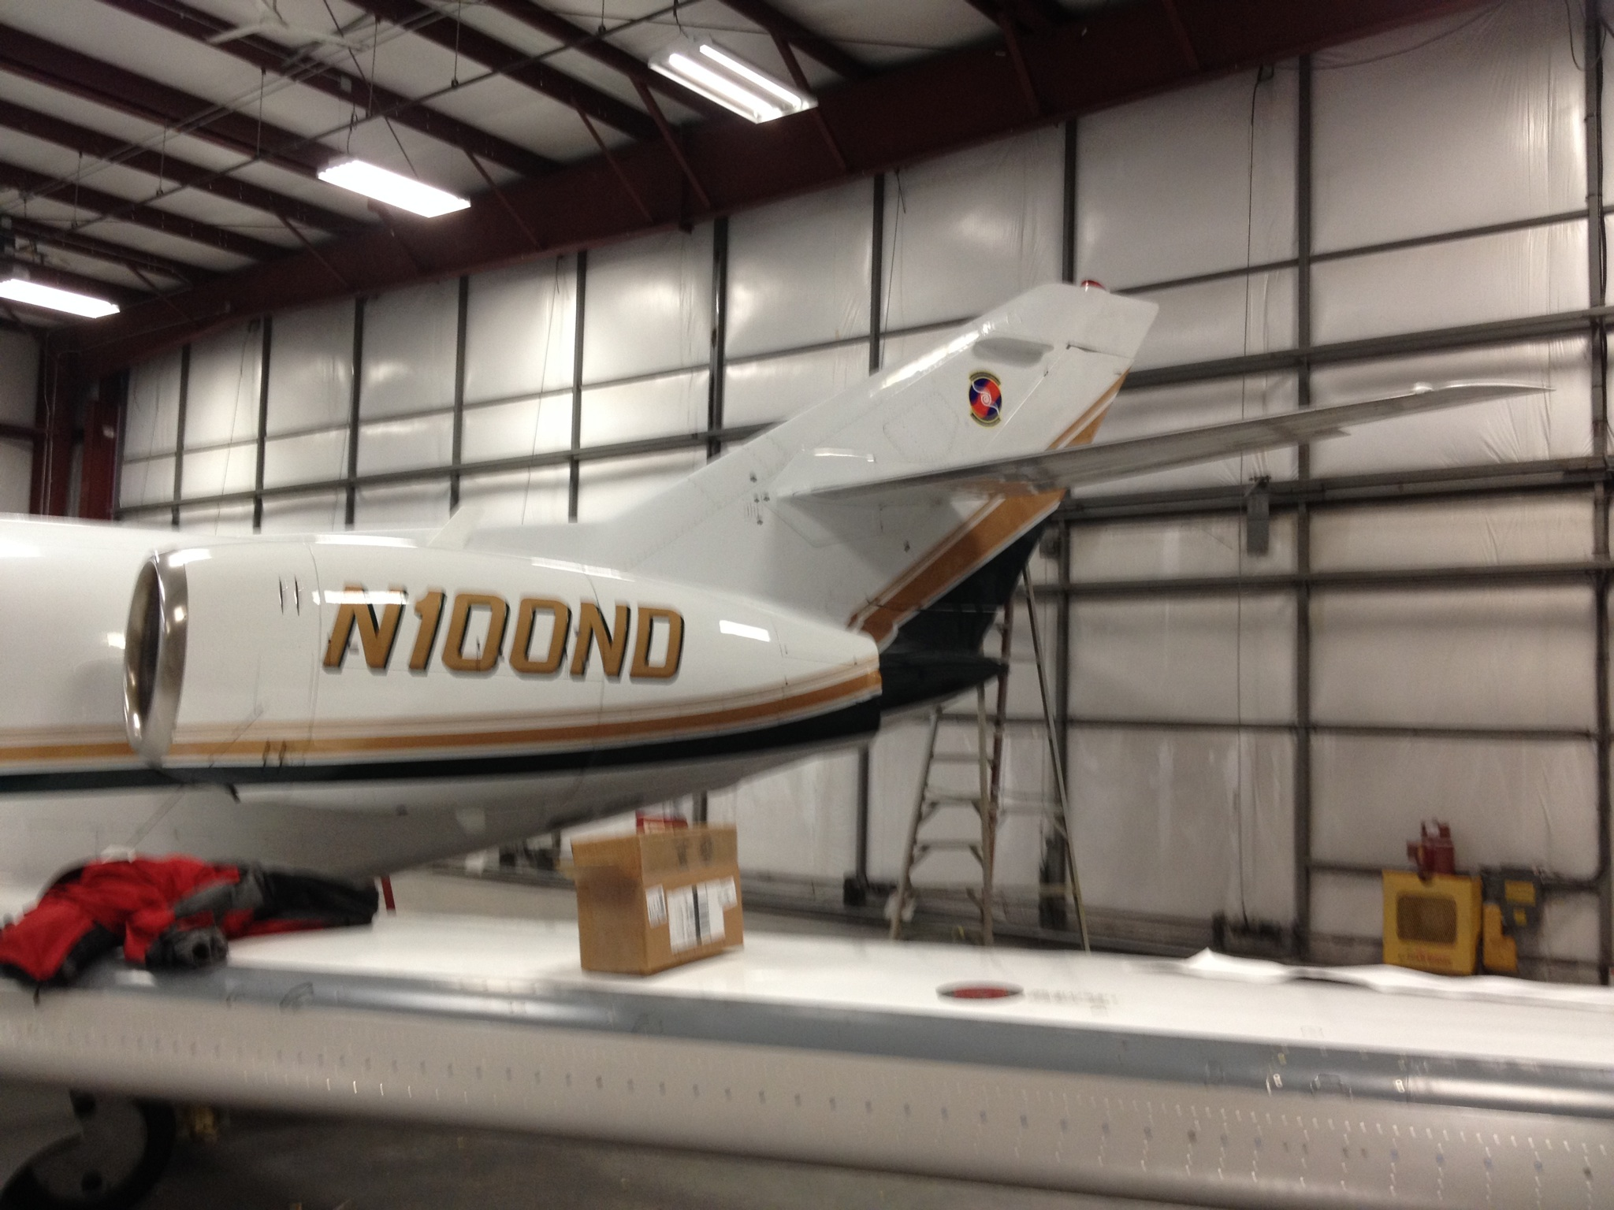
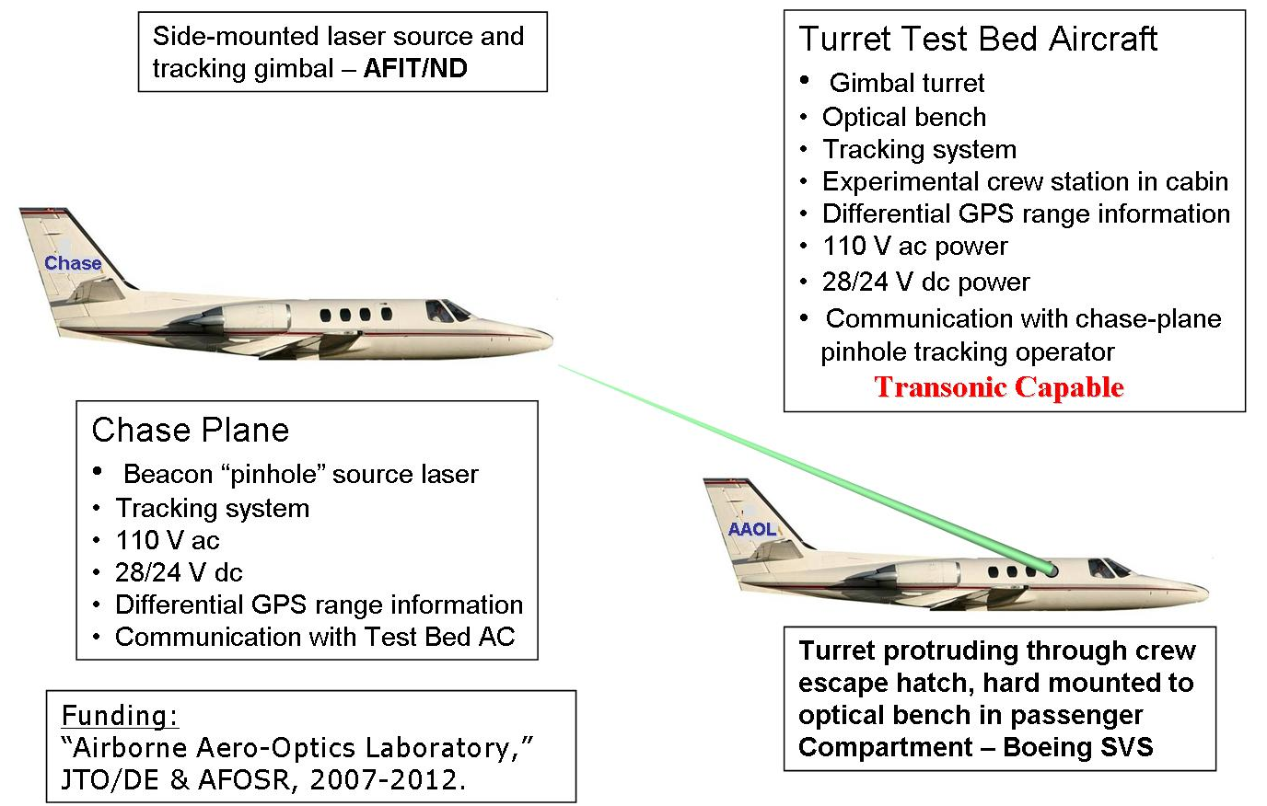
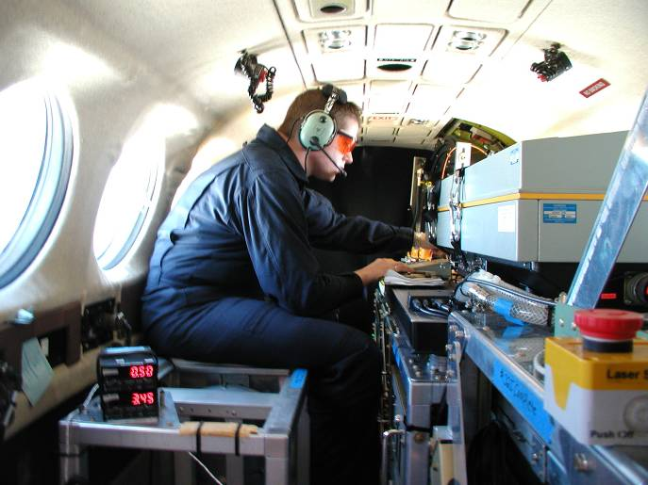
Airborne Aero-optics Laboratory
Falcon 10
Dynamic correction of optical distortions produced by compressible flow structures

Slide 20








FlowPAC Fabrication Shop
4 Axis Mill
5 Axis Mill
Num. Lathe

Slide 21


High Fidelity CFD
HPT Tip Clearance Analysis
Embedded Large Eddy Simulation (ELES)
(375M Mesh Points, 512 Processor Cores)

Slide 22





Tunable Plasma Metamaterials
AFOSR MURI: Mitat Birkan
Plasma Adaptive Optics
DARPA DSO: Brian Holloway
Metamaterials are designed with a lattice structure of materials having two indices of refraction.
Conventional metamaterials are designed for a single EM wavelength.
Lattice tuning capability with a broad range of positive and negative plasma permittivity offers numerous applications.
The free electrons, neutrals, metastables, and ions in an ionized gas can affect the permittivity to EM waves.
Change in the permittivity affects refractive index >>> Plasma Adaptive Optics (PAO). Technology Driver: Bandwidth
PAO
60GHz
Plasma optics OPD depends on the length of the plasma, electron density, EM wavelength, gas composition, and heavy particle density.
PAO Array
AIAA J., 50, 1, 123-130 (2012); AIAA J., 51, 3, 657-664 (2013)
Patent: 8513583

Slide 23





Plasma Temperature/Pressure Sensor
Pulse-detonation Engine
Temperature Mode
Pressure Mode
Patents: US7275013B1, US7908115

Slide 24






Boundary Layer Transition Control
NASA Mach 3.5 0.5m Quiet Nozzle
4° AoA 14° Cone Model
40%
d
λ
d=76μm
d/λ=0.43

Slide 25


AFOSR Proposal in AF Academy Mach 6 Facility*
Same size test section, will accommodate existing model.
Provides same Re_{x} range as previous NASA experiment.
Intended to examine effect of higher Mach number and “noisy” environment on transition control.
0.5m
0.98m
*In review: Rengasamy (Pon) Ponnappan

Slide 26
Hypersonic High-Reynolds-Number Quiet Tunnel
Motivation
Schmisseur AIAA-2013-2606
DoD Hypersonic Vehicle Programs
Advanced Hypersonic Weapon (AHW-2):
  Army, Navy
Tactical Boost Glide:
  Air Force, Navy, DARPA
Hypersonic Air-breathing Weapon Concept (HAWC)
  AFRL High Speed Strike Weapon (HSSW)
15min. Range at Mach 6 & 9
Glide: Boeing, Raytheon, Lockheed Martin
Air-breathing: Boeing, Raytheon
$180M CRAD for technology maturation
China reported to have had 3 hypersonic boost-glide flights in 2014.

Slide 27

Hypersonic High-Reynolds-Number Quiet Tunnel
Motivation
Kimmel, “HIFiRE-1 Hypersonic Flight Test”, 2012
Key issue is on the accurate prediction of if and where turbulent transition occurs.
Determines the degree of heat transfer to the vehicle.
3x
?
quiet
Ground tests require hypersonic wind tunnels that can simulate flight conditions:
  Low disturbances
  Natural transition Reynolds numbers
Re_{x-trans} (x10⁶)
2x
Flight Rex-trans
noisy
40

Slide 28

High Reynolds Number Mach 6 & 10 Quiet Wind Tunnel
STATUS QUO
SOLUTION
Ludwieg tubes with large diameter, long, slow expansion axisymmetric nozzles that suppress cross-flow and Görtler instabilities.
Throat suction and heating to suppress TS.
UND DESIGN
L_{Q}
Mach 6 & 10 quiet zone to Re_{x}≥40M.
33’ long nozzle, 2’ I.D. test section.
200’ long, 2.5’ I.D. driver tube.
80,000 gal. vacuum tank.
2 sec. run time.
1 hr. run frequency.
P₀ ≤ 10Bar > acceptable throat waviness ~1-2 mil./in. (NC lathe).
Throat heated to ~670K (~750°F) to minimize TS growth.
Present “quiet” hypersonic wind tunnels are limited in quiet zone length, L_{Q}
  TA&M Blow-down: Re_{LQ}=6M
  Purdue 9” Ludwieg Tube: Re_{LQ}=13M
Natural transition in these facilities only observed when instability growth is accelerated by geometry or disturbance generators.
Notes:
Include notes that would be helpful to the reader or someone (other than yourself) who needs to understand the details. Ideally the chart will be useful even without the author to explain the details. Also include references to published papers plus URLs to online versions if available.
Keep in mind that somewhere or other in this chart, each of these questions should be answered:
1. What technical challenge is being undertaken on behalf of the project
2. Why is it hard and what are the open problems
3. How has this problem been addressed in the past
4. What new intellectual tools are being brought to bear on the problem
5. What is the main intermediate achievement
6. How and when does this achievement align with the project roadmap (end-of-phase or end-of-project goal)
7. What are the even long-term objectives and consequences?

Slide 29

High Reynolds Number Mach 6 & 10 Quiet Wind Tunnel
200 ft. (61 m)
Existing White Field Laboratory (subsonic tunnel, turbomachinery test cells, etc.)
Building expansion (nozzle, test section, and diffuser plus labs and office space

Slide 30
Vital Statistics
Tunnel configuration | Ludwieg tube
Mach number | 6.0
Nozzle exit diameter | 0.60 m | 24 in.
Nozzle length | 10 m (!) | 33 ft.
Throat diameter | 0.084 m | 3.3 in.
Stagnation pressure (quiet flow) | 1 MPa, 10 atm | 150 psia
Stagnation temperature | 430 K | 310 ºF
Freestream unit Re (quiet flow) | 11*10^6 /m | 3.4*10^6 /ft.
Re_L (based on quiet-flow core length) | 40*10^6
Free jet test section length | 0.9 m | 3 ft.
Driver diameter | 0.74 m ID | 30 in. OD
Driver length | 61 m | 200 ft.
Vacuum capacity | 300 m^3 | 80,000 gal
Run time | 2 s
Run frequency | Pending compressor & pumps, ~ 1 /hr
Re variation during run | -9%

Slide 31



Mach 6 Performance Estimates

Slide 32


High Reynolds Number Mach 6 & 10 Quiet Wind Tunnel
SCHEDULE
Boeing has committed FY15 funds to CFD design of Mach 6 nozzle.
Pending DURIP submitted to ONR/AFOSR).
Seeking other corporate support.
Seeking UND benefaction support.
Estimated $3.1M Phase I.
Mach 6 operation 24 mo. from funding start.
Engineering design and major fabrication at UND.
Phase II Mach 10 design starting in Year 3 from start of funding.

Slide 33
Mach 6&10 Quiet Tunnel Size Perspective

