Slide 2
Introductions
Tell your neighbor
about one memorable event
that happened this year
during one of your ISI kit lessons

Slide 3
How do we learn?
Quickly? ……(in an instant?)
Slowly? (over several lessons?) (“or several exposures”)
How and what do we remember?
Why are concepts more important than facts?
How the brain works should affect the ways we teach….
How does your brain work?

Slide 4
Questions
Questions
Questions
The Questioning Class
(Teachers AND Students)
Inquiring minds want to know!!
Are there many answers to your questions?
Are there many answers to THEIR questions?

Slide 5
Questions in a “Constructivist” classroom
What is a “constructivist” classroom?
Just another word for “Guided Inquiry”
The essence of the ISI……..

Slide 6
constructivist vs transmissionist
cooperative inquiry vs lecture/demonstration
student-centered vs teacher-centered
active engagement vs passive reception
student activity vs teacher demonstration
student articulation vs teacher presentation
lab-based vs textbook-based
Guided Inquiry -> group investigations
-> peer learning of concepts
Notes:
Here are the key ways in which the modeling method differs from conventional instruction.
Students present solutions to problems which they have to defend, rather than listen to clear presentations from the instructor. The instructor, by paying attention to student’s reasoning, can judge the level of student understanding.

Slide 7
The NGSS’s Framework of
Scientific and Engineering Practices
1. Asking questions & defining problems
2. Developing & using models
3. Planning & carrying out investigations
4. Analyzing & interpreting data
5. Using mathematics and computational thinking
6. Constructing explanations & designing
solutions
7. Engaging in argument from evidence
8. Obtaining, evaluating, & communicating information

Slide 8
Facilitator/ Participant Teacher/Student Interaction Model
PING PONG | Facilitator/teacher asks a question; labels response right or wrong and then moves onto another question and another student
FEEDBACK LOOPs (Batting practice) | Teacher/facilitator and responder engage in more than a single exchange as point is clarified or expanded. May involve more than 1 participant
RICH CONVERSATIONS (Volleyball) | While the facilitator takes responsibility for guiding the conversation, all members of the learning community take active roles in commenting, questioning, offering clarifications and extending the thought.

Slide 9
Question Rungs on the Ladder of Inquiry
Closed Questions | Comprehension Level questions: “Right” or “Wrong” Answers
Open and shut closed questions | Call for a yes or no or can be answered with a single word or phrase. Often Ping Pong interactions use this exclusively. Emphasis on rote recall Not productive in stimulating thinking feedback loops or conversation.
Level 1: Unlocked closed questions | Very useful for developing and clarifying comprehension of the text as well as of a respondent’s meaning.
Open Questions | Call for thinking/reflection; part of problem-solving process Answers must be supported
Level 2: Analyzing questions | involve inferences as well as comparisons or other kinds of structural analysis; More than one response is possible, but all must include explanations or support that are likely to go back to the text or to further unpacking a previous statement, including asking for examples.
Level 3: Evaluating and synthesizing open questions | Call for “higher order thinking” in systems like Bloom’s taxonomy of knowledge. They are questions that allow respondents to make highly personal, individual connections and synthesize understandings in a unique and creative way.

Slide 10
Neighbor – neighbor questions:
1 – Write down a ping-pong question
2- exchange your questions with your neighbor
3 – Re-write the question as a higher level question
Let’s exchange our results with the whole class….
Question – what levels are the new questions?
3 Evaluating/Synthesizing Inquiry Abstract/Symbolic
2 Analyzing/Applying Inquiry Pictorial
1 Knowledge & Comprehension Inquiry Concrete

Slide 11
Bloom’s Taxonomy of Question Levels
(inverse pyramid)
6
5
4
3
2
1
Creating
Evaluating
Analyzing
Applying
Understanding
Remembering
http://www.odu.edu/educ/roverbau/Bloom/blooms_taxonomy.htm

Slide 12
All Children are born hard-wired for Inquiry
Traditional Science teaching tends to short-circuit their curiosity

Slide 13
Traditionally Science teachers have been trained to do “Cook book” Science
The curriculum is owned by
Textbook/ educational publishers
Teachers and Learners
Get it Right
Or
Get it wrong

Slide 14
The Framework’s Scientific and Engineering Practices
1. Asking questions & defining problems
2. Developing & using models
3. Planning & carrying out investigations
4. Analyzing & interpreting data
5. Using mathematics and computational thinking
6. Constructing explanations & designing
solutions
7. Engaging in argument from evidence
8. Obtaining, evaluating, & communicating information

Slide 15
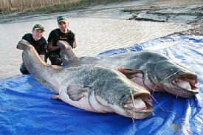
Inquiry, Play and Research
are Synonymous
Notes:
Gordon

Slide 16
IF TEACHERS ARE TO GUIDE INQUIRY
THEY (YOU!) MUST EXPERIENCE
GUIDED INQUIRY
As Learners

Slide 17
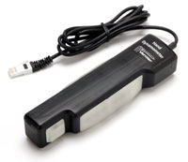
How strong are you?
Let’s work in 4 groups, to find out…..
This device (called a dynamometer) measure your “Squeezing power”
(turn on its controller – the labquest, to see your squeezing power)
Your group should collect some data to show the class how strong
each of you are (in this case – how good a squeezer each of you are…)
Put your results on the big whiteboard,
so that we can have a “BOARD MEETING”
INCLUDE QUESTIONS your group has about this experiment
Note: You can present your results in different ways…..
e.g. as a table…, as a graph….. In words… as a picture……

Slide 18
What Makes a successful Guided Inquiry Lesson?
The 3-part lesson-plan: QIP
Each part is Satisfying, Intentional Problem-solving
Problem-setting Questions(Engagement)
Investigate (Explore)
Problem solving (Evaluate)

Slide 19
Whose Questions Drove this Inquiry?
And how many different ways did information/understanding
get represented?

Slide 20
A self-assessment tool that you can use
in your own classroom and for your lesson plan
Q
Q
I
I
P
P
Notes:
Gordon

Slide 21
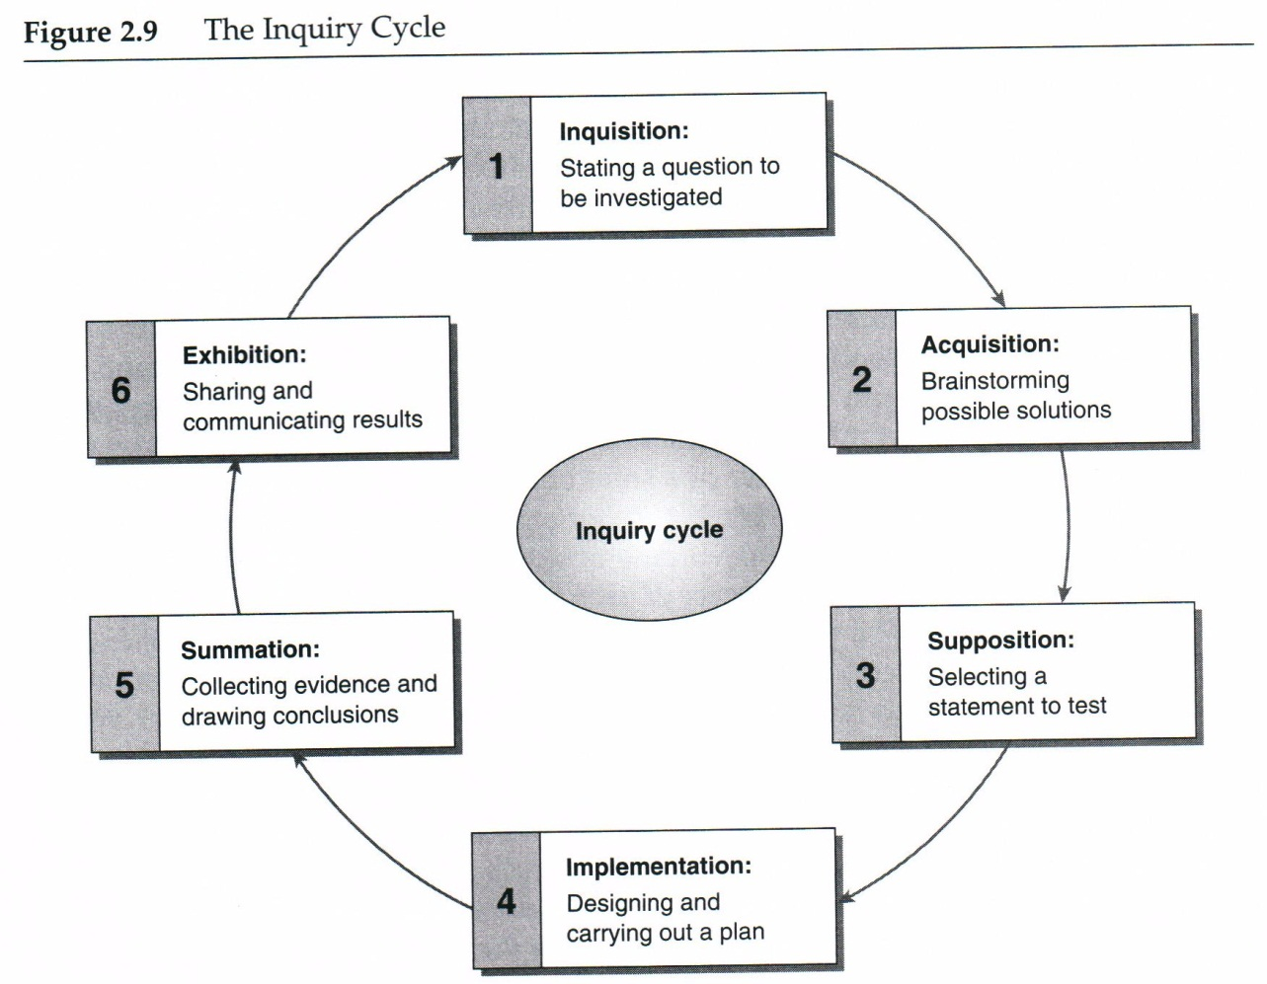

Slide 22
The Essential ABCs
Always Be Conversing
Always Be Connecting
Always Build Competence

