Slide 1
Integrating Guided Inquiry and Modeling:
An example of “Reading an Object” for any grade, any age, any science topic
Gordon Berry* and Mary Hynes-Berry**
*Physics Dept., University of Notre Dame, Notre Dame IN 46556
hgberry@nd.edu
**The Erikson Institute, Chicago, maryhbe@gmail.com
Notes:
1 Hour
Focus - Mary
Need
9-9:20
Brief Intro and drawing a catfish experience
Blank paper, (1 sheet or notebook?)
Catfish photos
Informational handout on catfish
9:20-9:40
Reflection and theory - Mary – 14 min
PPT Gordon – 6 min
9:40-10:00
Cases in Point: preschool teachers and children – 9 minutes
Middle and high school – 10 minutes
1 minute – reflections slide – 1 sheet blank paper

Slide 2

All students are born hard-wired for
Inquiry
Traditional Science teaching tends to short-circuit their curiosity

Slide 3

Traditionally Science teachers have been trained to do “Cook book” Science
The curriculum is owned by
Textbook/ educational publishers
Teachers and Learners
Get it Right
Or
Get it wrong

Slide 4

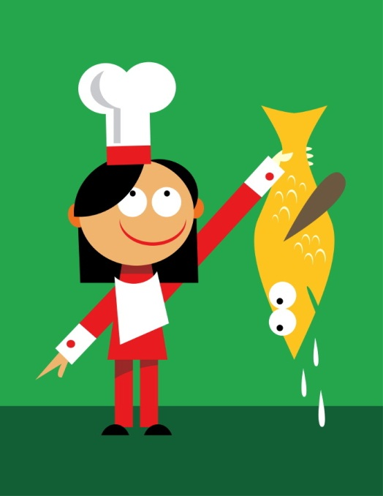
Force-Feeding
Pre-Processed Fish ?
BUT: What Promotes Learning?
OR
Teaching
The Joys Of Fishing?

Slide 5
Fish or Learning to Fish?
Common Core Practice Standards for Math
&
The NGSS Framework for K-12 Science & Engineering Practices
Agree 100%
TEACH FISHING

Slide 6
The NGSS’s Framework of
Scientific and Engineering Practices
1. Asking questions & defining problems
2. Developing & using models
3. Planning & carrying out investigations
4. Analyzing & interpreting data
5. Using mathematics and computational thinking
6. Constructing explanations & designing
solutions
7. Engaging in argument from evidence
8. Obtaining, evaluating, & communicating information
These Practices are how
any guided inquiry classroom is defined!!

Slide 7
constructivist vs transmissionist
cooperative inquiry vs lecture/demonstration
student-centered vs teacher-centered
active engagement vs passive reception
student activity vs teacher demonstration
student articulation vs teacher presentation
lab-based vs textbook-based
Guided Inquiry -> group investigations
-> peer learning of concepts
Notes:
Here are the key ways in which the modeling method differs from conventional instruction.
Students present solutions to problems which they have to defend, rather than listen to clear presentations from the instructor. The instructor, by paying attention to student’s reasoning, can judge the level of student understanding.

Slide 8
IF TEACHERS ARE TO GUIDE INQUIRY
THEY MUST EXPERIENCE
GUIDED INQUIRY
As Learners—
Let’s Go Fishing (hunting)

Slide 9
Hunting for Alpacas
(our object for today)
Q On the first page of your notebook,
do your best to draw an alpaca
Q Join two others to form a learning trio.
    Turn and talk to other members of your trio comparing your drawings.

Slide 10
Keep Hunting
in your group – now using a whiteboard…
- Draw a second draft of an alpaca,
based on your discussion.
- Has your group any questions about Alpacas?
Let’s have a whiteboard session….

Slide 11
Keep Hunting
In your trio, read the “blurb” about alpacas…
Examine the different “wools”
Examine the photos of the camelids
Can you complete a careful “scientific” drawing of an alpaca (which distinguishes it from the other camelids, and other “wooly” animals such as sheep, goats….?)
Record questions and thoughts that you have about alpacas and the other camelids
Debriefing discussion

Slide 12
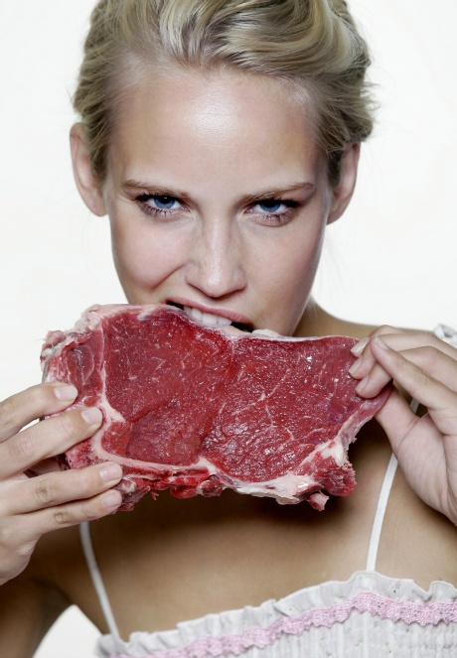
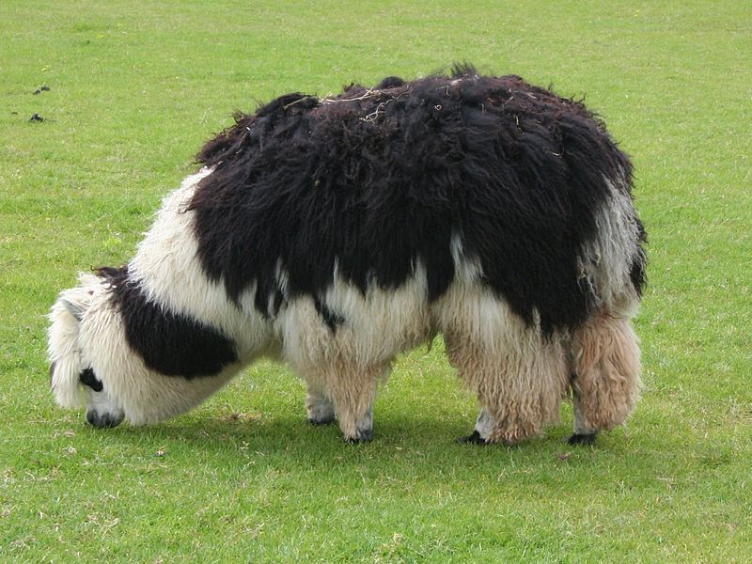
REFLECTION
Force- Fed Learning
Or
Hunting for ideas ?

Slide 13
Which of the Framework Practice Standards Came Into Play?
Whose Questions Drove this Inquiry?

Slide 14
The NGSS’s Framework of
Scientific and Engineering Practices
1. Asking questions & defining problems
2. Developing & using models
3. Planning & carrying out investigations
4. Analyzing & interpreting data
5. Using mathematics and computational thinking
6. Constructing explanations & designing
solutions
7. Engaging in argument from evidence
8. Obtaining, evaluating, & communicating information

Slide 15
Whose Questions Drove this Inquiry?
In how many different ways did information/understanding
get represented?
http://fohn.net/camel-pictures-facts/camel-quiz.html

Slide 16
Facilitator/ Participant Teacher/Student Interaction Model
PING PONG | Facilitator/teacher asks a question; labels response right or wrong and then moves onto another question and another student
FEEDBACK LOOPs (Batting practice) | Teacher/facilitator and responder engage in more than a single exchange as point is clarified or expanded. May involve more than 1 participant
RICH CONVERSATIONS (Volleyball) | While the facilitator takes responsibility for guiding the conversation, all members of the learning community take active roles in commenting, questioning, offering clarifications and extending the thought.

Slide 17
Bloom’s Taxonomy of Question Levels
(inverse pyramid)
6
5
4
3
2
1
Creating
Evaluating
Analyzing
Applying
Understanding
Remembering
http://www.odu.edu/educ/roverbau/Bloom/blooms_taxonomy.htm

Slide 18
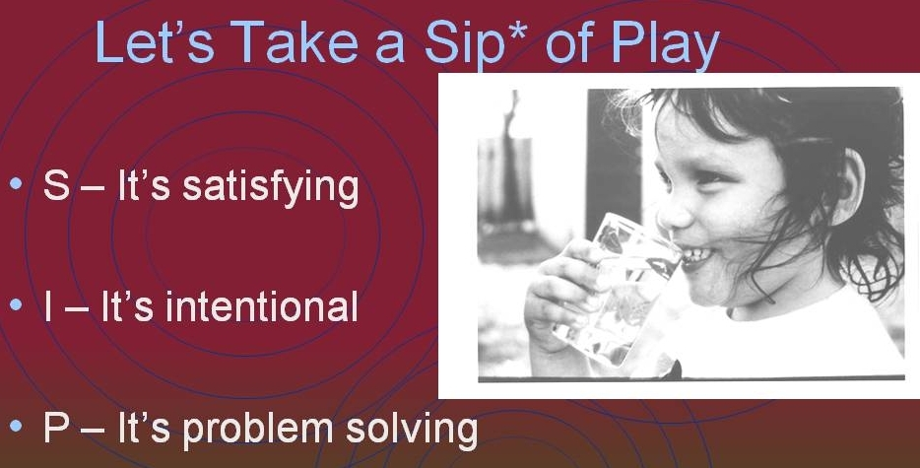
Inquiry and Play and science research are Synonymous
Notes:
Gordon

Slide 19
DOUBLING THE SIP
Set a positive atmosphere by Structuring Play---not cookbook science
Invite Inquiry—Facilitate questions
Promote Problem-solving -- constructing understanding, not force-fed right answers
Notes:
Gordon

Slide 20
Do we have our own MODEL of the CONNECTIONS
about “learning/remembering” that we just made?
Answer =
YES!!
We (and students) use models all the time in our everyday life ……… AND
They depend on both your present and past experiences
You probably have a model of
…… How PLAY relates to PROBLEM-SOLVING
……. What is going to happen this afternoon after 5 pm…
…… How many fish there are in Minnesota
…………………………………

Slide 21
Building Models using “Representations”
– they are also used in science teaching
Picture
Concept
Or idea
Notes:
This word is used in many ways.
The physical system is objective; i.e., open to inspection by everyone. Each one of us attempts to make sense of it through the use of metaphors. Unfortunately, there is no way to peek into another’s mind to view their physical intuition. Instead, we are forced to make external symbolic representations; we can reach consensus on the way to do this, and judge the fidelity of one’s mental picture by the kinds of representations they make.
So the structure of a model is distributed over these various representations; later we’ll provide some specific examples.

Slide 22
What Makes a successful
Guided Inquiry Lesson?
The 3-part lesson-plan: QIP
Each part is Satisfying, Intentional Problem-solving
Problem-setting Questions(Engagement)
Investigate (Explore)
Problem solving (Evaluate)

Slide 23
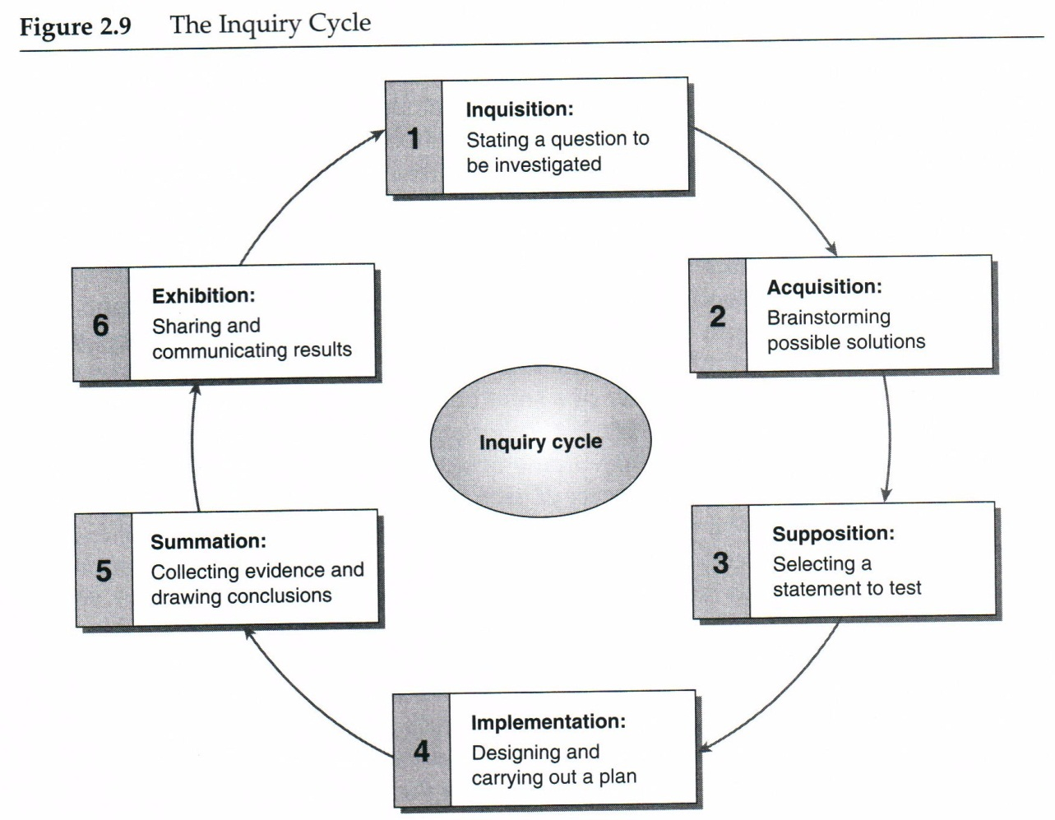

Slide 24
IF TEACHERS ARE TO GUIDE INQUIRY
THEY MUST EXPERIENCE
GUIDED INQUIRY
As Learners

Slide 25
A self-assessment tool that you can use
in your own classroom and for your lesson plan
Q
Q
I
I
P
P
Notes:
Gordon

Slide 26

Don’t Leave the Story in the Book
Mary Hynes-Berry – Teachers College Press
www.Mary Hynes-Berry.com

Slide 27
The Essential ABCs
Always Be Conversing
Always Be Connecting
Always Build Competence

