Slide 1
Effect and Costs of ITNs in Eastern Africa
American Journal for Tropical Medicine and Hygiene
Volume 68, Supplement 4, 2003
Notes:
Peremethrin-Treated bed nets
Need to be re-treated on 6-month uintervals

Slide 2
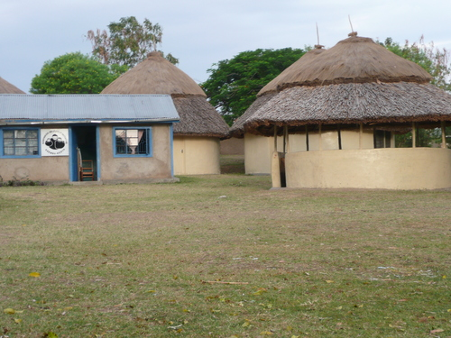
Mar-Apr
Nov-Dec
Jan
1999
Dec
1996
1,400 mm/year
79 Villages
2,500 Compounds
~17,000 Inhabitants
Notes:
Primarily subsidence farming with maize as staple

Slide 3
ITN’s affect on mosquitoes numbers
40 of 79 villages selected for ITN distribution
Bednets were handed out in Dec of 1996
Mosquito counts began March of 1997
Notes:
Collections were made from 7A to 10A
Treated the house with insecticide and swept up the mosquitoes
Each quarter, 20 control and 20 intervention houses were chosen.
Pyrethrum spray collection
Inspected those houses plus their 10 nearest neighbors

Slide 4
Entomological Results
Notes:
Rains Mar-Apr and Dec-Nov
Funestus is more present than anopheles

Slide 5
Entomological Results
Notes:
Rains Mar-Apr and Dec-Nov
Funestus is more presen

Slide 6
Reduction Effect of Variables
Variable | Value | An. Gam. Reduction | An. Fun. Reduction
Reside in Intervention Village |  | 58.5 | 94.5
Number of people in the house under bednets | All | 77.8 | 97.0
 | At lest 1 | 23.8 | 96.9
 | none | 5.2 | 82.2
Time since ITN treatment (days) | <90 | 82.0 | 98.9
 | 90-180 | 63.4 | 96.9
 | >180 | 16.9 | 84.2
Number of ITNs in a house | 1 | 42.6 | 92.4
 | 2 | 62.9 | 95.0
 | >2 | 77.0 | _
Notes:
Using poisson regression, evaluate the effect of variables

Slide 7
Local Effect of ITNs
Intervention
Compounds
Control
Compounds

Slide 8
Local Effect of ITNs
Mosquito | Distance (m) | Pre-Intervention | Post- Intervention
An. Gambiae | 0-299 | 0.74 | 0.48
 | 300-599 | 0.71 | 0.44
 | 600-899 | 0.79 | 0.68
 | >900 | 1 | 1
An. Funestus | 0-299 | 1.11 | 0.42
 | 300-599 | 1.15 | 0.62
 | 600-899 | 0.98 | 1.10
 | >900 | 1 | 1

Slide 9
How Much Did it All Cost
Capital Costs | Recurrent Costs
Vehicles | Permethrin
Furniture/Equipment | Staff $52,000/year
ITNs | Fuel/Maintenance
 | Office Rental
 | Training
 | Supplies $100,000/year
$320,000
$725,700
$181,425/year

Slide 10
Economic Savings
$53,567 less on child health care per year
$5,621 saved on funeral expenses
$1,024 saved on health center visits
Net annual cost: $88,644
Notes:
$6.50 per child $0.44 per doctor visit
$77 per family per year

Slide 11
Resource Savings
73 child deaths averted per year
62,500 people protected
3,540 life-years gained
Cost per life year saved: $25

