Slide 1
Notes:
A14D-03

Slide 2
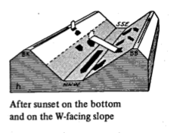
Evening Transition
Shadow Front – Definition
“The current is extremely sensitive to changes in the insolation, and a temporary shading of the slopes will cause an immediate response by the wind. Also, the differences in the starting time of the current is determined by the varying time at which insolation begins on slopes of different exposures.”
- F. Defant (1951)
Illustration of a Shadow Front in the Dischma Valley,
From Hennemuth and Schmidt, 1985 referring to the work of Urfer Henneberger, 1970
Notes:
Sometimes referred to as Shade Boundary

Slide 3
Shadow Front
Generalizing the Impact of Shadow Fronts on slope valley transition dynamics and turbulence
La Fouly-Suisse
Nadeau et al. 2012
QJRMS
East Slope
MATERHORN, Utah
Meteor Crater, Arizona
Martinez et al. 2013, JAMC
sun
sun
shade
shade
Shadow Fronts on Steep Slopes:
Rapid transition in surface radiation & surface temperature
Winds & turbulence transition up the slope closely following shadow
Shadow Front follows a balance between buoyancy and inertial forces (Hunt et al. 2003, JAS)
Questions to be addressed here:
Are there shadow front generalizations?
Is East Slope of Granite Peak in a steep slope regime?
Notes:
Previous work has inconsistent response due
La Fouly – Delay of wind shift from local sunset: 15 minutes Rapid Response
Meteor Crater – Delayed responses WD: ~ 1hr after sunset on west upper slope to before sunset on crater floor,
Very little consistentcy – depends on TKE level, cloud cover

Slide 4

MATERHORN-X Team
Collaborators
IIBR, Israel
University of Vienna, Austria
Institut Mational de la Recherche Scientifique
Army Research Laboratory
NCAR
Princeton University
Oregon State University
University of Colorado, Boulder

Slide 5
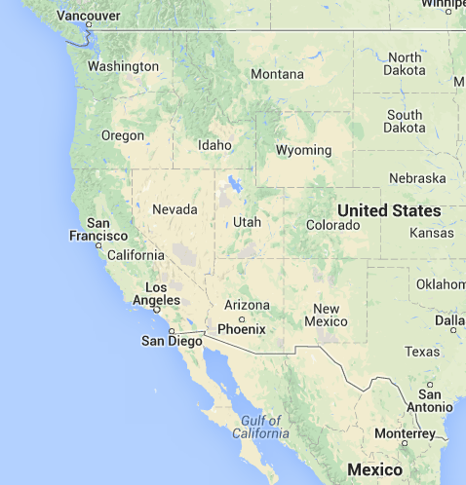
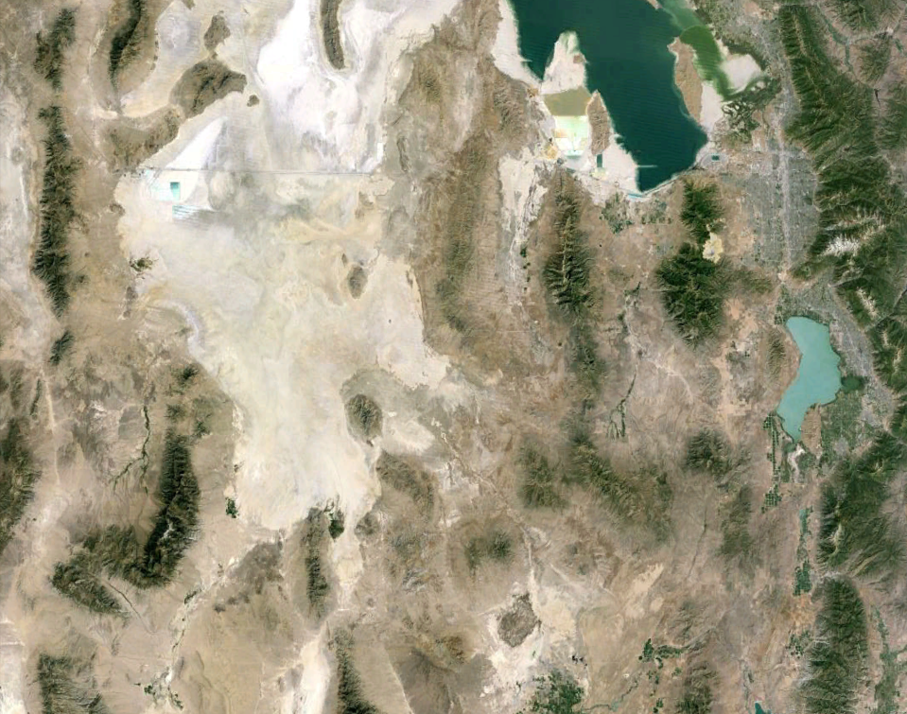
Dugway Proving Ground – Utah’s West Desert
Great Salt Lake
Playa
Granite Peak
Notes:
Granite peak 7082 ft (2160 m) – 1330 m
830 m delta

Slide 6
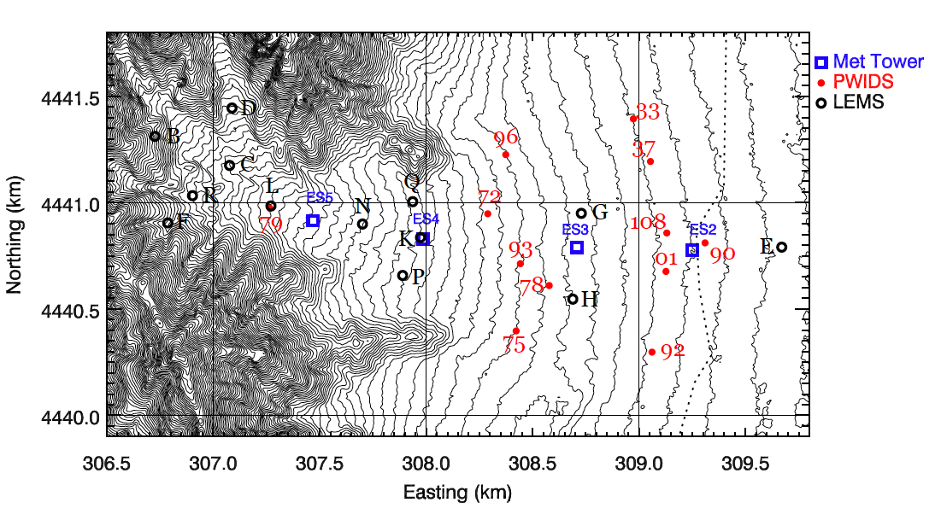
Focus Area
East Slope of Granite Peak

Slide 7
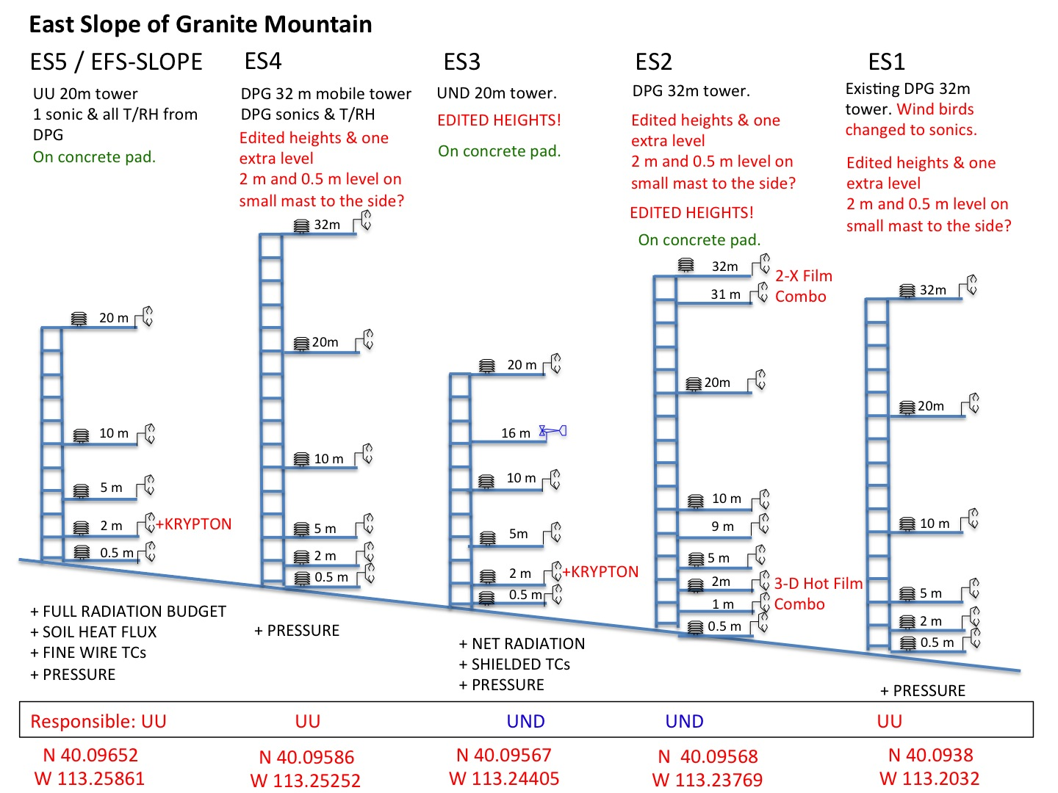
East Slope Experiment
Notes:
FLIR Systems ThermoCAM SC4000 IR camera – 1/10 Hz acquisition

Slide 8
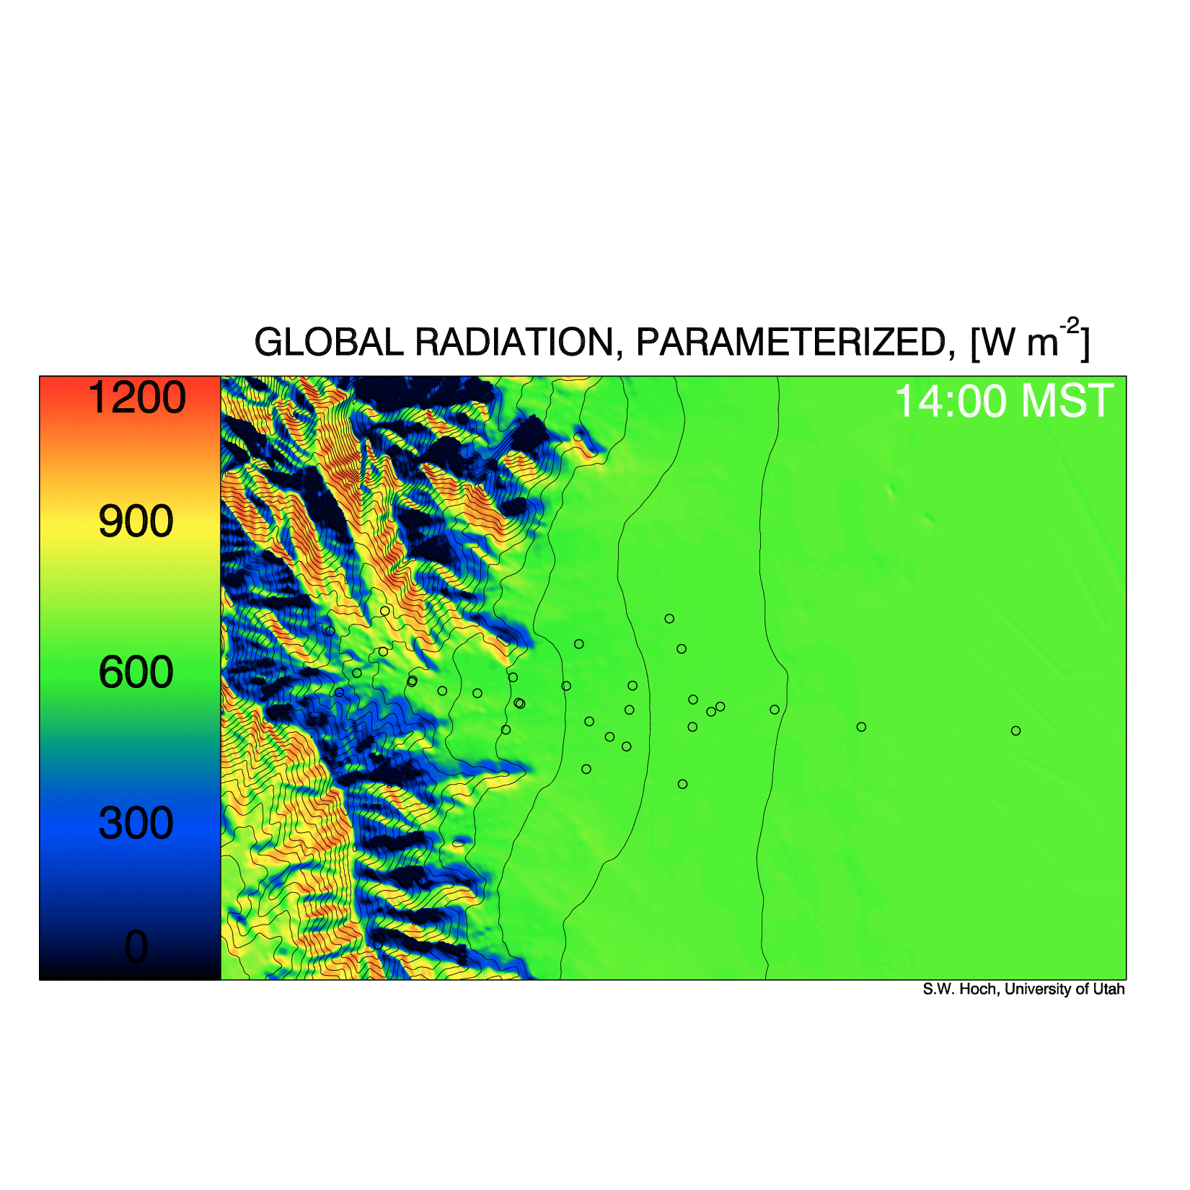
Shadow Front
Computed Global Radiation October 17, 2012
Notes:
This movie gives us an idea of the forcing and how we might expect the surface temperature, etc. to respond.

Slide 9
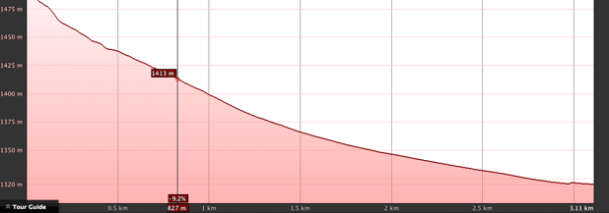
Wind Direction Transition
Local sunset
Downslope
ES5
SS
Wind Shift Delays from local sunset:
ES5 ~ 45 min
ES4 ~ 40 min
ES3 ~ 28 min
ES4
SS
ES3
SS
Upslope
ES5
ES4
ES3
ES2
Notes:
Winds do NOT track the shadow front: As seen in the movie all stations except ES1 (far down in the valley) change direction at nearly the same time between 17-17h10
Start looking at other nights

Slide 10
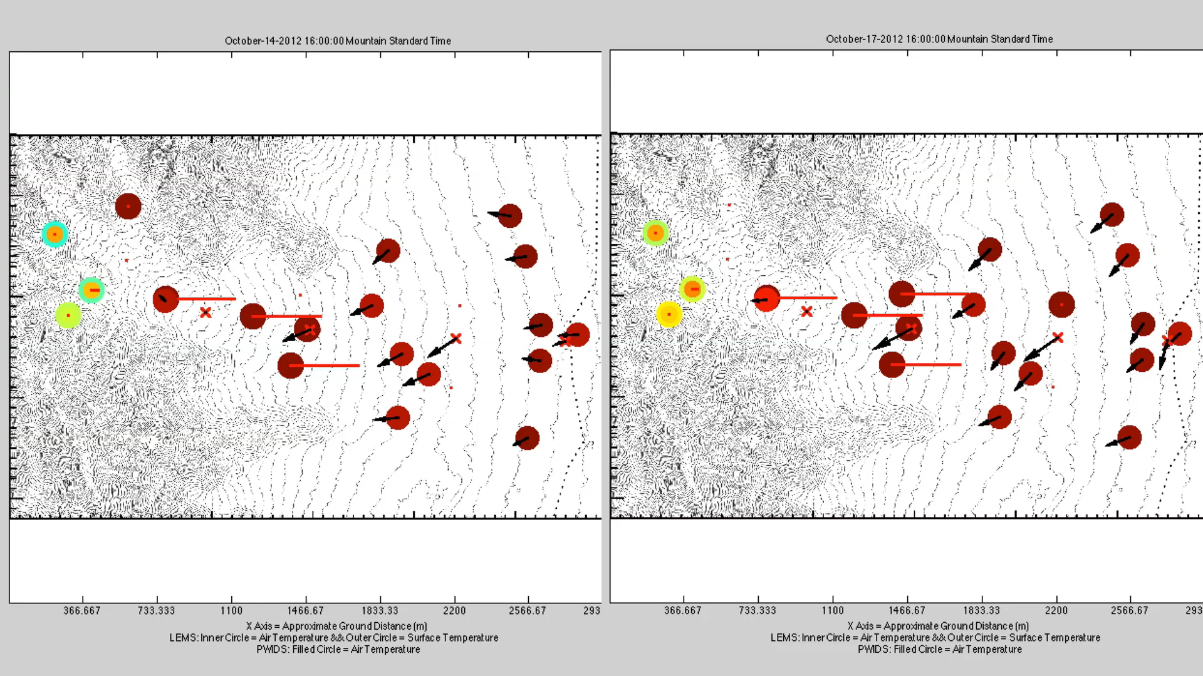
Slope Transition
Non-local Front
“Sliding Slab” Transition (Local)
ES5
upslope
ES4
upvalley
Notes:
Sunset was ~ 19:51 local (MDT) or 18:51 MST

Slide 11
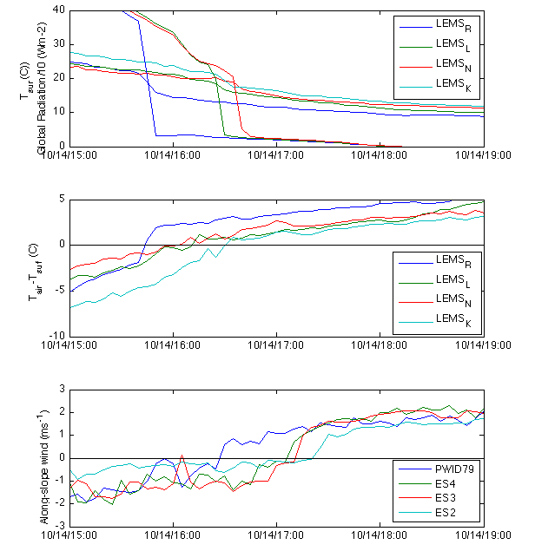
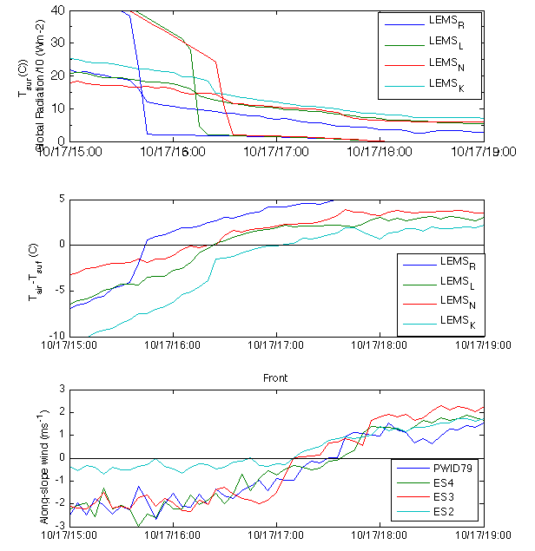
Transition Profiles
Non-local Front
“Sliding Slab” Transition (Local)
2m winds
Notes:
Temperatures are higher on the 14th – Front day

Slide 12
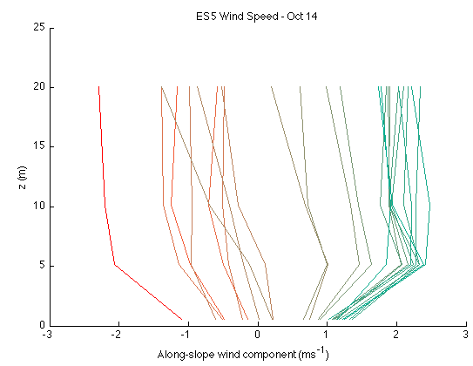
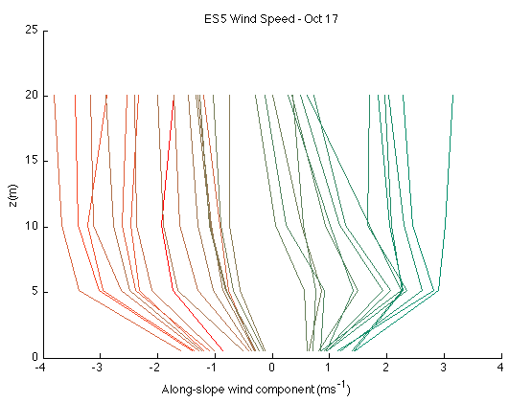
Transition Profiles
Non-local Front
“Sliding Slab” Transition (Local)
Upslope Flow
Downslope Flow
Upslope Flow
Downslope Flow
See Fernando et al. 2013 BLM for discussion on these two transitions
Notes:
Temperatures are higher on the 14th – Front day

Slide 13
Summary
Shadow Front
  Winds on East Slope do not obviously transition with the shadow front
  Not a strong driver in this mountain geometry
Multiple Transition Phenomena:
  Evidence of the existence of both
    Non-local Front
    Slab-cooling
    See Fernando et al. 2013 BLM 147:443–468
This research was funded by the Office of Naval Research Award # N00014-11-1-0709, Mountain Terrain Atmospheric Modeling and Observations (MATERHORN) Program. Additional support for the Twin Otter was provided by the Environmental Sciences group at the Army Research Office (ARO).

Slide 14
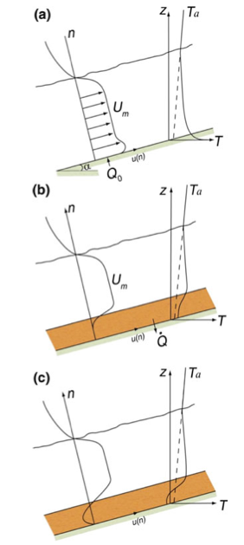
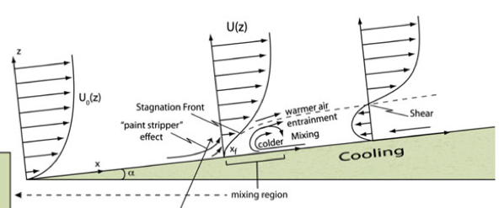
Transition Profiles
Non-local Front
“Sliding Slab” Transition (Local)
From Fernando et al. 2013 BLM
Notes:
Temperatures are higher on the 14th – Front day

Slide 15
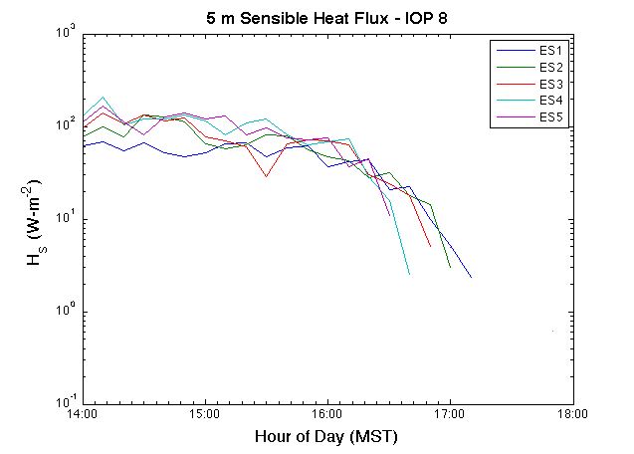
Near Surface Sensible Heat Flux
ES5
ES4
ES3
ES2

Slide 16
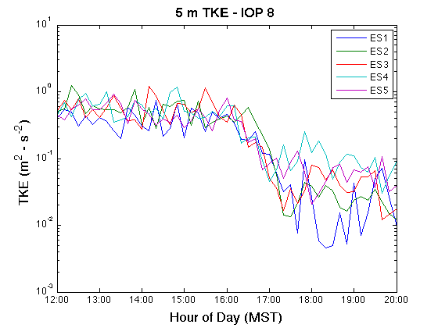
TKE Decay
ES5
ES4
ES3
ES2

Slide 17
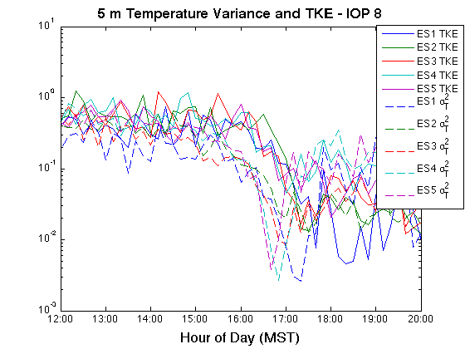
TKE &Temperature Fluctuations Decay
ES5
ES4
ES3
ES2
Notes:
As expected sigma T decays earlier, but both decay in order of shading. It is just very weekly correlated.

