Slide 1
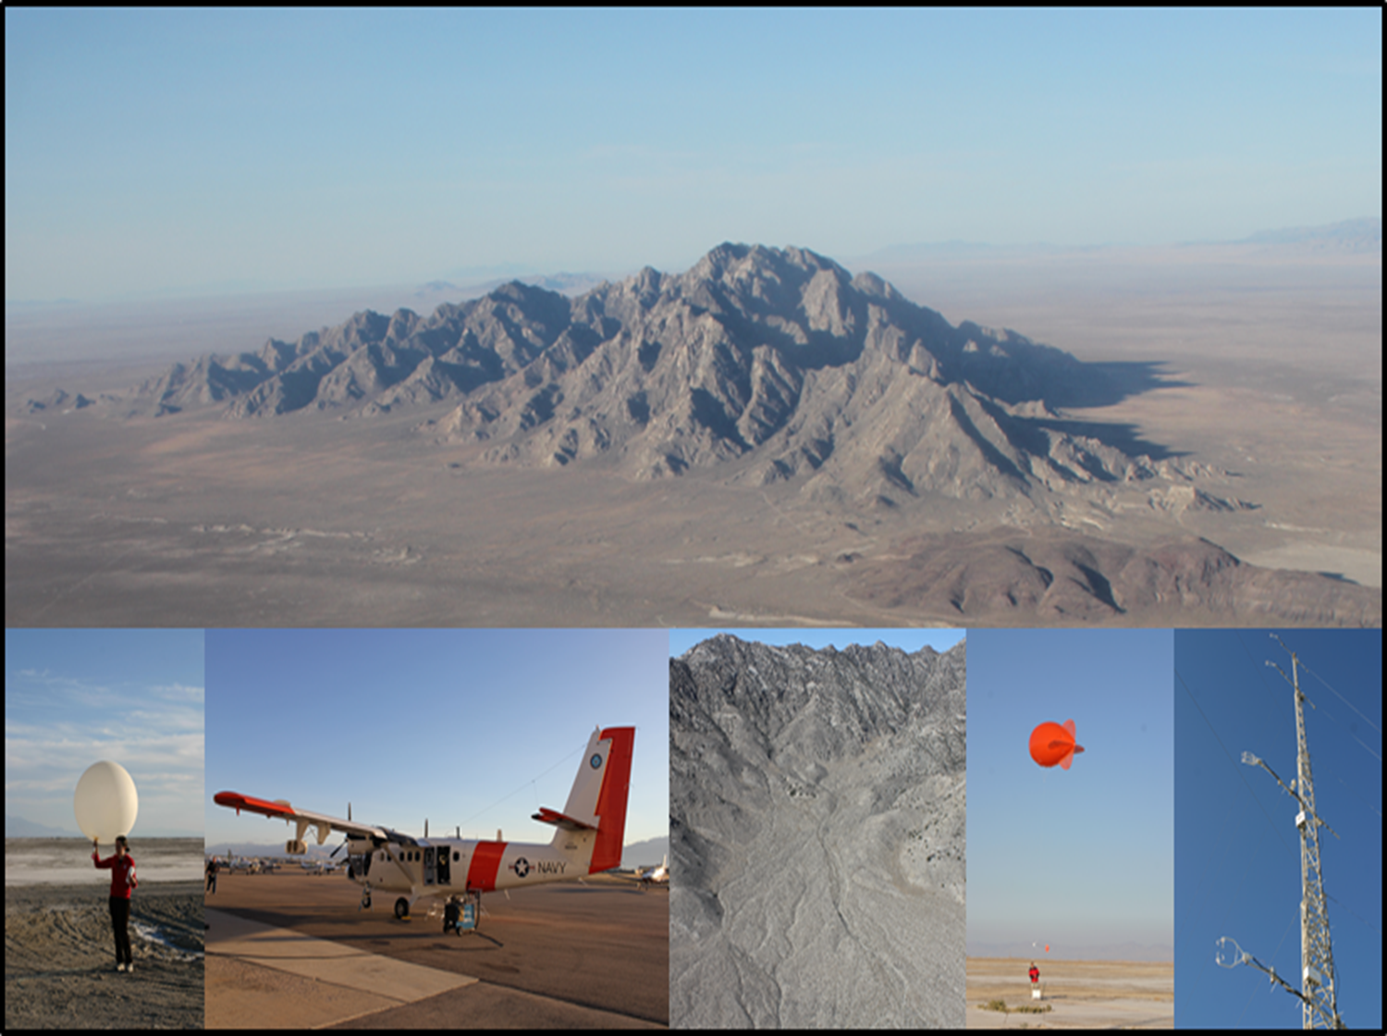
Observations and simulations of the wind structure in the boundary layer around an isolated mountain during the MATERHORN field experiment
Stephan F.J. De Wekker¹, Y. Liu², J.C. Knievel²,
S. Pal¹, G. D. Emmitt³
1. University of Virginia, Charlottesville, VA, United States.
2. National Center for Atmospheric Research, Boulder, CO, United States.
3. Simpson Weather Associates, Charlottesville, VA, United States
AGU meeting, San Francisco
9 December 2013

Slide 2
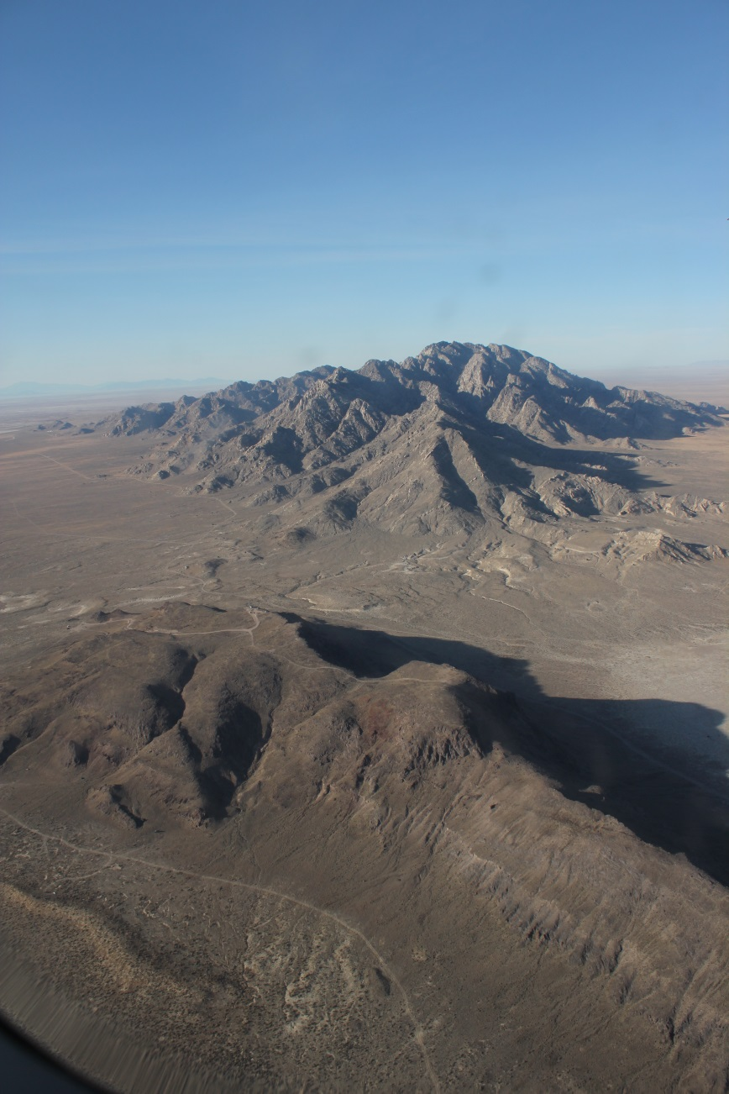
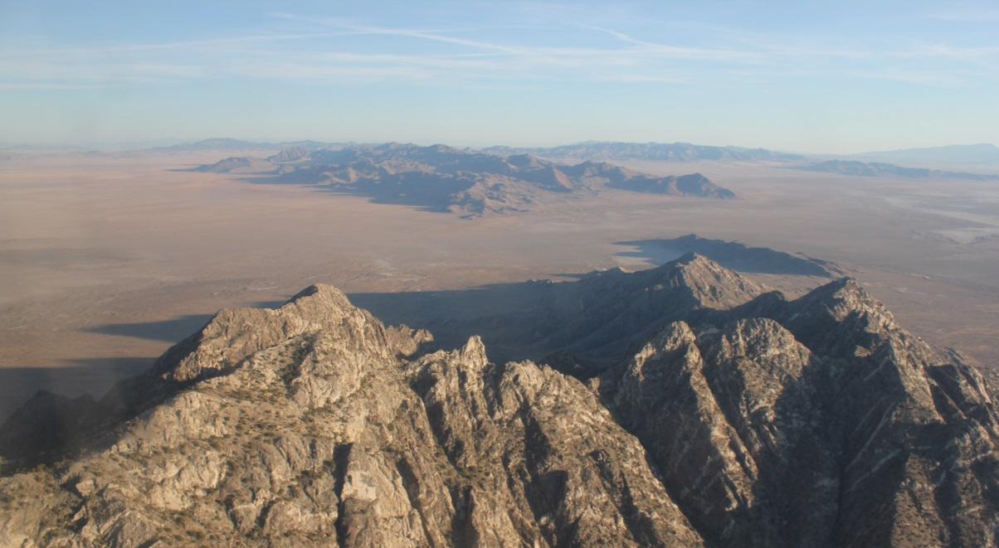
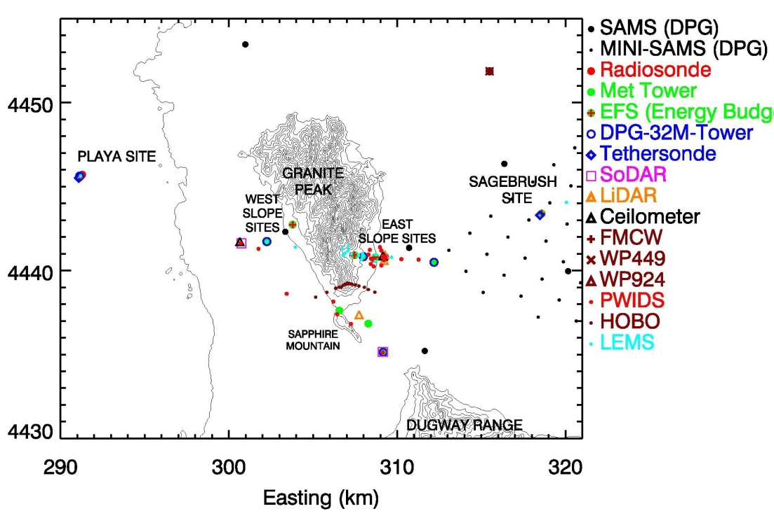
MATERHORN FIELD SITE
Looking north
Looking south
Dugway Range
Sapphire Mountain
Granite Mountain
Granite Mountain
Sapphire Mountain

Slide 3
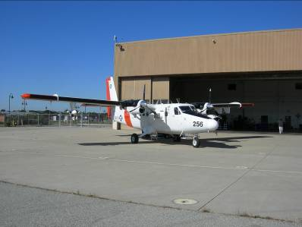
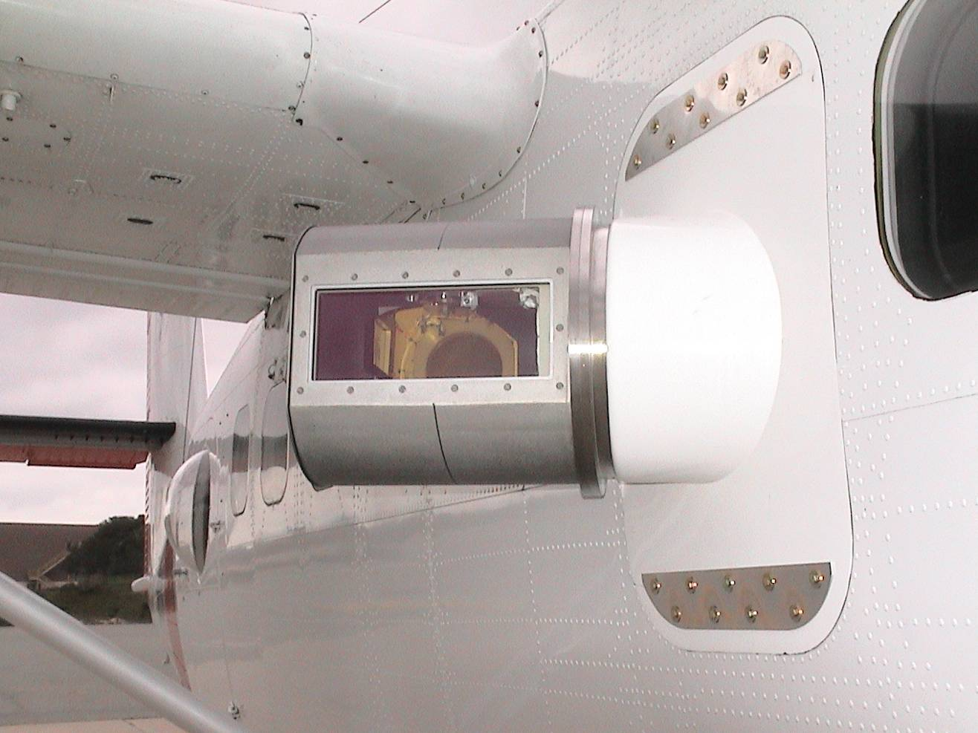
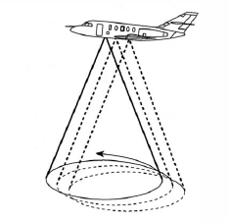
Twin Otter Doppler Wind Lidar
TODWL (Twin Otter Doppler Wind Lidar) has been operated since 2002 by CIRPAS (Center for Interdisciplinary Remotely Piloted Aircraft Studies), a part of the Naval Postgraduate School, Monterey, CA.
U,V,W with 50 m vertical resolution, and 1.5 km horizontal resolution
Accuracy: < 0.10 m/s in three wind components
SNR (aerosols)
TODWL SCANNER
2 µm coherent detection
side door mounted scanner
conical scans below the aircraft
azimuth angle steps of 30°

Slide 4
Main objectives of MATERHORN- airborne measurements
Provide MATERHORN with high resolution wind data at the mesoscale that provide the background information needed to interpret the many surface-based remote sensing and in-situ observations collected around Granite Mountain
Investigate spatial PBL structure and interaction of boundary layer flows with Granite Mountain

Slide 5
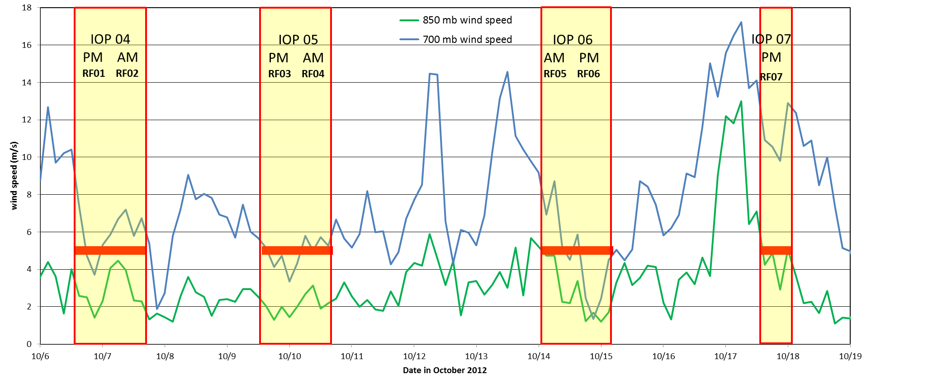
MATERHORN-X Fall - airborne
Twin Otter in Utah between 5 October and 18 October, 2012, participated in 4 IOPs
Missions lasted ~ 4 hours
7 research flights yielded ~3000 wind profiles between surface and 3400 m MSL
Rainfall event
quiescent
quiescent
quiescent
moderate

Slide 6
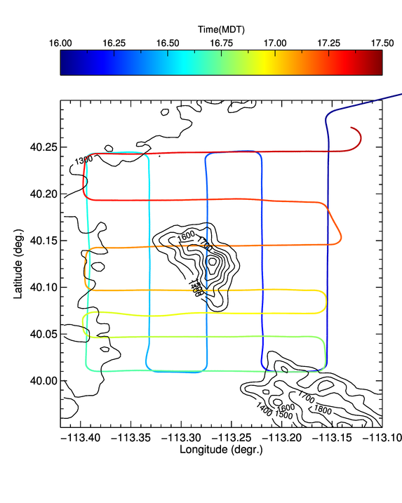
Example Flight pattern 09 October 2012
Afternoon flight (RF03)
Aircraft was based out of Salt Lake City ~ 20 minute to Granite Mountain
Climb to ~ 4 km MSL (~1500 m above Granite Peak)
North-south and east west legs of ~20-30 km
Low level flights

Slide 7
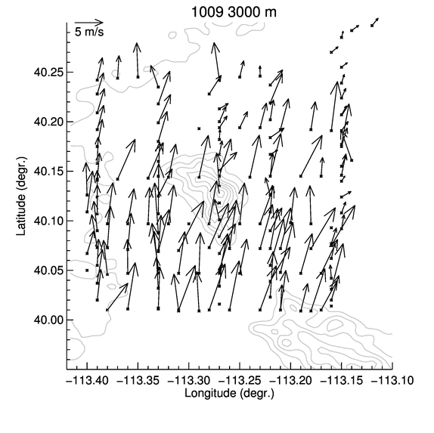
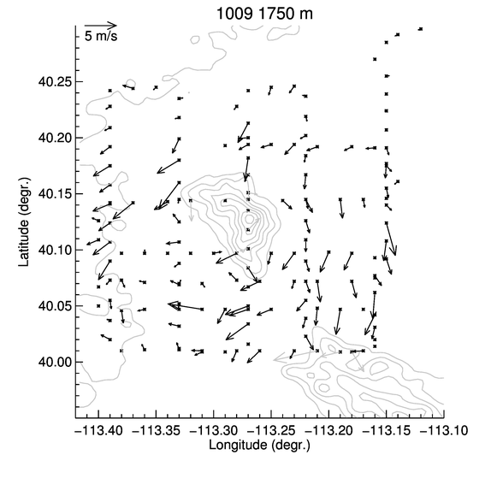
wind pattern 09 October 2012
Upper-level flow
Near-surface flow (~400 m AGL)

Slide 8
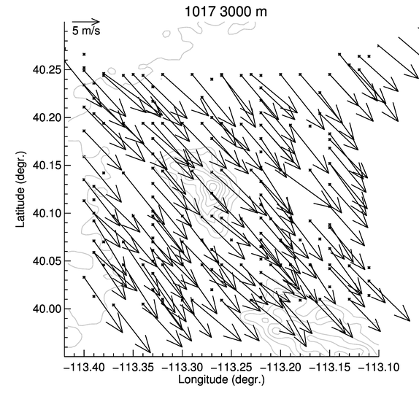
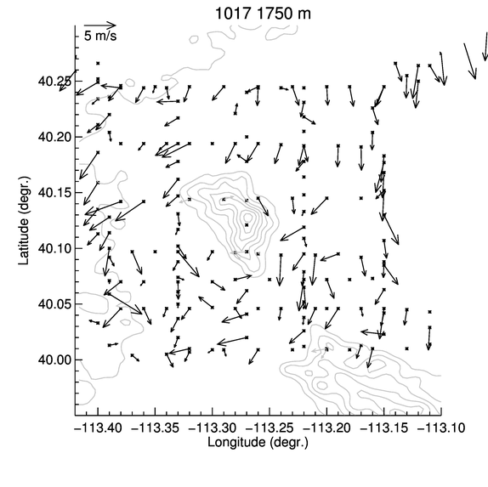
wind pattern 17 October 2012
Upper-level flow
Near-surface flow (~400 m AGL)
Afternoon near-surface flow patterns appears unaffected by synoptic flow speed and direction

Slide 9
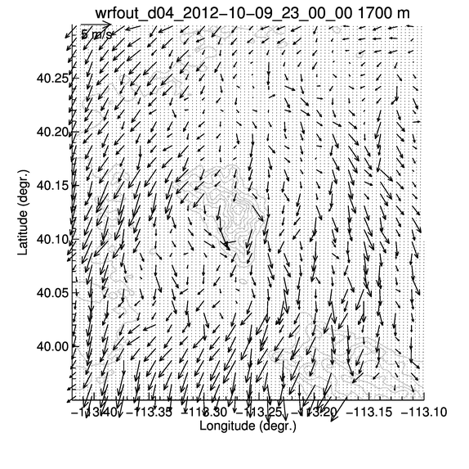
Preliminary example of comparison with Very Large Eddy Simulation (VLES)for Dugway Proving Ground
Near-surface flow (~400 m AGL)
300-m simulation
Courtesy of Yubao Liu, NCAR

Slide 10
Summary
7 successful research fights were conducted during MATERHORN-X collecting data during 4 afternoons and 3 mornings in quiescent to moderate synoptic conditions
Started an investigation of spatio-temporal variability of PBL structure and flow interaction with Granite Mountain
recurring pattern of northerly thermally driven upvalley flows flowing around Granite mountain with channeling through gap.
Very Large Eddy Simulation modeling at 300 m horizontal resolution – shows promising results
Outlook:
vertical velocities,
in-situ aircraft measurement, (fluxes!),
organized convective structures/thermal and interaction with flows,
assimilation of wind data from airborne Doppler lidar data in WRF,
LES simulation at 30-m planned for select cases
etc.
Acknowledgments: This research is funded by grants from the Office of Naval Research, the Army Research Office, and the National Science Foundation.

