Slide 1

Analyzing LHC Data on 10K Cores with Lobster and Work Queue
Douglas Thain
(on behalf of the Lobster Team)

Slide 2

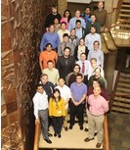
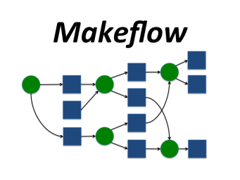
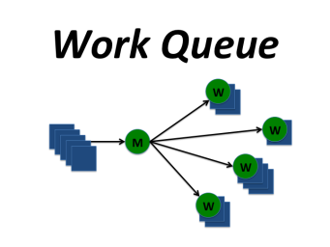
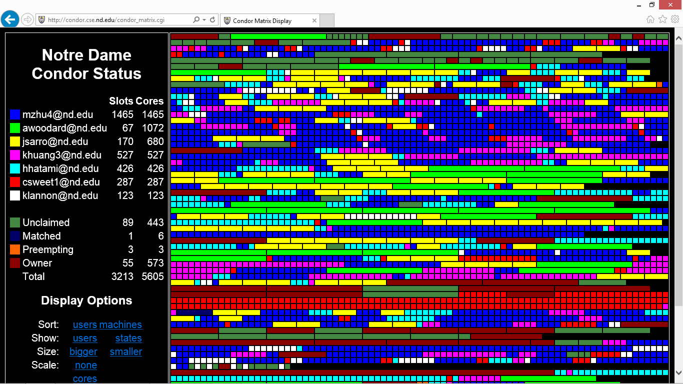
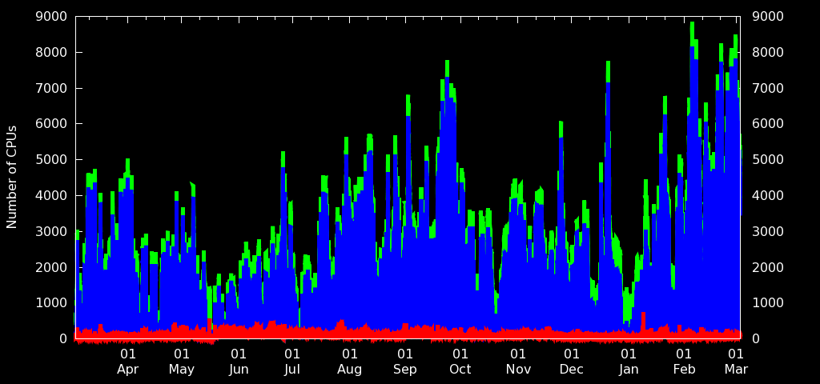
The Cooperative Computing Lab
http://ccl.cse.nd.edu

Slide 3
The Cooperative Computing Lab
We collaborate with people who have large scale computing problems in science, engineering, and other fields.
We operate computer systems on the O(10,000) cores: clusters, clouds, grids.
We conduct computer science research in the context of real people and problems.
We release open source software for large scale distributed computing.
http://www.nd.edu/~ccl

Slide 4
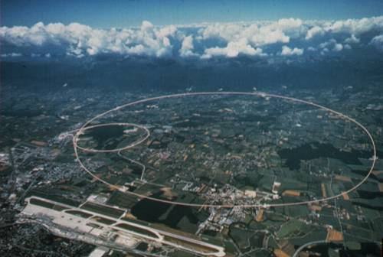
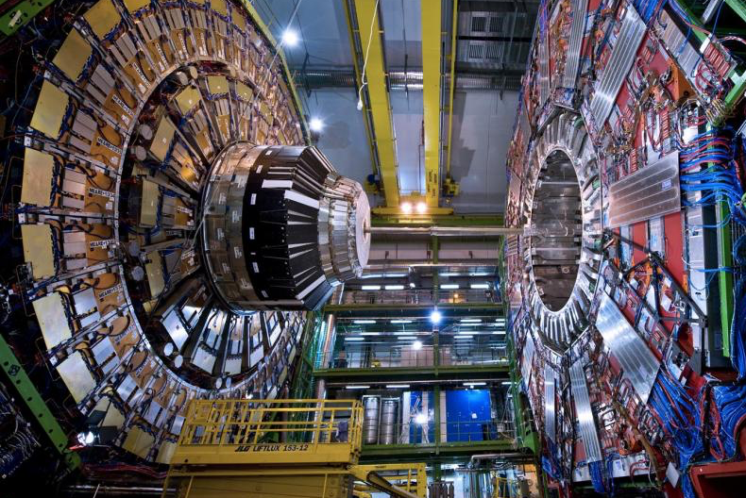
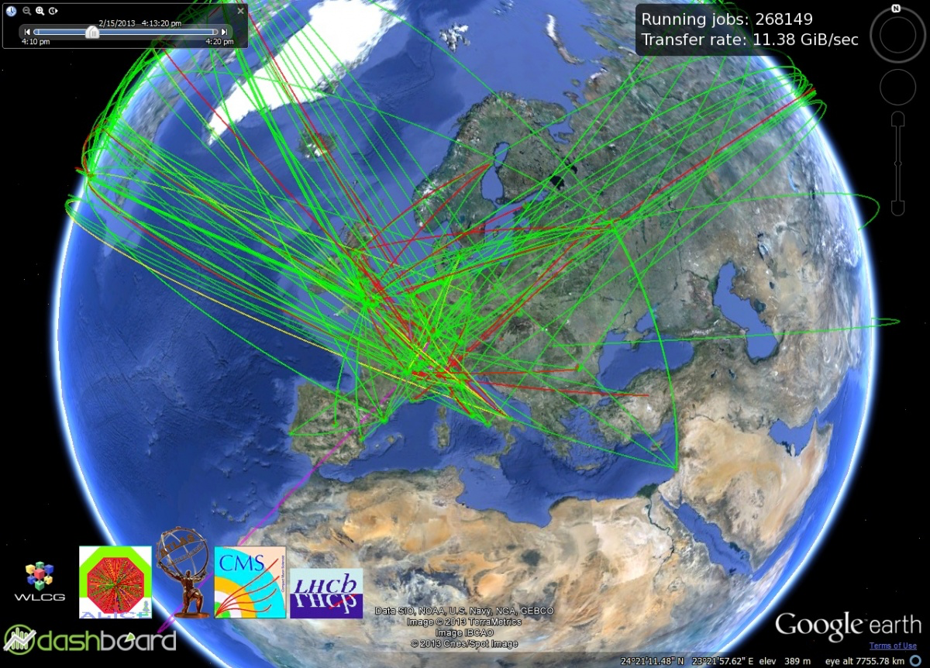
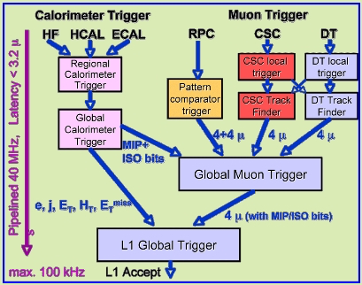
Large Hadron Collider
Compact Muon Solenoid
100 GB/s
Worldwide LHC Computing Grid
Many PB
Per year
Online Trigger

Slide 5


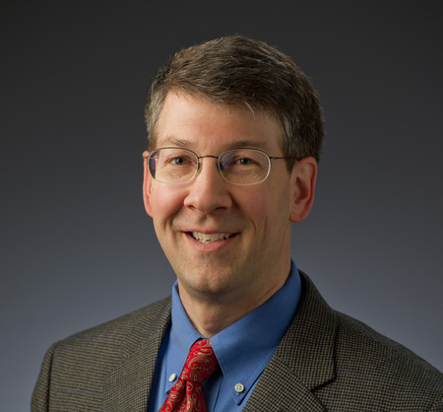

CMS Group at Notre Dame
Matthias Wolf
Anna Woodard
Sample Problem:
Search for events like this:
t t H -> τ τ -> (many)
τ decays too quickly to be observed directly, so observe the many decay products and work backwards.
Was the Higgs Boson generated?
(One run requires successive reduction of many TB of data using hundreds of CPU years.)
Prof. Hildreth
Prof. Lannon

Slide 6
Why not use the WLCG?
ND-CMS group has a modest Tier-3 facility of O(300) cores, but wants to harness the ND campus facility of O(10K) cores for their own analysis needs.
But, CMS infrastructure is highly centralized
  One global submission point.
  Assumes standard operating environment.
  Assumes unit of submission = unit of execution.
We need a different infrastructure to harness opportunistic resources for local purposes.

Slide 7
Condor Pool at Notre Dame

Slide 8
Users of Opportunistic Cycles

Slide 9
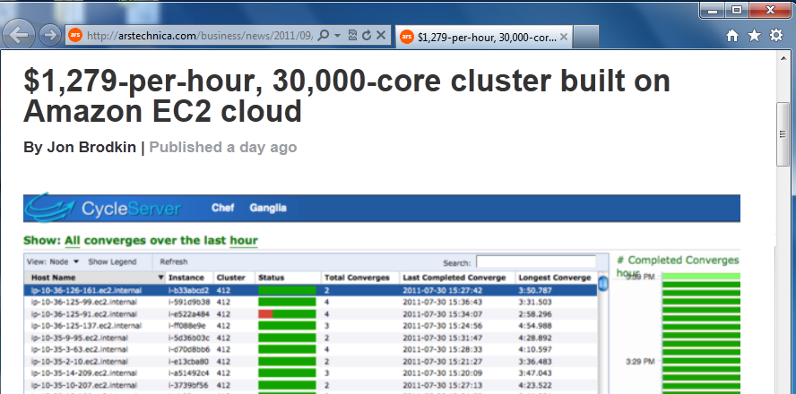
Superclusters by the Hour
http://arstechnica.com/business/news/2011/09/30000-core-cluster-built-on-amazon-ec2-cloud.ars

Slide 10
An Opportunity and a Challenge
Lots of unused computing power available!
And, you don’t have to wait in a global queue.
But, machines are not dedicated to you, so they come and go quickly.
Machines are not configured for you, so you cannot expect your software to be installed.
Output data must be evacuated quickly, otherwise it can be lost on eviction.

Slide 11
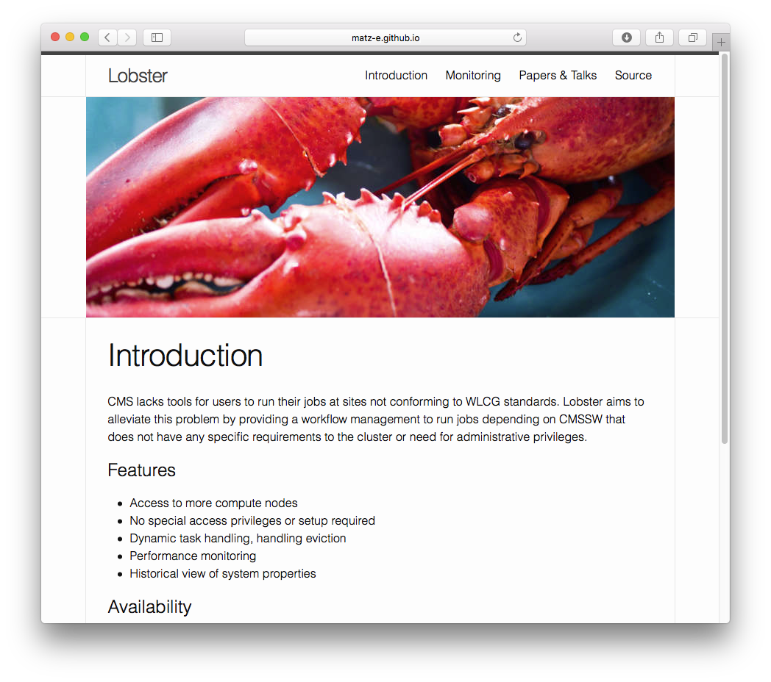
Lobster
A personal data analysis system for custom codes running on non-dedicated machines at large scale.
http://lobster.crc.nd.edu

Slide 12
Lobster Architecture
Analyze( Dataset, Code )
Traditional Batch System
Lobster Master
Merge
W
W
Task
Task
Output Files
W
Task
Submit
Workers
W
W
Output
Storage
Task
Task
W
W
Task
Task
Output Chunks
CVMFS
XRootD
Software
Archive
Data Distribution
Network

Slide 13
Nothing Left Behind!
Analyze( Dataset, Code )
Traditional Batch System
Lobster Master
Output Files
Submit
Workers
Output
Storage
Output Chunks
CVMFS
XRootD
Software
Archive
Data Distribution
Network

Slide 14
Task Management with Work Queue

Slide 15
Work Queue Library
#include “work_queue.h”
while( not done ) {
while (more work ready) {
task = work_queue_task_create();
// add some details to the task
work_queue_submit(queue, task);
}
task = work_queue_wait(queue);
// process the completed task
}
http://ccl.cse.nd.edu/software/workqueue

Slide 16
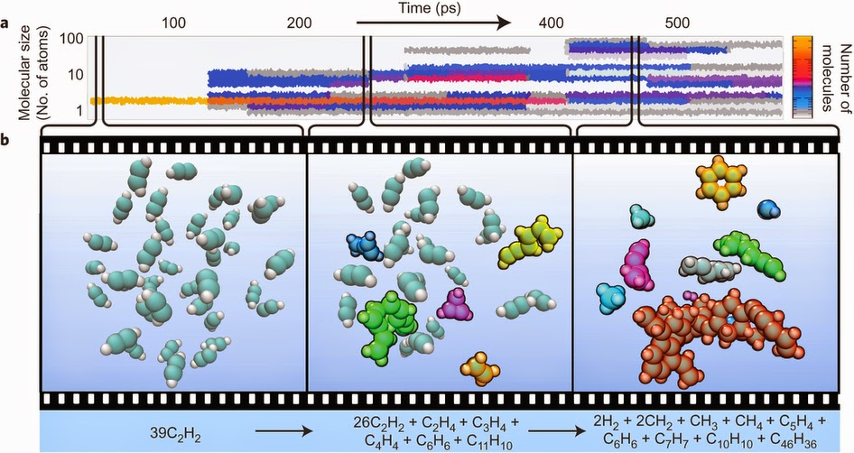
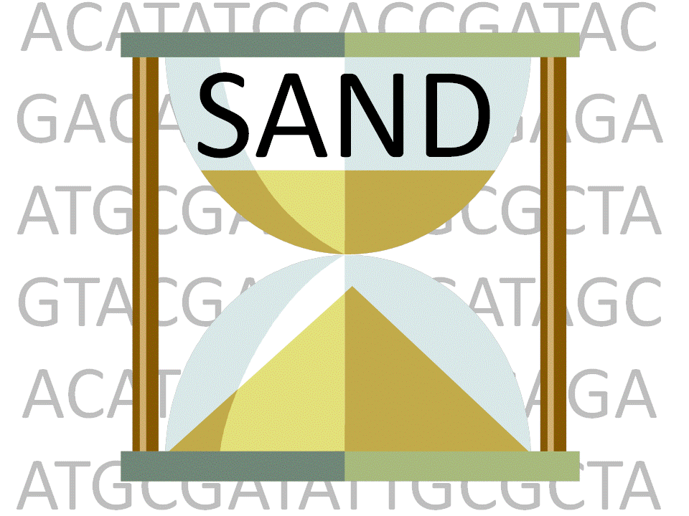
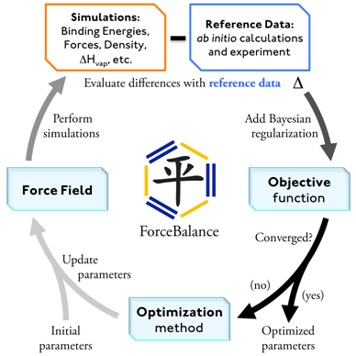
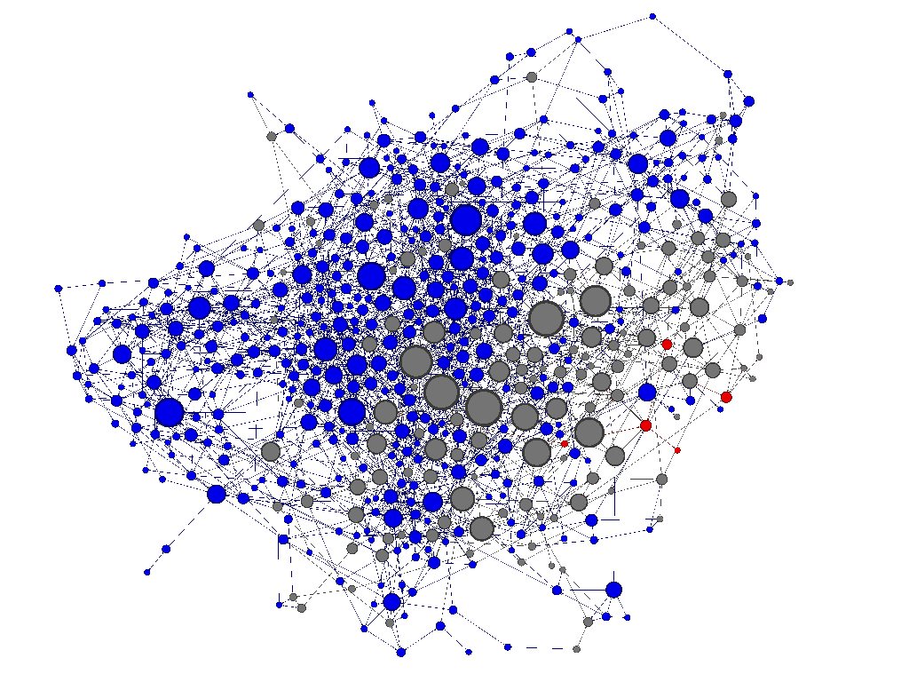
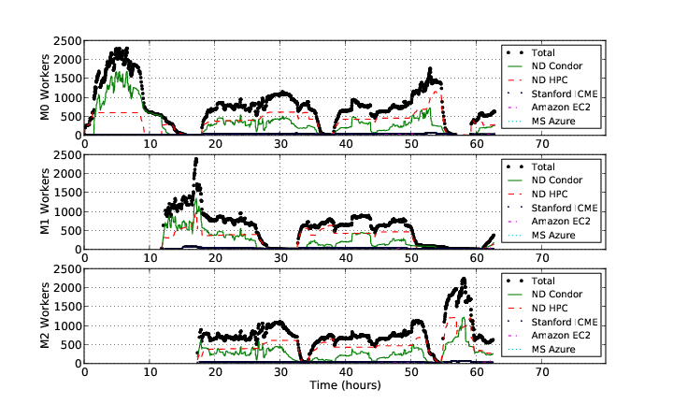
Work Queue Applications
Nanoreactor MD Simulations
Scalable Assembler at Notre Dame
ForceBalance
Adaptive Weighted Ensemble

Slide 17
Work Queue Architecture
Lobster Master Application
Submit Task1(A,B)
Submit Task2(A,C)
Submit
Wait
4-core machine
Work Queue
Master Library
Send files
Worker Process
Send tasks
A
A
A
A
B
C
T
T
C
B
B
C
Local Files and Programs
Cache
Dir
Task.1
Sandbox
Task.2
Sandbox
2-core task
2-core task

Slide 18
Run Workers Everywhere
sge_submit_workers
Private
Cluster
Shared
SGE
Cluster
Lobster
Master
W
W
Thousands of Workers in a
Personal Cloud
W
submit
tasks
W
W
W
Work Queue Master
Campus
Condor
Pool
Public
Cloud
Provider
W
W
W
A
B
C
W
W
W
W
Local Files and Programs
condor_submit_workers
ssh

Slide 19
Scaling Up to 20K Cores
16-core Worker
Lobster Master Application
16-core Worker
Foreman
16-core Worker
16-core Worker
$$$
$$$
Submit
Wait
Work Queue
Master Library
Foreman
16-core Worker
16-core Worker
16-core Worker
$$$
16-core Worker
$$$
Foreman
16-core Worker
A
B
C
16-core Worker
16-core Worker
$$$
16-core Worker
Local Files and Programs
$$$
Michael Albrecht, Dinesh Rajan, Douglas Thain,
Making Work Queue Cluster-Friendly for Data Intensive Scientific Applications,
IEEE International Conference on Cluster Computing, September, 2013.DOI: 10.1109/CLUSTER.2013.6702628

Slide 20
Choosing the Task Size
Setup
100 Event Task
OUT
Setup
100 Event Task
OUT
Setup
100 Event Task
OUT
Small Tasks: High Overhead, low cost of failure, high cost of merging.
Setup
200 Event Task
OUT
Setup
200 Event Task
Large Tasks: Low overhead, high cost of failure, low cost of merging.

Slide 21
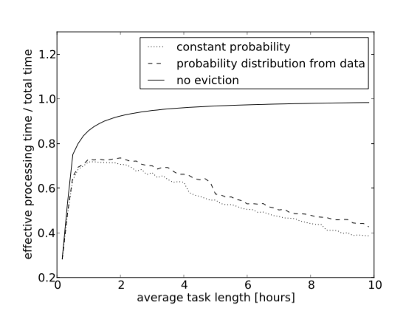
Trace Driven Simulation
Max Efficiency
Ideal Task Size

Slide 22
Software Delivery with Parrot and CVMFS

Slide 23
CMS Application Software
Carefully curated and versioned collection of analysis software, data access libraries, and visualization tools.
Several hundred GB of executables, compilers, scripts, libraries, configuration files…
User expects:
How can we deliver the software everywhere?
  export CMSSW /path/to/cmssw
  $CMSSW/cmsset_default.sh

Slide 24
Parrot Virtual File System
Unix
Appl
Custom Namespace
/home = /chirp/server/myhome
/software = /cvmfs/cms.cern.ch/cmssoft
Capture System
Calls via ptrace
Parrot Virtual File System
File Access Tracing
Sandboxing
User ID Mapping
. . .
Local
iRODS
Chirp
HTTP
CVMFS
Parrot runs as an ordinary user, so no special privileges required to install and use.
Makes it useful for harnessing opportunistic machines via a batch system.

Slide 25
Parrot + CVMFS
CMS
Task
HTTP GET
squid
proxy
HTTP GET
www
server
squid
proxy
squid
proxy
Parrot
Content
Addressable
Storage
data
metadata
CVMFS Driver
data
data
Build CAS
metadata
data
data
CMS
Software
967 GB
31M files
CAS Cache
http://cernvm.cern.ch/portal/filesystem

Slide 26
Parrot + CVMFS
Global distribution of a widely used software stack, with updates automatically deployed.
Metadata is downloaded in bulk, so directory operations are all fast and local.
Only the subset of files actually used by an applications are downloaded. (Typically MB)
Data sharing at machine, cluster, and site.
Jakob Blomer, Predrag Buncic, Rene Meusel, Gerardo Ganis, Igor Sfiligoi and Douglas Thain,
The Evolution of Global Scale Filesystems for Scientific Software Distribution,
IEEE/AIP Computing in Science and Engineering, 17(6), pages 61-71, December, 2015.

Slide 27
Lobster in Production

Slide 28
The Good News
Typical daily production runs on 1K cores.
Largest runs: 10K cores on data analysis jobs, and 20K cores on simulation jobs.
One instance of Lobster at ND is larger than all CMS Tier-3s, and 10% of the CMS WLCG.
Lobster isn’t allowed to run on football Saturdays – too much network traffic!
Anna Woodard, Matthias Wolf, Charles Mueller, Nil Valls, Ben Tovar, Patrick Donnelly, Peter Ivie, Kenyi Hurtado Anampa, Paul Brenner, Douglas Thain, Kevin Lannon and Michael Hildreth,
Scaling Data Intensive Physics Applications to 10k Cores on Non-Dedicated Clusters with Lobster,
IEEE Conference on Cluster Computing, September, 2015.

Slide 29
Running on 10K Cores

Slide 30
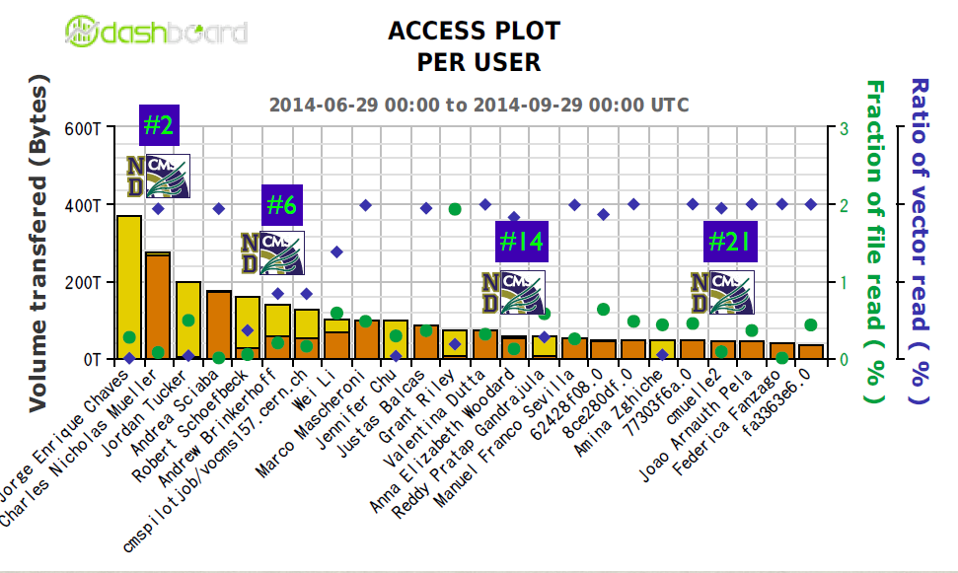
Lobster@ND Competitive with CSA14 Activity

Slide 31
The Hard Part:
Debugging and Troubleshooting
Output archive would mysteriously stop accepting output for >1K clients. Diagnosis: Hidden file descriptor limit.
Entire pool would grind to a halt a few times per day. Diagnosis: One failing HDFS node in an XRootD node at the University of XXX.
Wide are network outage would cause massive fluctuations as workers start/quit. (Robustness can be dangerous!)

Slide 32
Monitoring Strategy
Lobster Master
Traditional Batch System
Performance
Observed
By Task
wqidle 15s
wqinput 2.3s
setup 3.5s
stagein 10.1s
scram 5.9s
run 3624s
wait 65s
stageout 92s
wqooutwait 7s
wqoutput 2s
W
W
Task
Task
setup 3.5s
stagein 10.1s
scram 5.9s
run 3624s
wait 65s
stageout 92s
W
Monitor
DB
Task
W
W
Task
Task
W
W
Task
Task
Output
Archive
CVMFS
XRootD
Software
Archive
Data Distribution
Network

Slide 33
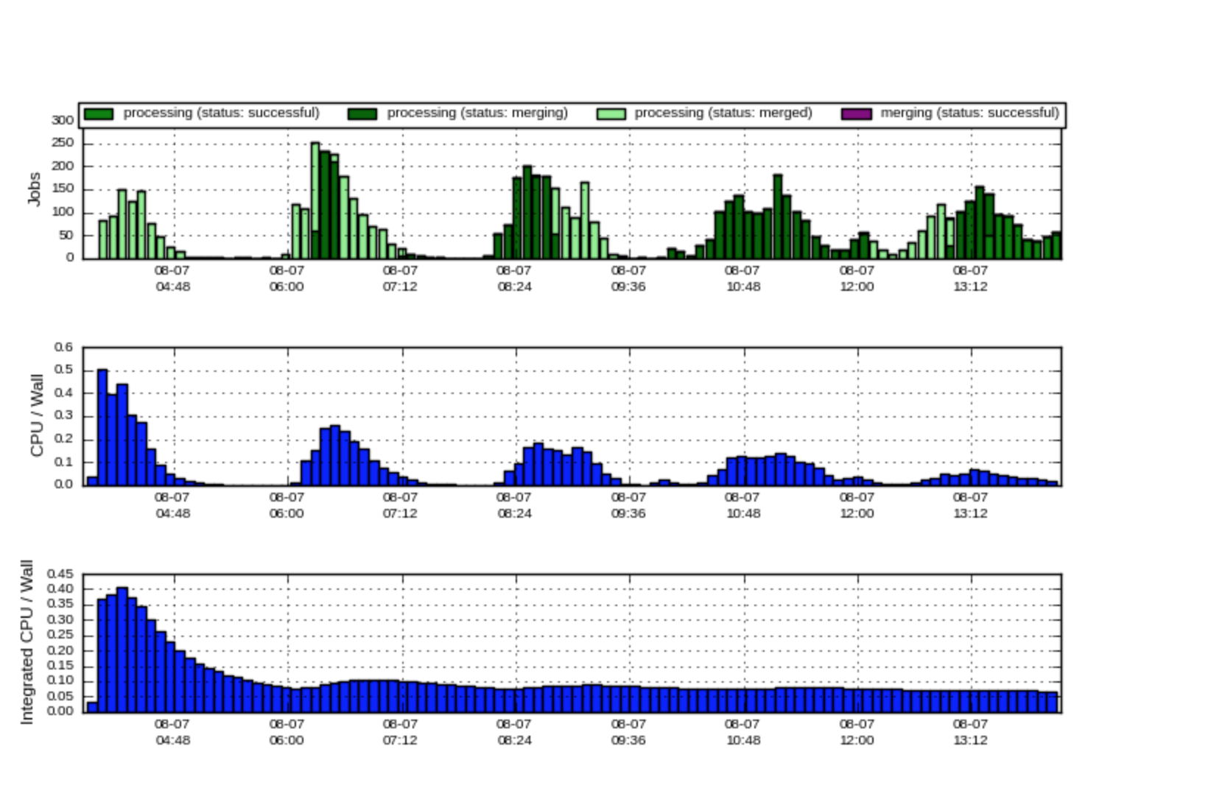
Problem: Task Oscillations

Slide 34
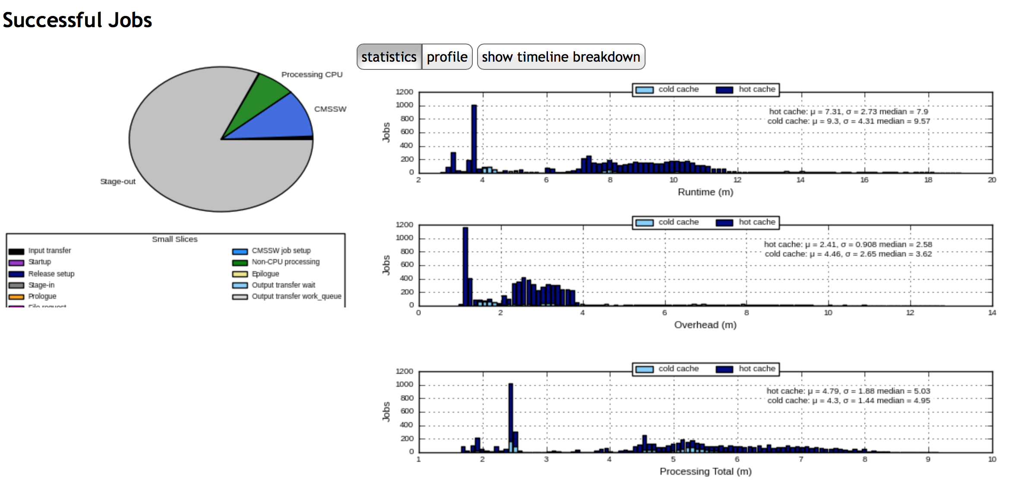
Diagnosis: Bottleneck in Stage-Out

Slide 35
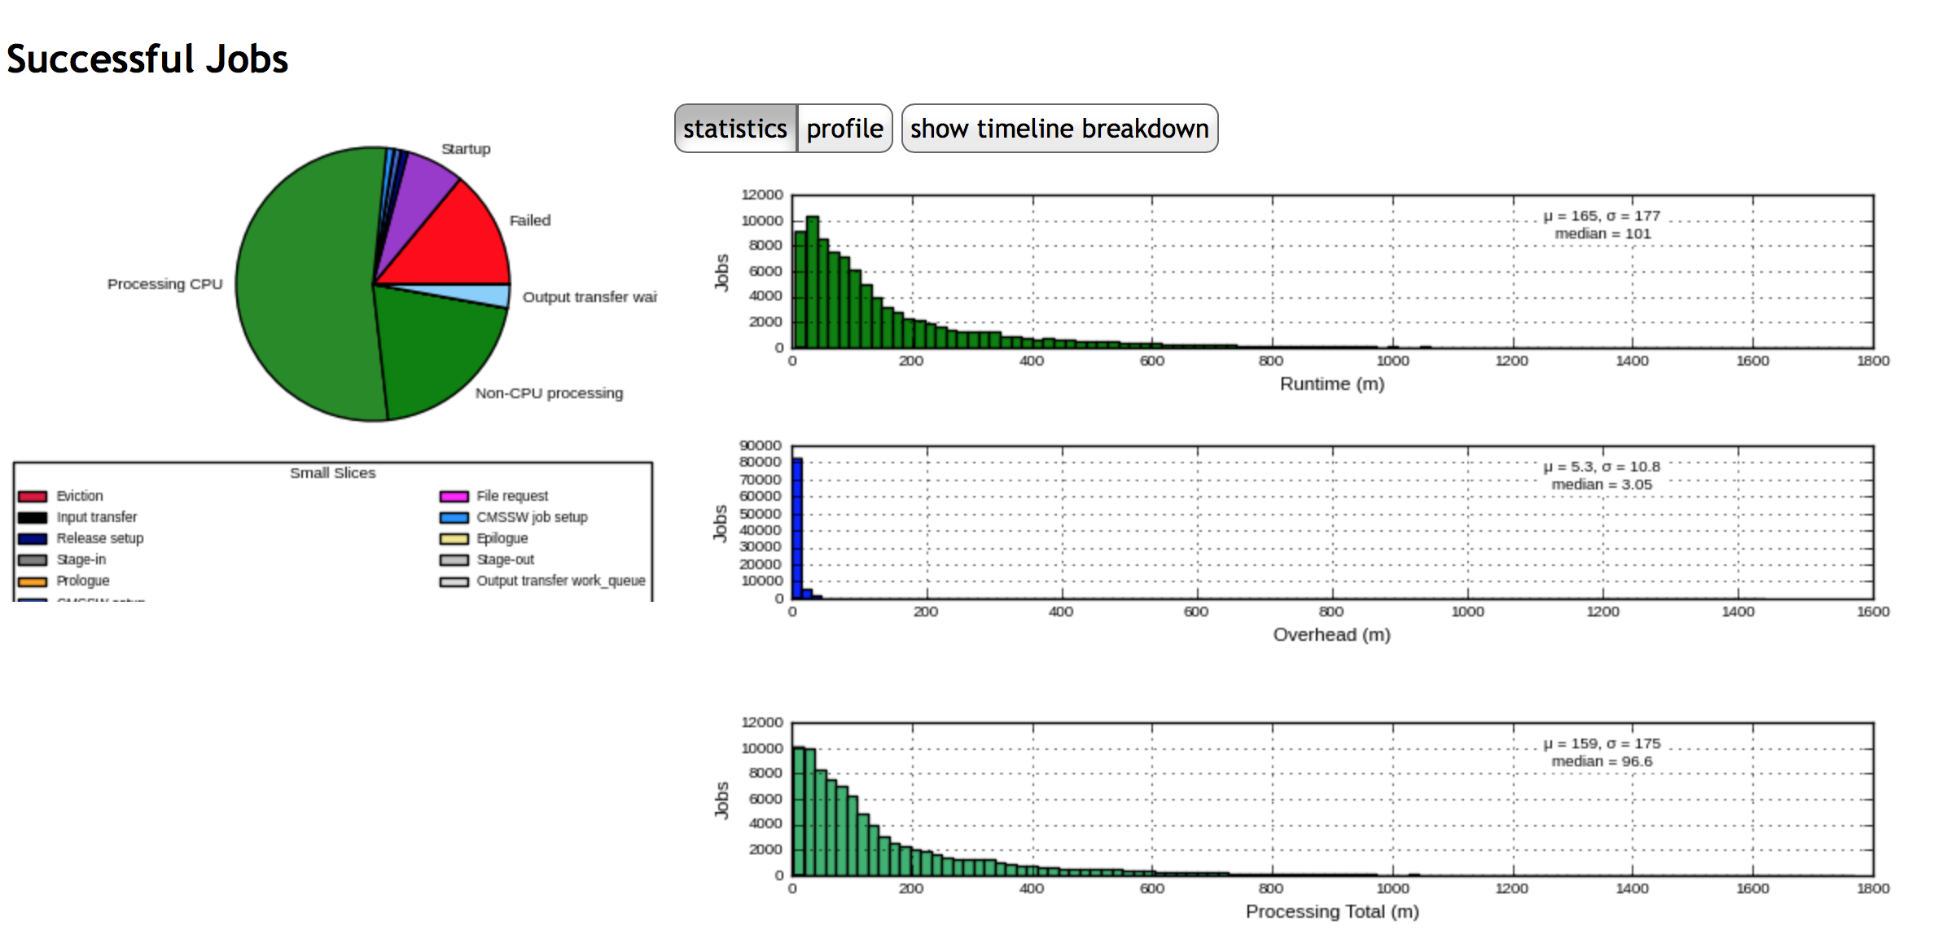
Good Run on 10K Cores

Slide 36
Lessons Learned
Distinguish between the unit of work and the unit of consumption/allocation.
Monitor resources from the application’s perspective, not just the system’s perspective.
Put an upper bound on every resource and every concurrent operation.
Where possible, decouple the consumption of different resources. (e.g. Staging/Compute)

Slide 37

Acknowledgements
Notre Dame CMS Team
Anna Woodard
Matthias Wolf
Chales Mueller
Nil Valls
Kenyi Hurtado
Kevin Lannon
Michael Hildreth
CCL Team
Ben Tovar
Peter Ivie
Patrick Donnelly
Center for Research Computing
Paul Brenner
Sergeui Fedorov
HEP Community
Jakob Blomer – CVMFS
David Dykstra - Frontier
NSF Grant ACI 1148330: “Connecting Cyberinfrastructure with the Cooperative Computing Tools”

Slide 38
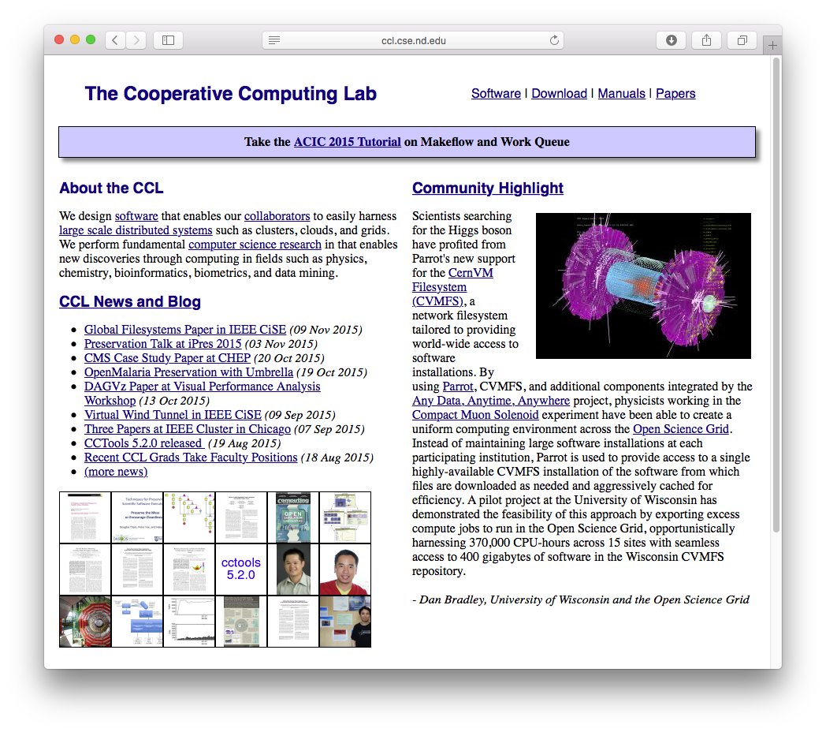

The Lobster Data Analysis System
  http://lobster.crc.nd.edu
The Cooperative Computing Lab
  http://ccl.cse.nd.edu
Prof. Douglas Thain
  http://www.nd.edu/~dthain
  @ProfThain

