Slide 1
A Tale of Two Depressions

Slide 2
World: Then and Now

Slide 3
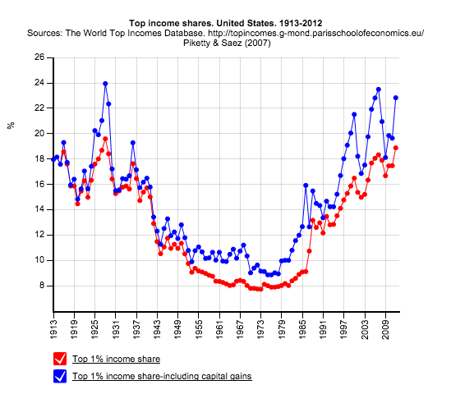
United States: Then and Now

Slide 4
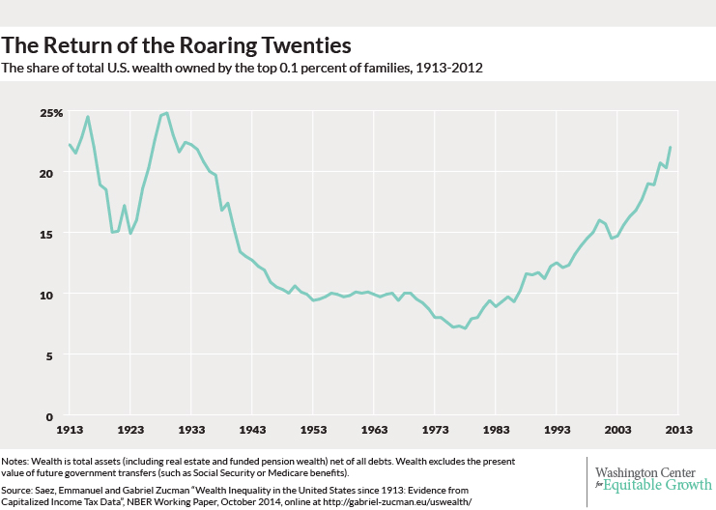

Slide 6
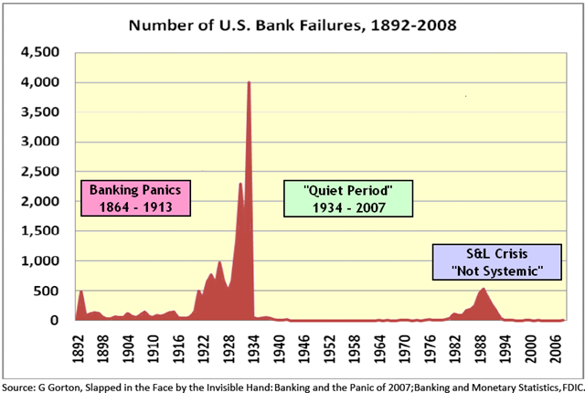
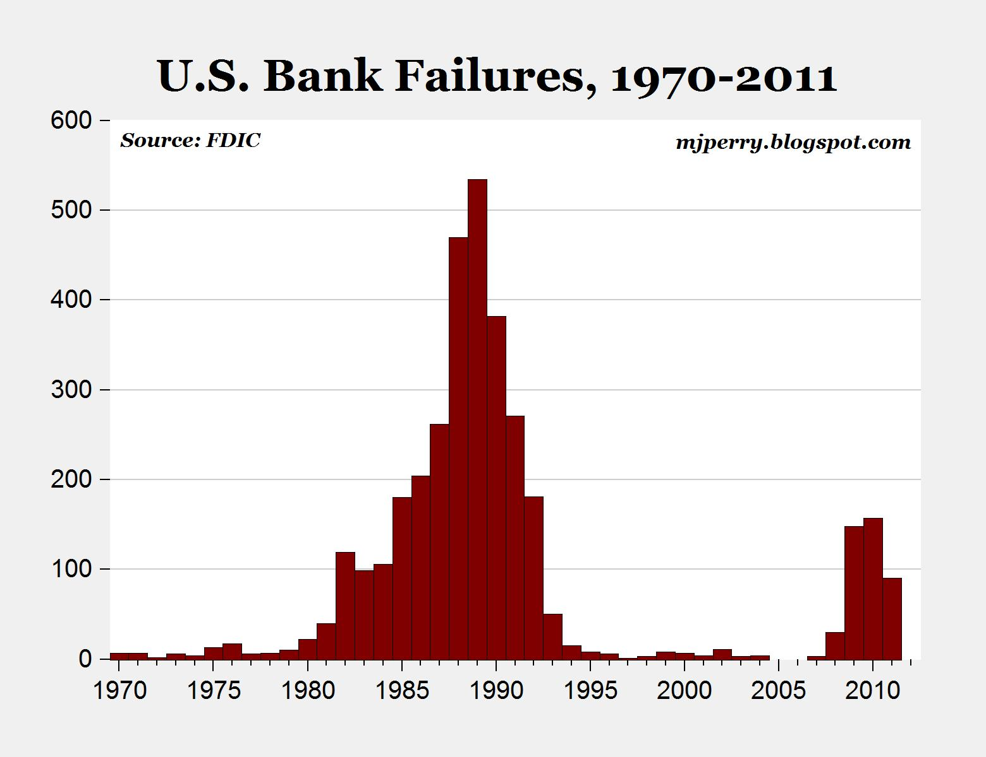

Slide 7
First Great Depression

Slide 8
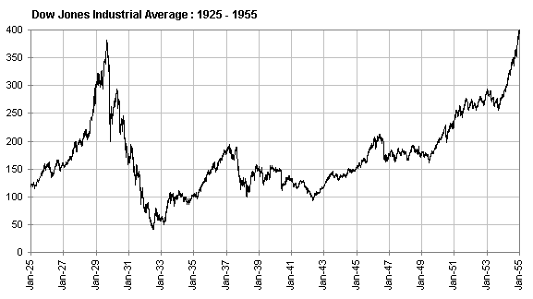

Slide 9
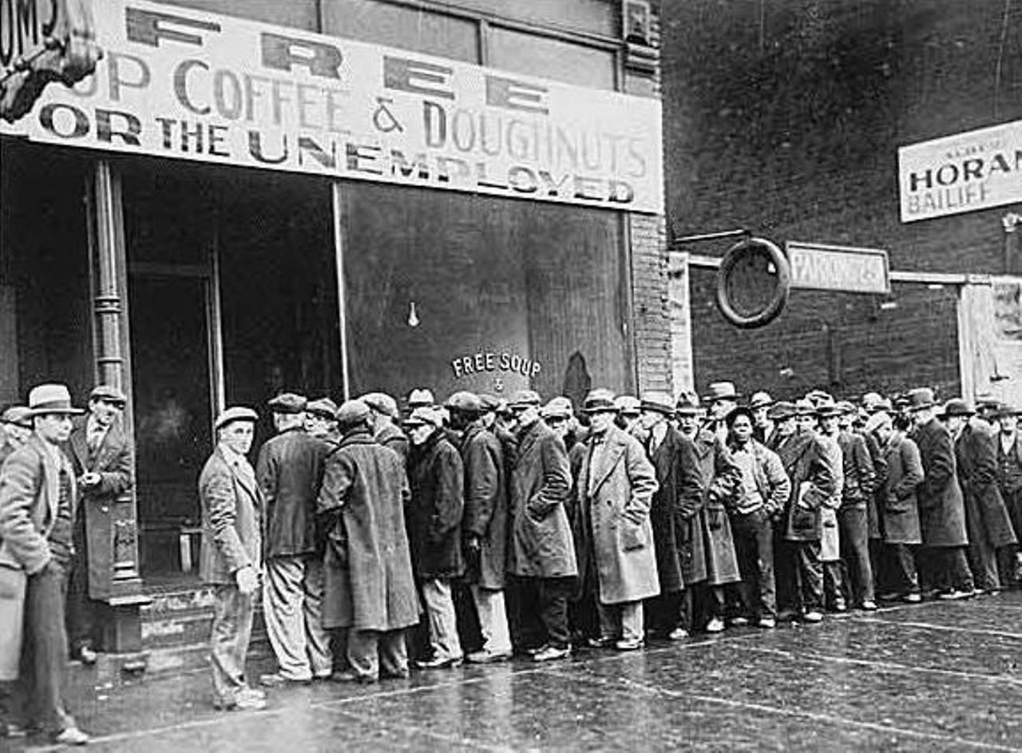
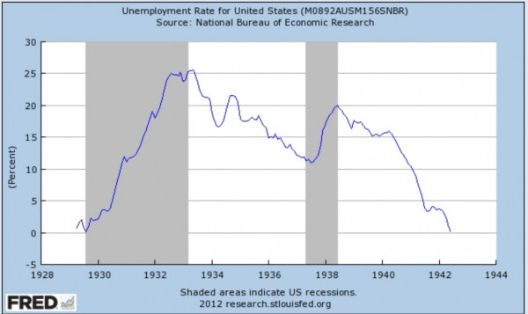

Slide 11
Second Great Depression

Slide 12
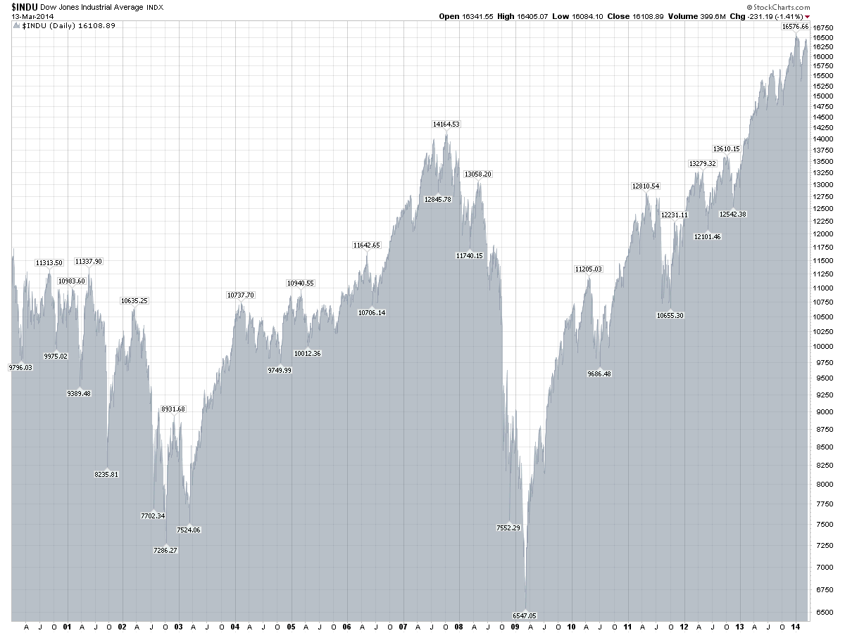

Slide 13
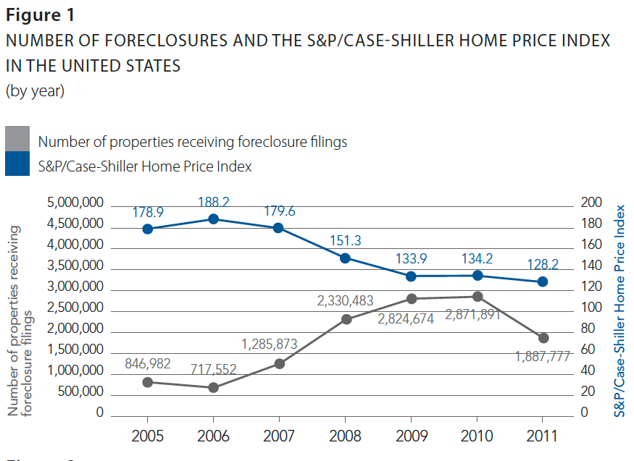

Slide 15
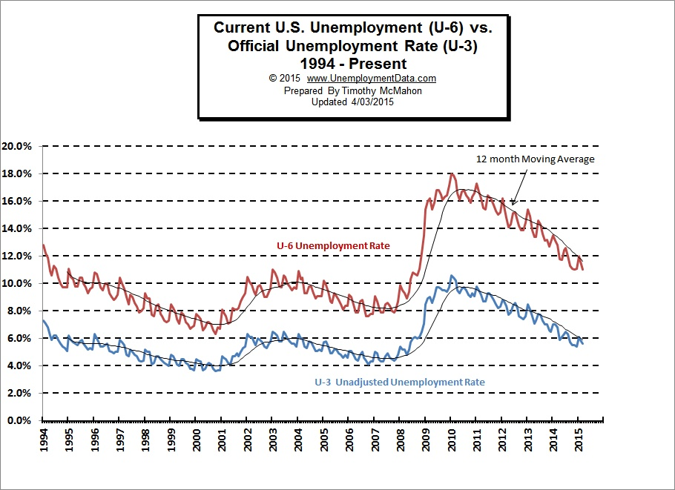

Slide 17
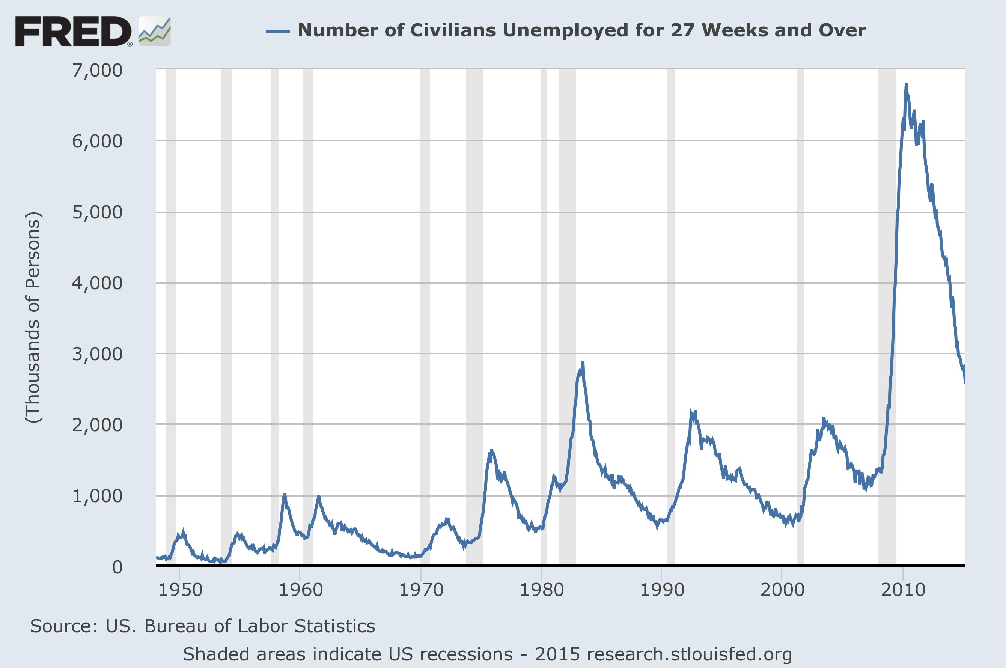

Slide 18
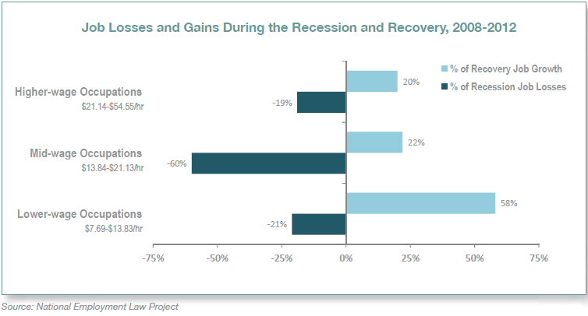

Slide 19
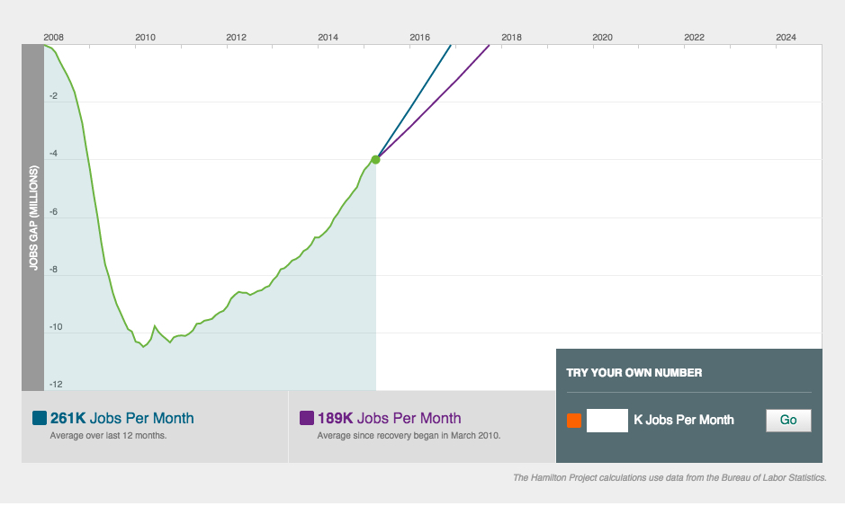

Slide 20
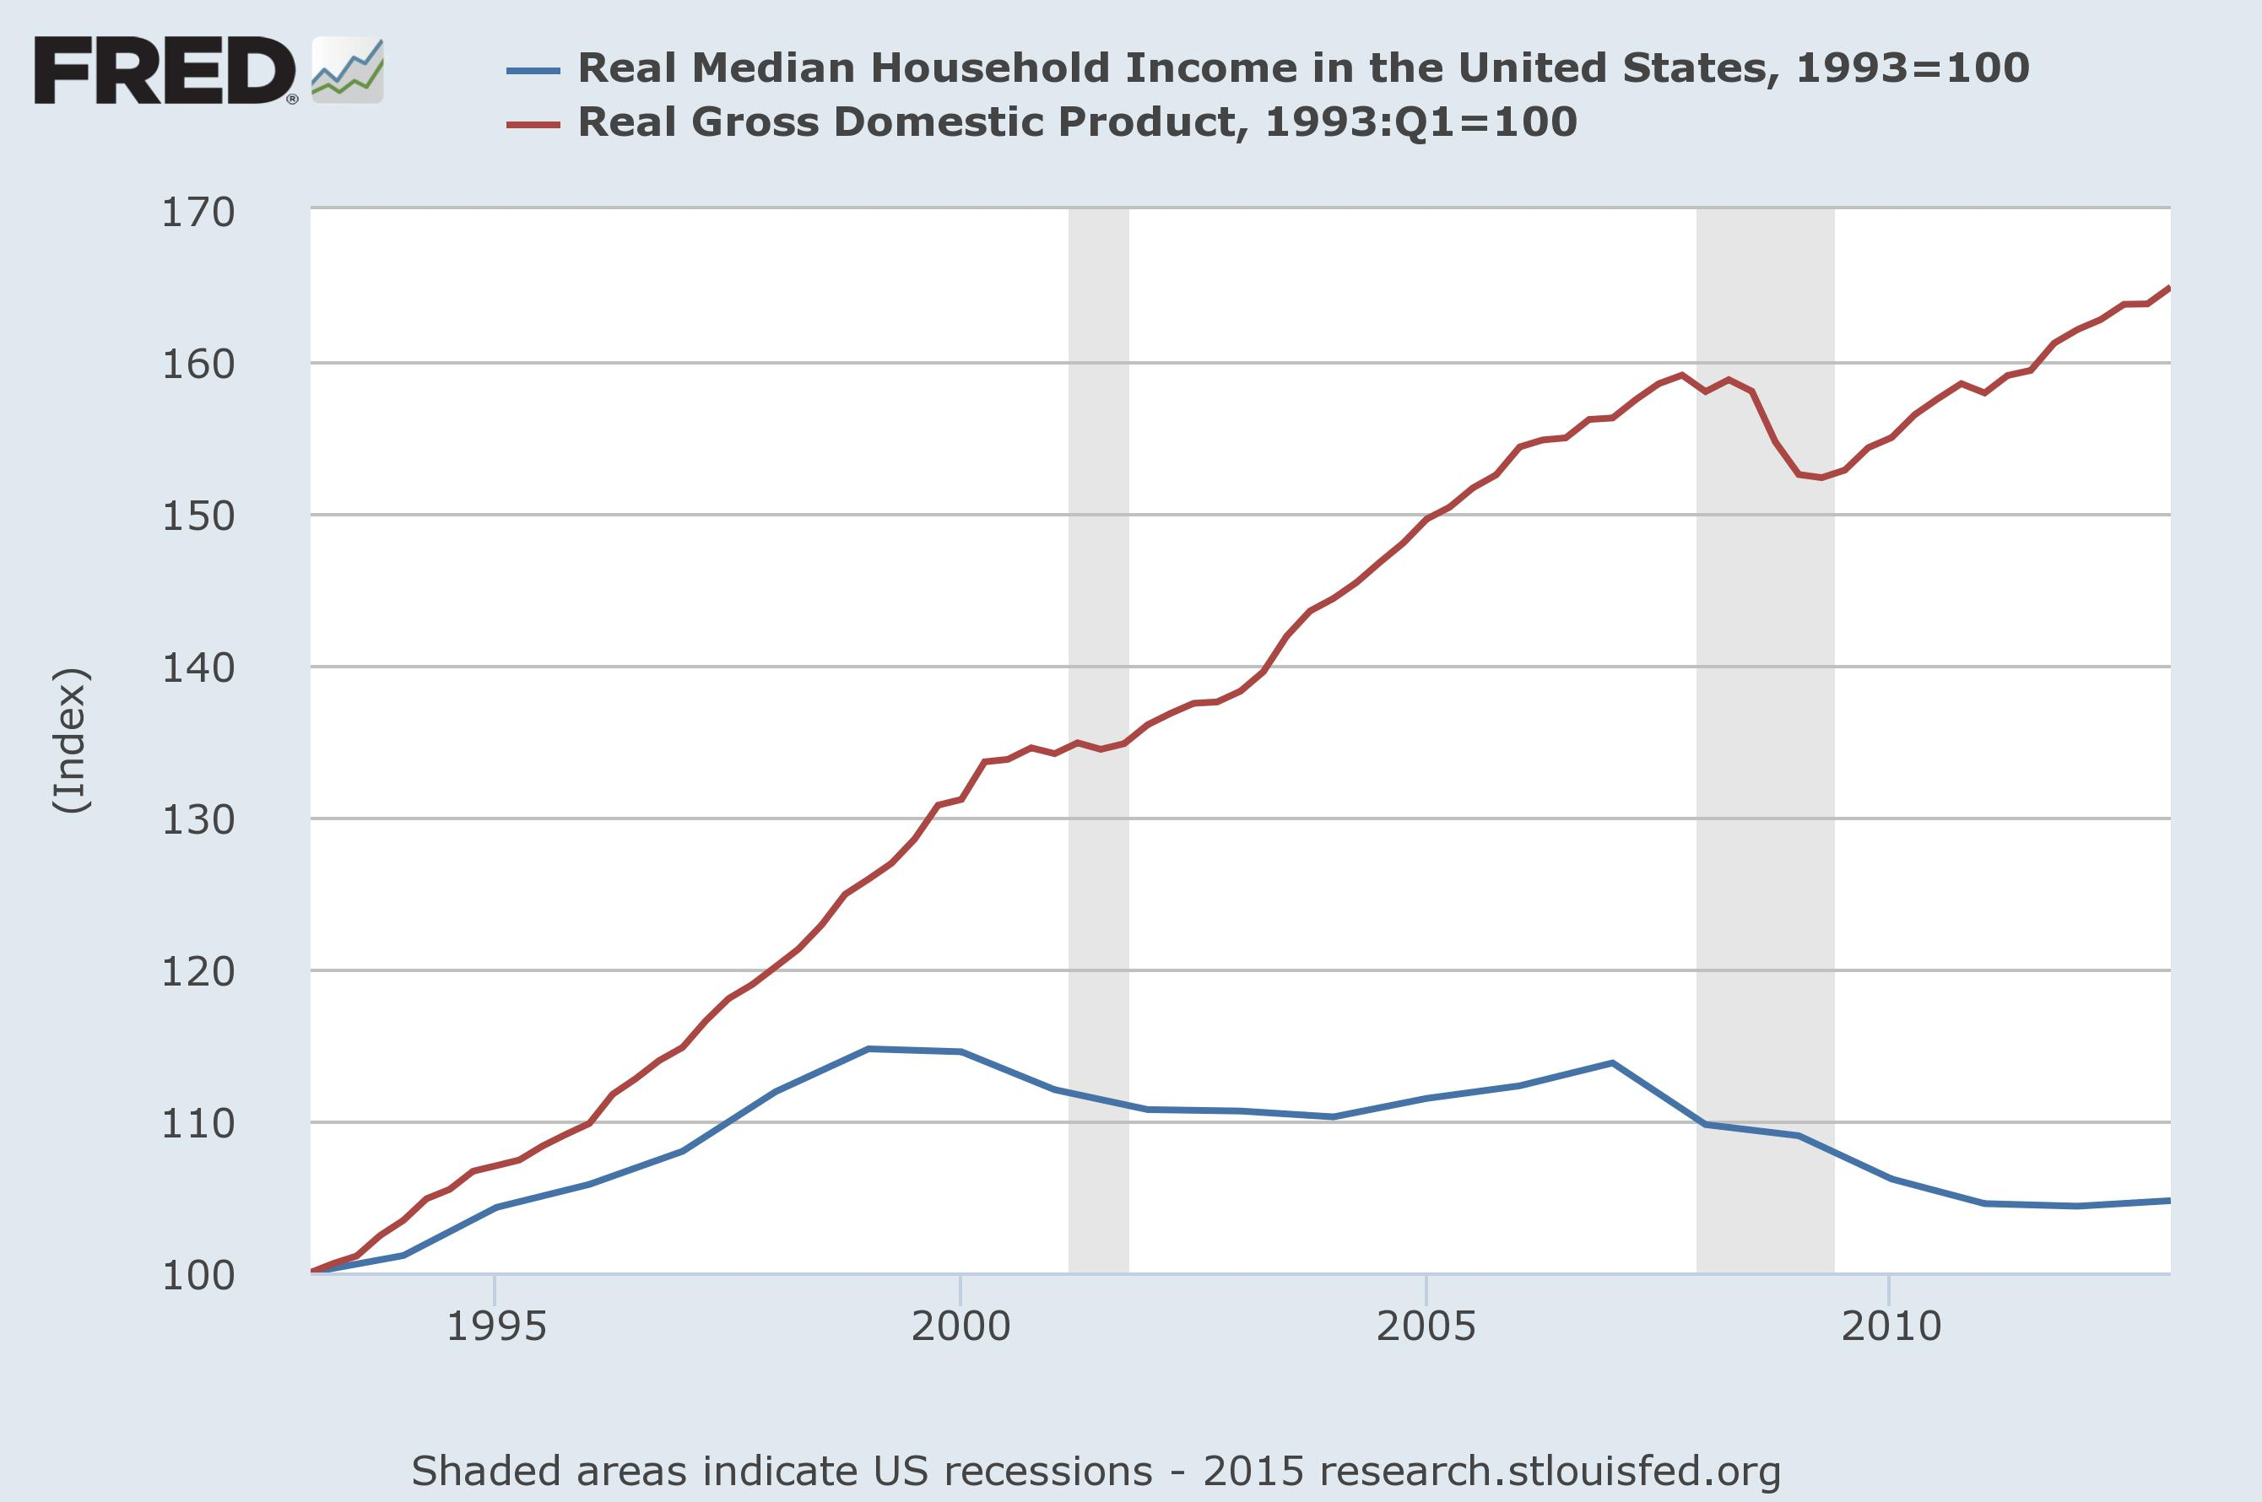

Slide 21
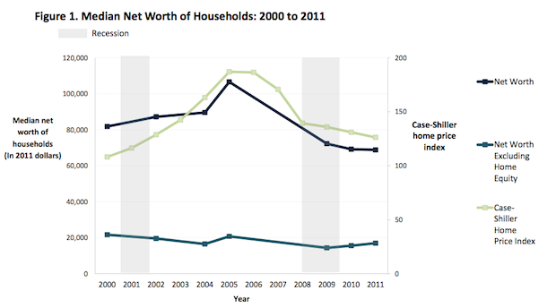
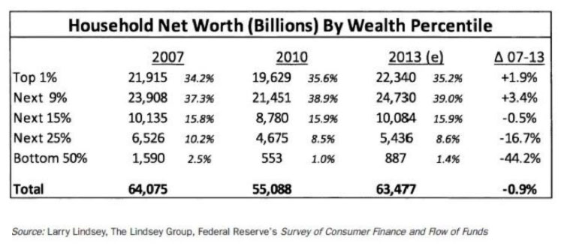

Slide 22
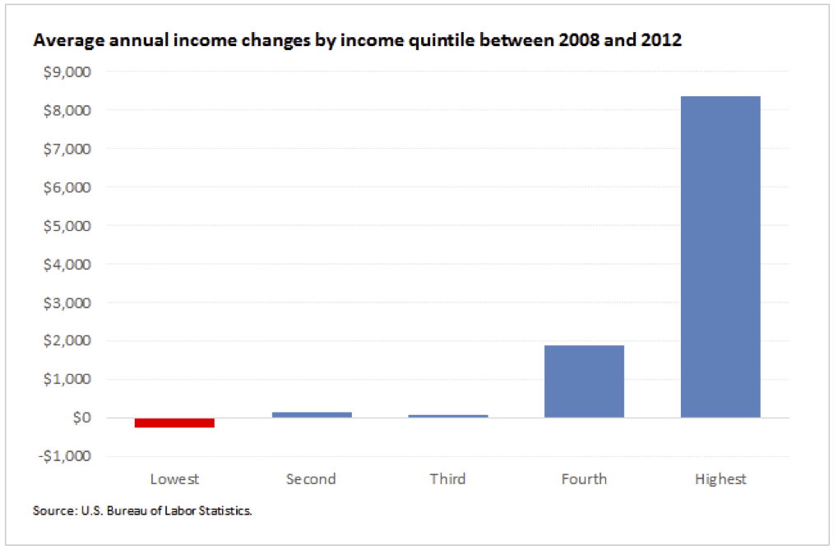
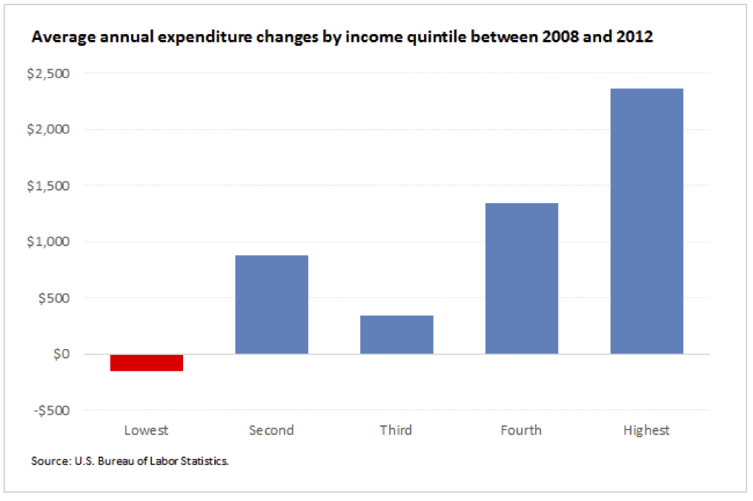

Slide 23
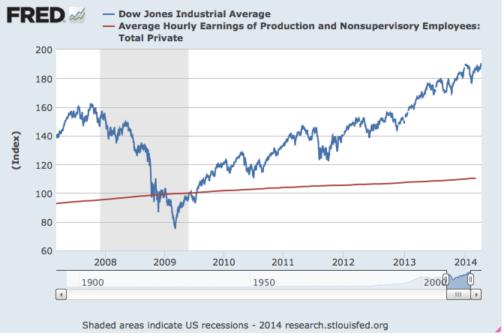

Slide 24
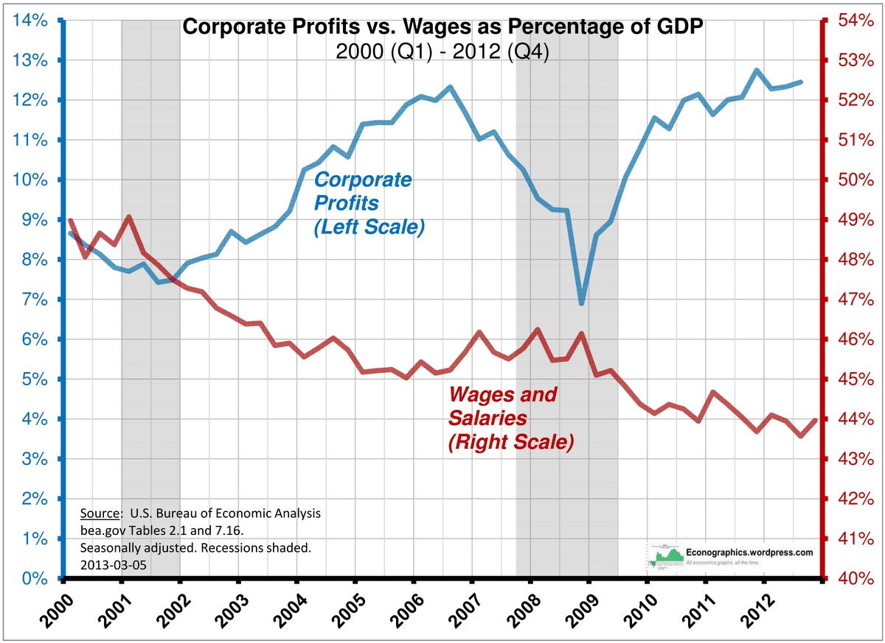

Slide 25
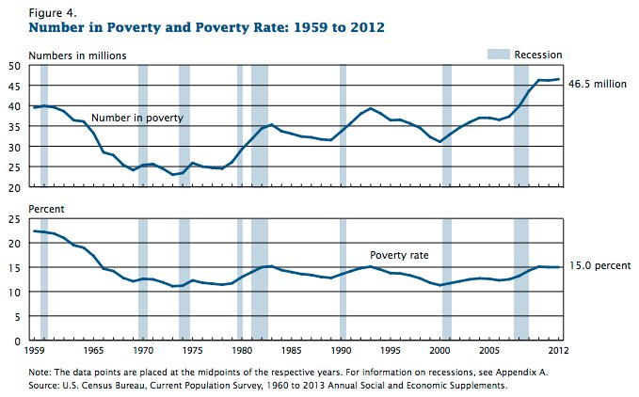

Slide 26
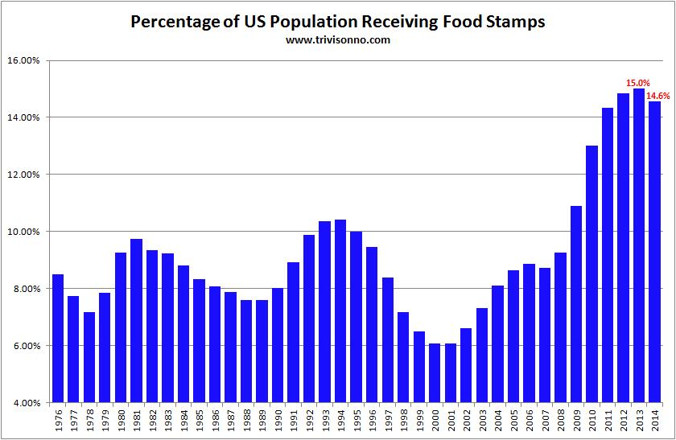

Slide 27
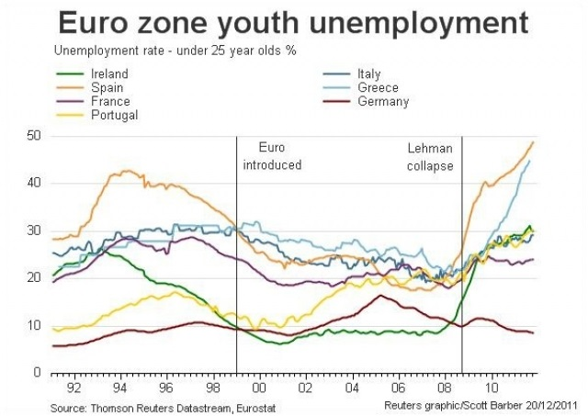
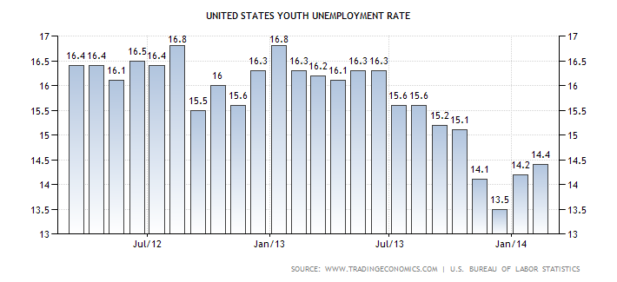

Slide 28
Sources
Barry Eichengreen, Kevin Hjortshøj O’Rourke, “A Tale of Two Depressions Redux” (6 March 2012) http://www.voxeu.org/article/tale-two-depressions-redux
World Top Incomes Databasehttp://topincomes.g-mond.parisschoolofeconomics.eu/
Federal Reserve Economic Data (St. Louis Fed)http://research.stlouisfed.org/fred2/
Jobs Gap calculator (Hamilton Project) http://www.hamiltonproject.org/jobs_gap/

