Slide 1
A Deep Learning Approach to Selecting Representative Time Steps for Time-Varying Multivariate Data
William P. Porter, University of Notre Dame
Yunhao Xing, Sichuan University
Blaise R. von Ohlen, University of Notre Dame
Jun Han, University of Notre Dame
Chaoli Wang, University of Notre Dame

Slide 2
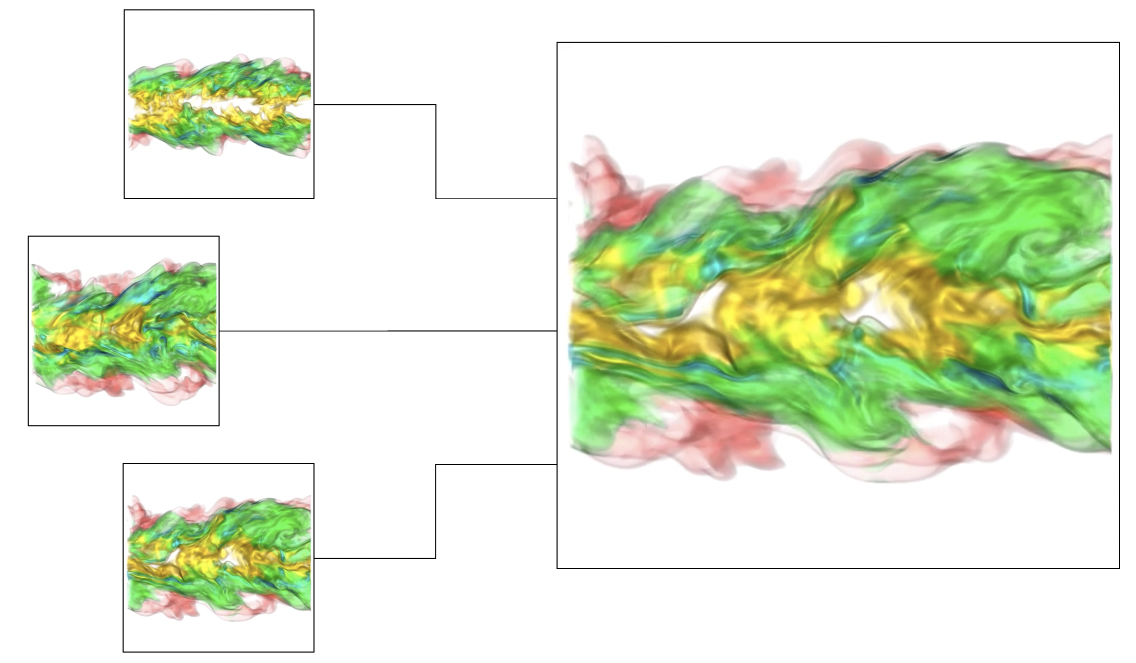
Introduction
Time-varying multivariate data analysis and visualization has been an important research topic in scientific visualization
How to select representative time steps from a series of volumes?
1

Slide 3
Introduction
Our approach is novel:
  First approach that applies deep learning techniques for time step selection
  Integrate feature learning, projection, and exploration into a single framework for time step selection
  Naturally handle multivariate data sets by selecting representative time steps based on multivariate temporal features
2

Slide 4
Related work
Existing works on time step selection are mainly
  Information-theoretic methods (Wang et al. [VIS 2008], Zhou and Chiang [EuroVis 2018])
  Dynamic programming techniques (Tong et al. [LDAV 2012])
Rely on hand-crafted data features such as histograms to evaluate similarity of time steps
3

Slide 5
Related work
Zhang et al. [ECCV 2016]
  Captured temporal dependency among video frames of annotated videos through CNN and LSTM
Gong et al. [NIPS 2014]
  Sequential determinantal point process (SeqDPP) for supervised selecting informative video frames
Zhang et al. [CVPR 2016]
  CNN though human-created summaries to perform automatic keyframe-based video summarization
4

Slide 6
Related work
Differences between past work and our work
  Our deep learning framework functions without annotation
  Only CNN (no LSTM)
Similar to Han et al. [TVCG 2018]
  Use an autoencoder to learn streamline features from binary volume representation
5

Slide 7
Approach (feature learning)
6

Slide 8
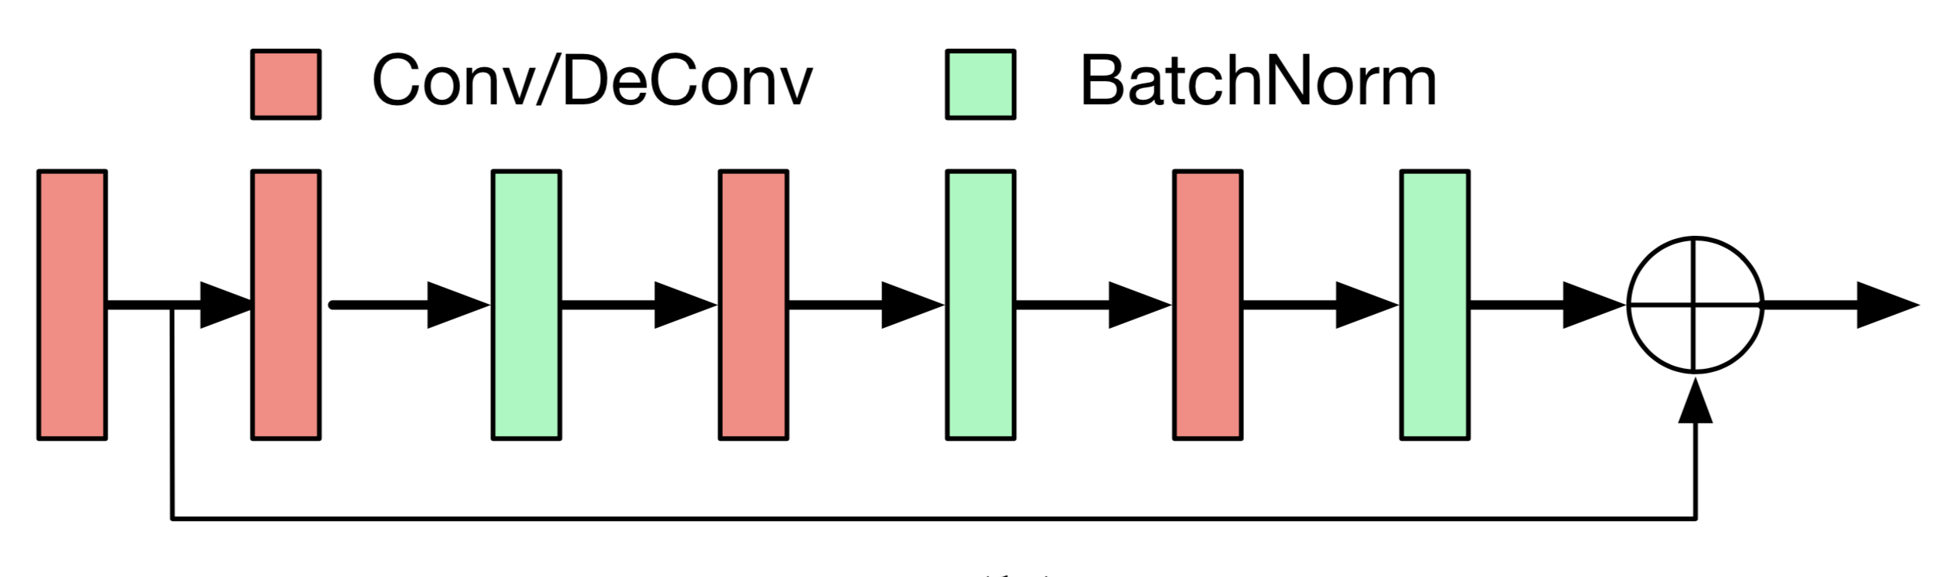
Approach (feature learning)
Encoder accepts C x L x W x H input and outputs feature descriptor
Decoder accepts feature descriptor and outputs reconstructed volumes
Encoder: Learning blocks that include
  Convolutional (deconvolutional) layer
  ReLU layer
  Residual block
7

Slide 9
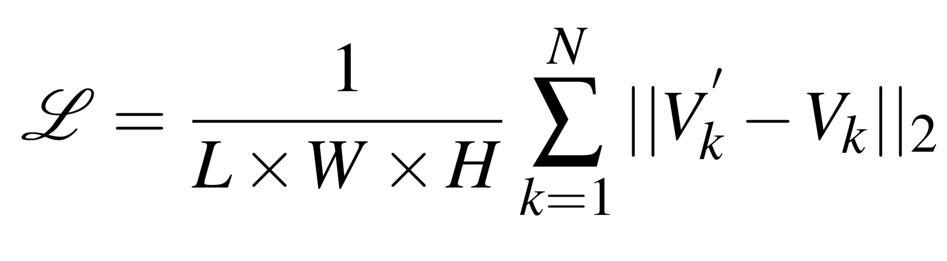
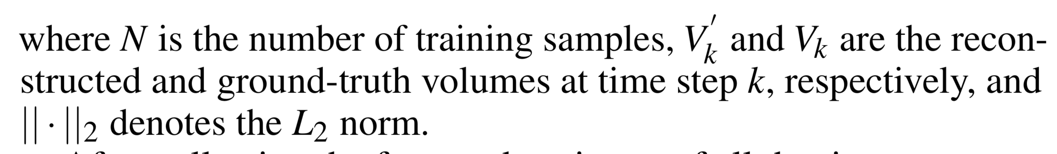
Approach (feature learning)
Use the mean-square error (MSE) to calculate the loss between the ground-truth and reconstructed volumes
8

Slide 10
Approach (time step selection)
t-SNE reduces feature dimension from 1024 to 2
Each point represents a time step
Connect the neighboring time steps to form a “path” and select representatives in the following ways:
  Arclength-based selection
  Angle-based selection
  Mixed selection
9

Slide 11
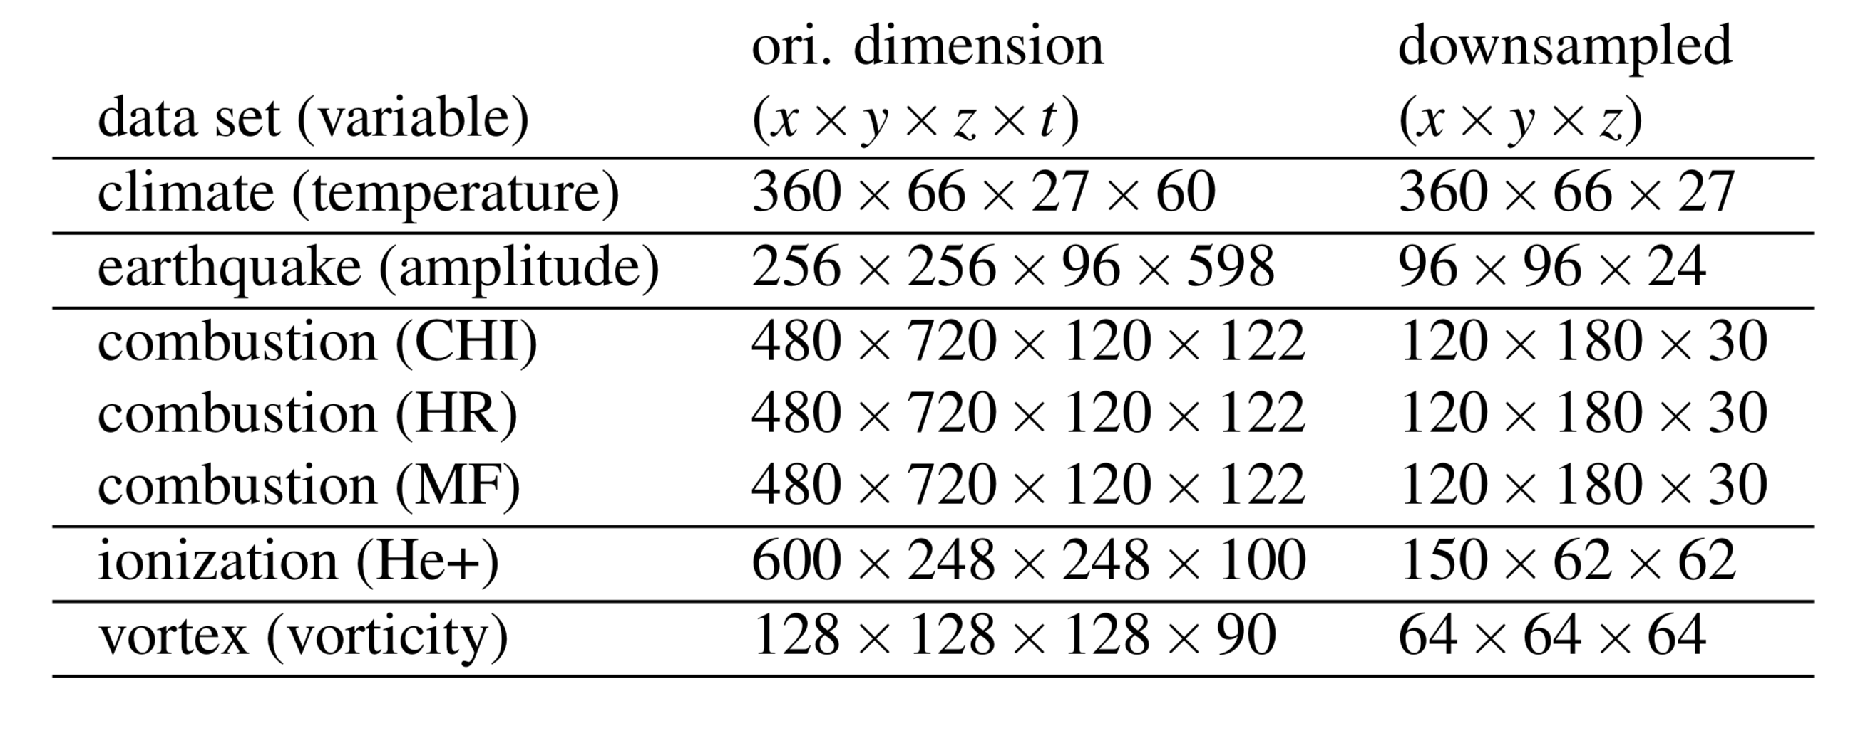
Results (datasets)
Climate: From a simulation of salinity and temperature in the equatorial region from 20°S to 20°N for a period of 100 years (1200 time steps)
Earthquake: Models the 3D seismic wave propagation of the 1994 Northridge earthquake
Combustion: Temporally evolving turbulent non-premixed flames where combustion reactions occur within the two layers
10

Slide 12
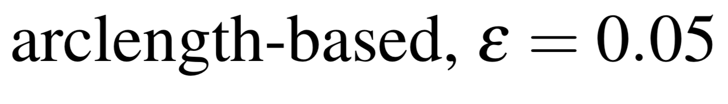
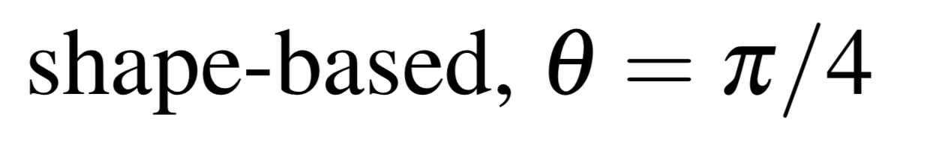
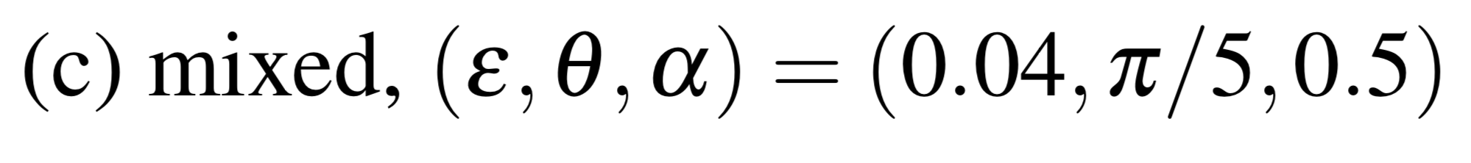
Results (different ways of selection with Vortex)
11

Slide 13
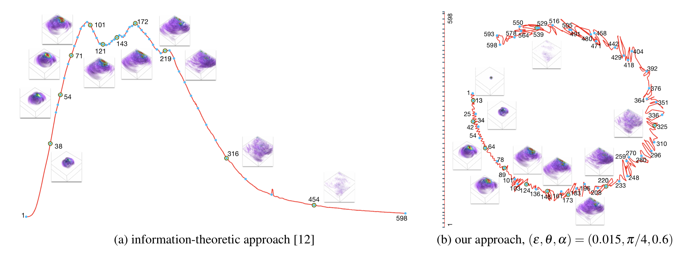
Results (information theoretic vs. our approach)
12

Slide 14
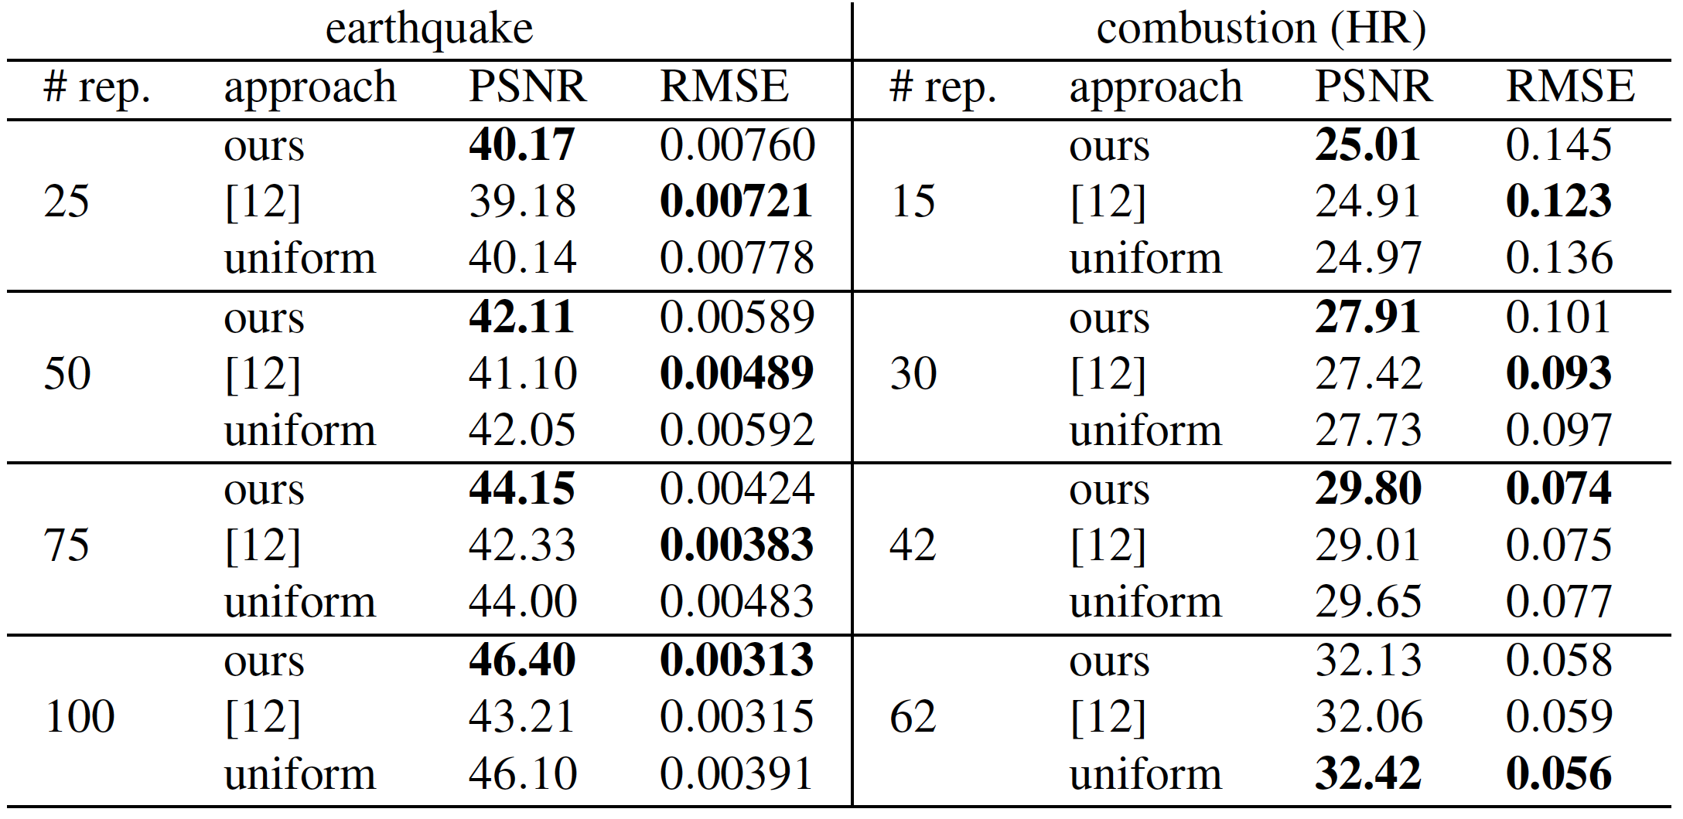
Results (information theoretic vs. our approach)
Utilize the peak signal-to-noise ratio (PSNR) and root-mean-square error (RMSE) to evaluate the quality of the interpolated time steps
  PSNR: Measures the peak error
  RMSE: Cumulative error between the reconstructed and original volumes
13

Slide 15
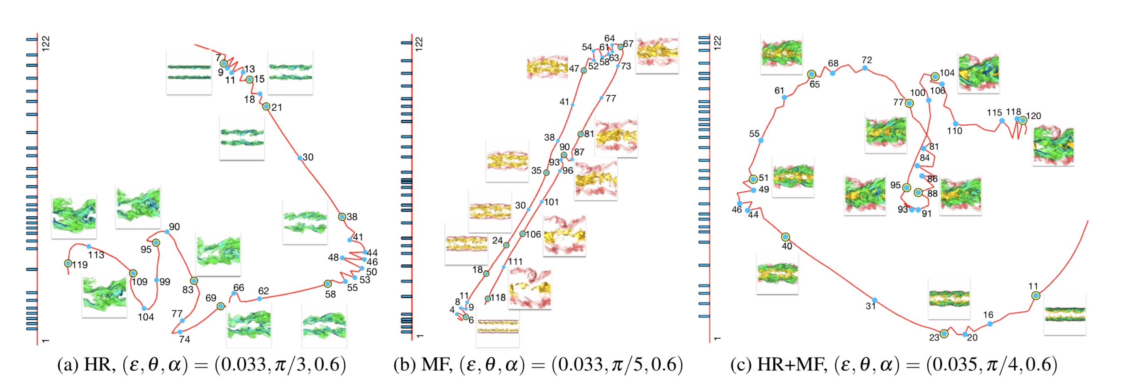
Results (single and two variables for Combustion)
14

Slide 16
Results (other datasets)
Ionization
(regular)
Climate
(periodic)
Combustion (chi)
(turbulent)
15

Slide 17
Conclusion and future work
Deep learning approach for selecting representative time steps from time-varying multivariate datasets
Automatically learn feature descriptors from volumetric data and across multiple variables in a latent space
Learned features are used to guide the selection of representatives in the 2D projected space
We would consider the visual quality of interpolated intermediate time steps as a constraint using deep reinforcement learning
16

Slide 18
Acknowledgements
NSF IIS -1455886, CNS-1629914, DUE-1833129
NVIDIA GPU Grant Program
Notre Dame Flatley CUSE Grant
17

Slide 19
Questions

