Slide 1
CCVis: Visual analytics of student online learning behaviors using course clickstream data
Maggie Celeste Goulden¹, Eric Gronda², Yurou Yang³, Zihang Zhang³, Jun Tao⁴, Chaoli Wang⁴, Xiaojing Duan⁴,
G. Alex Ambrose⁴, Kevin Abbott⁴, and Patrick Miller⁴
1. Trinity College Dublin; 2. University of Maryland, Baltimore County; 3. Zheijang University; 4. University of Notre Dame
Presented at IS&T/SPIE Conference on Visualization and Data Analysis 2019

Slide 2
Introduction
Motivation
Retention rate is related to student performance
Want to identify students at risk of poor performance early on to improve performance and retention rate
Learning Management Systems (LMS) have become prevalent in college education
Student clickstream data recorded by LMS is an underutilised metric for student performance
●

Slide 3
Introduction
Extract behaviour patterns from clickstream Categorise behaviour patterns
Explore how behaviour patterns relate to each other Explore grade distribution for a given behaviour pattern
Compare clickstream content of individual students Compare clickstream content for different grade bands
Our approach: CCVis
– Effectively relate student clickstream data to grade
●
●
●
●
●
●
●

Slide 4
Introduction
Data
– Moreau First Year Experience (FYE)
●
●
Mandatory two-semester course - helps first-year students transition to collegiate life at the University of Notre Dame.
2,000+ students
13 weekly assignments and a capstone assignment
35 unique URLs, of three types (reading, video, homepage) + 2 idle time measures (long, short)
●
●
●

Slide 5
Extracting Behaviour Patterns
First-order network (FON)
– Assigns a single webpage to each node in network
●
●
e.g. nodes are “9”, “18”, “12”
Fails to capture the complexity of the data
Higher-order network (HON)
Assigns a sequence of webpages to each node
●
●
e.g. nodes are “9|18.12”, “9|18”, “9|”
Keeps track of previous steps (only) if they influence the future progression
Can use HON nodes to represent behavior patterns

Slide 6
Extracting Behaviour Patterns
FON
HON
A = URL corresponding to assignment 2; B = URL corresponding to assignment 3; C = idle time of 30-45 minutes.

Slide 7
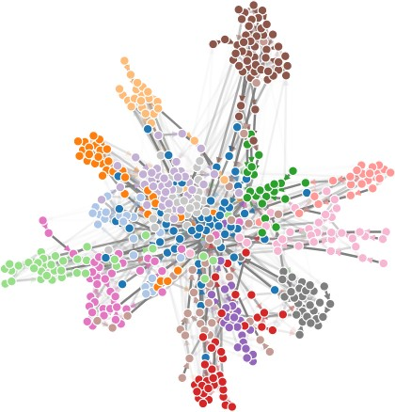
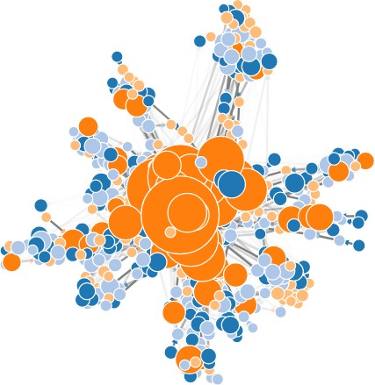
Categorising Behaviour Patterns
●
Community
Structural identity

Slide 8
Categorising Behaviour Patterns
Community groupings
Use Louvain method to identify closely related behaviour patterns
Groups behaviour patterns temporally:
●
●
sequences that contain webpages from the same week tend to be in the same community

Slide 9
Categorising Behaviour Patterns
Structural identity
– Structural identity = a measure of how a node fits into its network
●
how many direct connections the node has; how many connections its direct connections have; and so on
struc2vec generates vectors based on structural identity
Apply k-means clustering to generated vectors:
●
●
assign a structural classification to each node

Slide 10
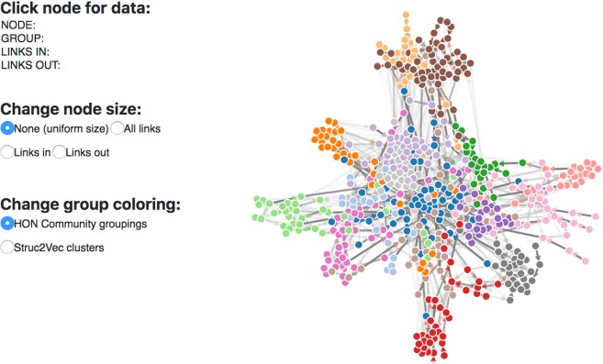
Exploring Behaviour Patterns
Behaviour Pattern View
– Default view
●

Slide 11
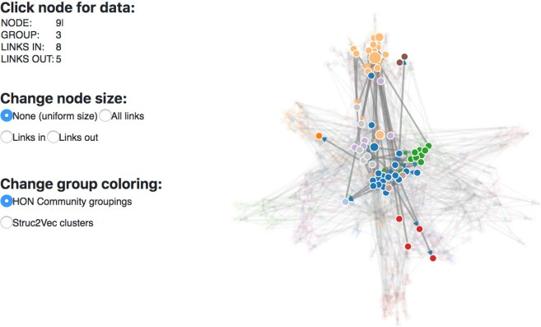
Exploring Behaviour Patterns
Behaviour Pattern View
– After selecting node 9|
●

Slide 12
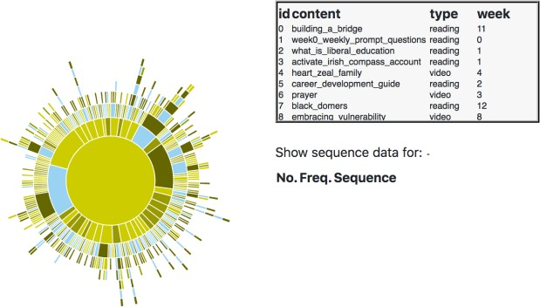
Exploring Behaviour Patterns
Behaviour Breakdown View
– Default view
●

Slide 13
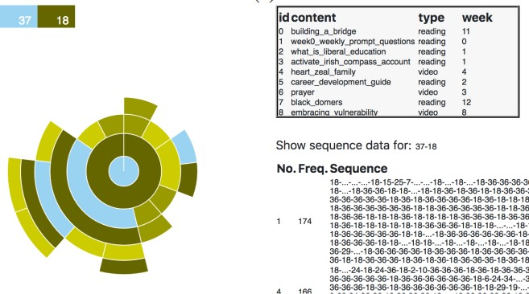
Exploring Behaviour Patterns
Behaviour Breakdown View
– After selecting node 18|37
●

Slide 14
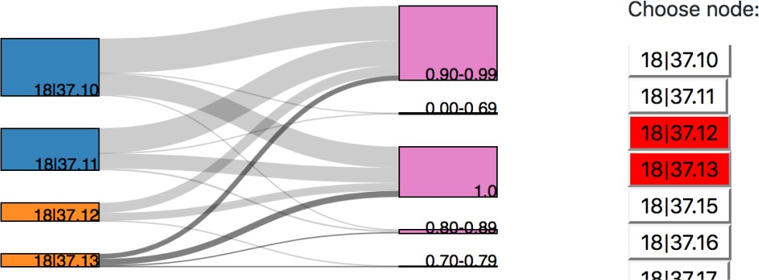
Grade Distribution for a Behaviour Pattern
Grade Distribution View
– Select node(s) of interest
●
●
Grade distributions for two typical nodes (18|37.10 and 18|37.11) and two outlier nodes (18|37.12 and 18|37.13)

Slide 15
Compare Individual Students
Clickstream Comparison View
Default: single student
Colours correspond to community grouping
●

Slide 16
Compare Individual Students
Clickstream Comparison View
“student number 1” changed manually to 777
“student number 2” automatically updates to student whose clickstream content is most different
●

Slide 17
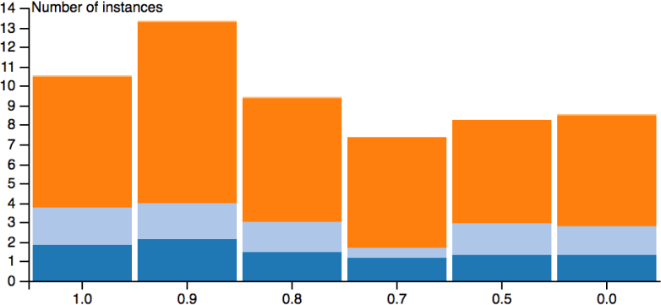
Compare Grade Bands
Clickstream Comparison View
“Aggregate data” option selected
Colours correspond to struc2vec grouping
●

Slide 18
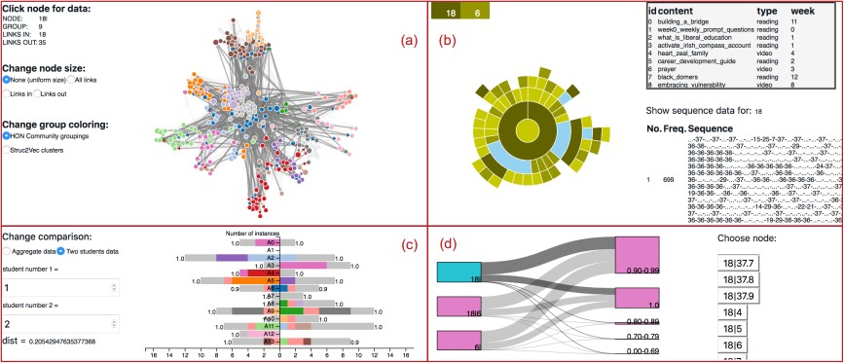
Interface Brushing and Linking
●
(a) = behavior pattern view;
(b) = behavior breakdown view;
(c) = clickstream comparative view;
(d) = grade distribution view

Slide 19
Key Findings from Case Studies
Struc2vec classifications are meaningful
Hubs (orange, blue) correspond to sequences either of a single activity or of mixed idle times / homepage,
Satellites (pale orange, pale blue) correspond to sequences with >2 webpages from same assignment
Can identify students that perform worse than others despite having more clicks
Clicks must be relevant to the assignment to improve grade
Strongest indicator of student performance is given by fraction of dark blue / dark orange nodes
●
●
●

Slide 20
Expert Evaluation
Behaviour Pattern View
Community groupings are clear; show activity pattern by week
Structural identity less intuitive – meaning of each color unclear
Behaviour Breakdown View
Enables users to investigate how click pathway leads to certain behavior
Coded number labeling system is difficult to navigate
Clickstream Comparative View
Uncovers weeks where students had no clicks – students at risk
Grade scales (0 -1) do not match scale used by instructors (0-20)
Grade Distribution View
Visual impact is very effective
Coded number labeling system once again adds difficulty
Grade distribution on right should have a fixed order while comparing
●
●
●
●

Slide 21
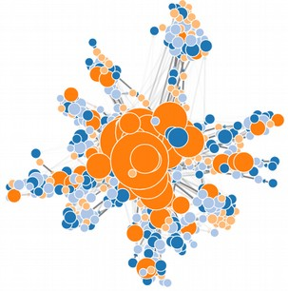
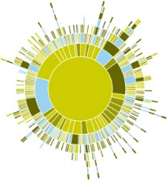
Conclusion and Future Work
●
CCVis is an effective tool for analyzing student course clickstream data and exploring student online learning behaviors
Address issues
●
Behaviour Pattern View could suffer from scalability and occlusion issues
Behaviour Breakdown View is aesthetically pleasing but could be difficult to read

Slide 22
Conclusion and Future Work
Future Work
Go beyond the clickstream data and collect student writing and instructor feedback for text mining
Design different versions of CCVis to serve individual students and administrators
●
Allow students to compare behaviour to peers
Allow administrators to accurately estimate student retention
●
●

Slide 23
Acknowledgements
National Science Foundation
– NSF IIS-1455886
– NSF IIS-1560363
– NSF DUE-1833129
Reviewers and VDA conference organizers
●
●
Thank you!

