Slide 1
iMap: A stable layout for navigating large image collections with embedded search
Chaoli Wang, John P. Reese, Huan Zhang,
Jun Tao, and Robert J. Nemiroff
Michigan Technological University
Presented at IS&T/SPIE Conference on Visualization and Data Analysis 2013

Slide 2
Introduction
Motivation
  Booming of digital image archiving and photo sharing website
  Images are often tagged with names, keywords, hyperlinks
  Traditional presentation of a set of thumbnail images can show neither the relationship among images nor their associated information

Slide 3
Introduction
Our approach: iMap
  Effective sense-making of large image collections
    Similarity based on visual and textual information
    Image ranking and clustering
  Stable treemap based layout for images
  Embedded text visualization for image keywords
Data
  Astronomy Picture of the Day (APOD)
    A popular online astronomy archive
    Thousands of handpicked picture since 1995
    Annotated astronomical images on the Internet

Slide 4
Image distance measure
Visual distance
  Grayscale image distance
    Borrow the idea of structural similarity index
    Use the grayscale version of image
    Consider luminance, contrast, structure information
    Color information is considered separately
  Spectrum image distance
    Use power spectrum of the grayscale image
    Compute the similarity through evaluating blockwise Pearson linear correlation

Slide 5
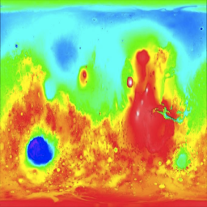

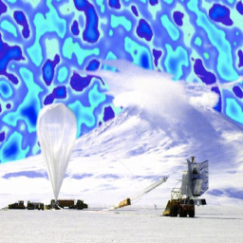

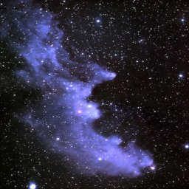
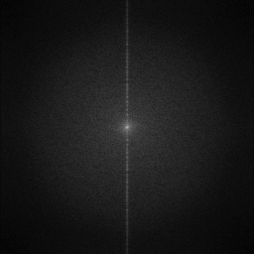
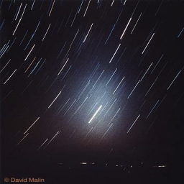
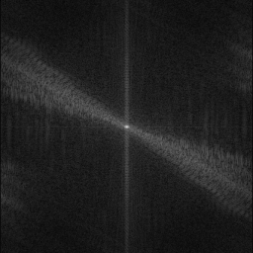
Image distance measure
Images and their grayscale frequency spectrum images
(a)
(b)
(c)
(d)

Slide 6
Image distance measure
Visual distance (continued)
  Color histogram distance
    Sample each of the R, G, B channels into eight level (i.e., a color histogram of 512 entries)
    Use the symmetric Jensen-Shannon divergence to measure the difference among histograms

Slide 7
Image distance measure
Textual distance
  Keyword list distance
    Extract meta-tagged keywords in the HTML
    Distance between two keywords is measured by their edit distance
    Distance between two lists of keyword is given by the average minimum distance values of keyword pairs
  Hyperlink list distance
    An internal link: a URL in the same website
    An external link: a URL in a different website
    Split the hyperlink into subdomains

Slide 8
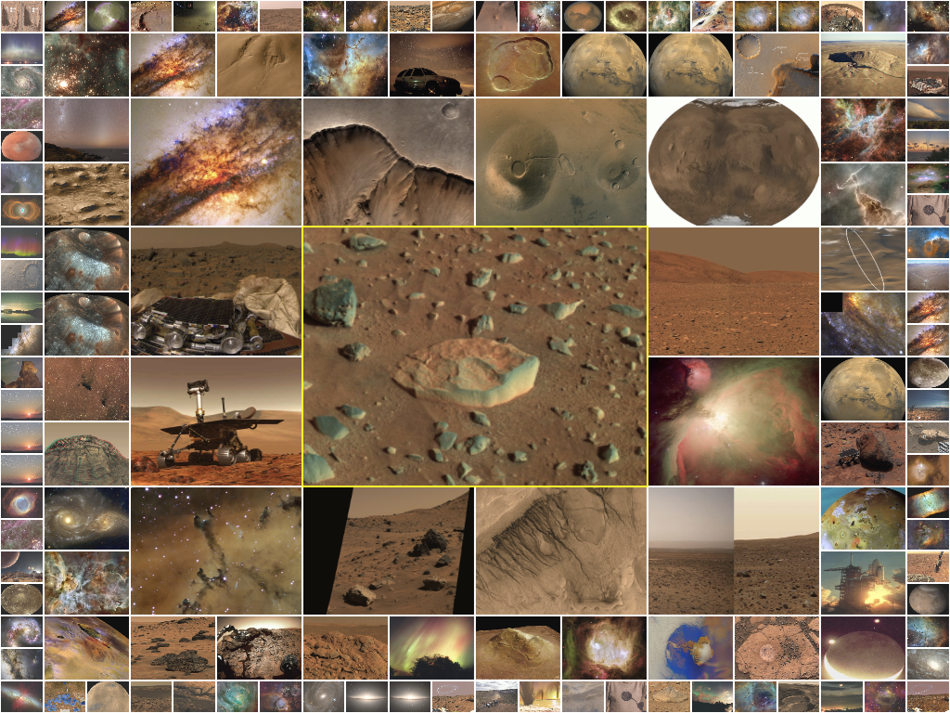
Image distance measure
Visual distance only

Slide 9
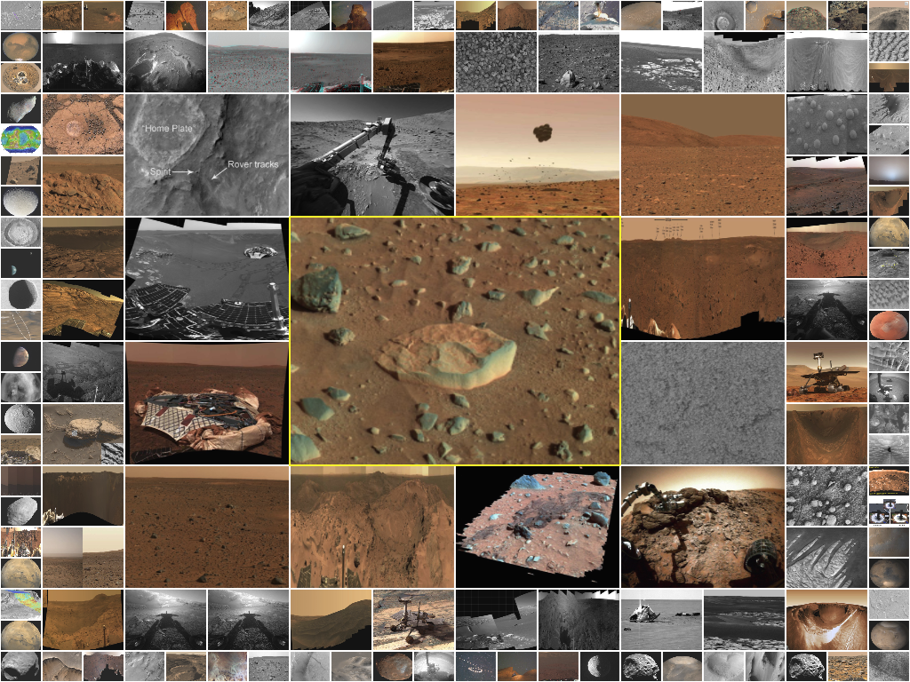
Image distance measure
Textual distance only

Slide 10
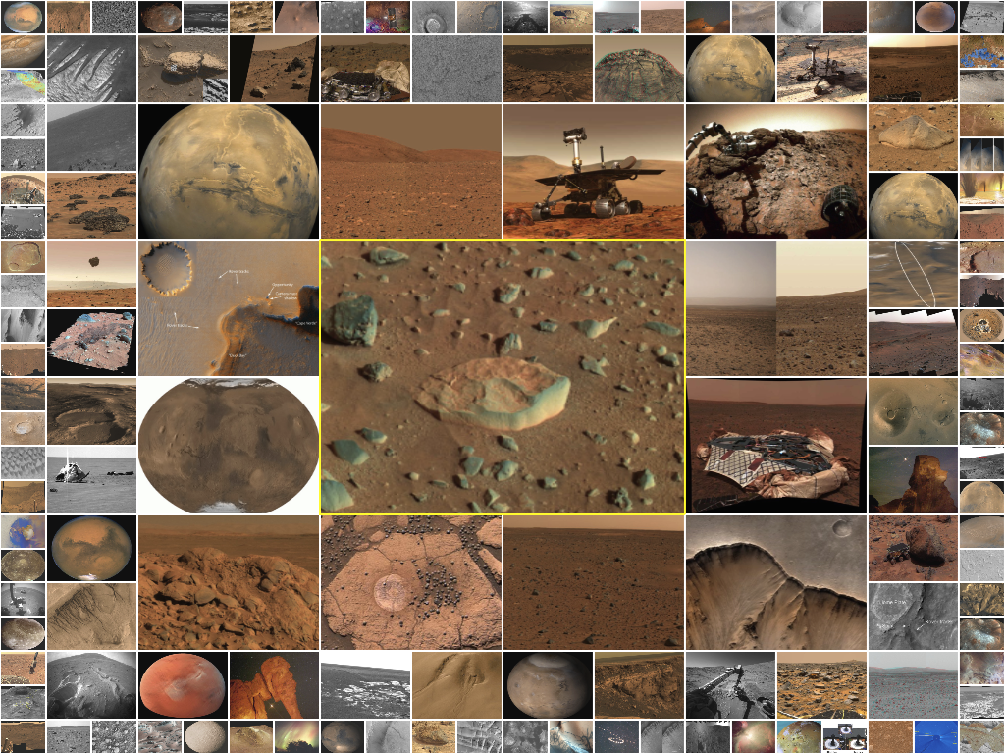
Image distance measure
Visual and textual distance

Slide 11
Image ranking and clustering
Symmetric distance matrix
  Recording the distance between any two images
Image ranking
  All images are ranked based on a user-selected query image
Image clustering
  Use a list of distance thresholds with increasing value
  Create a hierarchy where each level is based on one threshold

Slide 12
Image layout and interaction
iMap layout
  Hybrid layout combines quantum and spiral layout
    Use of quantum with a fixed aspect ratio
    Spiral pattern maintains stable update

Slide 13
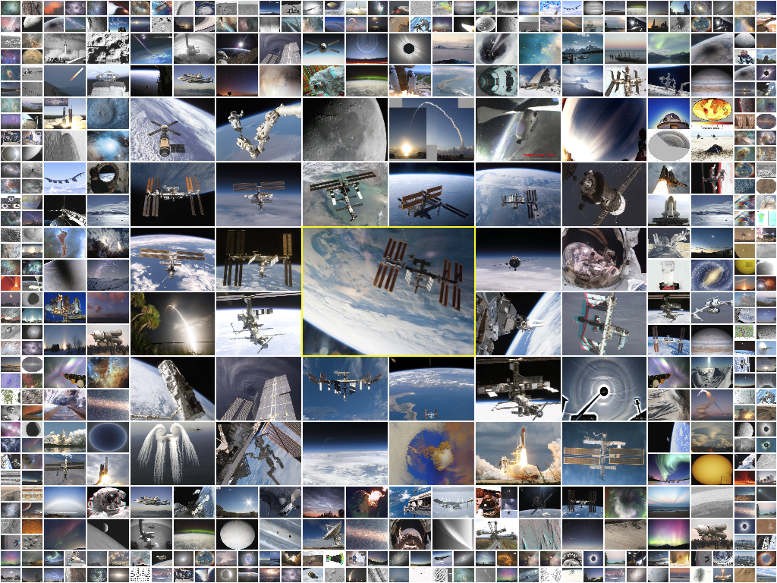
Image layout and interaction
Query result

Slide 14
Image layout and interaction
iMap layout (continued)
  Two-level layout for clustering results
    Quad-tree layout for different levels of hierarchy
    Spiral layout for images within each level

Slide 15
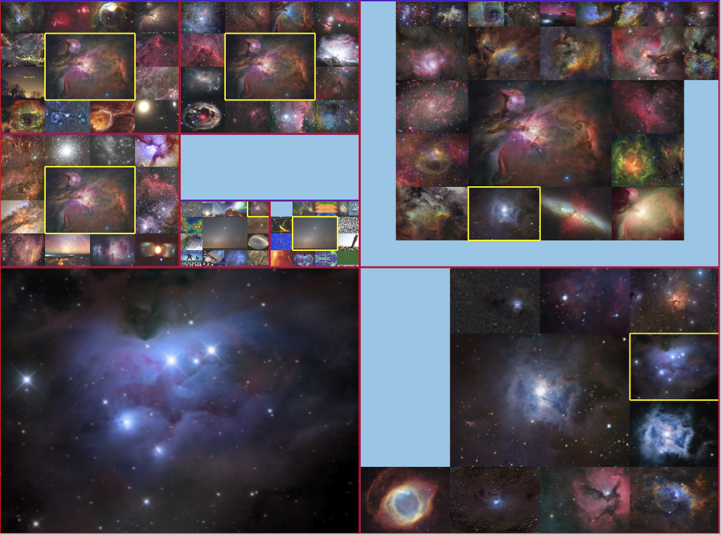
Image layout and interaction
Clustering result

Slide 16
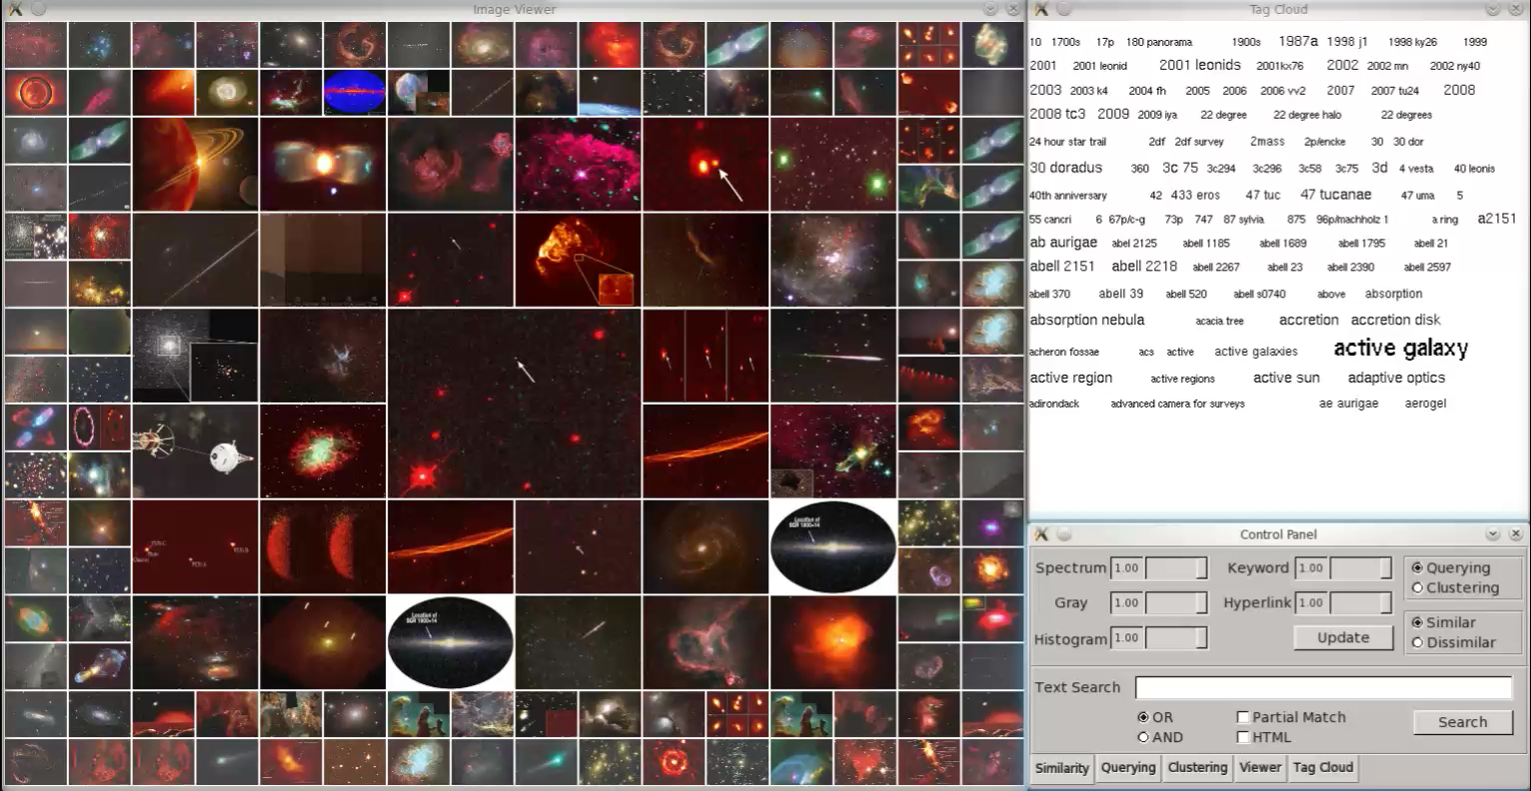
Image layout and interaction
Clustering result

Slide 17
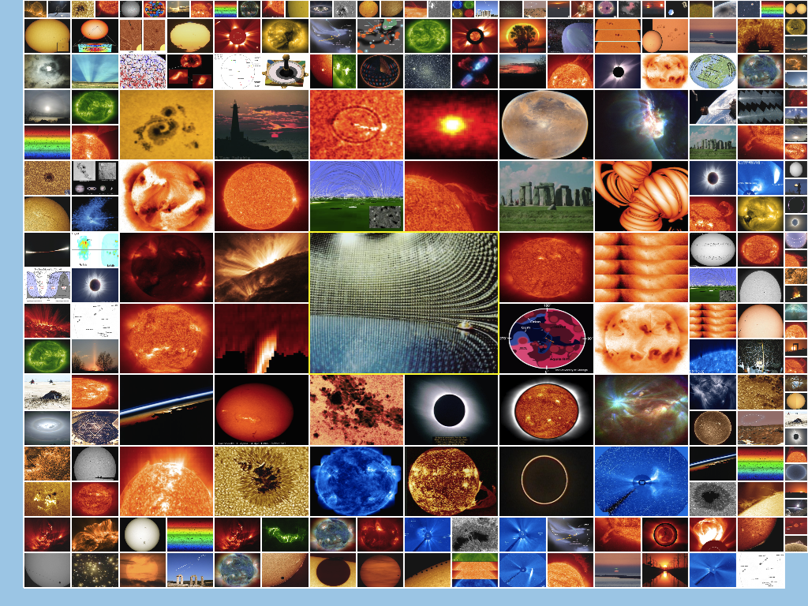
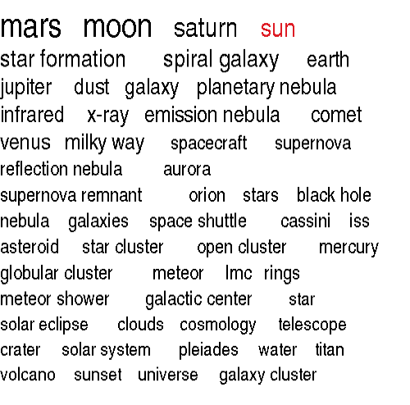
Image layout and interaction
Integrating text into image search
  Keyword input
  Tag cloud

Slide 18
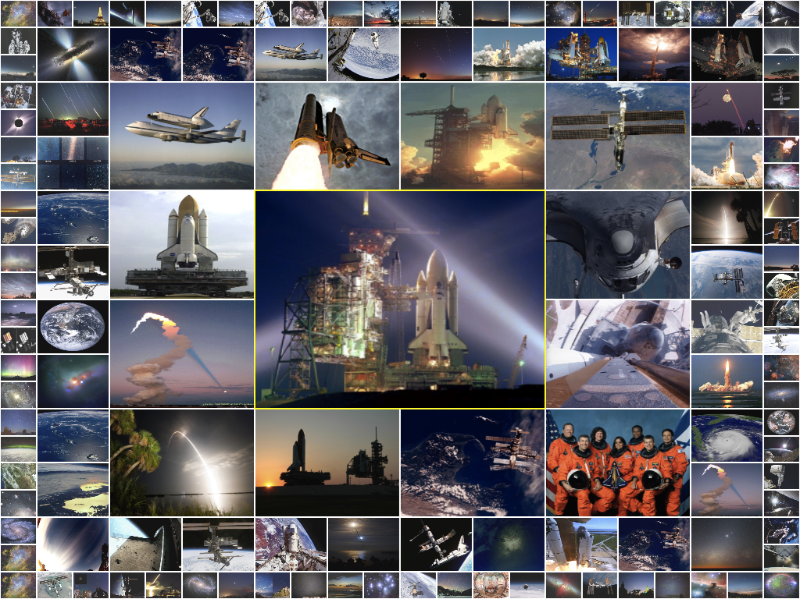
Image layout and interaction
Integrating text into image search (continued)
  Embedded text for result filtering
Image search
result:

Slide 19
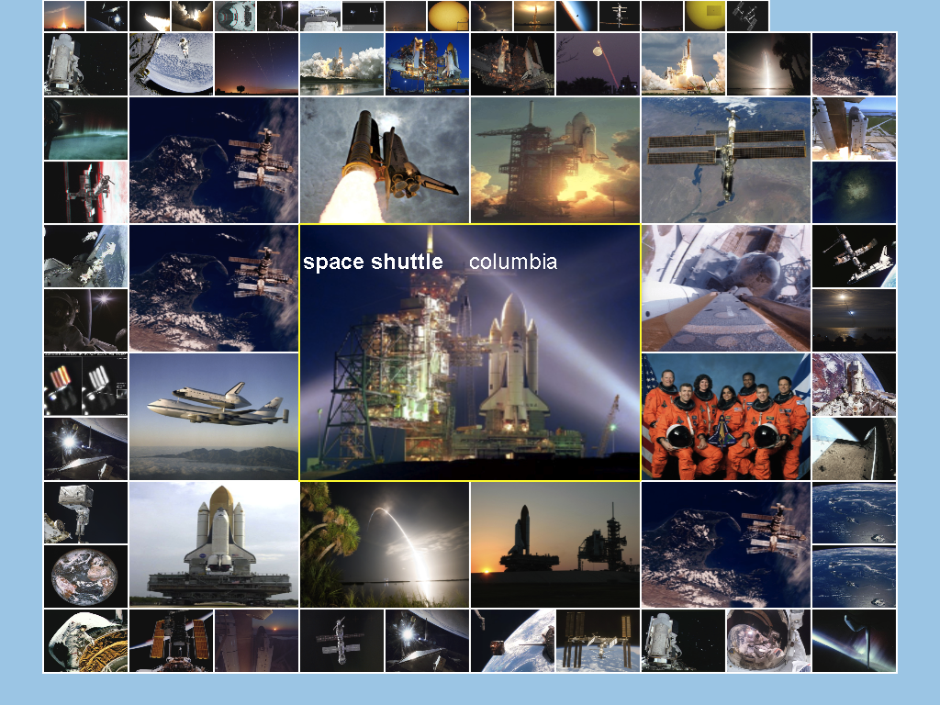
Image layout and interaction
Integrating text into image search (continued)
  Embedded text for result filtering
Filtered
by keyword
“space shuttle”

Slide 20
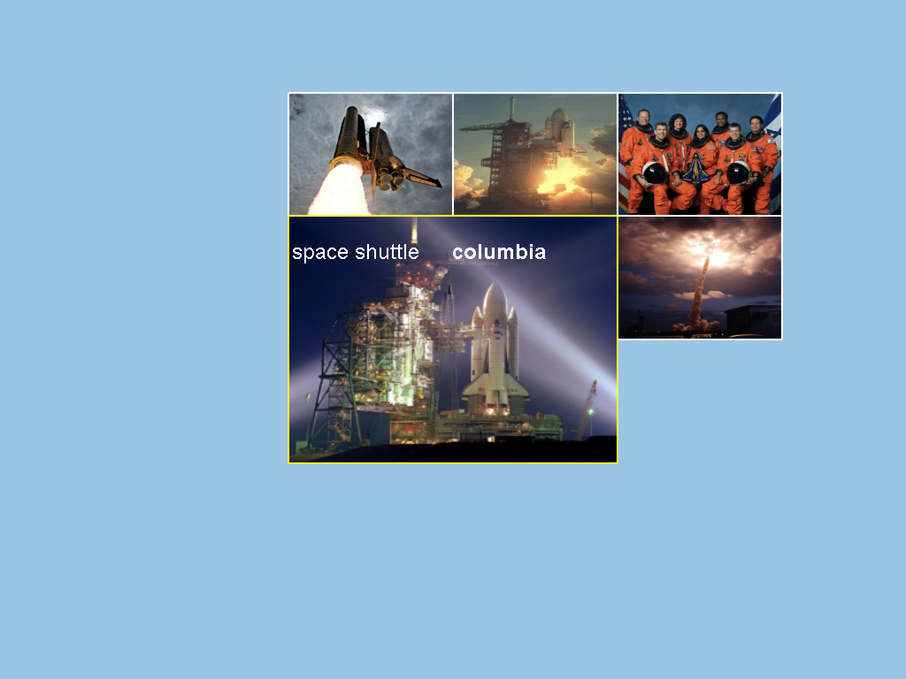
Image layout and interaction
Integrating text into image search (continued)
  Embedded text for result filtering
Filtered
by keyword
“columbia”

Slide 21
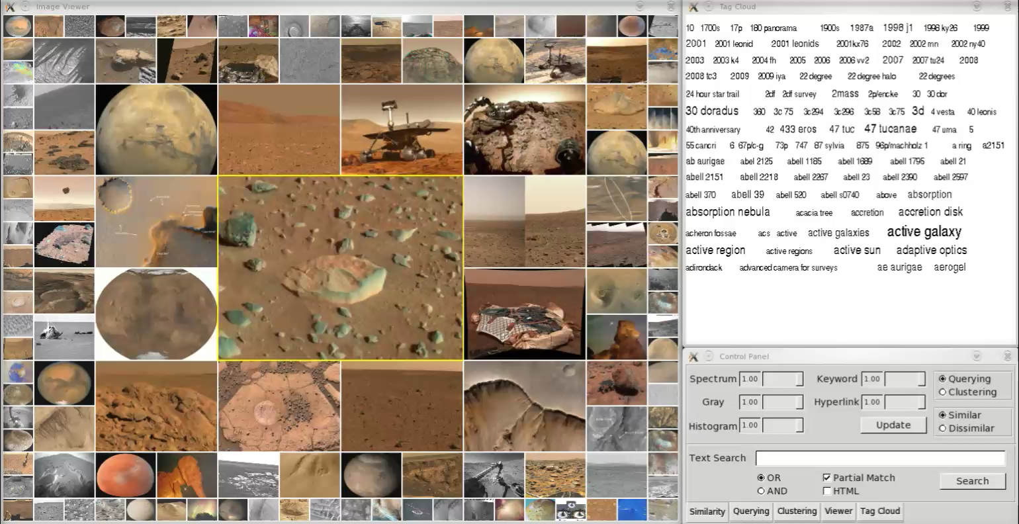
Image layout and interaction
Integrating text into image search (continued)

Slide 22
User study
2 conditions
  iMap vs. online APOD
3 tasks to search an image
  Given keywords and description only (task 1)
  Given the image only (task 2)
  Given the image and keywords (task 3)
16 students participated in the study

Slide 23
User study
Result
  iMap vs. online APOD (timing)

Slide 24
User study
Result (continued)
  iMap vs. online APOD (rating)
    S1, S2, S3 and S4 corresponding to task1, task2, task3 and overall, respectively

Slide 25
Conclusion and future work
Enable effective searching, browsing and understanding of large image collections
Address issues
  Stable layout, screen utilization, and in-place interaction
Future work
  Improve distance measure
    High-level image features
    Relationship between words
  Develop online version
  Incorporate animated transitions

Slide 26
Acknowledgements
National Science Foundation
  NSF IIS-1017935
  NSF CNS-1229297
Students participated in the user study
Reviewers and VDA conference organizers
Thank you!

