Slide 1
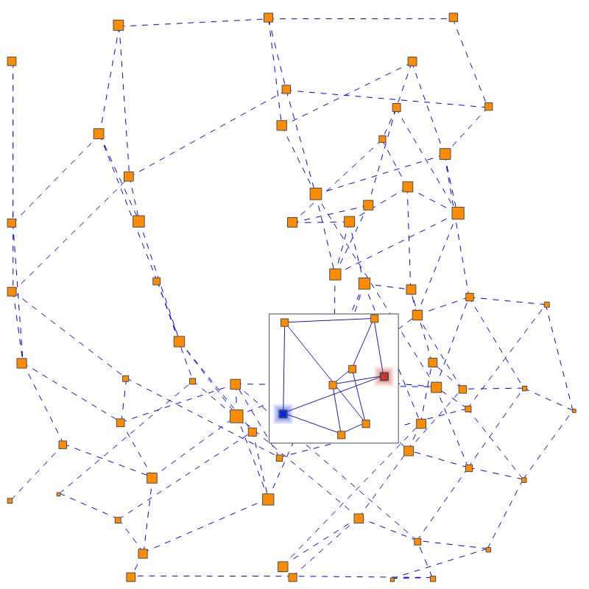
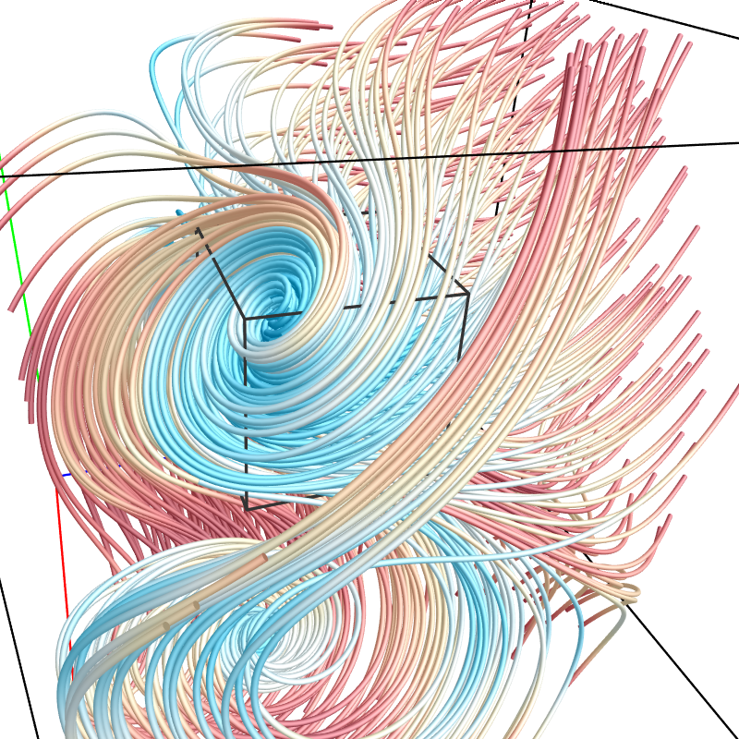
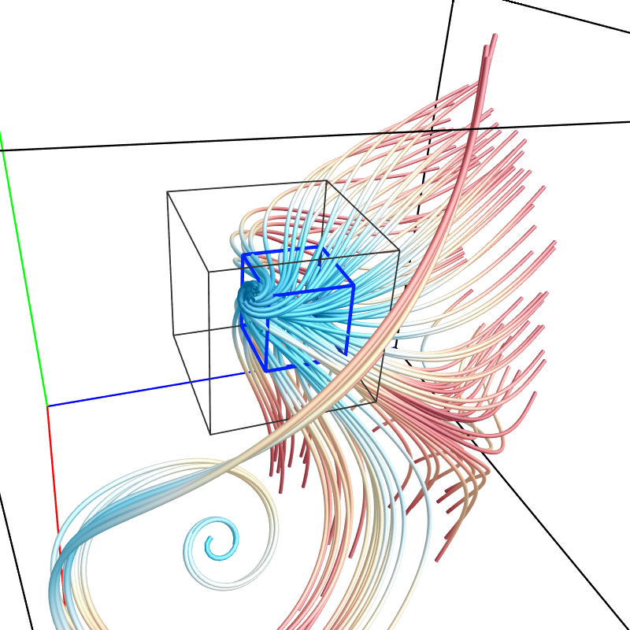
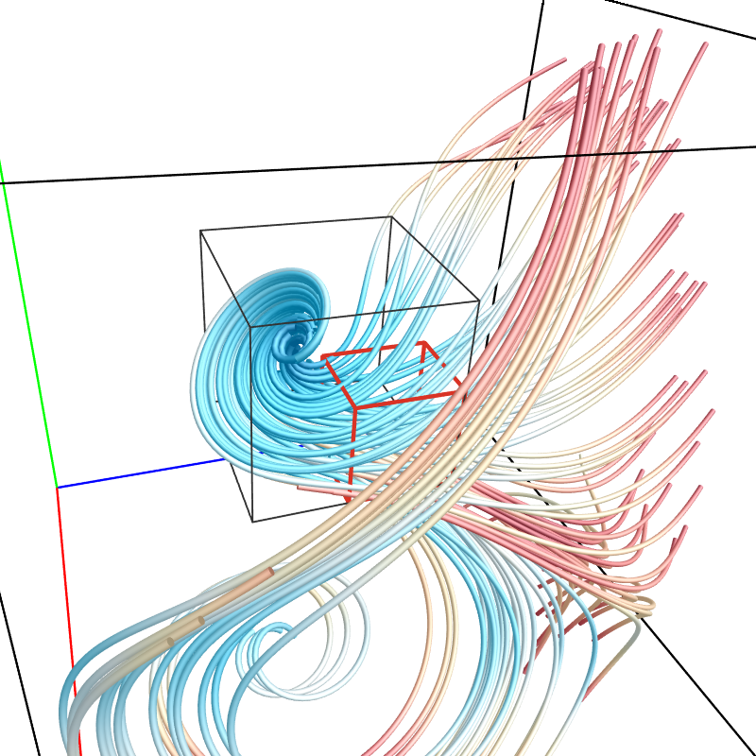
FlowGraph: A Compound Hierarchical Graph for Flow Field Exploration
Jun Ma, Chaoli Wang, Ching-Kuang Shene
Michigan Technological University
Presented at IEEE Pacific Visualization Symposium
1 March 2013
Sydney, Australia

Slide 2
Challenges for 3D streamline visualization
Occlusion and clutter challenge
Poor scaling from 2D flow to 3D flow
Possible to reduce but impossible to eliminate
Prevent occlusion-free observation and comparison of streamline relationships
Visual exploration challenge
Streamlines are difficult to pick in 3D
Difficult to observe streamlines and their spatial relationships in a controllable fashion

Slide 3
Flow Web vs. FlowGraph
Flow Web [Xu and Shen 2010]
Nodes are spatial regions that are hierarchically organized
Edges indicate the number of particles traveling in between
Do not store information about streamline clusters
Queries such as identifying streamline bundles become a trial-and-error process
Our FlowGraph
Explicitly store information about streamline clusters
Extend Flow Web to a compound graph representation
Allow full exploration of streamline clusters, spatial regions and their interconnections

Slide 4
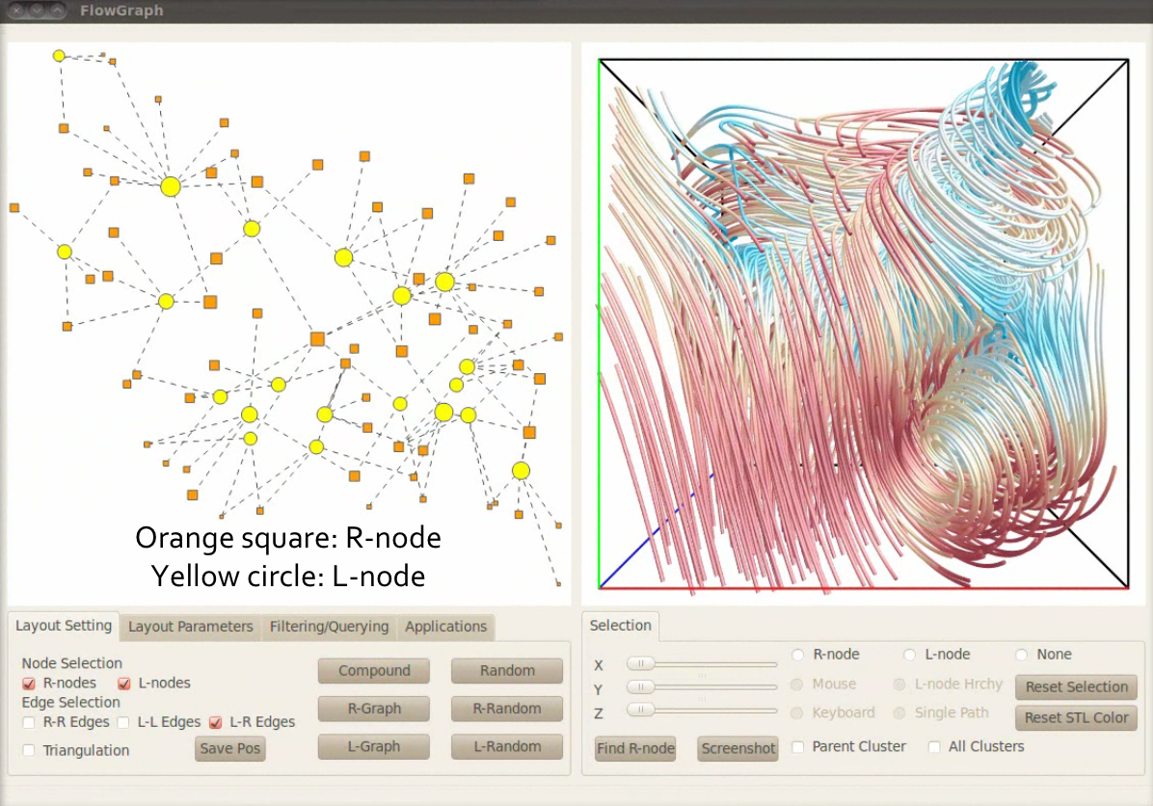

Slide 5
Orange square: R-node
Yellow circle: L-node

Slide 6
FlowGraph definition (1)
Two kinds of nodes
R-nodes (spatial regions)
Spatial regions partitioned in an octree manner
Stop the top-down partitioning if the flow entropy is smaller than a given threshold
L-nodes (streamline clusters)
Streamline clusters organized hierarchically
Group spatially neighboring and geometrically similar streamlines in a bottom-up manner (more detail to come)

Slide 7
FlowGraph definition (2)
Three kinds of weighted edges
R-R edges
Record the number of common streamlines shared between two R-nodes at the same level of the space hierarchy
L-L edges
Record the number of common leaf-level regions traversed in order between two L-nodes at the same level of the streamline hierarchy
L-R edges
Record the number of streamlines in the L-node passing through the R-node between a L-node and a R-node

Slide 8
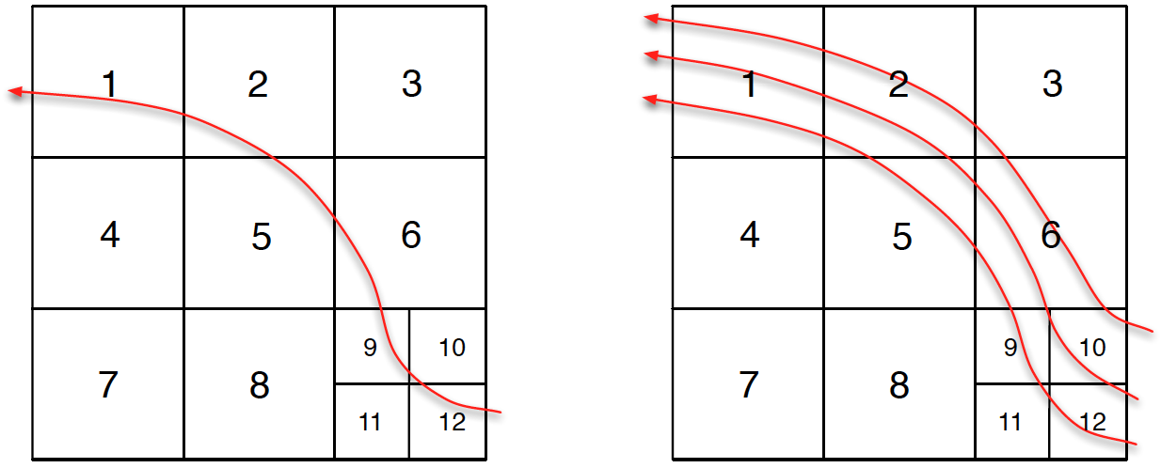
Signature of L-node
(12, 10, 9, 6, 5, 2, 1)
(1, 2, 3, 5, 6, 9, 10, 11, 12)
For a single streamline: record a sequence of the leaf-level regions the streamline traverses in order
For a group of streamlines: record a set of the leaf-level regions traversed by all streamlines without ordering

Slide 9
Streamline hierarchy construction
Streamline similarity between two streamlines l₁ and l₂ (for leaf level L-nodes)
Longest common subsequence (LCS) of the signatures of l₁ and l₂
Mean of the closest region distances (MCR) of the signatures of l₁ and l₂
Streamline cluster similarity between two streamline clusters c₁ and c₂ (for non-leaf level L-nodes)
Shared set (SS) of the signatures of c₁ and c₂
Mean of the closest region distances (MCR) of the signatures of c₁ and c₂

Slide 10
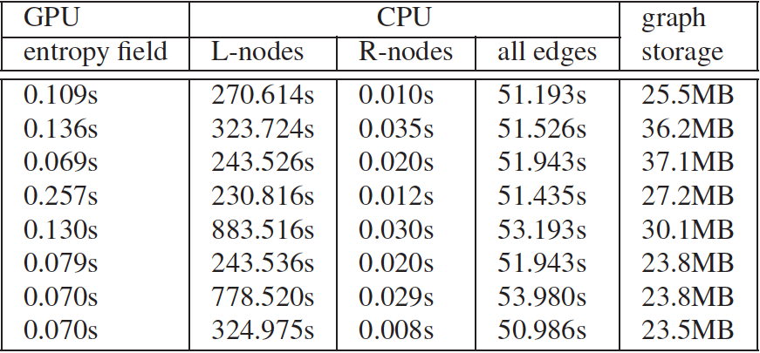
Time and storage cost
It takes up to 15 minutes and the required storage is less than 40MB

Slide 11
FlowGraph drawing (1)
Apply a force-directed graph layout algorithm to draw FlowGraph in 2D
How to update the graph during hierarchical exploration?
Apply a triangulation to the underlying coarsest level of the graph
Consider a set of additional forces to reposition the nodes to
Reduce the overlap
Maintain the topology

Slide 12
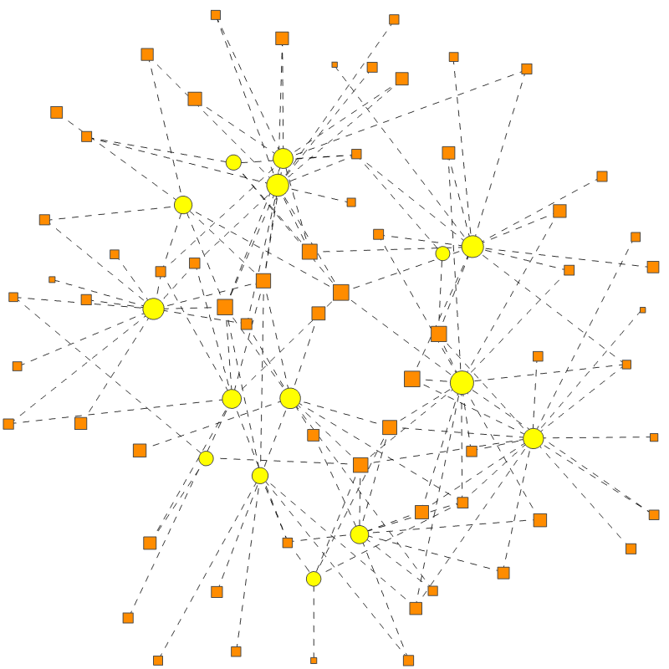
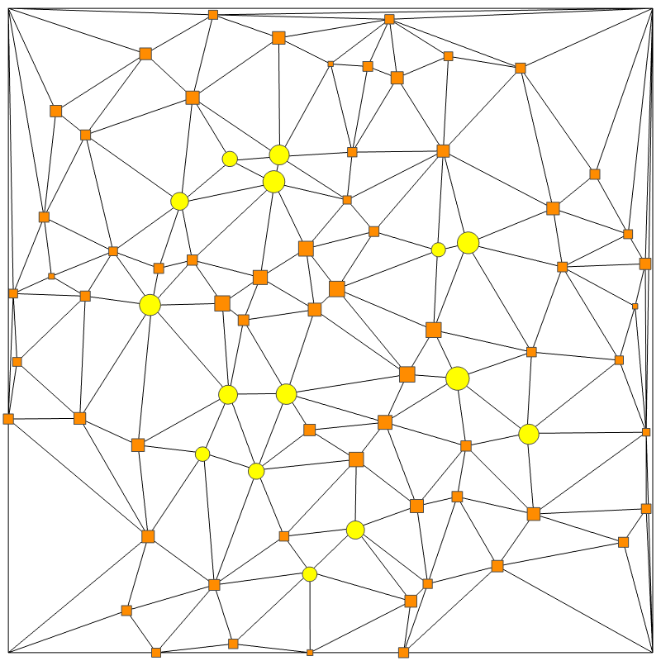
FlowGraph drawing (2)
Orange square: R-node
Yellow circle: L-node

Slide 13
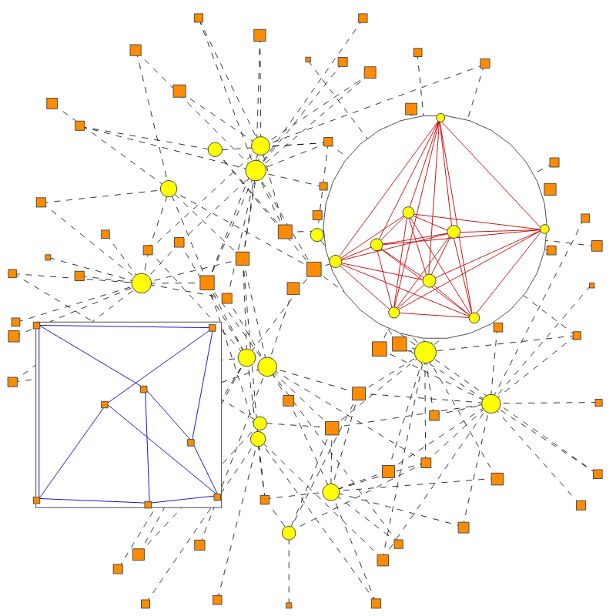
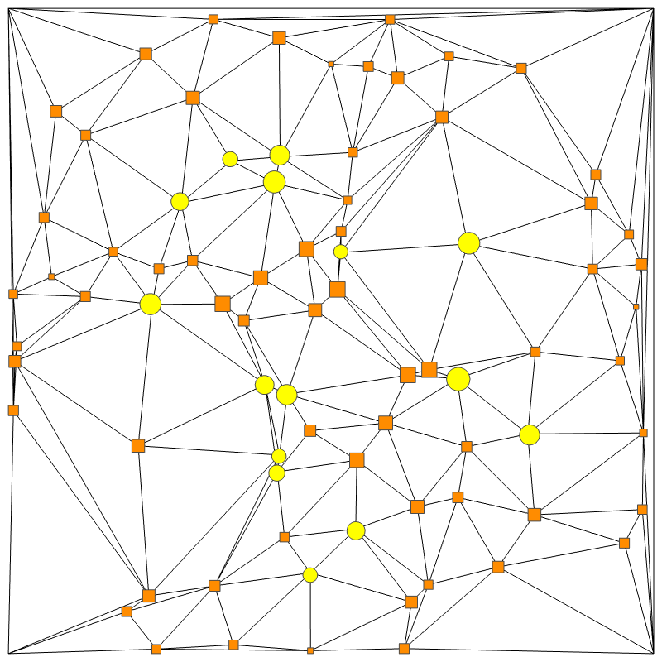
FlowGraph drawing (3)

Slide 14
FlowGraph exploration
Standard exploration
Hierarchical exploration
Brushing and linking
Filtering and querying
Specific to FlowGraph
Path comparison
Region comparison
Graph transition
Path illustration

Slide 16
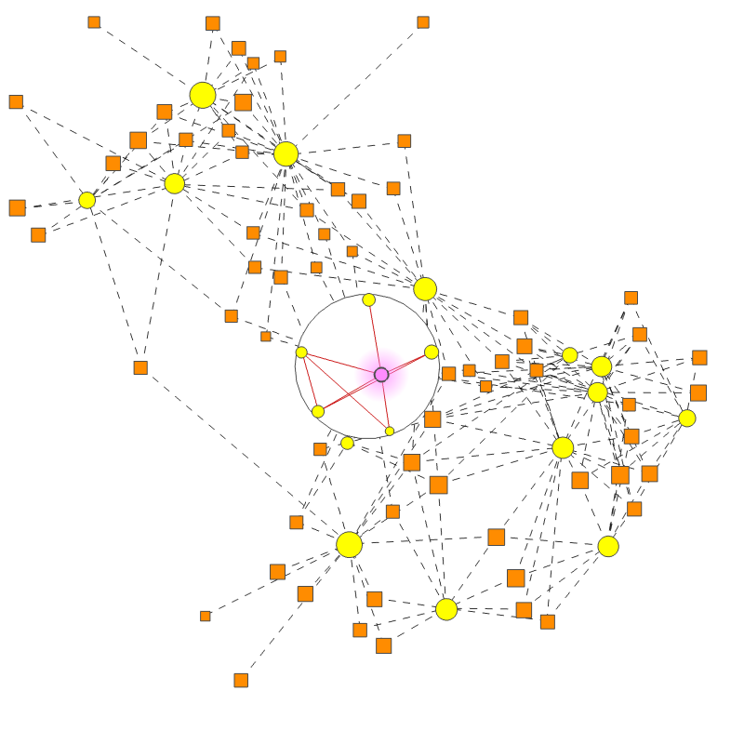
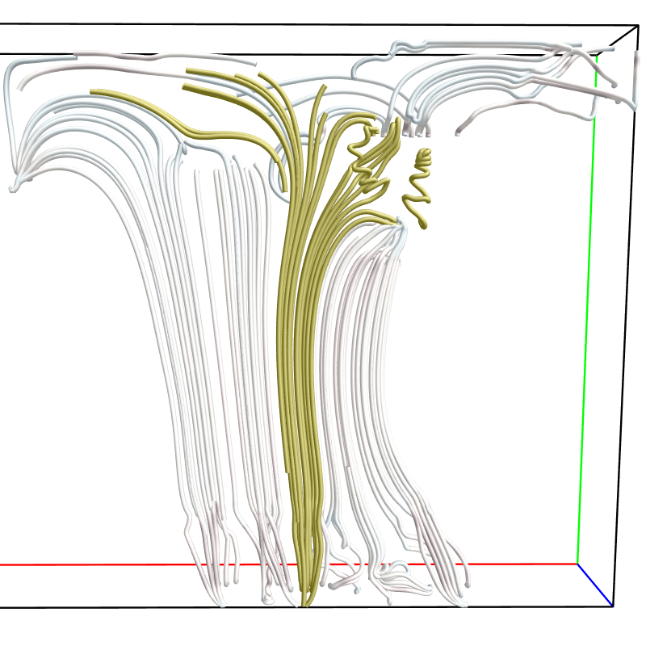
Expanding L-node

Slide 18
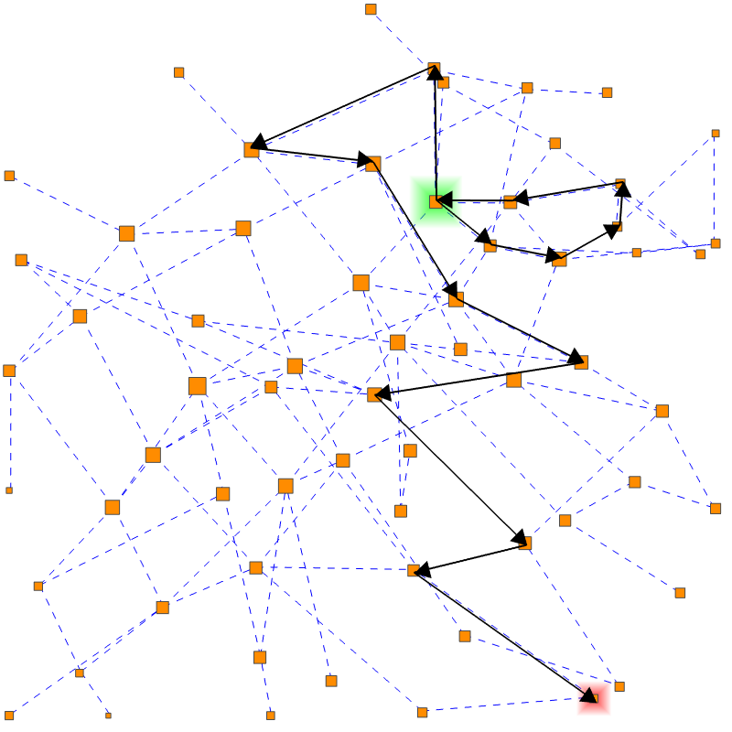
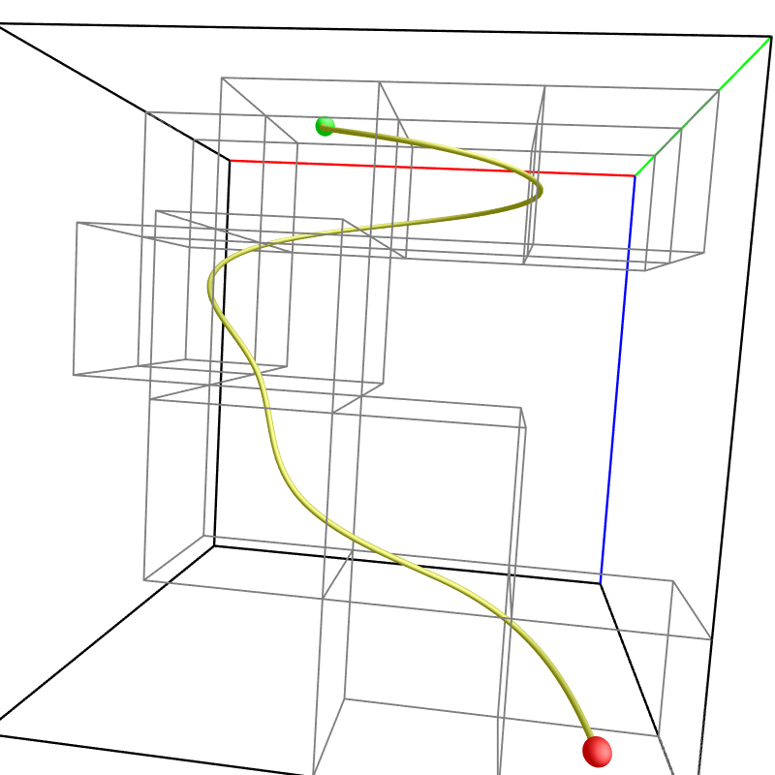
Path illustration

Slide 20
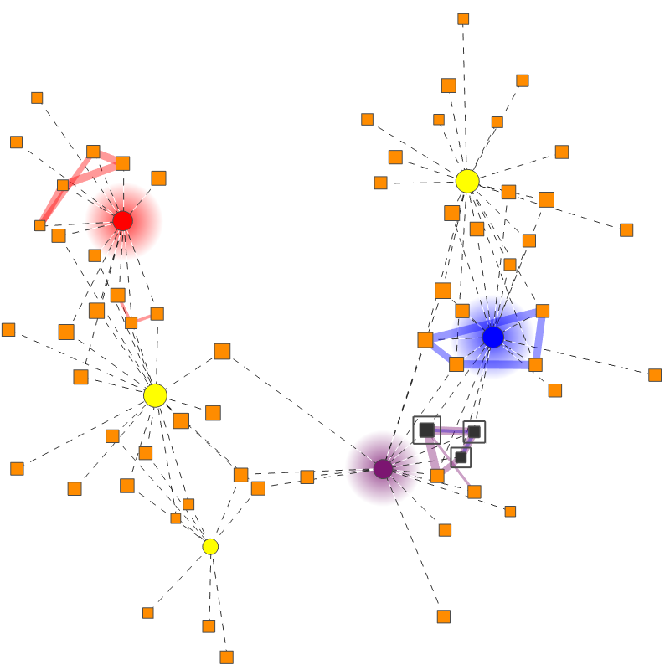
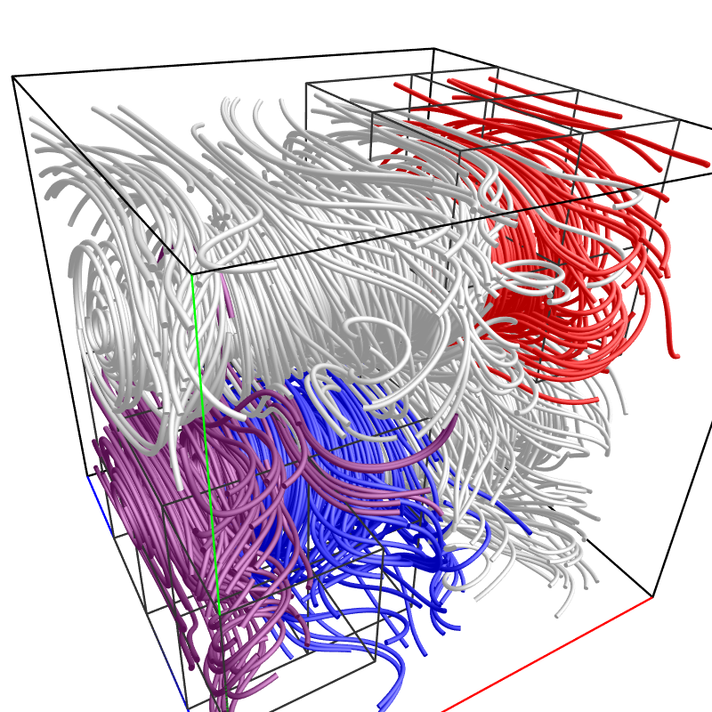
Path comparison

Slide 22
Summary
FlowGraph
Address intrinsic difficulty when visualizing and understanding 3D streamlines and their spatial relationships
Extract essential information from flow data to enable analytics reasoning facilitated by interactive visual interface
Future work
Tackle time-varying flow fields: pathlines (4D to 2D)
Acknowledgements
U.S. National Science Foundation

