Slide 1
Building Scalable Applications on the Cloud with Makeflow and Work Queue
Douglas Thain and Patrick Donnelly
University of Notre Dame
Science Cloud Summer School
Indiana University, August 1st 2012

Slide 2
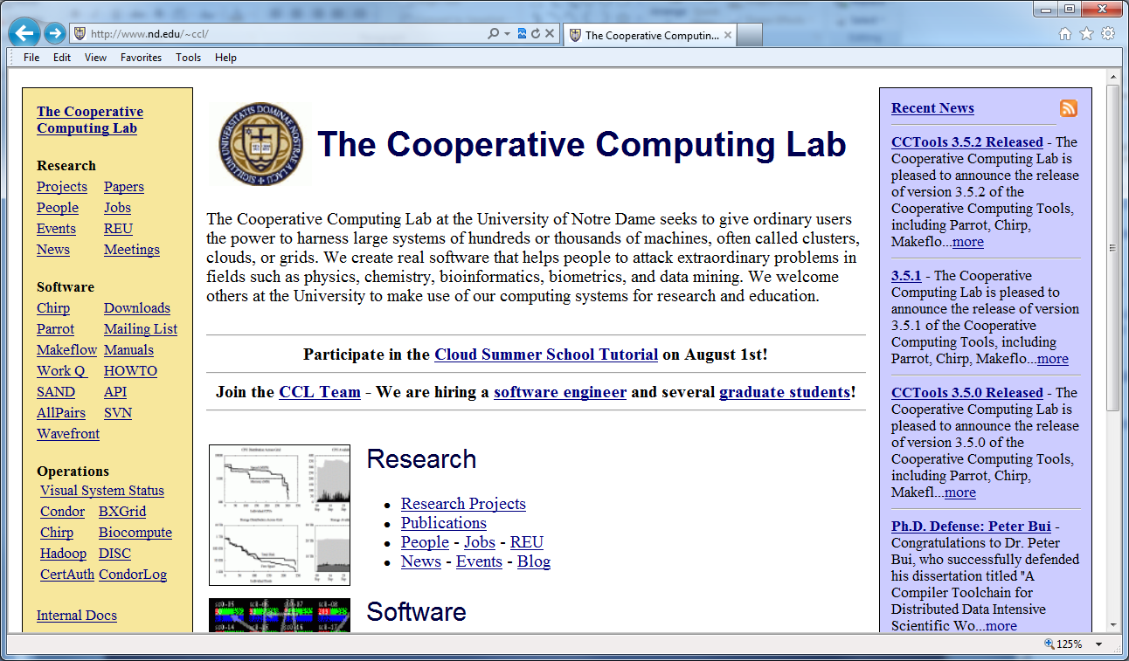
Go to: http://www.nd.edu/~ccl Click on “Cloud Summer School Tutorial”

Slide 3
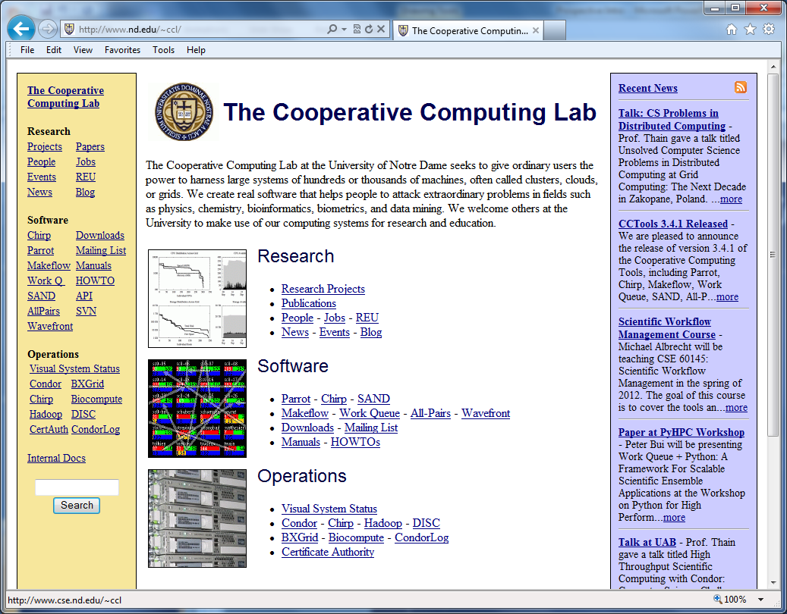
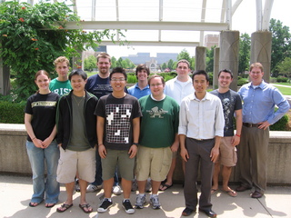
The Cooperative Computing Lab

Slide 4
The Cooperative Computing Lab
We collaborate with people who have large scale computing problems in science, engineering, and other fields.
We operate computer systems on the O(10,000) cores: clusters, clouds, grids.
We conduct computer science research in the context of real people and problems.
We develop open source software for large scale distributed computing.
http://www.nd.edu/~ccl

Slide 5
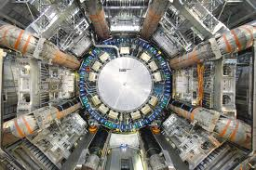
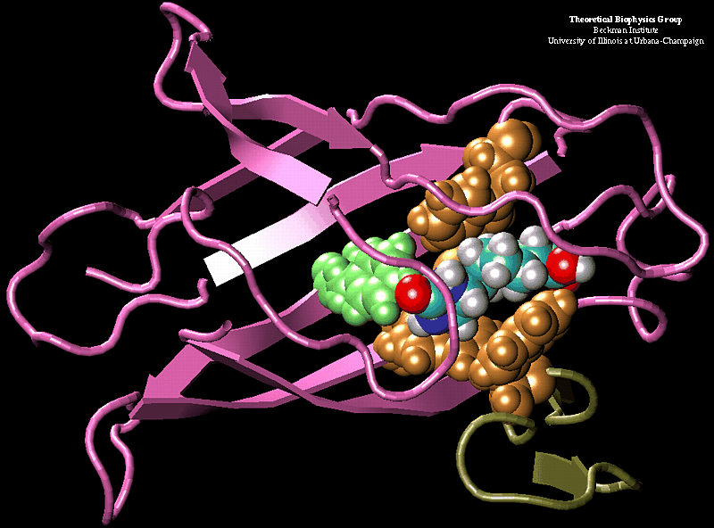
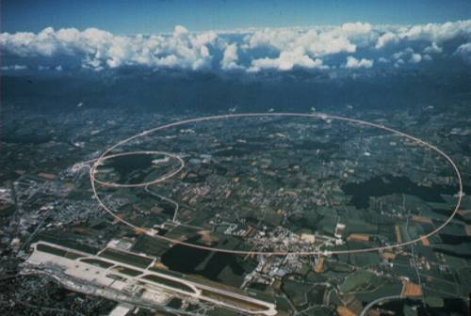
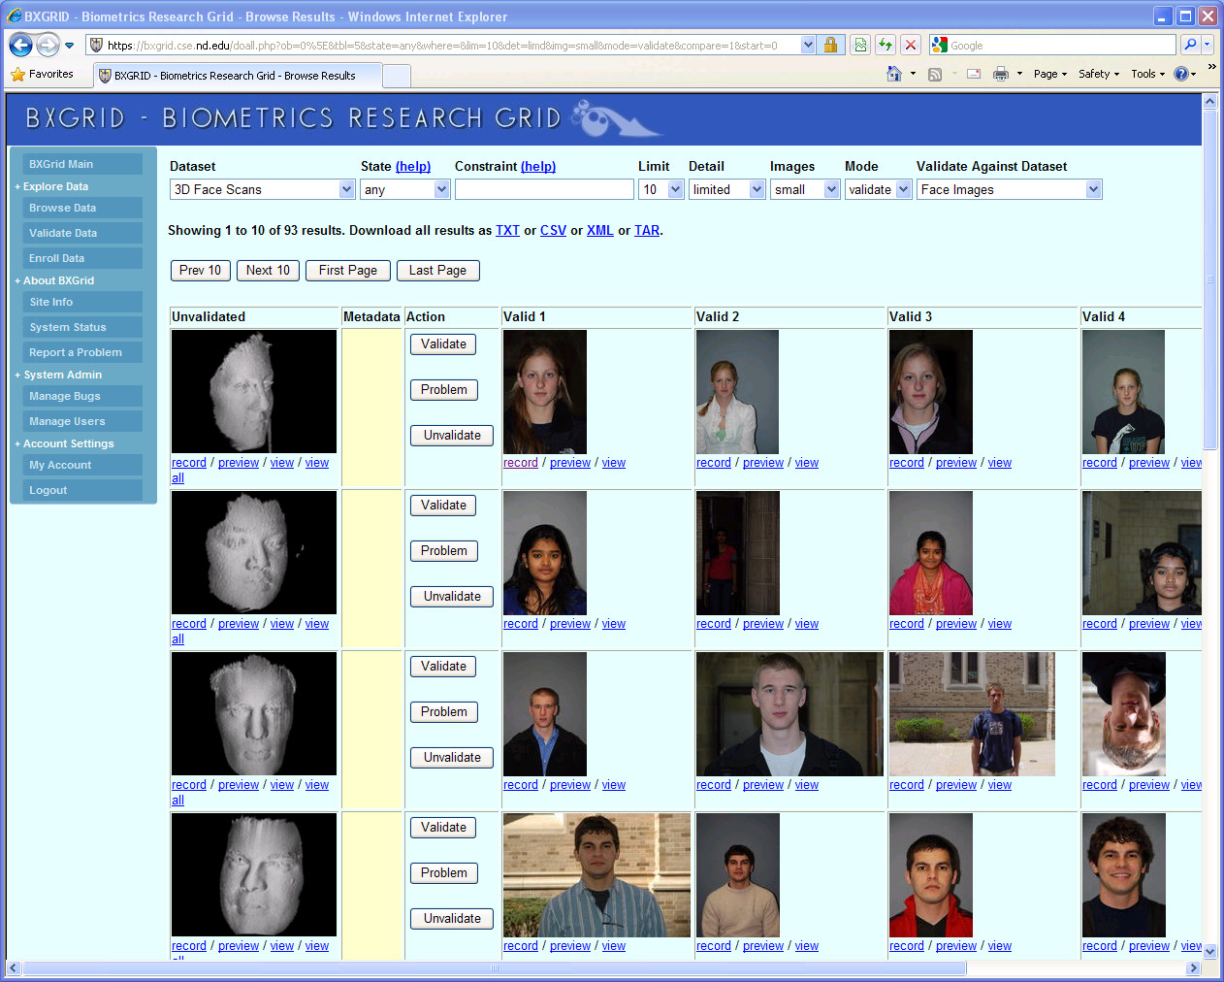
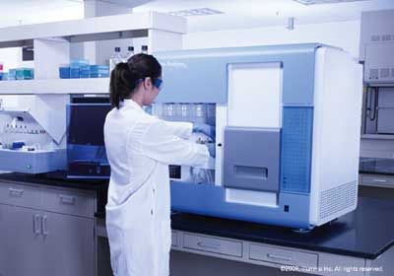
Science Depends on Computing!
AGTCCGTACGATGCTATTAGCGAGCGTGA…

Slide 6
The Good News: Computing is Plentiful!

Slide 7
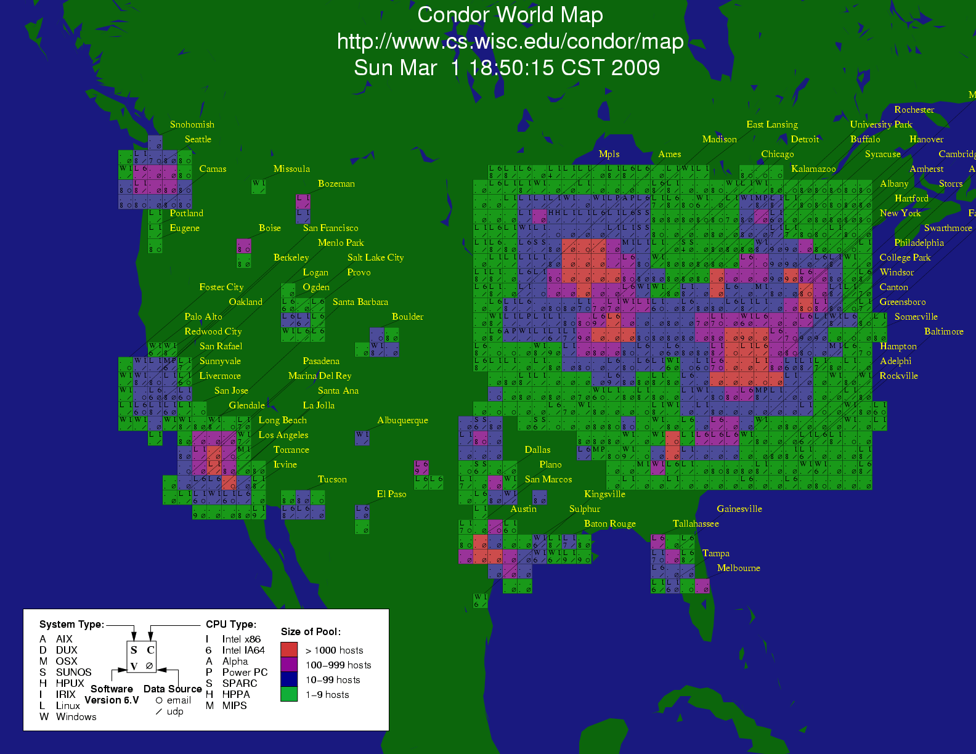
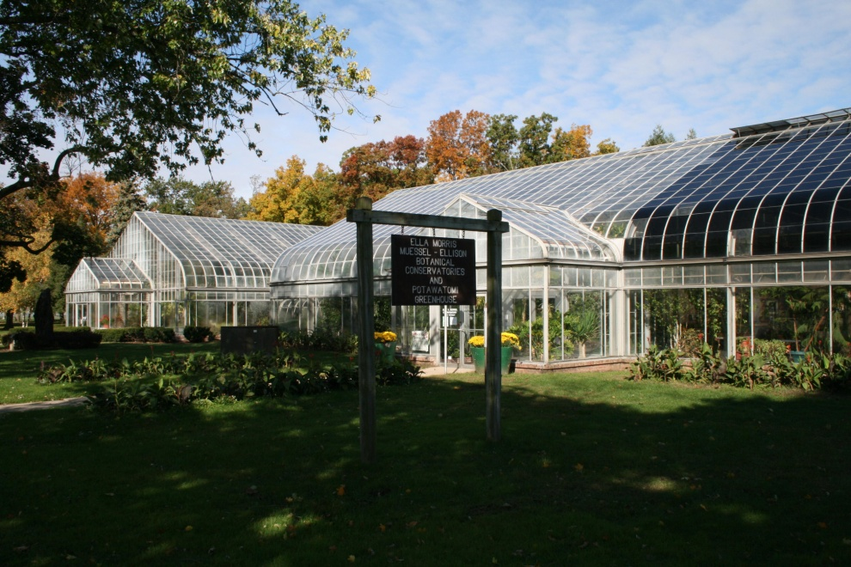
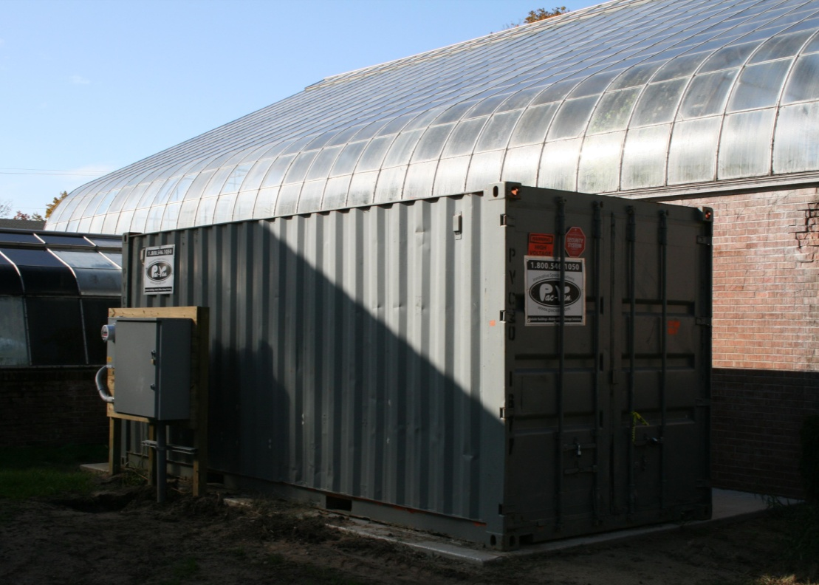

Slide 8
Big clusters are cheap!
http://arstechnica.com/business/news/2011/09/30000-core-cluster-built-on-amazon-ec2-cloud.ars

Slide 9
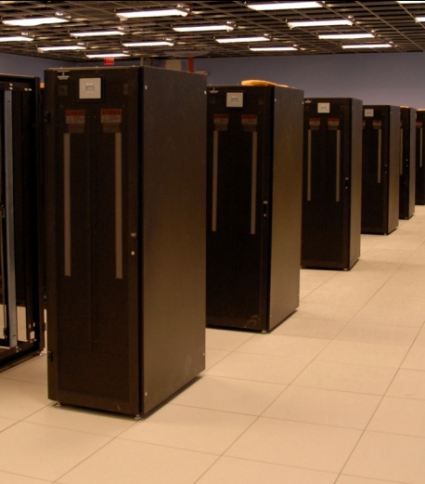
I have a standard, debugged, trusted application that runs on my laptop.
A toy problem completes in one hour.
A real problem will take a month (I think.)
Can I get a single result faster?
Can I get more results in the same time?
Last year,
I heard about
this grid thing.
This year,
I heard about
this cloud thing.
What do I do next?

Slide 10
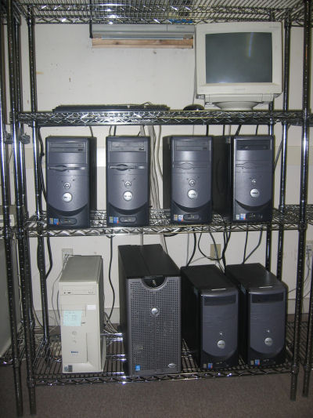
What they want.
What they get.

Slide 11
I can get as many machines on the cloud as I want! How do I organize my application to run on those machines?

Slide 12
Our Philosophy:
Harness all the resources that are available: desktops, clusters, clouds, and grids.
Make it easy to scale up from one desktop to national scale infrastructure.
Provide familiar interfaces that make it easy to connect existing apps together.
Allow portability across operating systems, storage systems, middleware…
Make simple things easy, and complex things possible.
No special privileges required.

Slide 13
A Quick Tour of the CCTools
Open source, GNU General Public License.
Compiles in 1-2 minutes, installs in $HOME.
Runs on Linux, Solaris, MacOS, Cygwin, FreeBSD, …
Interoperates with many distributed computing systems.
Condor, SGE, Torque, Globus, iRODS, Hadoop…
Components:
Makeflow – A portable workflow manager.
Work Queue – A lightweight distributed execution system.
All-Pairs / Wavefront / SAND – Specialized execution engines.
Parrot – A personal user-level virtual file system.
Chirp – A user-level distributed filesystem.
http://www.nd.edu/~ccl/software

Slide 14
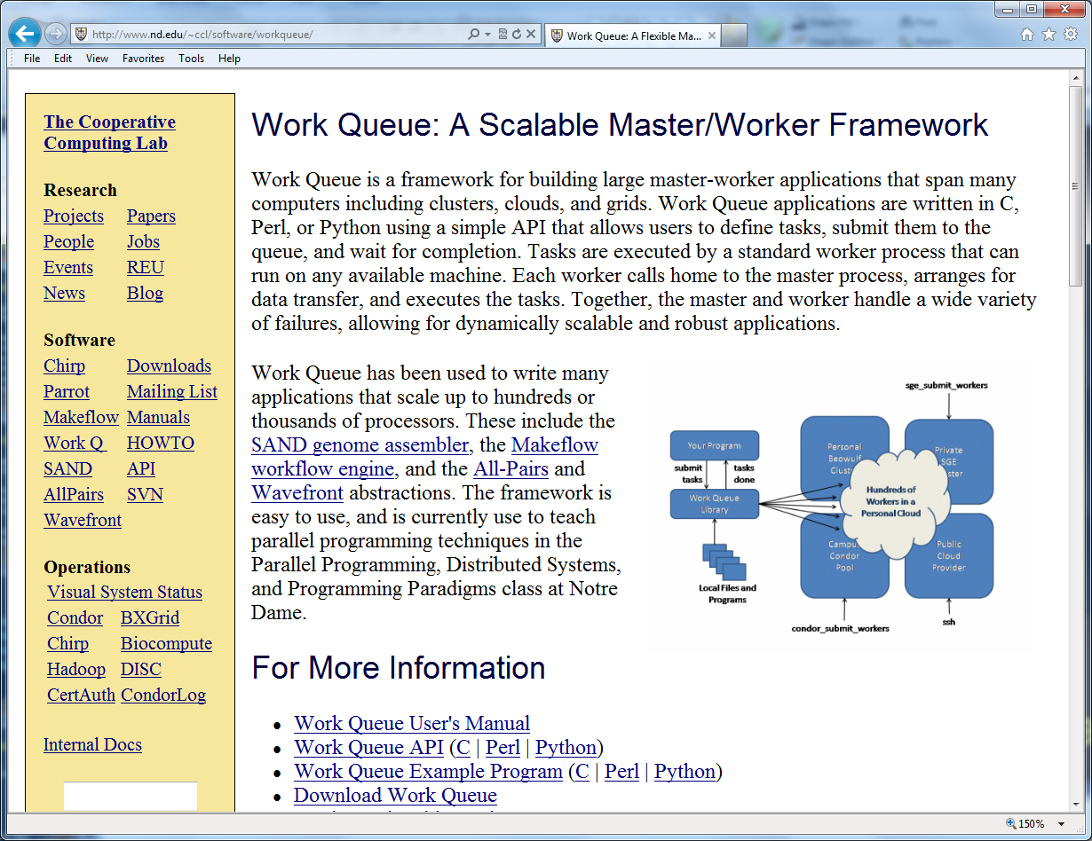
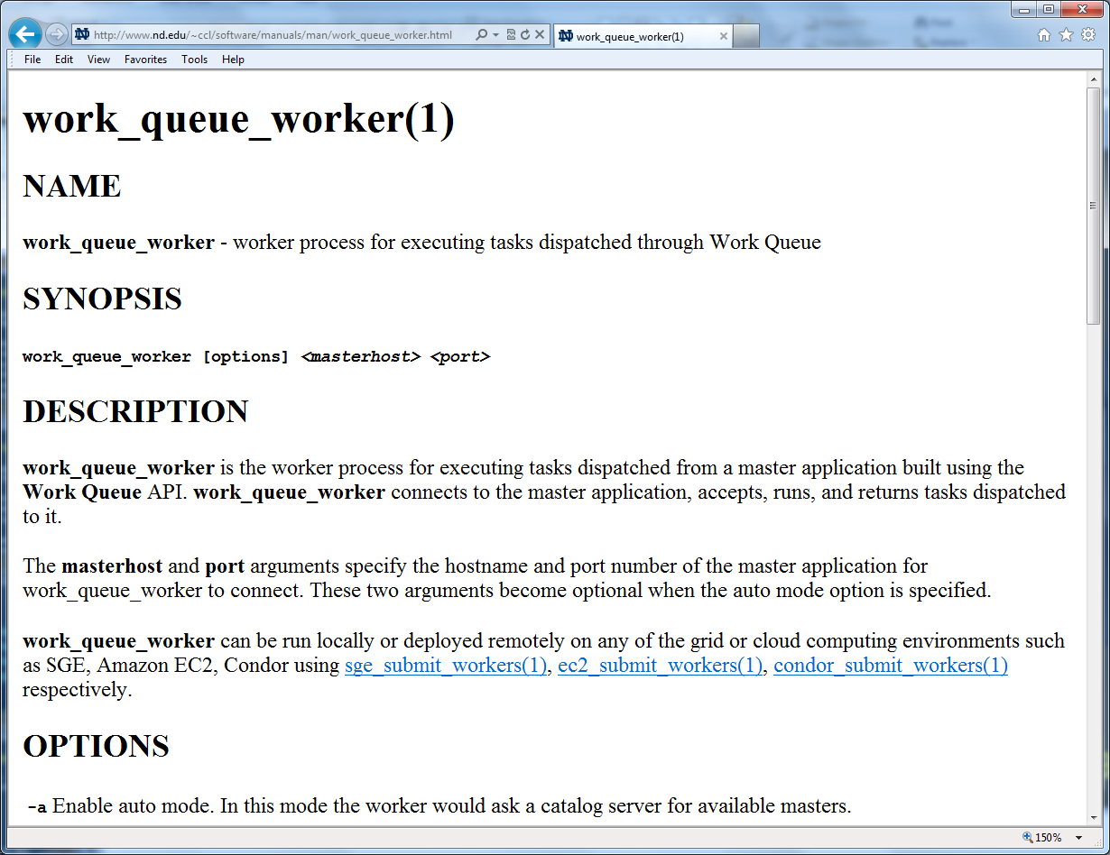
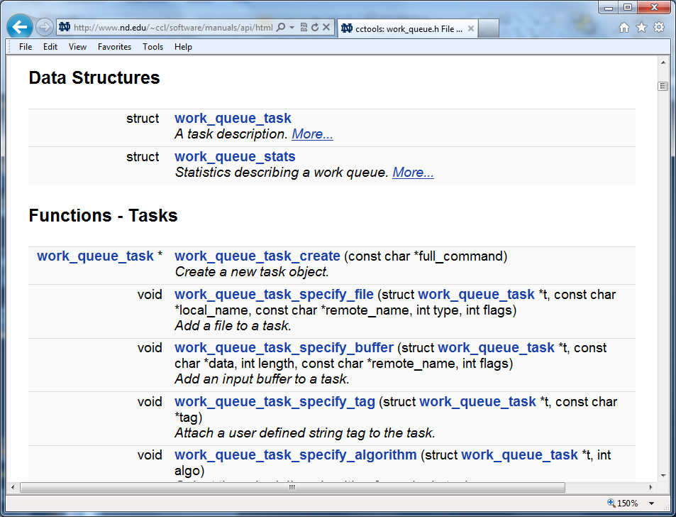
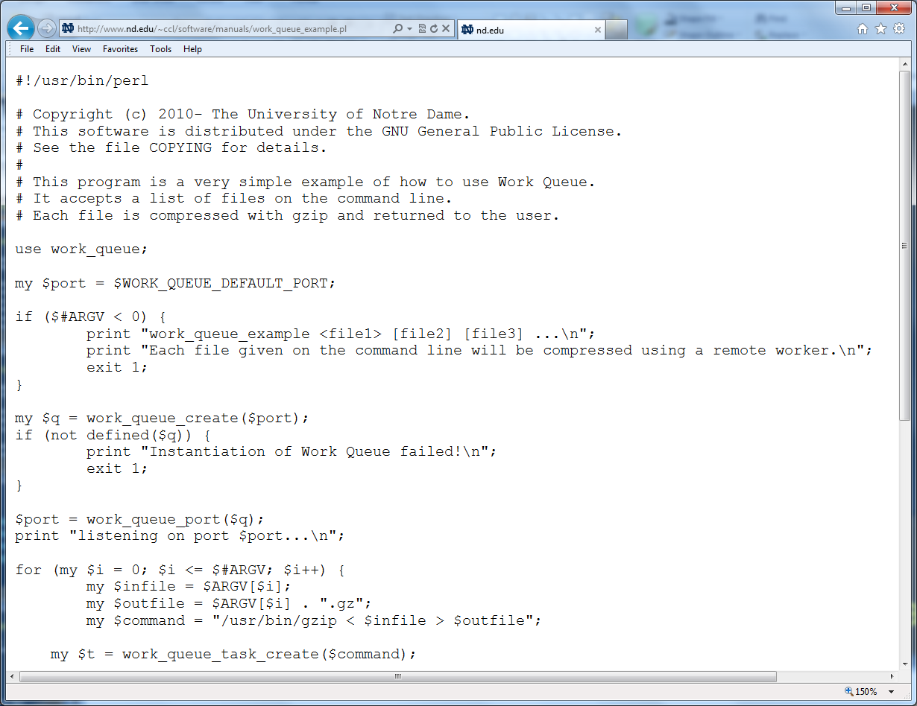
http://www.nd.edu/~ccl/software/manuals

Slide 15
Makeflow: A Portable Workflow System

Slide 16
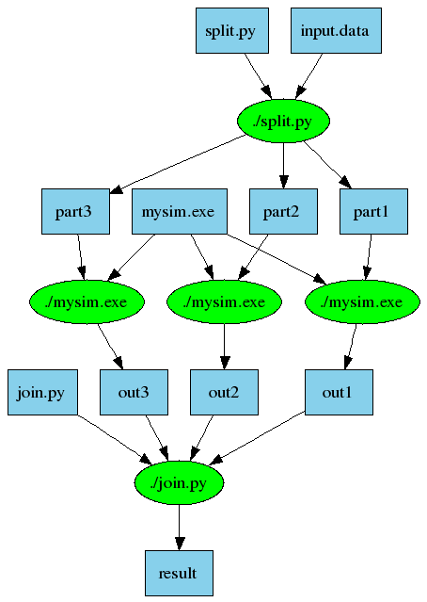
An Old Idea: Makefiles
part1 part2 part3: input.data split.py
./split.py input.data
out1: part1 mysim.exe
./mysim.exe part1 >out1
out2: part2 mysim.exe
./mysim.exe part2 >out2
out3: part3 mysim.exe
./mysim.exe part3 >out3
result: out1 out2 out3 join.py
./join.py out1 out2 out3 > result

Slide 17
Makeflow = Make + Workflow
Provides portability across batch systems.
Enable parallelism (but not too much!)
Fault tolerance at multiple scales.
Data and resource management.
Makeflow
Local
Condor
Torque
Work
Queue
http://www.nd.edu/~ccl/software/makeflow

Slide 18
Makeflow Syntax
[output files] : [input files]
[command to run]
One Rule
calib.dat
sim.exe
out.txt
in.dat
sim.exe in.dat –p 50 > out.txt
out.txt : in.dat
sim.exe –p 50 in.data > out.txt
out.txt : in.dat calib.dat sim.exe
sim.exe –p 50 in.data > out.txt
Not Quite Right!

Slide 19
You must state all the files needed by the command.

Slide 20
sims.mf
out.10 : in.dat calib.dat sim.exe
sim.exe –p 10 in.data > out.10
out.20 : in.dat calib.dat sim.exe
sim.exe –p 20 in.data > out.20
out.30 : in.dat calib.dat sim.exe
sim.exe –p 30 in.data > out.30

Slide 21
How to run a Makeflow
Run a workflow locally (multicore?)
makeflow -T local sims.mf
Clean up the workflow outputs:
makeflow –c sims.mf
Run the workflow on Torque:
makeflow –T torque sims.mf
Run the workflow on Condor:
makeflow –T condor sims.mf

Slide 22
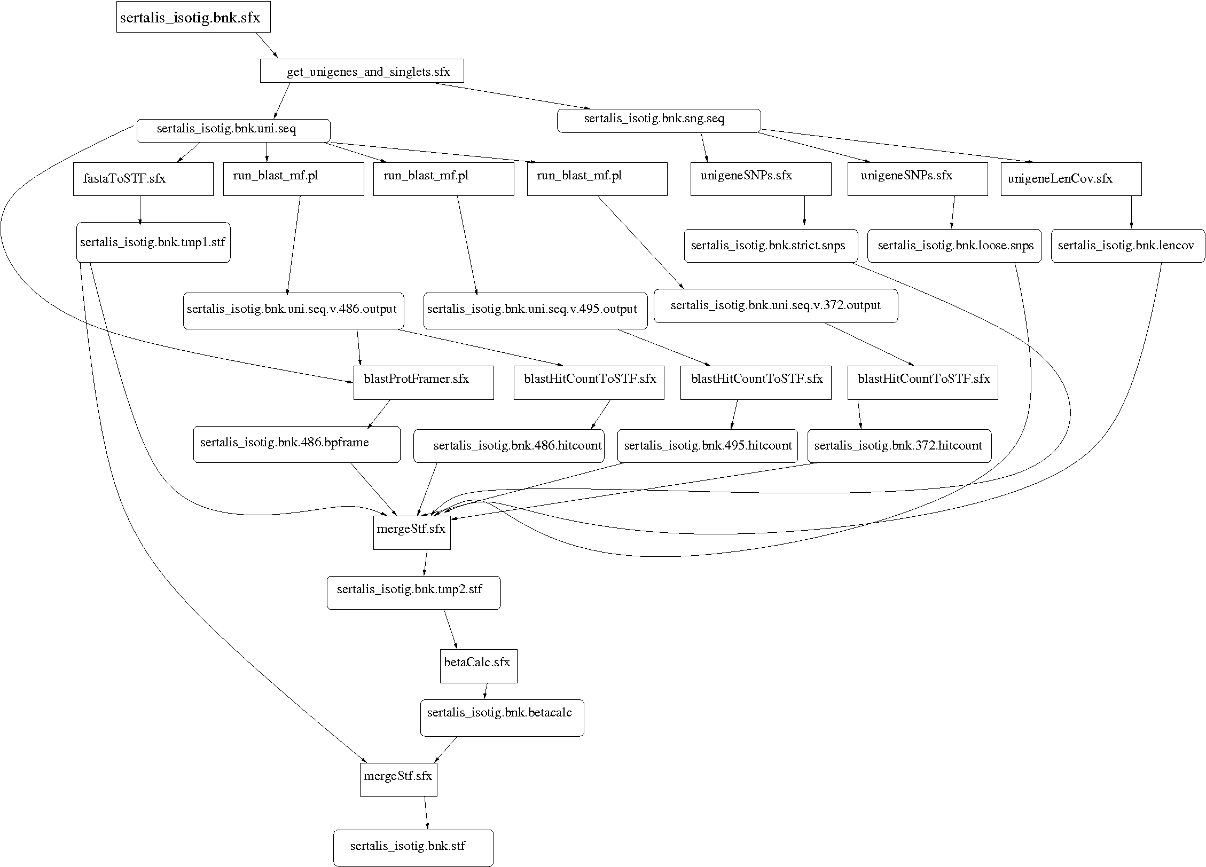
Example: Biocompute Portal
BLAST
SSAHA SHRIMP
EST
MAKER
…
Progress
Bar
Generate Makefile
Transaction Log
Condor
Pool
Update
Status
Run
Workflow
Make
flow
Submit
Tasks

Slide 23
Makeflow + Work Queue

Slide 24
Makeflow + Batch System
FutureGrid
Torque
Cluster
Private
Cluster
Makefile
makeflow –T torque
???
Makeflow
???
Campus
Condor
Pool
Public
Cloud
Provider
makeflow –T condor
Local Files and Programs

Slide 25
Makeflow + Work Queue
torque_submit_workers
FutureGrid
Torque
Cluster
Private
Cluster
Makefile
W
W
Thousands of Workers in a
Personal Cloud
W
submit
tasks
W
W
W
Makeflow
Campus
Condor
Pool
Public
Cloud
Provider
W
W
W
W
W
W
W
Local Files and Programs
condor_submit_workers
ssh

Slide 26
Advantages of Work Queue
Harness multiple resources simultaneously.
Hold on to cluster nodes to execute multiple tasks rapidly. (ms/task instead of min/task)
Scale resources up and down as needed.
Better management of data, with local caching for data intensive tasks.
Matching of tasks to nodes with data.

Slide 27
Makeflow and Work Queue
To start the Makeflow
% makeflow –T wq sims.mf
Could not create work_queue on port 9123.
% makeflow –T wq –p 0 sims.mf
Listening for workers on port 8374…
To start one worker:
% work_queue_worker alamo.futuregrid.org 8374

Slide 28
Start Workers Everywhere!
Submit workers to Torque:
torque_submit_workers alamo.futuregrid.org 8374 25
Submit workers to Condor:
condor_submit_workers alamo.futuregrid.org 8374 25
Submit workers to SGE:
sge_submit_workers alamo.futuregrid.org 8374 25

Slide 29
Keeping track of port numbers gets old fast…

Slide 30
Project Names
makeflow …
–a –N myproject
work_queue_worker
-a –N myproject
Makeflow
(port 4057)
connect to
alamo:4057
Worker
advertise
query
Catalog
work_queue_status
query
“myproject”
is at alamo:4057

Slide 31
Project Names
Start Makeflow with a project name:
makeflow –T wq –p 0 –a –N fg-tutorial sims.mf
Listening for workers on port XYZ…
Start one worker:
work_queue_worker -a -N fg-tutorial
Start many workers:
torque_submit_workers –a –N fg-tutorial 5

Slide 32
work_queue_status

Slide 33
Resilience and Fault Tolerance
MF +WQ is fault tolerant in many different ways:
If Makeflow crashes (or is killed) at any point, it will recover by reading the transaction log and continue where it left off.
Makeflow keeps statistics on both network and task performance, so that excessively bad workers are avoided.
If a worker crashes, the master will detect the failure and restart the task elsewhere.
Workers can be added and removed at any time during the execution of the workflow.
Multiple masters with the same project name can be added and removed while the workers remain.
If the worker sits idle for too long (default 15m) it will exit, so as not to hold resources idle.

Slide 34
Managing Your Workforce
work_queue_pool –T condor
Master
A
Condor
Pool
W
WQ
Pool
200
W
500
W
W
W
Master
B
W
Submits new workers.
Restarts failed workers.
Removes unneeded workers.
Torque
Cluster
W
W
WQ
Pool
200
Master
C
0
W
work_queue_pool –T torque

Slide 35
What if my program is dynamic? Write a program to use the Work Queue API.

Slide 36
Work Queue API
#include “work_queue.h”
while( not done ) {
while (more work ready) { task = work_queue_task_create();
// add some details to the task
work_queue_submit(queue, task);
}
task = work_queue_wait(queue);
// process the completed task
}
http://www.nd.edu/~ccl/software/workqueue

Slide 37
Work Queue System
1000s of workers
dispatched to clusters, clouds, and grids
worker
worker
worker
worker
worker
worker
Work Queue Program
C / Python / Perl
Work Queue Library
put P.exe
put in.txt
exec P.exe <in.txt >out.txt
get out.txt
worker
In.txt
P
out.txt
cache of recently used files

Slide 38
Run One Task in C
#include “work_queue.h”
struct work_queue *queue;
struct work_queue_task *task;
queue = work_queue_create( 0 );
work_queue_specify_name( “myproject” );
task = work_queue_task_create(“sim.exe –p 50 in.dat >out.txt”);
/// Missing: Specify files needed by the task.
work_queue_submit( queue, task );
while(!work_queue_empty(queue)) {
task = work_queue_wait( queue, 60 );
if(task) work_queue_task_delete( task );
}

Slide 39
Run One Task in Perl
use work_queue;
$queue = work_queue_create( 0 );
work_queue_specify_name( “myproject” );
$task = work_queue_task_create(“sim.exe –p 50 in.dat >out.txt”);
### Missing: Specify files needed by the task.
work_queue_submit( $queue, $task );
while(!work_queue_empty($queue)) {
$task = work_queue_wait( $queue, 60 );
if($task) work_queue_task_delete( $task );
}

Slide 40
Run One Task in Python
from work_queue import *;
queue = WorkQueue( name=“myproject”, port = 0 )
task = Task(“sim.exe –p 50 in.dat >out.txt”)
### Missing: Specify files needed by the task.
queue.submit( task );
While not queue.empty():
task = queue.wait(60);

Slide 41
Specify Files for a Task
calib.dat
sim.exe
out.txt
in.dat
sim.exe in.dat –p 50 > out.txt
work_queue_specify_file( task,“in.dat”,”in.dat”,
WORK_QUEUE_INPUT, WORK_QUEUE_NOCACHE );
work_queue_specify_file( task,“out.dat”,”out.dat”,
WORK_QUEUE_OUTPUT, WORK_QUEUE_NOCACHE );
work_queue_specify_file( task,“calib.dat”,”calib.dat”,
WORK_QUEUE_INPUT, WORK_QUEUE_CACHE );
work_queue_specify_file( task,“sim.exe”,”sim.exe”,
WORK_QUEUE_INPUT, WORK_QUEUE_CACHE );

Slide 42
You must state all the files needed by the command.

Slide 43
Sample Applications of Work Queue

Slide 44
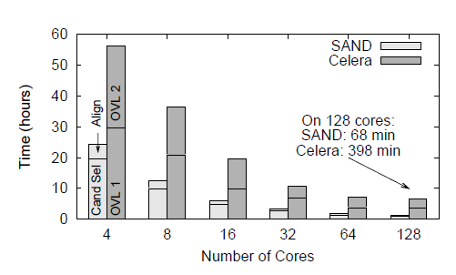
Genome Assembly
Sequence
Data
Modified Celera Assembler
SAND
filter
master
SAND
align
master
Celera
Consensus
W
W
Using WQ, we could assemble a human genome in 2.5 hours on a collection of clusters, clouds, and grids with a speedup of 952X.
W
W
W
W
W
Christopher Moretti, Andrew Thrasher, Li Yu, Michael Olson, Scott Emrich, and Douglas Thain, A Framework for Scalable Genome Assembly on Clusters, Clouds, and Grids, IEEE Transactions on Parallel and Distributed Systems, 2012

Slide 45
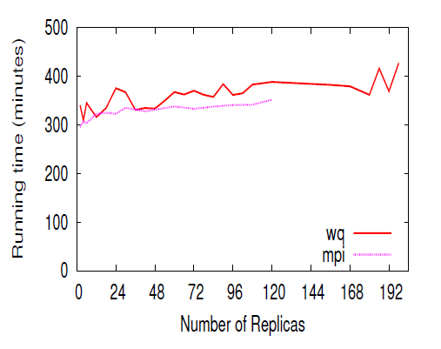
Replica Exchange
Simplified Algorithm:
Submit N short simulations at different temps.
Wait for all to complete.
Select two simulations to swap.
Continue all of the simulations.
Replica Exchange
Work Queue
T=10K
T=20K
T=30K
T=40K
Dinesh Rajan, Anthony Canino, Jesus A Izaguirre, and Douglas Thain, Converting A High Performance Application to an Elastic Cloud Application, Cloud Com 2011/

Slide 46
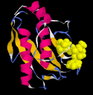
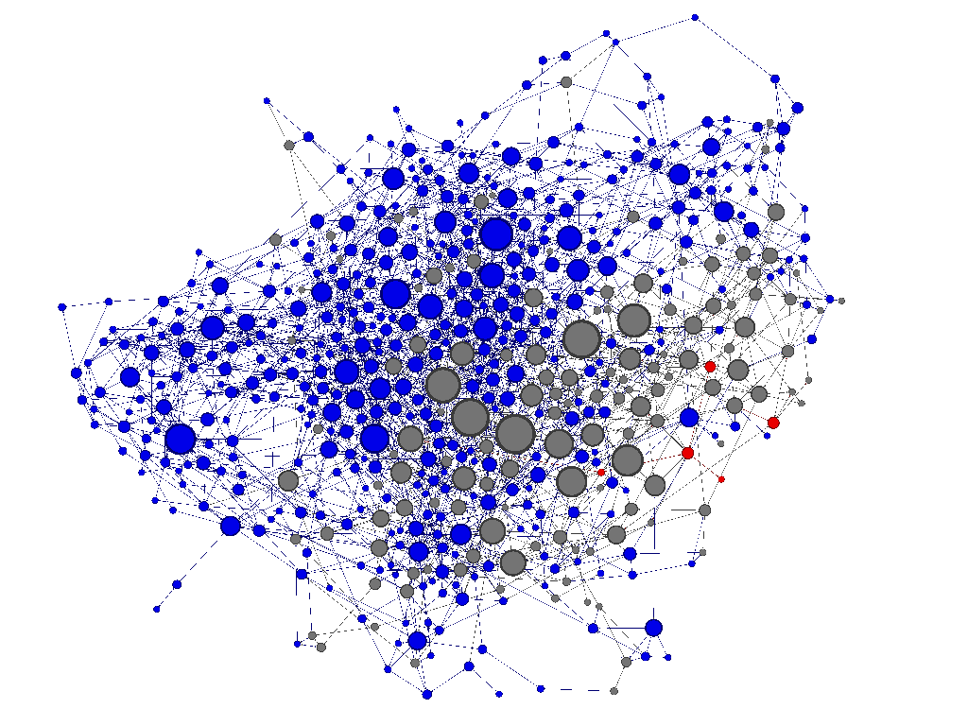
Adaptive Weighted Ensemble
Proteins fold into a number of distinctive states, each of which affects its function in the organism.
How common is each state?
How does the protein transition between states?
How common are those transitions?

Slide 47
AWE Using Work Queue
Simplified Algorithm:
Submit N short simulations in various states.
Wait for them to finish.
When done, record all state transitions.
If too many are in one state, redistribute them.
Has enough data been collected?
Yes – Stop
No – Go back to the beginning.

Slide 48
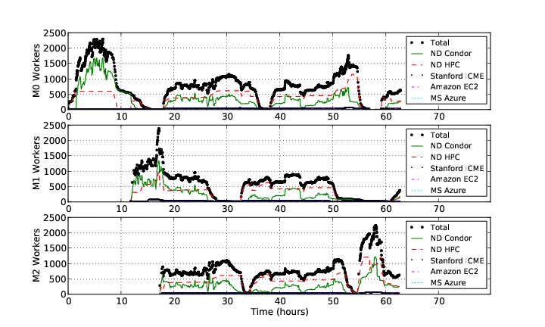
AWE on Clusters, Clouds, and Grids

Slide 49
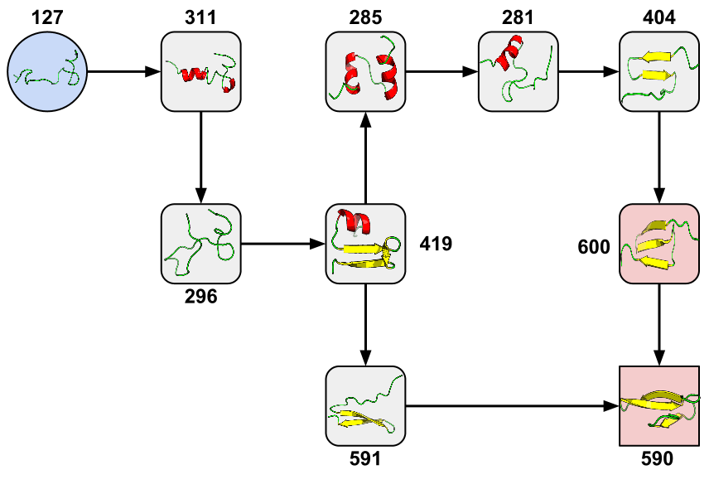
New Pathway Found!
Credit: Joint work in progress with Badi Abdul-Wahid, Dinesh Rajan, Haoyun Feng, Jesus Izaguirre, and Eric Darve.

Slide 50
Other parts of the CCTools…

Slide 51
Parrot Virtual File System
Ordinary
Appl
Filesystem Interface: open/read/write/close
Parrot Virtual File System
Local
HTTP
CVMFS
Chirp
iRODS
Web Servers
iRODS
Server
CVMFS
Network
Chirp
Server

Slide 52
All-Pairs and Wavefront
Specialized tools for very specific workflow patterns.
allpairs A.list B.list F.exe
wavefront M.data F.exe
A1
A2
A3
M[0,4]
M[2,4]
M[3,4]
M[4,4]
x
F
d
y
M[0,3]
M[3,2]
M[4,3]
B1
F
F
F
x
F
x
F
d
y
d
y
M[0,2]
x
M[4,2]
x
F
x
F
F
B2
F
F
F
d
y
d
y
d
y
M[0,1]
x
F
x
F
x
F
x
F
B3
F
F
F
d
y
d
y
d
y
d
y
M[0,0]
M[1,0]
M[2,0]
M[3,0]
M[4,0]

Slide 53
Elastic Application Stack
All-Pairs
Wavefront
Makeflow
Custom
Apps
Work Queue Library
Thousands of Workers in a
Personal Cloud
Public
Cloud
Provider
Shared
SGE
Cluster
Campus
Condor
Pool
Private
Cluster
W
W
Wv
W
W
W
W
W
W

Slide 54
Computer Science Challenges in Scalable Programs
Capacity Management
Just because I can run on 1000 cores doesn’t mean it makes sense! What size gets the best perf, cost, etc?
Software Engineering Tools
A linker to gather up all the dependencies, a loader to move an entire workflow to the cloud, profiler, debugger…
Composability
Program A (500 cores) calls program B (800 cores ) and program C (1000 cores). But, I only have 600 cores. What happens next?
Portability and Reproducibility
This program ran correctly last year on Blue Sock Linux 35.2, but this year I have Green Scarf Linux 85. Will it work?
Effortless Scalability
Some component always has an arbitrary limit that breaks as you scale up (kernel, network, filesystem). How do we discover, avoid, and repair all of these issues?

Slide 55
Research is a Team Sport
Faculty Collaborators:
Patrick Flynn (ND)
Scott Emrich (ND)
Jesus Izaguirre (ND)
Eric Darve (Stanford)
Vijay Pande (Stanford)
Sekou Remy (Clemson)
Current Graduate Students:
Michael Albrecht
Patrick Donnelly
Dinesh Rajan
Peter Sempolinski
Li Yu
Recent CCL PhDs
Peter Bui (UWEC)
Hoang Bui (Rutgers)
Chris Moretti (Princeton)
Summer REU Students:
Chris Bauschka
Iheanyi Ekechuku
Joe Fetsch

Slide 56
Papers, Software, Manuals, …
http://www.nd.edu/~ccl
This work was supported by NSF Grants CCF-0621434, CNS-0643229, and CNS 08554087.

Slide 57
Next Steps:
Tutorial: Basic examples of how to use Makeflow and Work Queue on Future Grid.
Homework: Problems to work on this week when you have some free time.
Later: Get CCTools running on systems at your home institutions.

Slide 58
Form groups of three! (or FutureGrid will melt!)

Slide 59
Go to: http://www.nd.edu/~ccl Click on “Cloud Summer School Tutorial”

