Slide 1
Building Scalable Elastic Applications using Makeflow
Dinesh Rajan and Douglas Thain
University of Notre Dame
Tutorial at CCGrid, May 13 2013
Delft, Netherlands

Slide 2
Go to: http://www.nd.edu/~ccl Click on “Tutorial at CCGrid 2013”

Slide 3
Plan for Today’s Tutorial
What we do at CCL
Research & Software Overview: CCTools, Makeflow, Work Queue, Parrot, Chirp
Makeflow
Lecture: Overview, features
Tutorial: Write simple makeflows
Work Queue
Lecture: Overview, features
Tutorial: Write simple WQ programs

Slide 4
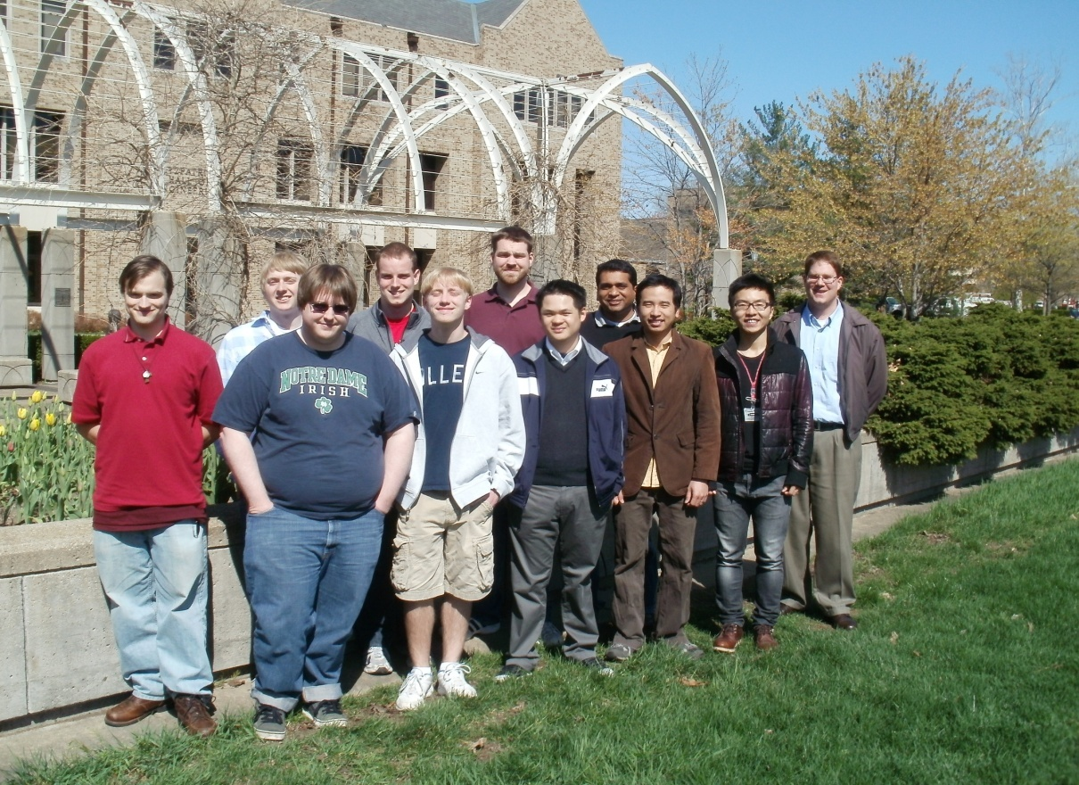
The Cooperative Computing Lab
University of Notre Dame
http://www.nd.edu/~ccl

Slide 5
The Cooperative Computing Lab
We collaborate with people who have large scale computing problems in science, engineering, and other fields.
We operate computer systems on the O(10,000) cores: clusters, clouds, grids.
We conduct computer science research in the context of real people and problems.
We develop open source software for large scale distributed computing.
http://www.nd.edu/~ccl
5

Slide 6
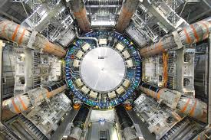
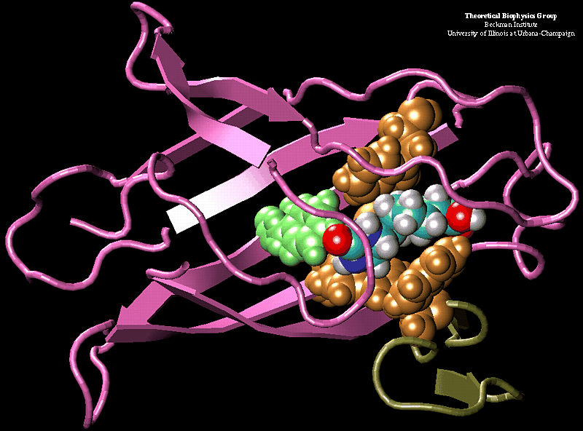
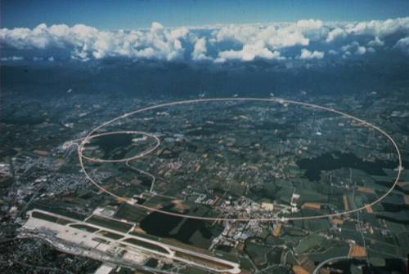
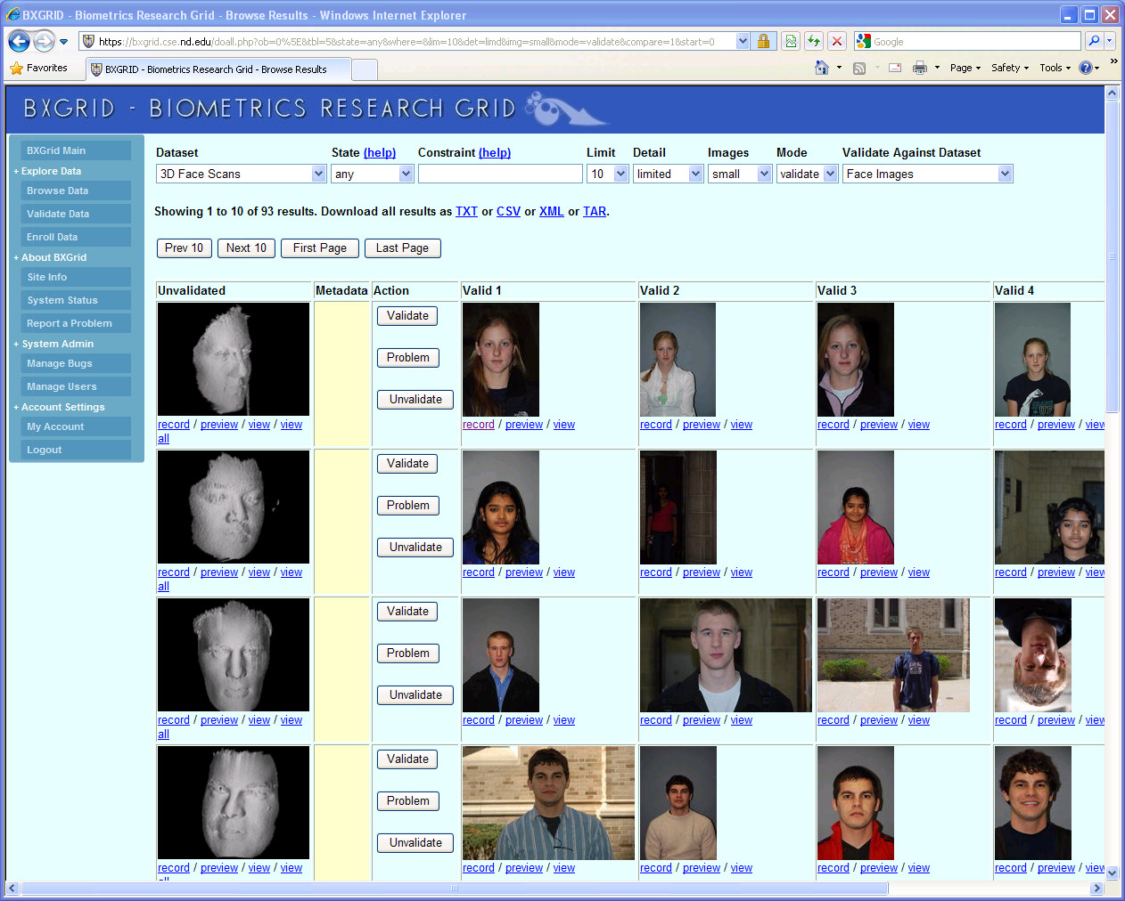
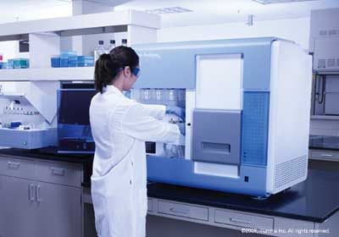
Science Depends on Computing!
AGTCCGTACGATGCTATTAGCGAGCGTGA…

Slide 7
The Good News: Computing is Plentiful!
7

Slide 8
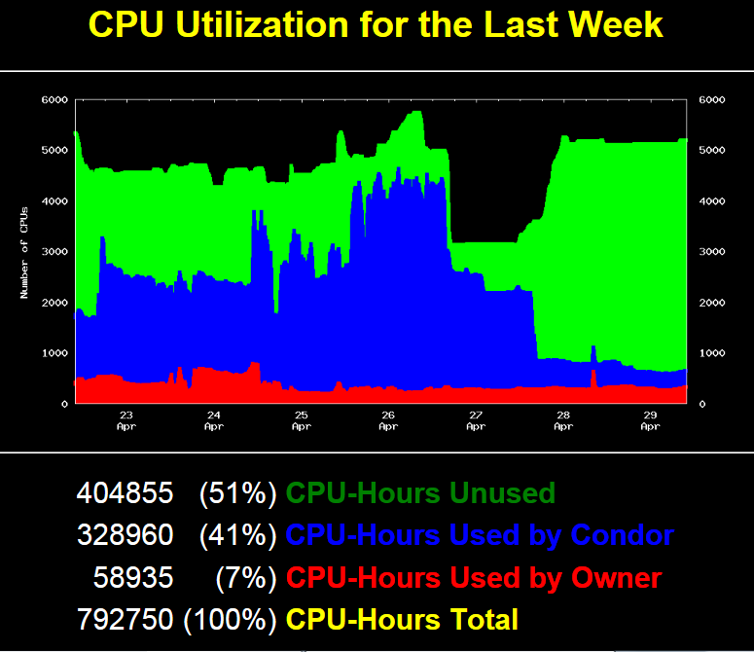

Slide 9
Superclusters by the Hour
http://arstechnica.com/business/news/2011/09/30000-core-cluster-built-on-amazon-ec2-cloud.ars

Slide 10
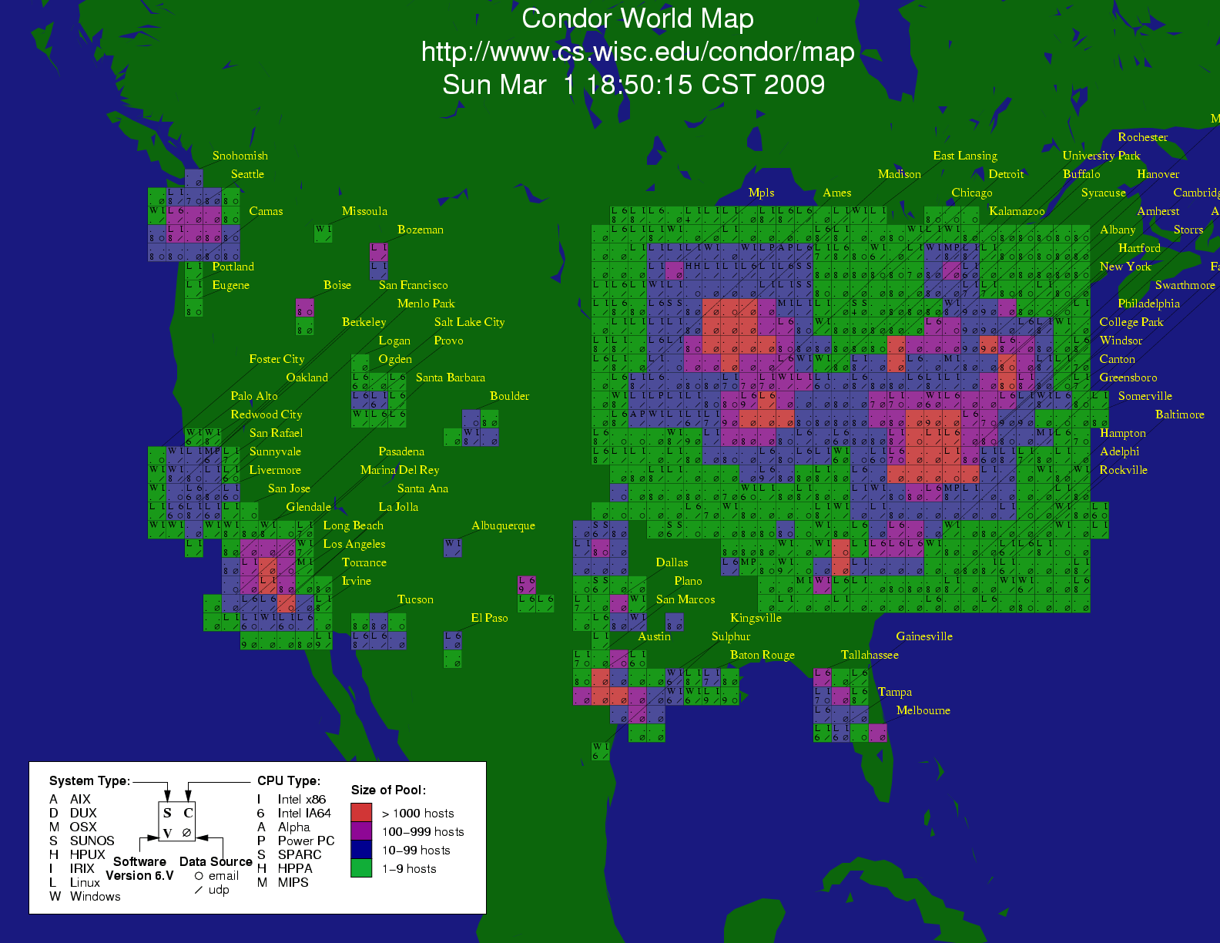
Notes:
10

Slide 11
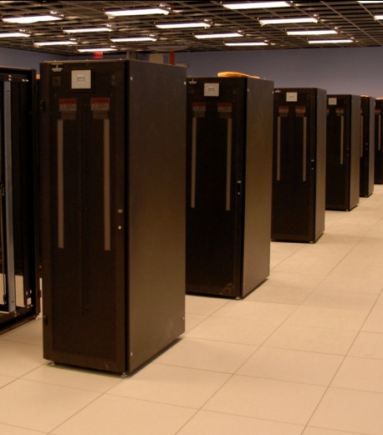
I have a standard, debugged, trusted application that runs on my laptop.
A toy problem completes in one hour.
A real problem will take a month (I think.)
Can I get a single result faster?
Can I get more results in the same time?
Last year,
I heard about
this grid thing.
This year,
I heard about
this cloud thing.
What do I do next?
11

Slide 12
Should I port my program to MPI or Hadoop?
Learn C / Java
Learn MPI / Hadoop
Re-architect
Re-write
Re-test
Re-debug
Re-certify

Slide 13
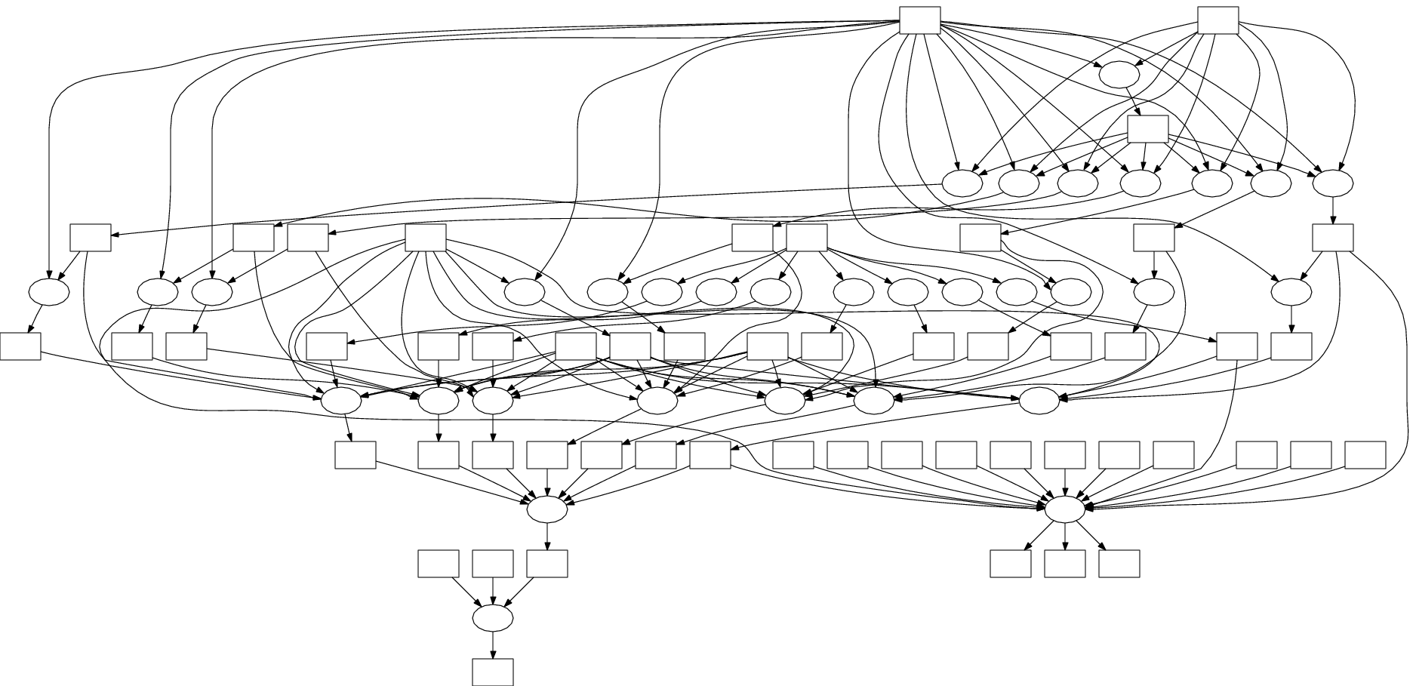
What if my application looks like this?

Slide 14
I can get as many machines on the cluster/grid/cloud as I want! How do I organize my application to run on those machines?

Slide 15
Our Philosophy:
Harness all the resources that are available: desktops, clusters, clouds, and grids.
Make it easy to scale up from one desktop to national scale infrastructure.
Provide familiar interfaces that make it easy to connect existing apps together.
Allow portability across operating systems, storage systems, middleware…
Make simple things easy, and complex things possible.
No special privileges required.

Slide 16
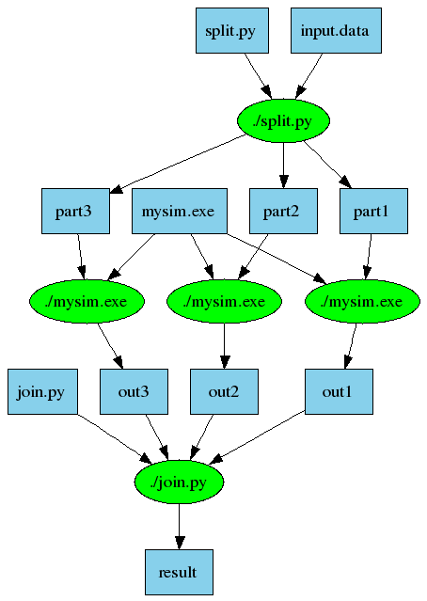
Makeflow = Make + Workflow
Provides portability across batch systems.
Enable parallelism (but not too much!)
Fault tolerance at multiple scales.
Data and resource management.
Makeflow
Local
Condor
SGE
Work
Queue
http://www.nd.edu/~ccl/software/makeflow

Slide 17
Work Queue Library
#include “work_queue.h”
while( not done ) {
while (more work ready) { task = work_queue_task_create();
// add some details to the task
work_queue_submit(queue, task);
}
task = work_queue_wait(queue);
// process the completed task
}
http://www.nd.edu/~ccl/software/workqueue

Slide 18
Parrot and Chirp
Ordinary
Appl
Filesystem Interface: open/read/write/close
Parrot Virtual File System
Local
HTTP
CVMFS
Chirp
iRODS
Web Servers
iRODS
Server
CVMFS
Network
Chirp
Server

Slide 19
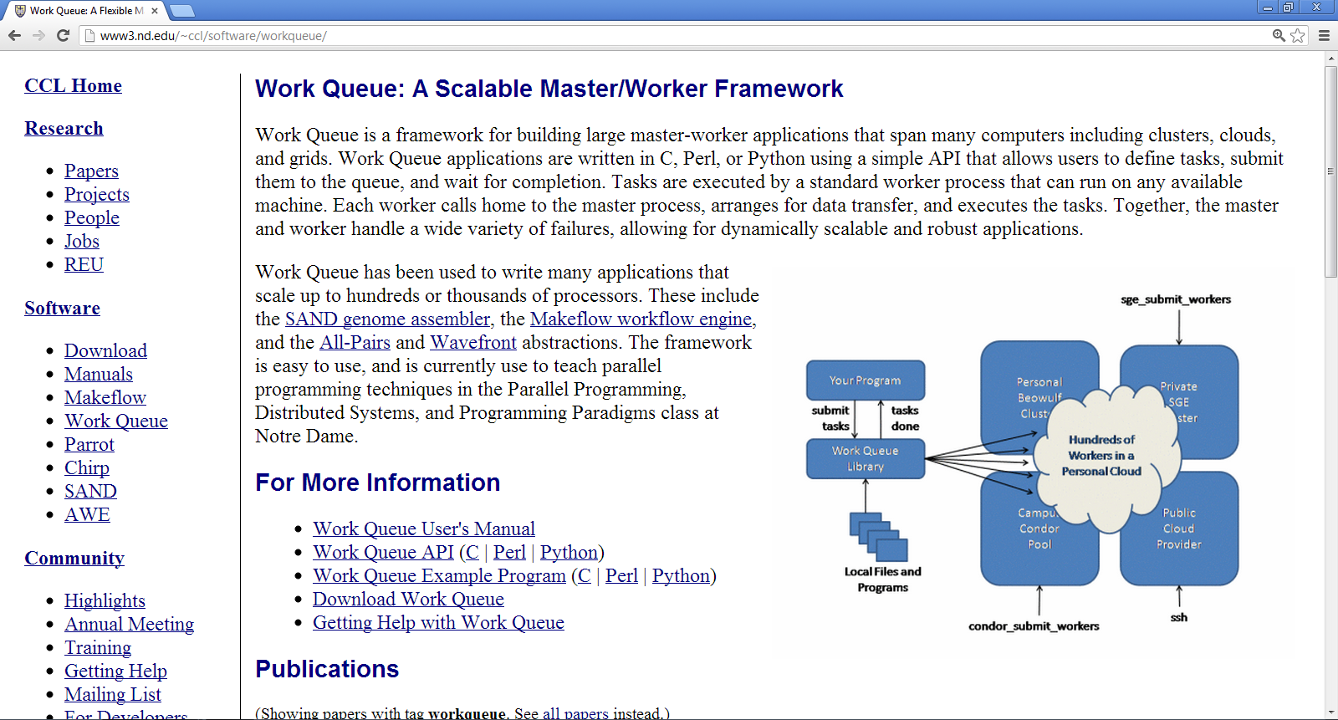
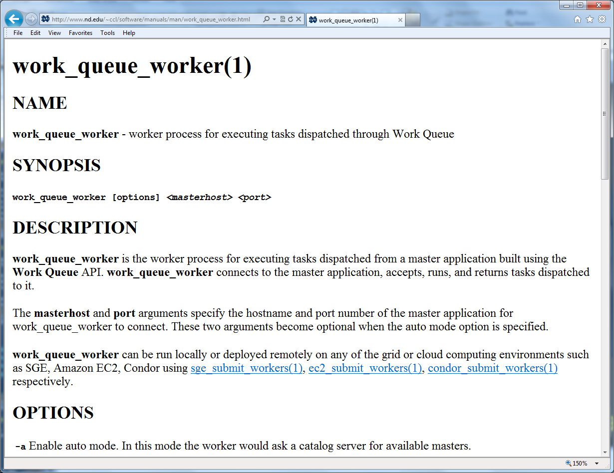
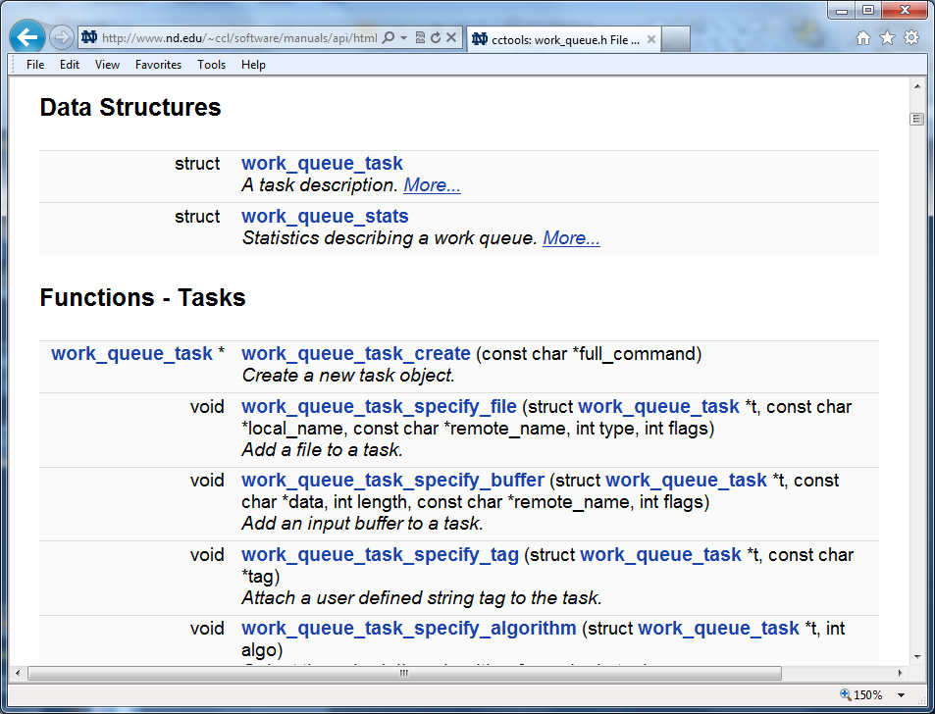
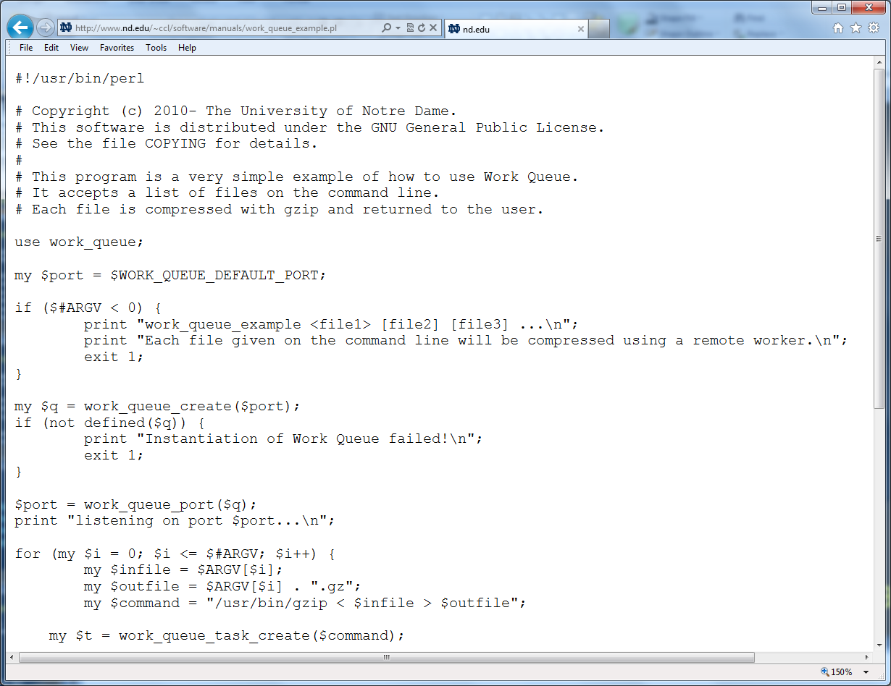
http://www.nd.edu/~ccl/software/manuals

Slide 20
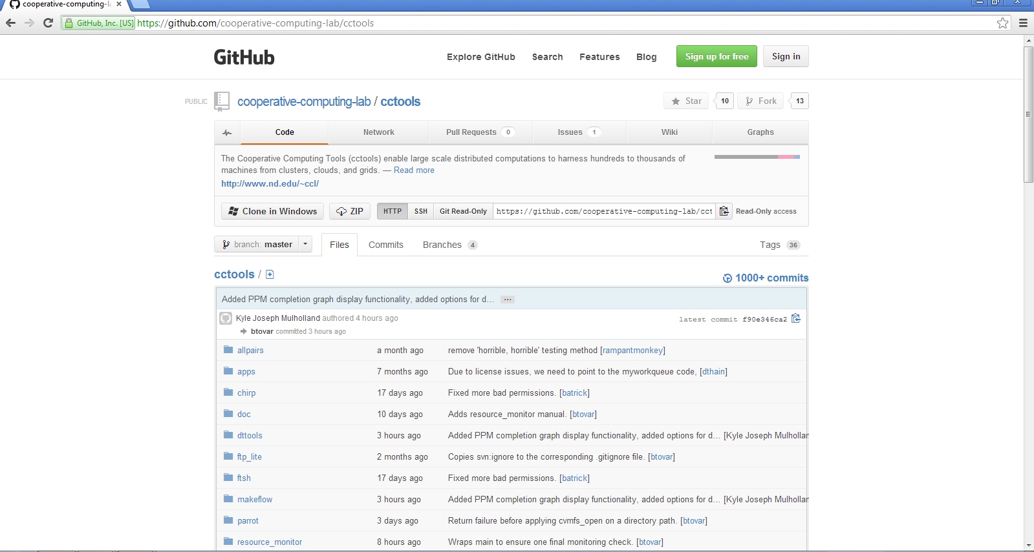
Source code in GitHub
http://github.com/cooperative-computing-lab/cctools

Slide 21
CS Research Questions
How do we allocate the appropriate resources from clusters/clouds/grids to run a given workload?
How do we avoid overloading shared resources that we do not control?
How do we safely compose multiple applications that have elastic parallelism?
How do we manage an ocean of results generated by scalable codes?

Slide 22
Makeflow: A Portable Workflow System

Slide 23
An Old Idea: Makefiles
part1 part2 part3: input.data split.py
./split.py input.data
out1: part1 mysim.exe
./mysim.exe part1 >out1
out2: part2 mysim.exe
./mysim.exe part2 >out2
out3: part3 mysim.exe
./mysim.exe part3 >out3
result: out1 out2 out3 join.py
./join.py out1 out2 out3 > result

Slide 24
Makeflow = Make + Workflow
Provides portability across batch systems.
Enable parallelism (but not too much!)
Fault tolerance at multiple scales.
Data and resource management.
Makeflow
Local
Condor
SGE
Work
Queue
http://www.nd.edu/~ccl/software/makeflow

Slide 25
Makeflow Language - Rules
Each rule specifies:
a set of target files to create;
a set of source files needed to create them;
a command that generates the target files from the source files.
part1 part2 part3: input.data split.py
./split.py input.data
out1: part1 mysim.exe
./mysim.exe part1 >out1
out2: part2 mysim.exe
./mysim.exe part2 >out2
out3: part3 mysim.exe
./mysim.exe part3 >out3
result: out1 out2 out3 join.py
./join.py out1 out2 out3 > result
out1 : part1 mysim.exe
mysim.exe part1 > out1

Slide 26
You must state all the files needed by the command.

Slide 27
sims.mf
out.10 : in.dat calib.dat sim.exe
sim.exe –p 10 in.data > out.10
out.20 : in.dat calib.dat sim.exe
sim.exe –p 20 in.data > out.20
out.30 : in.dat calib.dat sim.exe
sim.exe –p 30 in.data > out.30

Slide 28
Makeflow + Batch System
CRC SGE
Cluster
Private
Cluster
Makefile
makeflow –T sge
Work Queue
Makeflow
Work Queue
Campus
Condor
Pool
Public
Cloud
Provider
makeflow –T condor
Local Files and Programs

Slide 29
How to run a Makeflow
Run a workflow locally (multicore?)
makeflow -T local sims.mf
Clean up the workflow outputs:
makeflow –c sims.mf
Run the workflow on Torque:
makeflow –T torque sims.mf
Run the workflow on Condor:
makeflow –T condor sims.mf

Slide 30
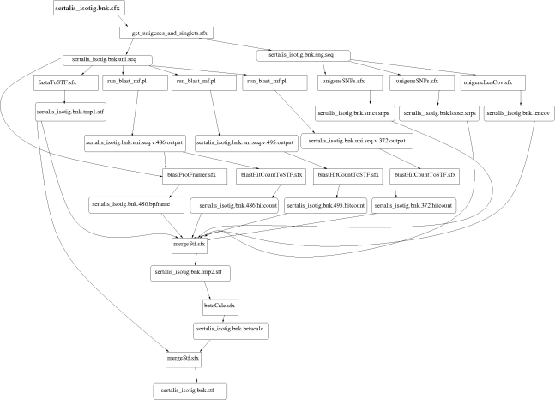
Example: Biocompute Portal
BLAST
SSAHA SHRIMP
EST
MAKER
…
Progress
Bar
Generate Makefile
Transaction Log
Condor
Pool
Update
Status
Run
Workflow
Make
flow
Submit
Tasks

Slide 31
Makeflow + Work Queue

Slide 32
Makeflow + Batch System
FutureGrid
Torque
Cluster
Private
Cluster
Makefile
makeflow –T torque
???
Makeflow
???
Campus
Condor
Pool
Public
Cloud
Provider
makeflow –T condor
Local Files and Programs

Slide 33
Makeflow + Work Queue
torque_submit_workers
FutureGrid
Torque
Cluster
Private
Cluster
Makefile
W
W
Thousands of Workers in a
Personal Cloud
W
submit
tasks
W
W
W
Makeflow
Campus
Condor
Pool
Public
Cloud
Provider
W
W
W
W
W
W
W
Local Files and Programs
condor_submit_workers
ssh

Slide 34
Advantages of Work Queue
Harness multiple resources simultaneously.
Hold on to cluster nodes to execute multiple tasks rapidly. (ms/task instead of min/task)
Scale resources up and down as needed.
Better management of data, with local caching for data intensive tasks.
Matching of tasks to nodes with data.

Slide 35
Makeflow and Work Queue
To start the Makeflow
% makeflow –T wq sims.mf
Could not create work_queue on port 9123.
% makeflow –T wq –p 0 sims.mf
Listening for workers on port 8374…
To start one worker:
% work_queue_worker ccl.cse.nd.edu 8374

Slide 36
Start Workers Everywhere!
Submit workers to Torque:
torque_submit_workers ccl.cse.nd.edu 8374 25
Submit workers to Condor:
condor_submit_workers ccl.cse.nd.edu 8374 25
Submit workers to SGE:
sge_submit_workers ccl.cse.nd.edu 8374 25

Slide 37
Keeping track of port numbers gets old fast…

Slide 38
Project Names
makeflow …
–a –N myproject
work_queue_worker
-a –N myproject
Makeflow
(port 4057)
connect to
ccl.cse.nd.edu:4057
Worker
advertise
query
Catalog
work_queue_status
query
“myproject”
is at ccl.cse.nd.edu:4057

Slide 39
Project Names
Start Makeflow with a project name:
makeflow –T wq –p 0 –a –N ccgrid-tutorial sims.mf
Listening for workers on port XYZ…
Start one worker:
work_queue_worker -a -N ccgrid-tutorial
Start many workers:
torque_submit_workers –a –N ccgrid-tutorial 5

Slide 40
work_queue_status

Slide 41
Resilience and Fault Tolerance
MF +WQ is fault tolerant in many different ways:
If Makeflow crashes (or is killed) at any point, it will recover by reading the transaction log and continue where it left off.
Makeflow keeps statistics on both network and task performance, so that excessively bad workers are avoided.
If a worker crashes, the master will detect the failure and restart the task elsewhere.
Workers can be added and removed at any time during the execution of the workflow.
Multiple masters with the same project name can be added and removed while the workers remain.
If the worker sits idle for too long (default 15m) it will exit, so as not to hold resources idle.

Slide 42
Advanced Features

Slide 43
Makeflow Visualization
Makeflow can output a makeflow file as a dot graph.
makeflow –D example.mf
digraph { node [shape=ellipse,color = green,style = unfilled,fixedsize = false]; N5 [label="/usr/bin/curl"]; N4 [label="/usr/bin/convert"]; N3 [label="/usr/bin/convert"]; N2 [label="/usr/bin/convert"]; N1 [label="/usr/bin/convert"]; N0 [label="/usr/bin/convert"]; node [shape=box,color=blue,style=unfilled,fixedsize=false]; F1 [label = "capitol.360.jpg"]; F2 [label = "capitol.270.jpg"]; ….
….

Slide 44
Makeflow Pre-execution Analysis
Makeflow can be asked to provide a quick analysis of your workflow
makeflow -i example.mf num_of_tasks 6 depth 3 width_uniform_task 4 width_guaranteed_max 4

Slide 45
Makeflow Syntax Checker
Makeflow can verify if your Makeflow file is syntactically correct
makeflow -k example.mf Makeflow: Syntax OK.
Makeflow will point out syntax errors if any
makeflow -k test.mf makeflow: test.jpg is defined multiple times at Makeflow:30 and Makeflow:30 makeflow: couldn't load Makeflow: Invalid argument

Slide 46
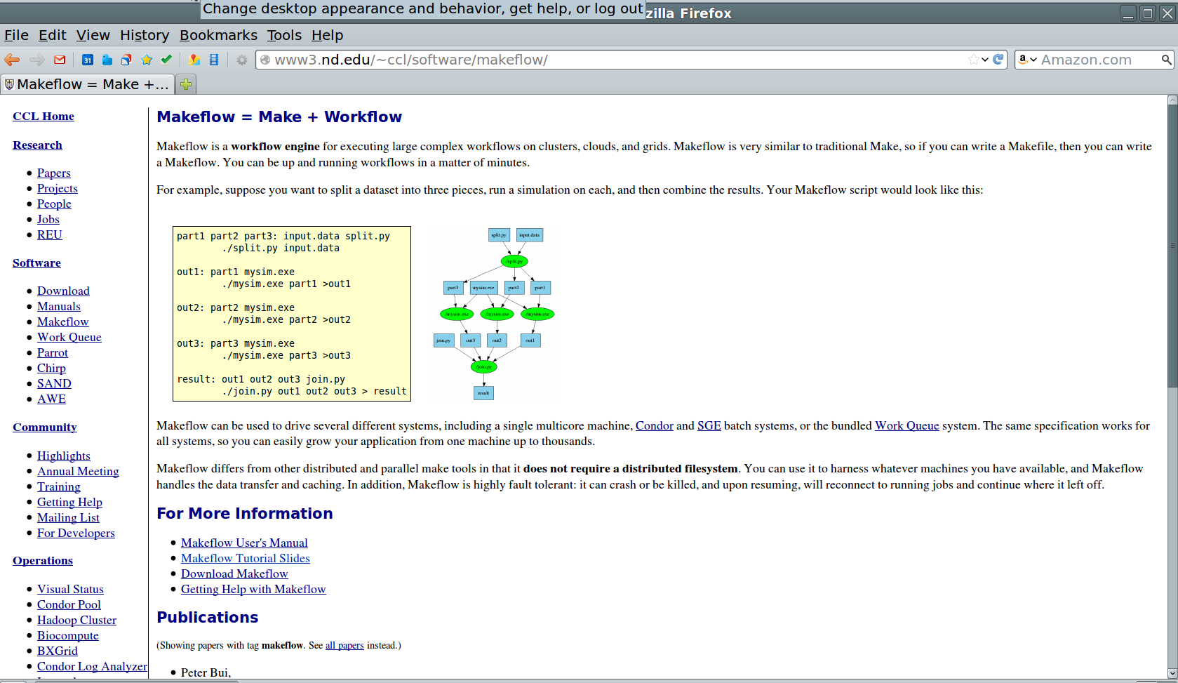
Makeflow Documentation
http://www.nd.edu/~ccl/software/makeflow/

Slide 47
Go to: http://www.nd.edu/~ccl Click on “Tutorial at CCGrid 2013”

Slide 48
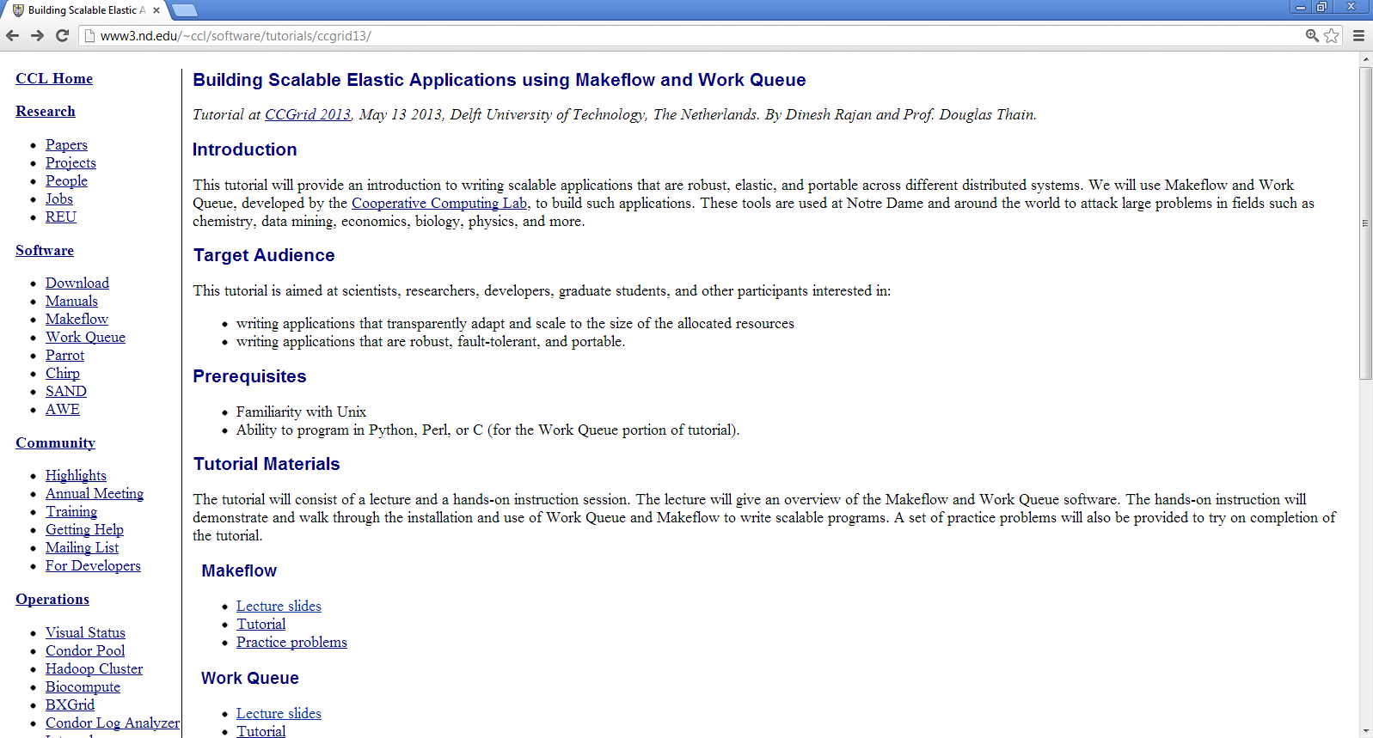
Click on “Tutorial” under Makeflow

