Slide 1
Building Scalable Scientific Applications with Work Queue
Douglas Thain and Dinesh Rajan
University of Notre Dame
Applied Cyber Infrastructure Concepts
University of Arizona, September 13, 2012

Slide 2
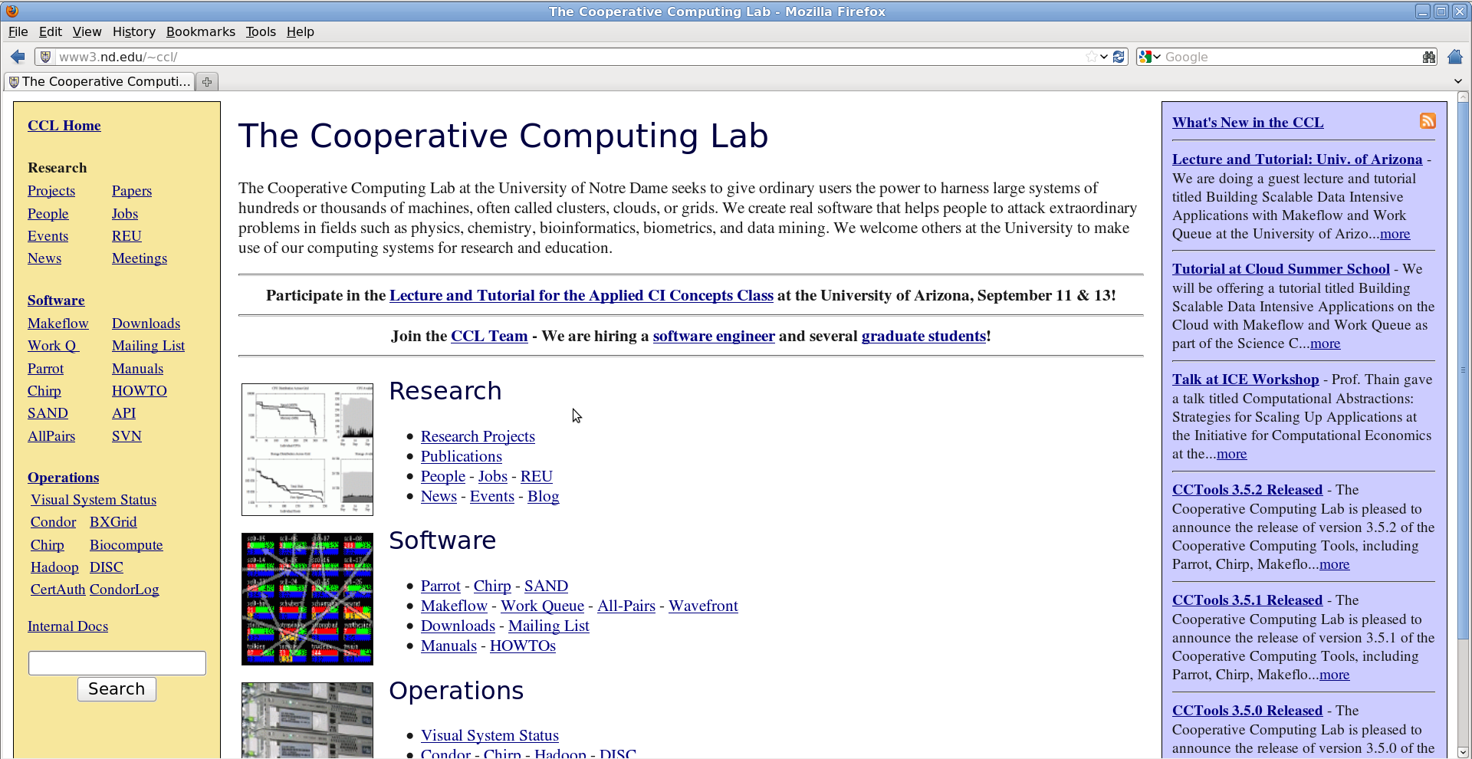
Go to: http://nd.edu/~ccl
Click “Lecture and Tutorial for Applied CI Concepts Class”

Slide 3
Recap: Makeflow

Slide 4
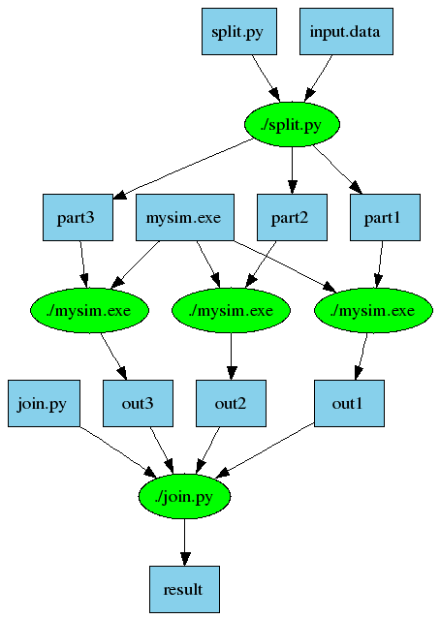
An Old Idea: Makefiles
part1 part2 part3: input.data split.py
./split.py input.data
out1: part1 mysim.exe
./mysim.exe part1 > out1
out2: part2 mysim.exe
./mysim.exe part2 > out2
out3: part3 mysim.exe
./mysim.exe part3 > out3
result: out1 out2 out3 join.py
./join.py out1 out2 out3 > result
4

Slide 5
Makeflow = Make + Workflow
Provides portability across batch systems.
Enable parallelism (but not too much!)
Fault tolerance at multiple scales.
Data and resource management.
Makeflow
Local
Condor
Torque
Work
Queue
http://www.nd.edu/~ccl/software/makeflow
5

Slide 6
Makeflow + Work Queue

Slide 7
Makeflow + Batch System
FutureGrid
Torque
Cluster
Private
Cluster
Makefile
makeflow –T torque
???
Makeflow
???
Campus
Condor
Pool
Public
Cloud
Provider
makeflow –T condor
Local Files and Programs

Slide 8
Makeflow + Work Queue
torque_submit_workers
FutureGrid
Torque
Cluster
Private
Cluster
Makefile
W
W
Thousands of Workers in a
Personal Cloud
W
submit
tasks
W
W
W
Makeflow
Campus
Condor
Pool
Public
Cloud
Provider
W
W
W
W
W
W
W
Local Files and Programs
condor_submit_workers
ssh

Slide 9
Makeflow and Work Queue with Project Names
Start Makeflow with a project name:
% makeflow –T wq –p 0 –a –N arizona-class sims.mf
Listening for workers on port XYZ…
Start one worker:
% work_queue_worker -a -N arizona-class
Start many workers:
% torque_submit_workers –a –N arizona-class 5

Slide 10
Advantages of Using Work Queue
Harness multiple resources simultaneously.
Hold on to cluster nodes to execute multiple tasks rapidly. (ms/task instead of min/task)
Scale resources up and down as needed.
Better management of data, with local caching for data intensive tasks.
Matching of tasks to nodes with data.

Slide 11
Makeflow
Great for static workflows!
- Tasks/dependencies are known beforehand
- DAGs
Great for file-based workflows!
- Input: files, Output: files

Slide 12
What if my workflow is dynamic? Write a program using the Work Queue API

Slide 13
Work Queue API
use work_queue;
queue = work_queue_create();
while( not done ) {
while (more work ready) { task = work_queue_task_create();
// add some details to the task
work_queue_submit(queue, task);
}
task = work_queue_wait(queue);
// process the completed task
}
http://www.nd.edu/~ccl/software/workqueue
13

Slide 14
Work Queue System
1000s of workers
dispatched to clusters, clouds, & grids
worker
worker
worker
worker
worker
worker
Work Queue Program
C / Python / Perl
Work Queue Library
put sim.exe
put in.txt
exec sim.exe < in.txt >out.txt
get out.txt
worker
in.txt
sim
out.txt
cache recently used files
14

Slide 15
Run One Task in Python
from work_queue import *
queue = WorkQueue( port = 0 )
queue.specify_name( “myproject” );
task = Task(“sim.exe –p 50 in.dat >out.txt”)
### Missing: Specify files needed by the task.
queue.submit( task )
While not queue.empty():
task = queue.wait(60)

Slide 16
Run One Task in Perl
use work_queue;
$queue = work_queue_create( 0 );
work_queue_specify_name( “myproject” );
$task = work_queue_task_create(“sim.exe –p 50 in.dat >out.txt”);
### Missing: Specify files needed by the task.
work_queue_submit( $queue, $task );
while(!work_queue_empty($queue)) {
$task = work_queue_wait( $queue, 60 );
if($task) work_queue_task_delete( $task );
}

Slide 17
Run One Task in C
#include “work_queue.h”
struct work_queue *queue;
struct work_queue_task *task;
queue = work_queue_create( 0 );
work_queue_specify_name( “myproject” );
task = work_queue_task_create(“sim.exe –p 50 in.dat >out.txt”);
/// Missing: Specify files needed by the task.
work_queue_submit( queue, task );
while(!work_queue_empty(queue)) {
task = work_queue_wait( queue, 60 );
if(task) work_queue_task_delete( task );
}

Slide 18
Python: Specify Files for a Task
calib.dat
sim.exe
out.txt
in.dat
sim.exe in.dat –p 50 > out.txt
task.specify_file( “in.dat”, ”in.dat”,
WORK_QUEUE_INPUT, cache = False )
task.specify_file( “calib.dat”, ”calib.dat”,
WORK_QUEUE_INPUT, cache = False )
task.specify_file( “out.txt”, ”out.txt”,
WORK_QUEUE_OUTPUT, cache = False )
task.specify_file( “sim.exe”, ”sim.exe”,
WORK_QUEUE_INPUT, cache = True )

Slide 19
Perl: Specify Files for a Task
calib.dat
sim.exe
out.txt
in.dat
sim.exe in.dat –p 50 > out.txt
work_queue_task_specify_file( $task,“in.dat”,”in.dat”,
$WORK_QUEUE_INPUT, $WORK_QUEUE_NOCACHE );
work_queue_task_specify_file( $task,“calib.dat”,”calib.dat”,
$WORK_QUEUE_INPUT, $WORK_QUEUE_NOCACHE );
work_queue_task_specify_file( $task,“out.txt”,”out.txt”,
$WORK_QUEUE_OUTPUT, $WORK_QUEUE_NOCACHE );
work_queue_task_specify_file( $task,“sim.exe”,”sim.exe”,
$WORK_QUEUE_INPUT, $WORK_QUEUE_CACHE );

Slide 20
C: Specify Files for a Task
calib.dat
sim.exe
out.txt
in.dat
sim.exe in.dat –p 50 > out.txt
work_queue_task_specify_file( task,“in.dat”,”in.dat”,
WORK_QUEUE_INPUT, WORK_QUEUE_NOCACHE );
work_queue_task_specify_file( task,“calib.dat”,”calib.dat”,
WORK_QUEUE_INPUT, WORK_QUEUE_CACHE );
work_queue_task_specify_file( task,“out.txt”,”out.txt”,
WORK_QUEUE_OUTPUT, WORK_QUEUE_NOCACHE );
work_queue_task_specify_file( task,“sim.exe”,”sim.exe”,
WORK_QUEUE_INPUT, WORK_QUEUE_CACHE );

Slide 21
You must state all the files needed by the command.

Slide 22
Start workers for your Work Queue program
Start one local worker:
work_queue_worker -a -N myproject
Submit workers to Torque:
torque_submit_workers -a –N myproject 25
Submit workers to Condor:
condor_submit_workers -a –N myproject 25
Submit workers to SGE:
sge_submit_workers -a –N myproject 25

Slide 23
Sample Applications of Work Queue

Slide 24
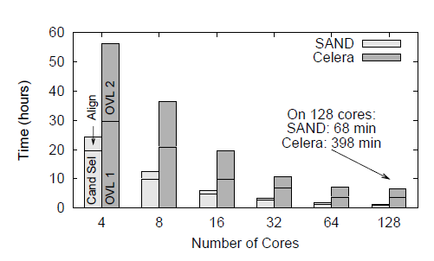
Genome Assembly
Sequence
Data
Modified Celera Assembler
SAND
filter
master
SAND
align
master
Celera
Consensus
W
W
Using WQ, we could assemble a human genome in 2.5 hours on a collection of clusters, clouds, and grids with a speedup of 952X.
W
W
W
W
W
Christopher Moretti, Andrew Thrasher, Li Yu, Michael Olson, Scott Emrich, and Douglas Thain, A Framework for Scalable Genome Assembly on Clusters, Clouds, and Grids, IEEE Transactions on Parallel and Distributed Systems, 2012

Slide 25
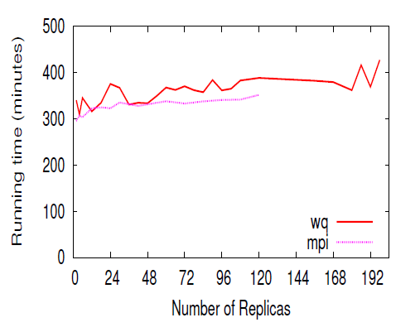
Replica Exchange
Simplified Algorithm:
Submit N short simulations at different temps.
Wait for all to complete.
Select two simulations to swap.
Continue all of the simulations.
Replica Exchange
Work Queue
T=10K
T=20K
T=30K
T=40K
Dinesh Rajan, Anthony Canino, Jesus A Izaguirre, and Douglas Thain, Converting A High Performance Application to an Elastic Cloud Application, Cloud Com 2011.

Slide 26
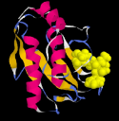
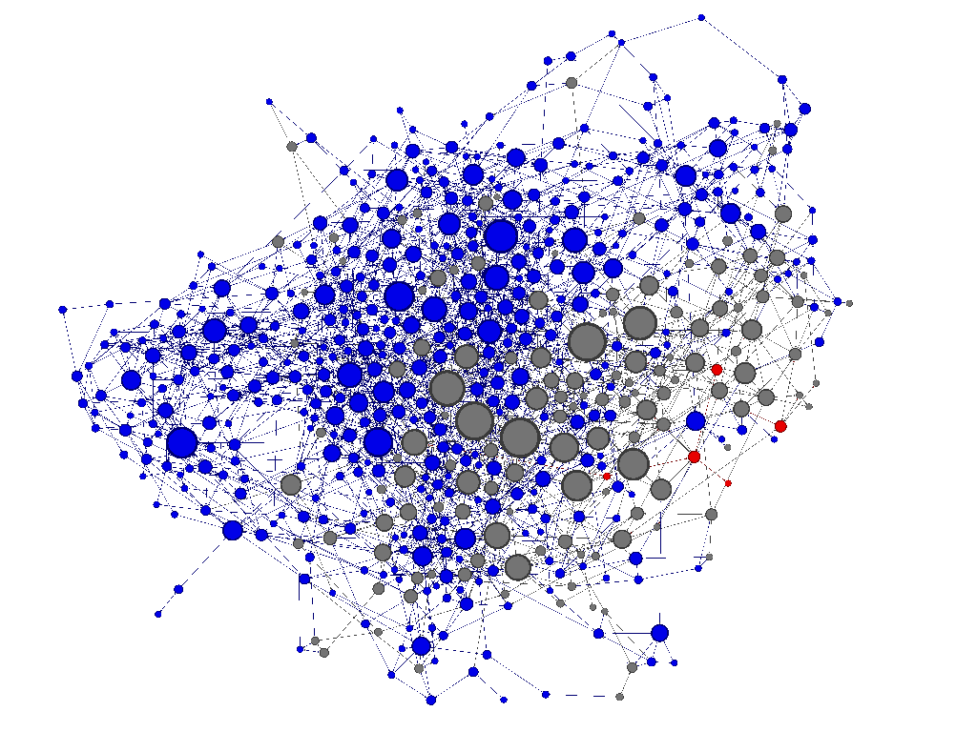
Adaptive Weighted Ensemble
Proteins fold into a number of distinctive states, each of which affects its function in the organism.
How common is each state?
How does the protein transition between states?
How common are those transitions?
26

Slide 27
AWE Using Work Queue
Simplified Algorithm:
Submit N short simulations in various states.
Wait for them to finish.
When done, record all state transitions.
If too many are in one state, redistribute them.
Has enough data been collected?
Yes : Stop
No : Go back to the beginning.
27

Slide 28
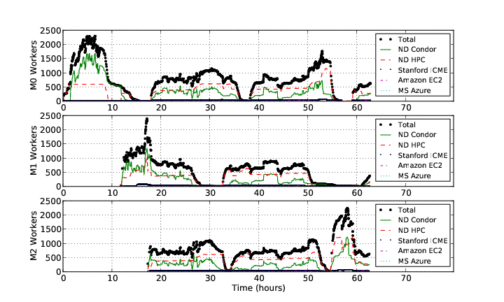
AWE on Clusters, Clouds, and Grids
28

Slide 29
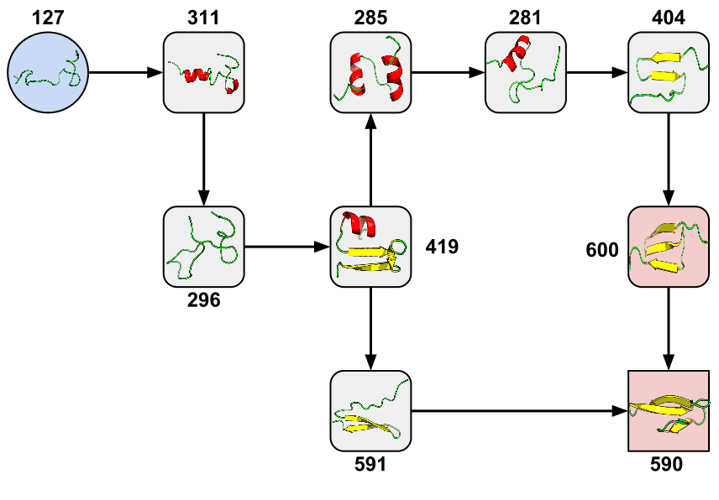
New Pathway Found!
Joint work with computational biologists:
Folding Proteins at 500 ns/hour with Work Queue, eScience 2012
29

Slide 30
Elastic Application Stack
All-Pairs
Wavefront
Makeflow
Custom
Apps
Work Queue Library
Thousands of Workers in a
Personal Cloud
Public
Cloud
Provider
Shared
SGE
Cluster
Campus
Condor
Pool
Private
Cluster
W
W
W
W
W
W
W
W
W
W

Slide 31
Next Steps:
Tutorial: Basic examples of how to write and use Work Queue on Future Grid.
Homework: Problems to work on this week.

Slide 32
Go to: http://nd.edu/~ccl
Click “Lecture and Tutorial for Applied CI Concepts Class”

